Slide 1
A912
New Product Introduction
Indoor Mini Hemispheric Dome

Slide 2
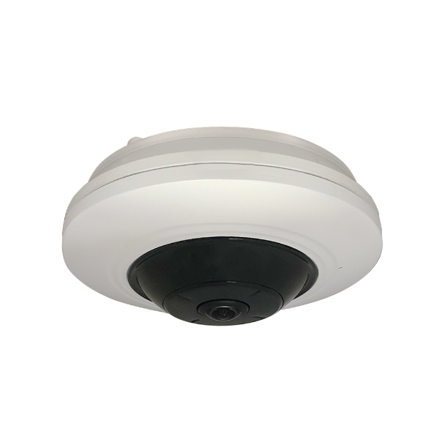
ACTi is introducing the newest products:
A912
5MP Indoor Mini Hemispheric Dome with D/N, IR LED, Superior WDR, SLLS, Fixed lens, f1.05mm/F2.25 (HOV:180°), H.265/H.264, Dewarping, PoE/DC12V

Slide 3
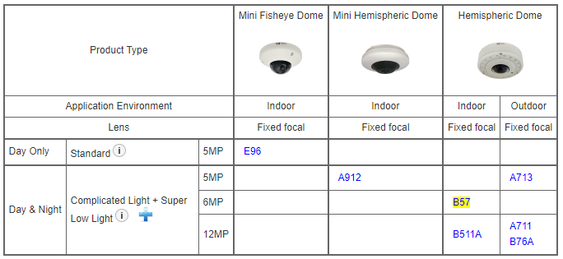
Product Matrix:
A912 is the advanced version of E96, with the built-in Dewarping capabilities and H.265 compression.
At the same time, it is a cost-down version of A713, with less features.
This is not a migration. All the models continue to exist.

Slide 4
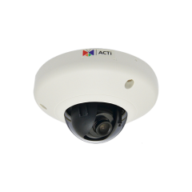
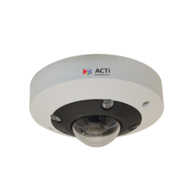
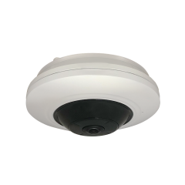
Spec Comparison:
Model | E96 | A713 | A912 (new)
Photo
Product type | Mini Fisheye | Hemispheric | Mini Hemispheric
Application Environment | Indoor | Outdoor | Indoor
Resolution | 5MP | 5MP | 5MP
HOR | 189.7° | 197° | 180°
Day/Night | No | Yes, with IR LED | Yes, with IR LED
WDR | Basic 74dB | Extreme 130dB | Superior 120dB
Low Light | Standard | Superior | Superior
Audio | No | 2-way | No
Compression | H.264 | H.265, H.264 | H.265, H.264
Mounting Options | Surface (Ceiling, Wall), Wall Mount, Pole Mount, Pendant, Gang Box | Surface (Ceiling, Wall), Wall Mount, Pole Mount, Pendant, Corner Mount, Gang Box | Surface (Ceiling, Wall), Pendant, Inclined Mount
NDAA | Yes | Yes | Yes
Availability | Now | Now | 2024/12/23

Slide 5
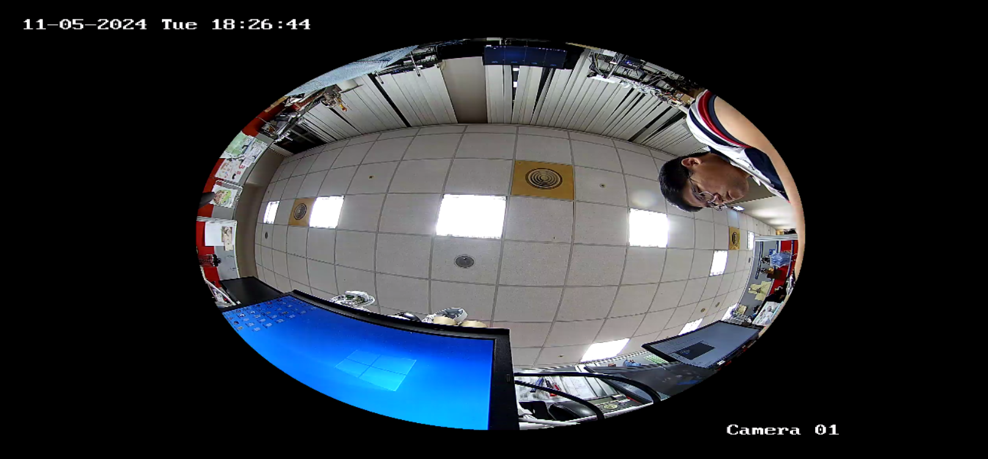
A912 Fisheye Mode:

Slide 6
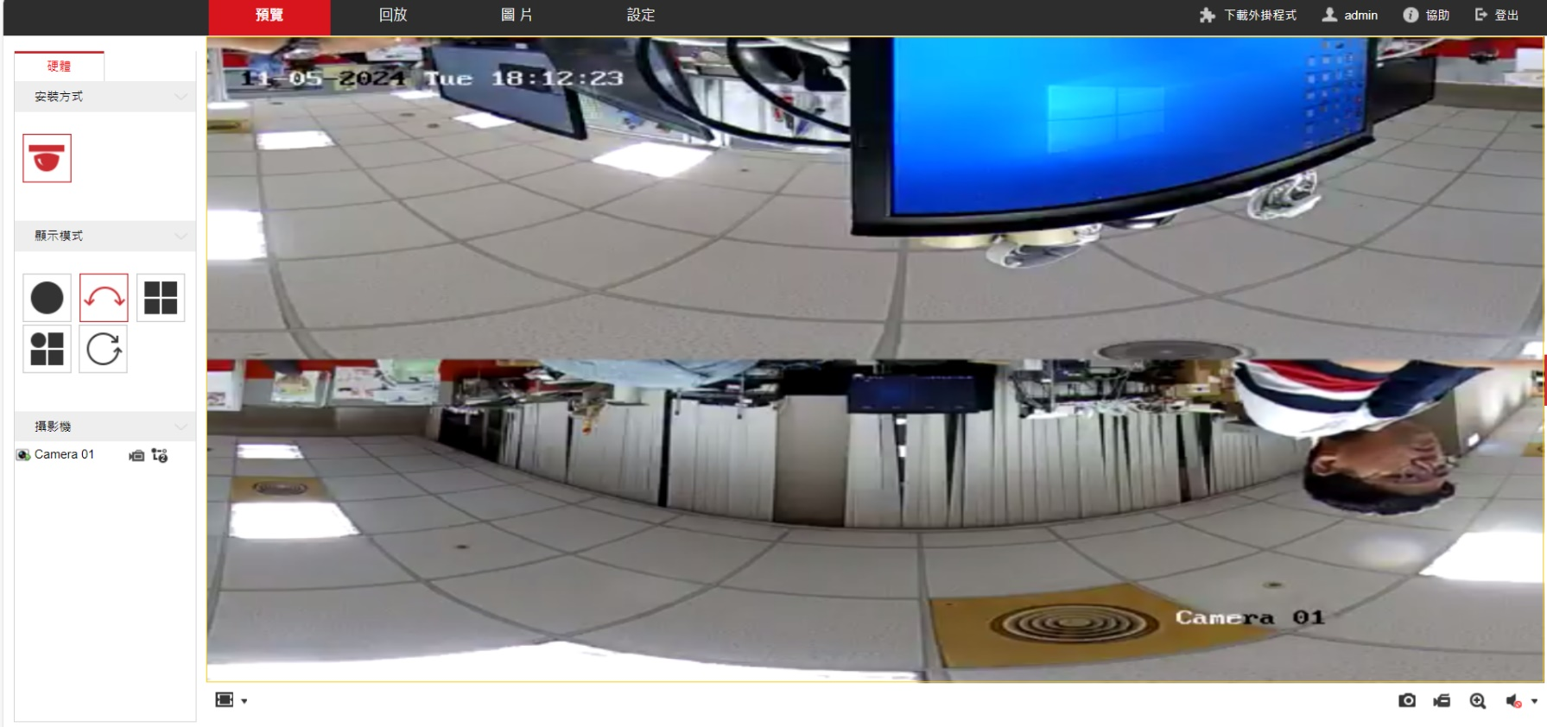
A912 Dewarped Mode:
Camera dewarps the circular fisheye image into human-friendly panoramic view. NVR does not need to waste computing power to process dewarping. Easier to integrate with any type of NVR.

Slide 7
Supported VMS and Solutions
 | Standard Features | AI Events/Meta | Solutions
NVR 3 Corporate | Yes | Yes | S110, S111, S112
NVR 3 Business | Yes | Yes | S110, S111, S112
CMS 2 | Yes | Yes | S120, S121, S122
ZNR-Series NVR | Yes |  | S60
ENR-Series NVR | Yes |  | S72

Slide 8
Applications
Budget driven indoor applications with 180-degree overview requirements:
Residential
Hospital
Retail
School

