Slide 1
Z322, Z722
New Product Introduction
Bullets and Turrets with WHITE LED!

Slide 2
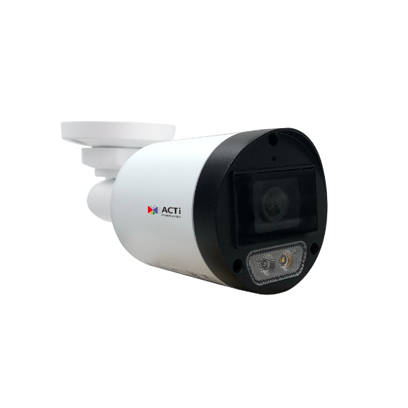
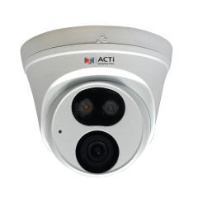
ACTi is introducing the newest products:
Z322
4MP Outdoor Mini Bullet with D/N, Adaptive IR, White LED (50 meters), Basic WDR, SLLS, Fixed lens, f2.8mm/F1.6 (HOV: 97°), H.265/H.264, 2D+3D DNR, Built-in Microphone, MicroSD, PoE/DC12V, IP67
Z722
4MP Outdoor Turret with D/N, Adaptive IR, White LED (40 meters), Basic WDR, SLLS, Fixed lens, f2.8mm/F1.6 (HOV: 97°), H.265/H.264, 2D+3D DNR, Built-in Microphone, MicroSD, PoE/DC12V, IP67

Slide 3
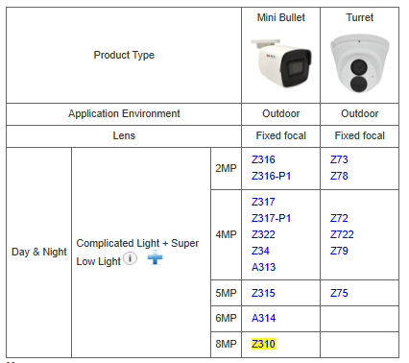
Product Matrix:
Z322 is the special version of Z317 with an additional WHITE LED.
Z722 is the special version of Z79 with an additional WHITE LED.
The previous models will continue to exist together with the new special models.

Slide 4

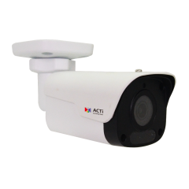
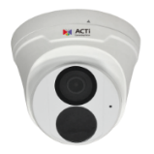

Spec Comparison:
Model | Z317 | Z322 (new) | Z79 | Z722 (new)
Photo
Product type | Mini Bullet | Mini Bullet | Turret | Turret
Resolution | 4MP | 4MP | 4MP | 4MP
Lens | f2.8mm | f2.8mm | f2.8mm | f2.8mm
HOR | 99° | 97° | 101.1° | 97°
LED | IR LED | IR & WHITE LED | IR LED | IR & WHITE LED
WDR | Superior 120dB | Superior 120dB | Superior 120dB | Superior 120dB
Low Light | Superior | Superior | Superior | Superior
Audio | Built-in Mic | Built-in Mic | Built-in Mic | Built-in Mic
Temperature | -40°C ~ 60°C | -40°C ~ 60°C | -40°C ~ 60°C | -40°C ~ 60°C
Environment | IP68, IK10 | IP67 | IP68, IK10 | IP67
Analytics | Yes | Yes | Yes | Yes

Slide 5
Analytics Comparison:
Analytics | Z317, Z79 | Z322, Z722
Tampering Detection | Y | Y
Object Line Crossing Detection | Y | -
Intrusion Detection | Y | -
People Detection | Y | Y
Vehicle Detection | Y | Y
Sound Detection | Y | Y

Slide 6
Supported VMS and Solutions
 | Standard Features | AI Events/Meta | Solutions
NVR 3 Corporate | Yes | Yes | S110, S111, S112
NVR 3 Business | Yes | Yes | S110, S111, S112
CMS 2 | Yes | Yes | S120, S121, S122
ZNR-Series NVR | Yes |  | S60
ENR-Series NVR | Yes |  | S72

Slide 7
Applications
These new models are designed for the applications where white LED is required.
While invisible IR LED is always ON at night and the people do not even notice it, the white LED is illuminating visible light spectrum and therefore it is very obvious.
Therefore, the user can decide when the white LED is ON.
It can be ON all the time, or only upon the events only, such as people detection.
Use WHITE LED when …
You want to deter the intruder with the White LED that turns on upon intrusion.
You want to capture the color evidence of the intruder, as the camera will be in the color mode while the white LED is on.

