Slide 1
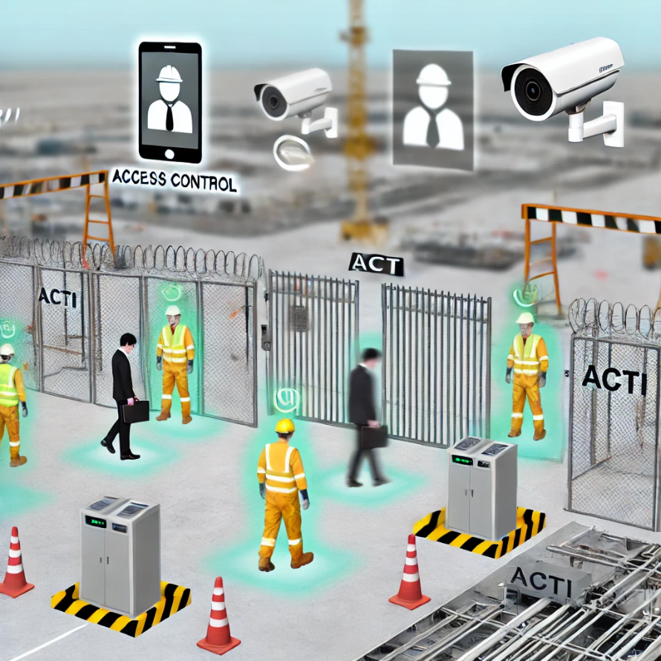
ACTi Construction Site Management Solution
Efficient, Secure, and Smart Construction Site Management

Slide 2
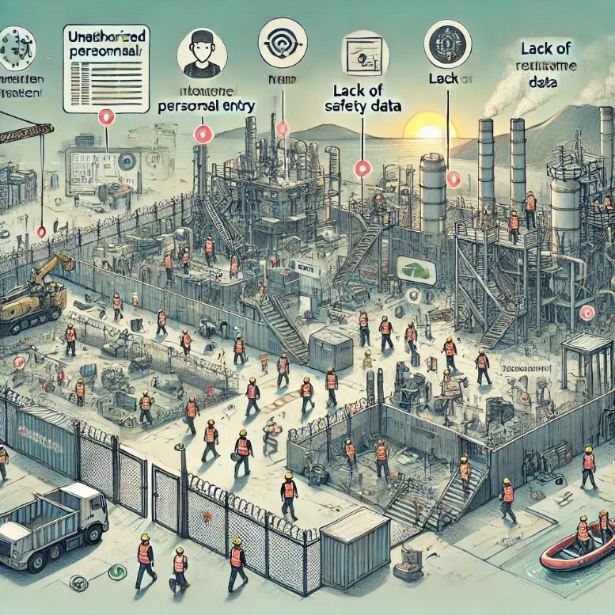
Pain Points of Construction Site Management
Unauthorized Personnel Access
Easily creates security vulnerabilities
Lack of Real-Time Data
Unable to monitor the number of workers on-site promptly
Safety Compliance Challenges
Increases the risk of accidents
      Difficulties in Access Control Management
      Hard to effectively control personnel entry and exit

Slide 3
ACTi's Solution
Providing Comprehensive Solutions to Enable Real-Time Monitoring and Access Control Management for Construction Sites.
Diversity
Integration
Customization
Manageability
Card、
Card/Face、
Card/
Face with Temperature Measurement.
Can integrate with HR systems; also allows for custom reports, export options, and setting access control schedules.
Can be integrated with other brands' access control devices when needed, reducing replacement costs.
Accessible via Web, enabling all users to utilize the platform's features.

Slide 4

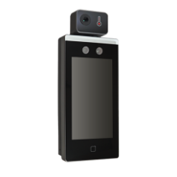
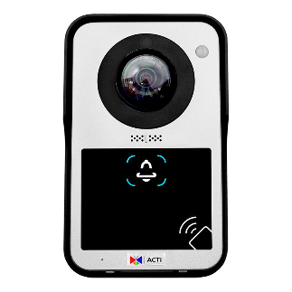
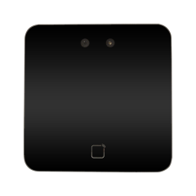
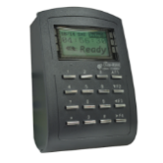
ACTi's Solution
Providing Comprehensive Solutions to Enable Real-Time Monitoring and Access Control Management for Construction Sites.
Real-Time Monitoring
Access Control
Visitor Management
Multi-Product Integration
Access Control Device

Slide 5







Access Control Attendance System (ACSS) - Structure
DI/DO
Control Door Lock
Attendance Feedback
Access Control Device
PoE Switch
Access Control Management Server
Card
Card＋Face
Face
Visitor Use
QR code
Different departments can use the same interface, with various management permissions configured.
Machine Recognition, Fast Speed
The access control device performs front-end recognition, so even if the server connection is lost, door control can still be maintained. Attendance data will be sent back to the server once the connection is restored.

Slide 6

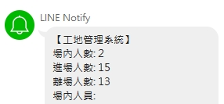
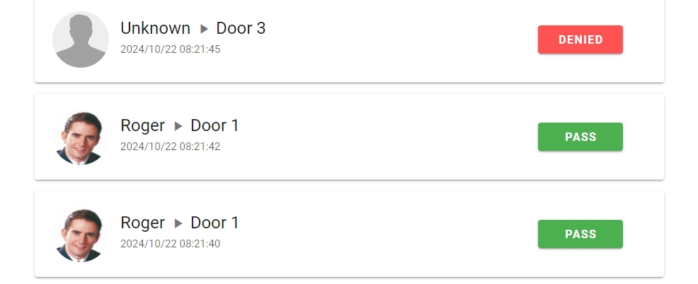
Core Function Display
Real-Time Tracking of Entries and Exits
Face Recognition
LINE Notifications
Automated Alerts

Slide 7
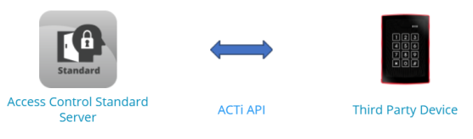
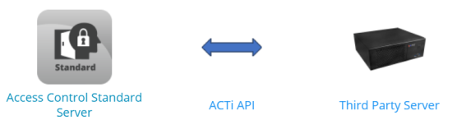
Technical Architecture and Integration
Integration from proprietary servers to devices based on projects
Integration from proprietary servers to servers based on projects
API documentation
Provide integration support services
Integration with Human Resources systems
PSIM integration
Integration with SCADA systems via Modbus
ACTi integrates third-party control devices through proprietary project integration using ACTi API
ACTi integrates third-party servers through proprietary project integration using ACTi API

Slide 8
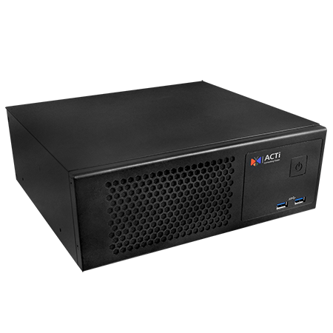
ACSS Product List - Access Control Host
ACS-100
Supports connections to up to 200 devices.
Real-time event monitoring and alerts
Intelligent search (Person/Time/Device/Access Results)
Group-based management mode (Person/Card Reader)
Export attendance-related reports
Integrates with cameras for video playback

Slide 9
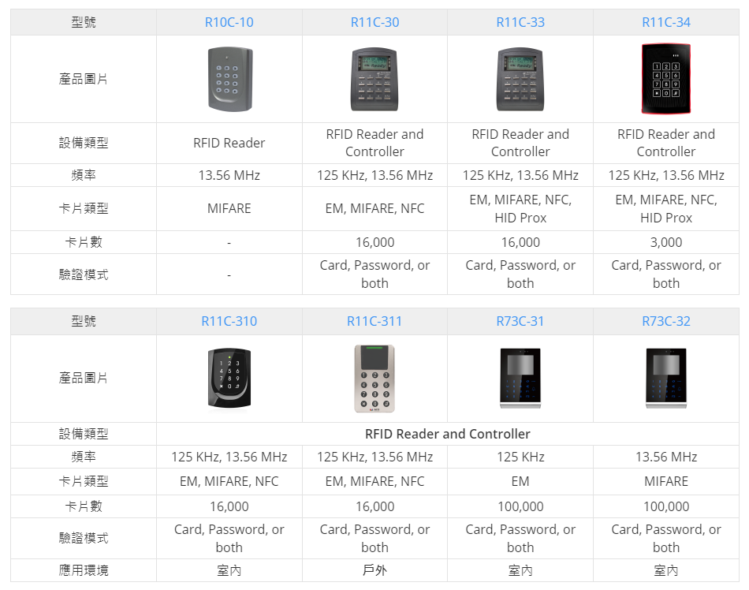
ACSS Product List – RFID Card Reader

Slide 10
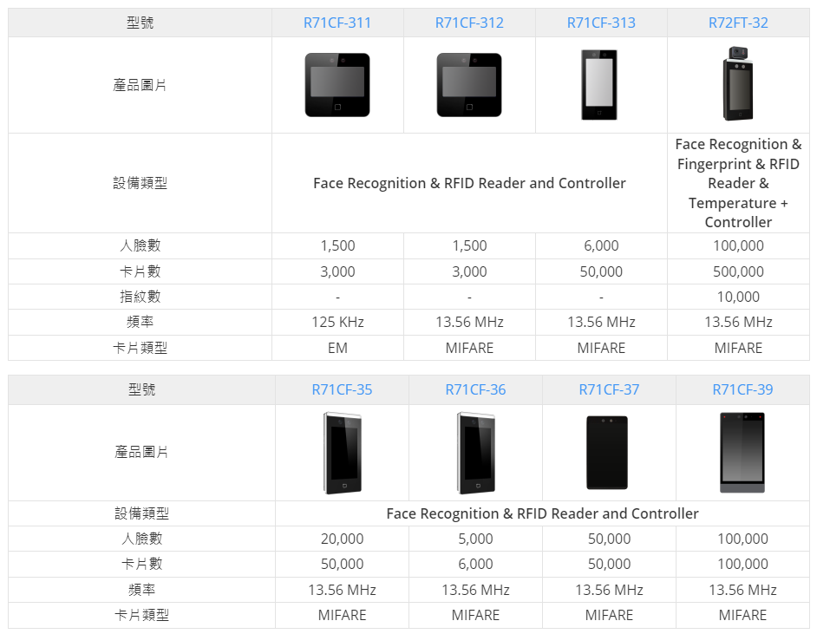
ACSS Product List – Facial Recognition Device

Slide 11
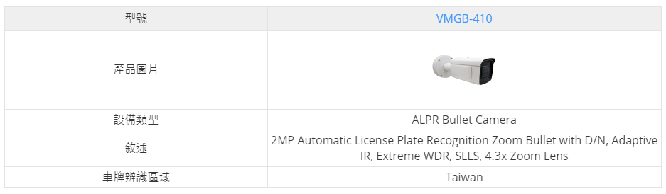
ACSS Product List – License Plate Recognition Device

Slide 12
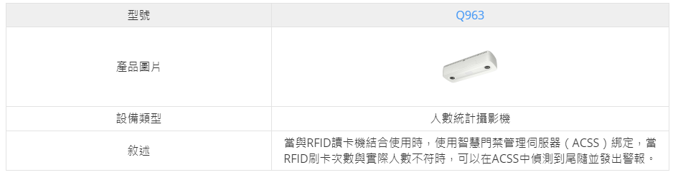
ACSS Product List – Tailgating Detection Device

Slide 13
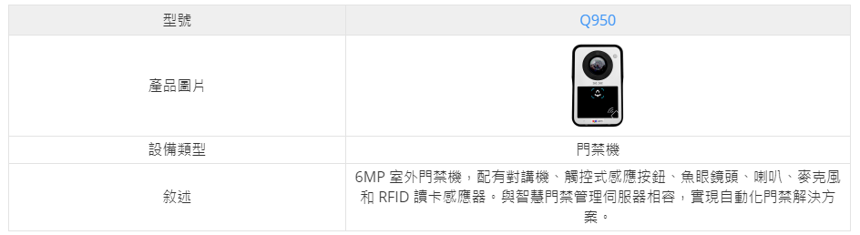
ACSS Product List – Intercom Device

Slide 14
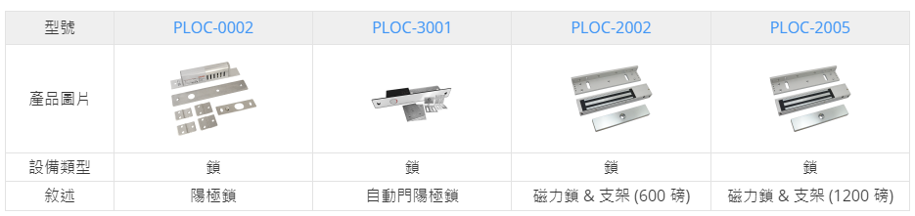
ACSS Product List – Door Lock

Slide 15

Access Control System Interface
Access Control

Slide 16
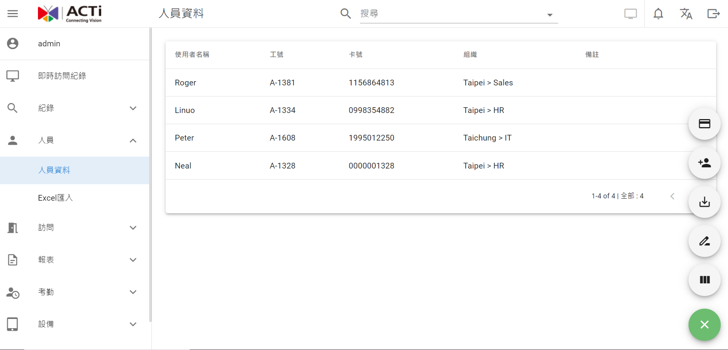
UI – Personnel -> Employee Data Menu
Unlock Card
Add New User
Export
Batch Edit
Show Columns
Demo site : acss.acti.com
( Account : admin ; Password : 123456 )

Slide 17
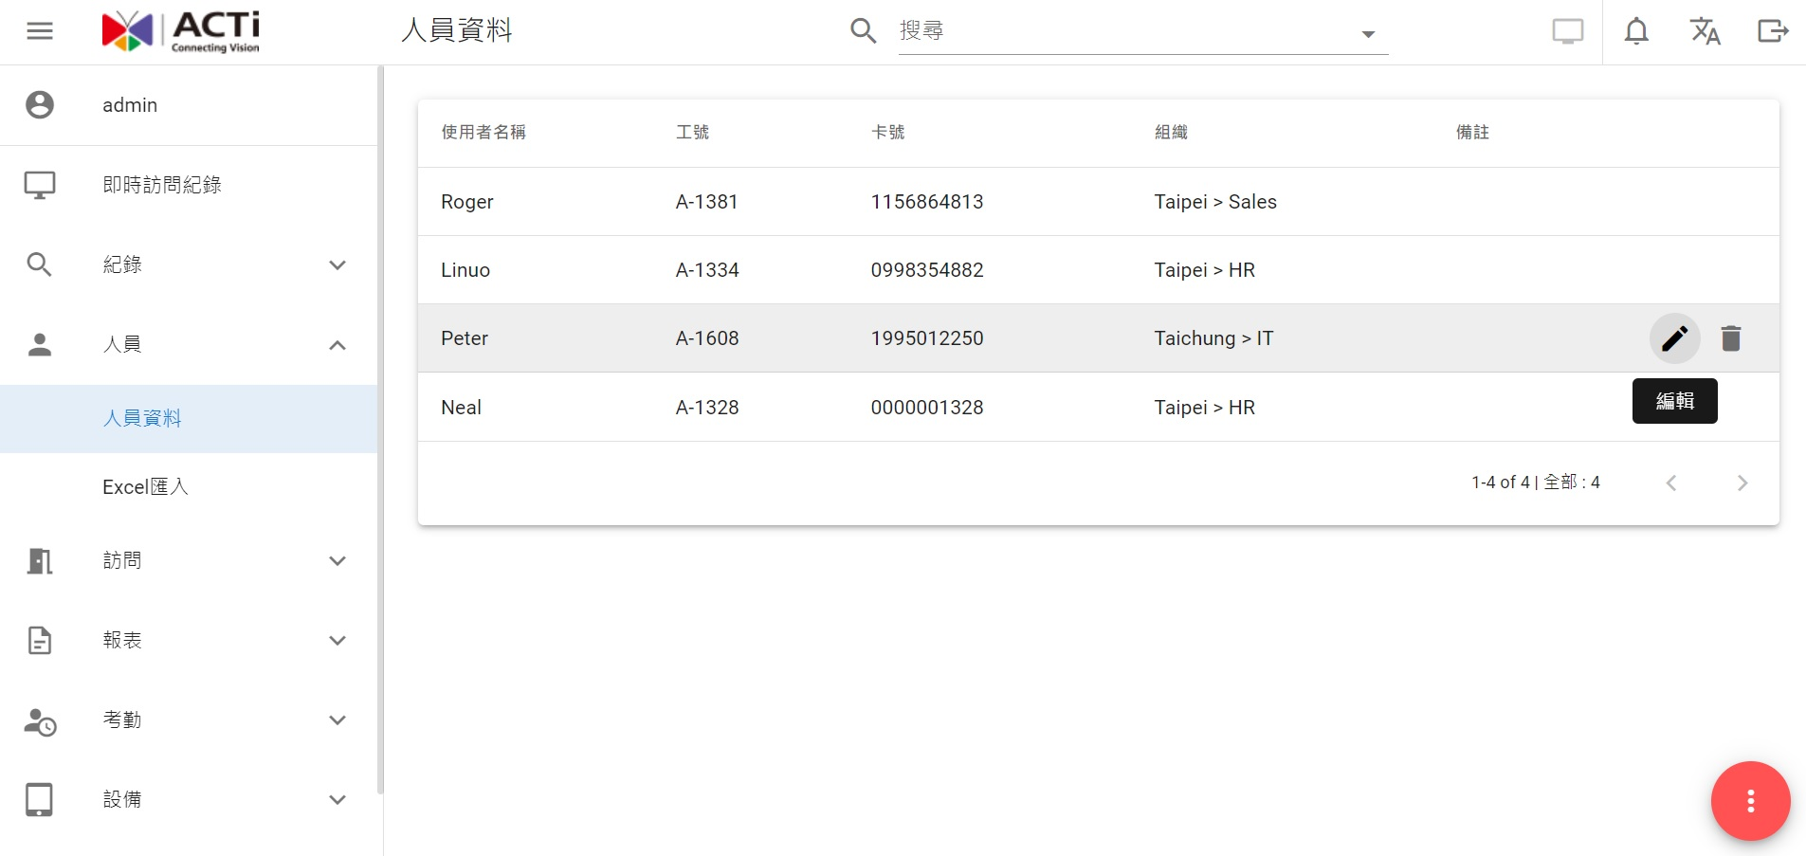
UI – Personnel -> Employee Data Edit
Demo site : acss.acti.com
( Account : admin ; Password : 123456 )

Slide 18
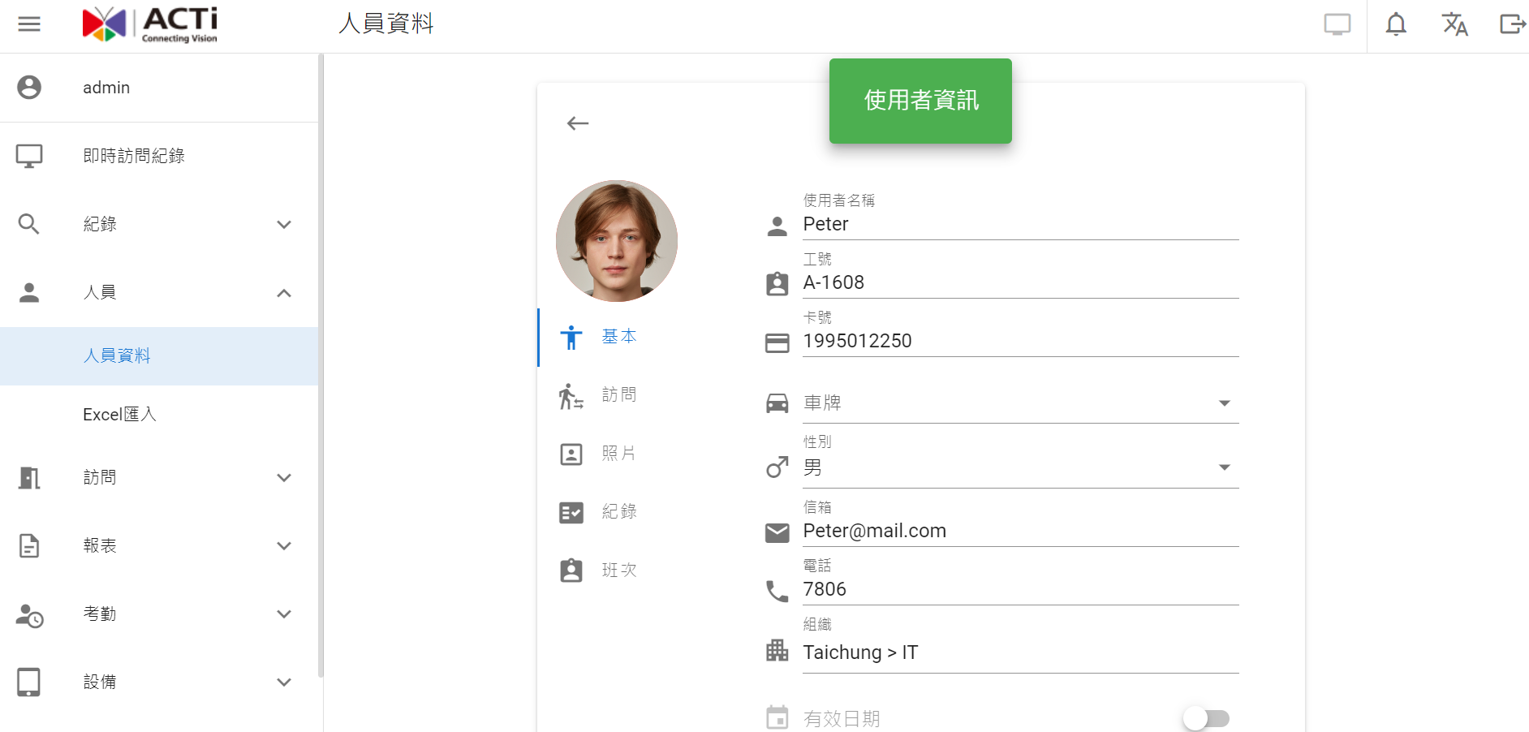
UI – Personnel -> Employee Data Edit
Demo site : acss.acti.com
( Account : admin ; Password : 123456 )

Slide 19
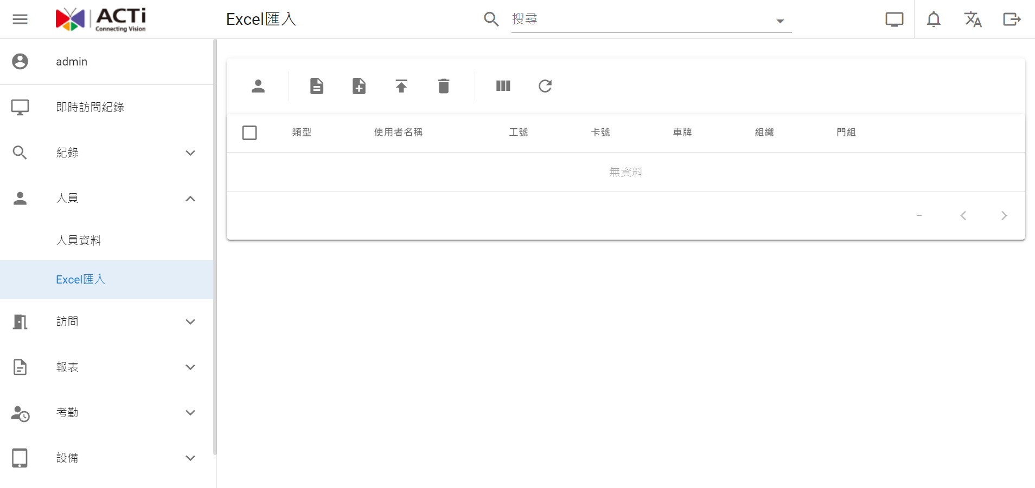
UI – Personnel -> Excel Employee Data Import
Select User
Download Template
Import Excel
Upload User
Delete
Show Columns
Refresh
Demo site : acss.acti.com
( Account: admin ; Password : 123456 )

Slide 20
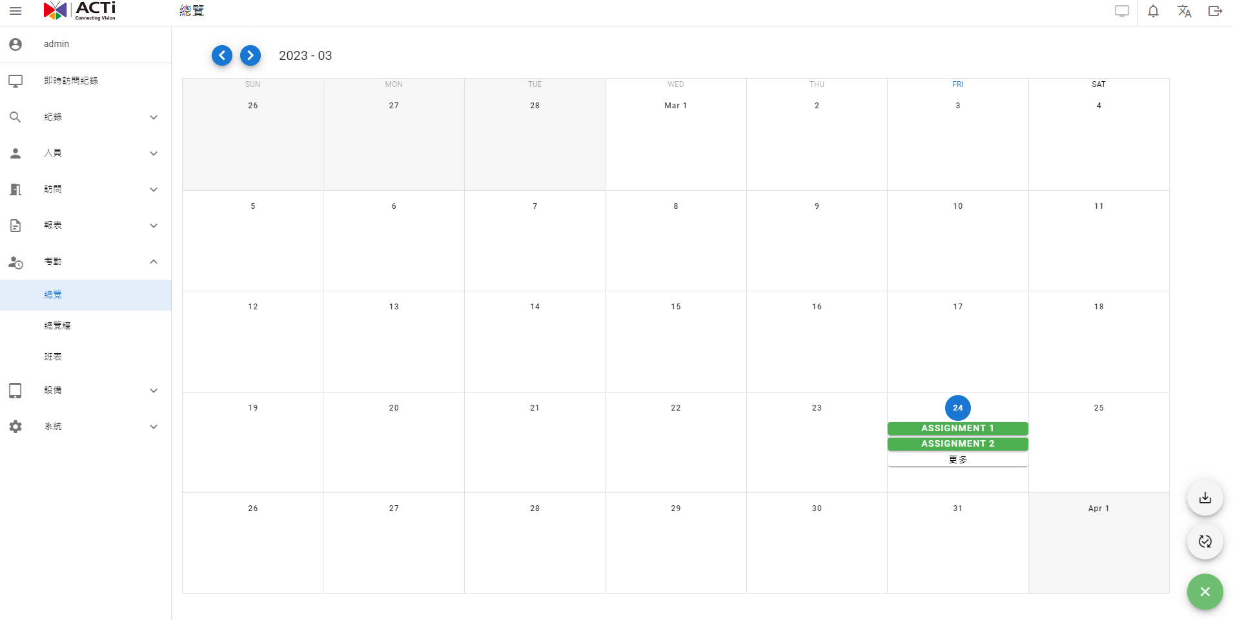
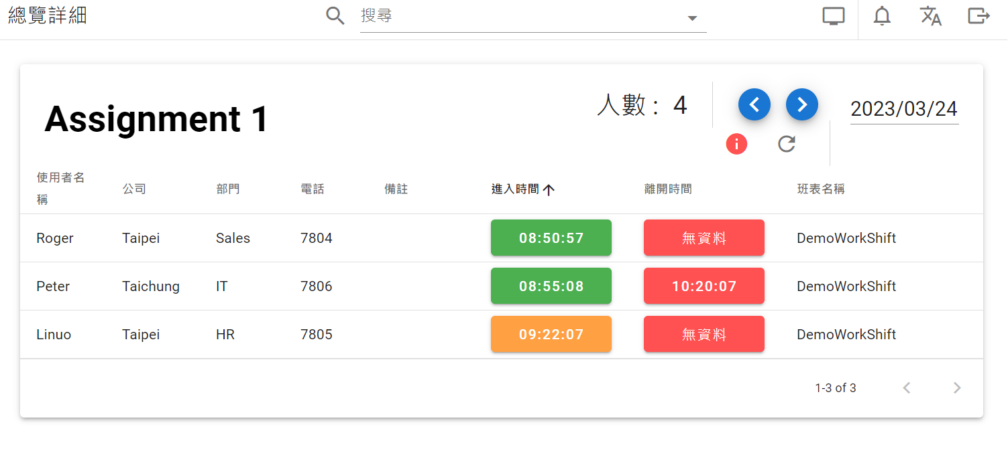
UI – Attendance-Overview
Click
Export
Traceable Data
Demo site : acss.acti.com
( Account : admin ; Password : 123456 )

Slide 21
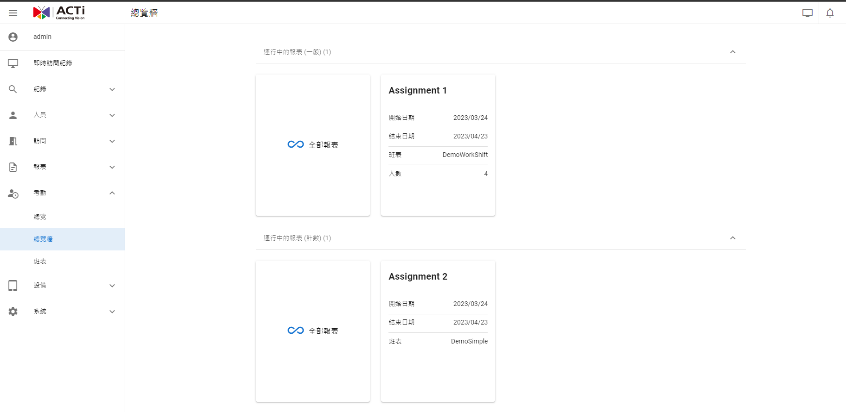
UI – Attendance-Overview Wall
Click to Enter Construction Site Dashboard
Demo site : acss.acti.com
( Account : admin ; Password : 123456 )

Slide 22
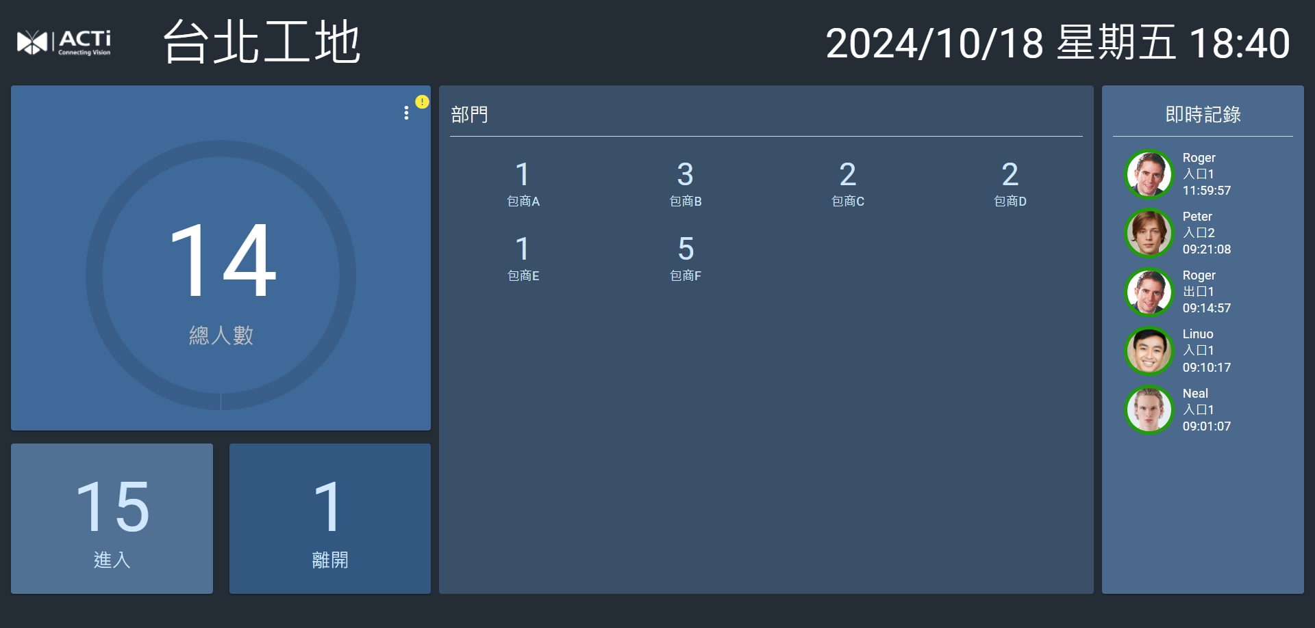
UI – Attendance-Overview Wall
Demo site : acss.acti.com
( Account : admin ; Password : 123456 )

Slide 23
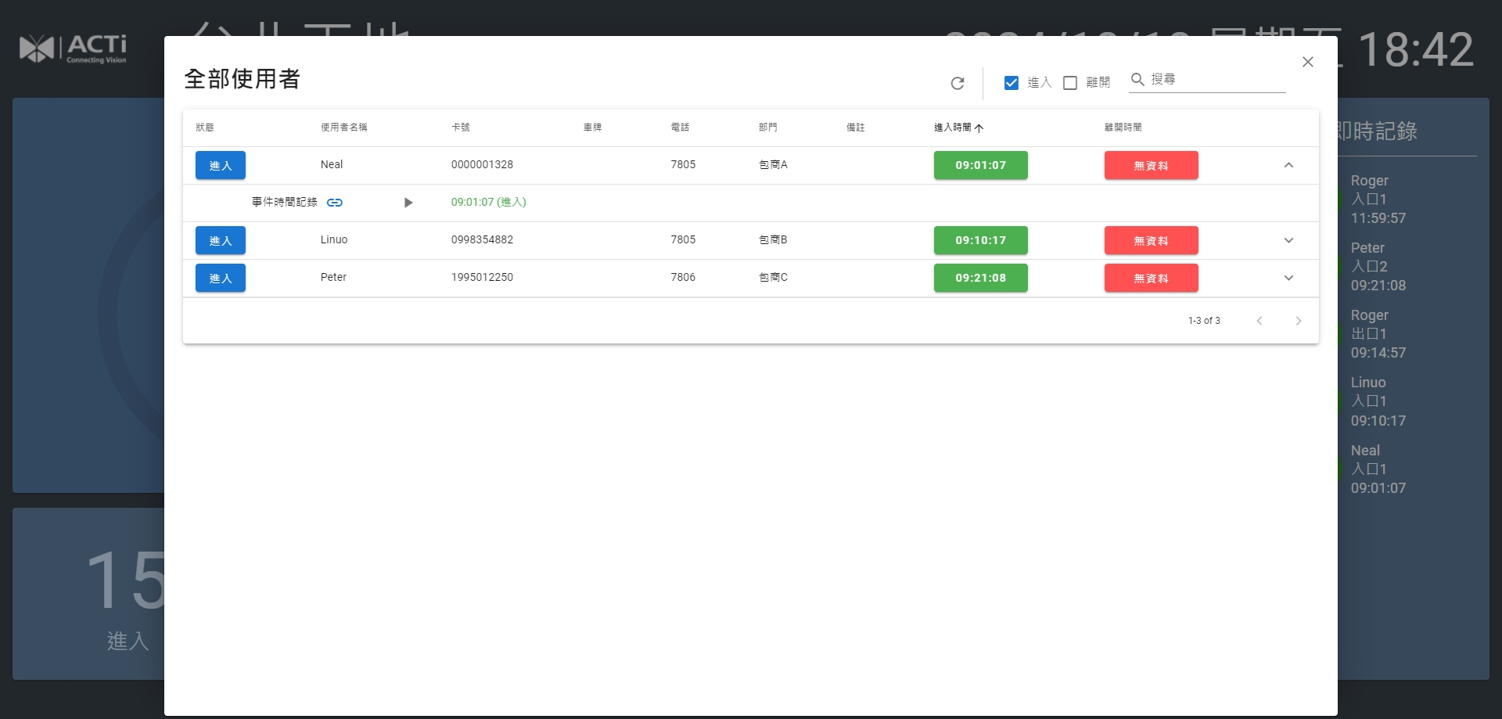
UI – Attendance-Overview Wall
Demo site : acss.acti.com
( Account : admin ; Password : 123456 )

Slide 24
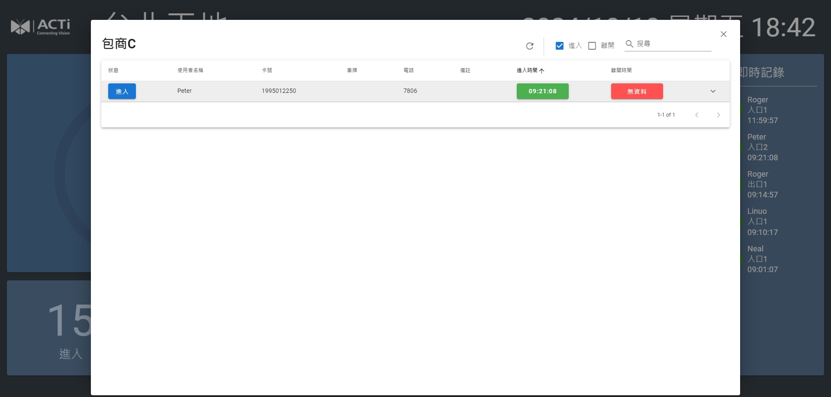
UI – Attendance-Overview Wall
Demo site : acss.acti.com
(Account: admin ; Password : 123456 )

Slide 25
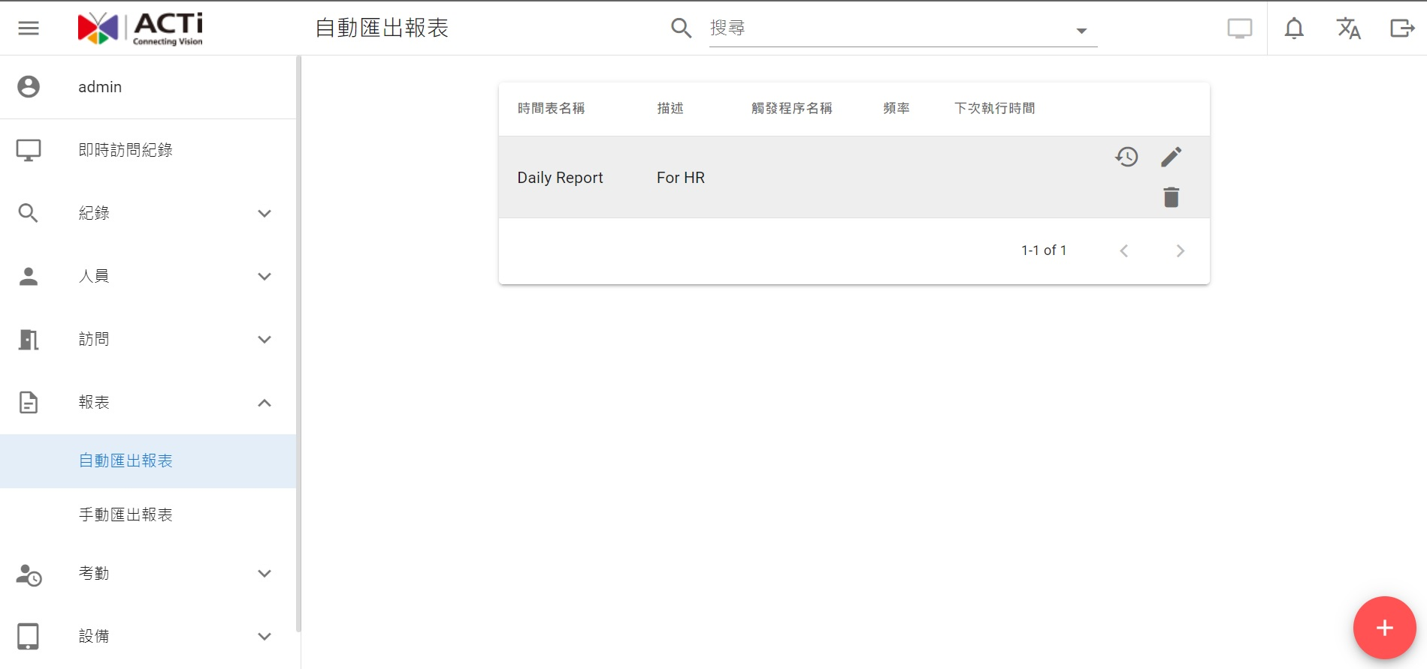
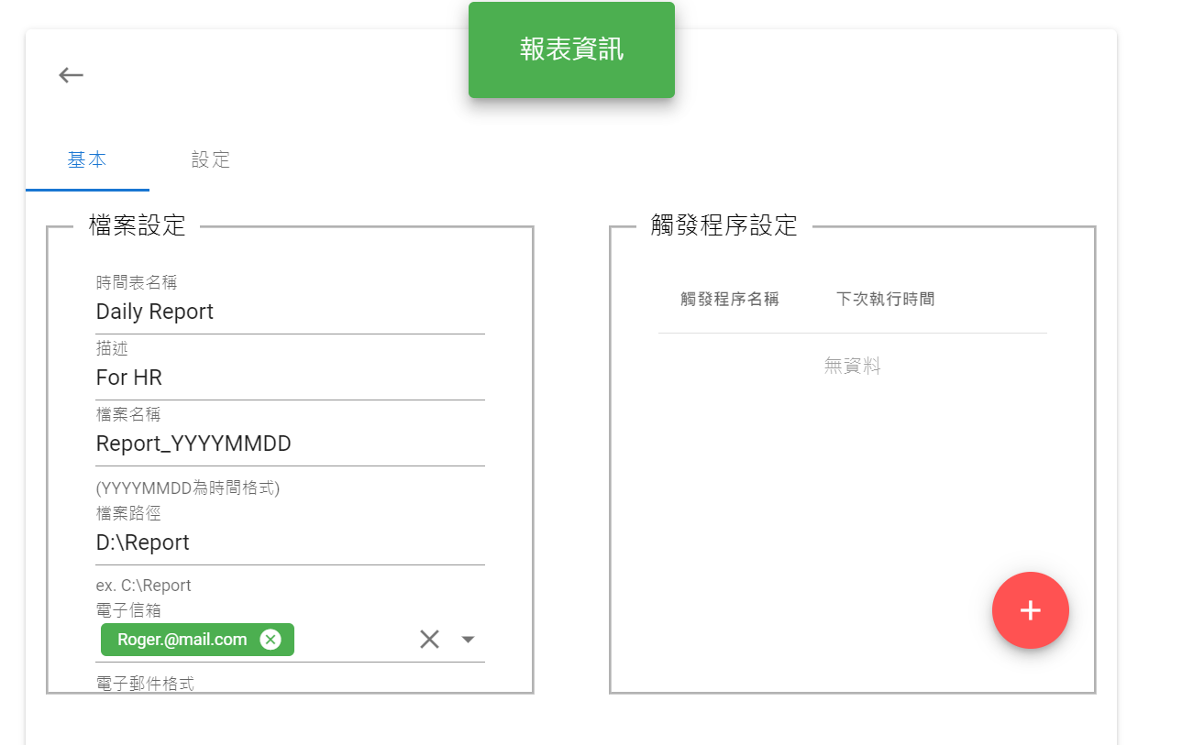
UI – Report Management -> Automatic Report Export
History Record
Delete
Edit
Add New Schedule
Demo site : acss.acti.com
(Account : admin ; Password : 123456 )

Slide 26
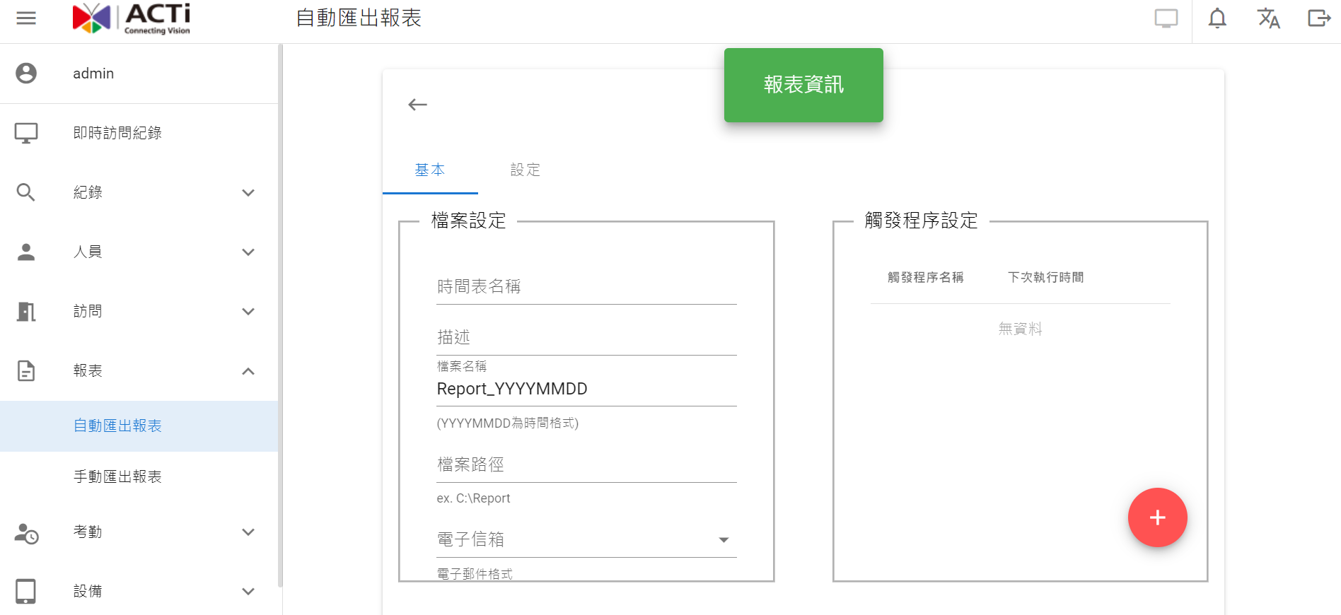
UI – Report Management -> Automatic Report Export
Demo site : acss.acti.com
(Account : admin ; Password : 123456 )

Slide 27
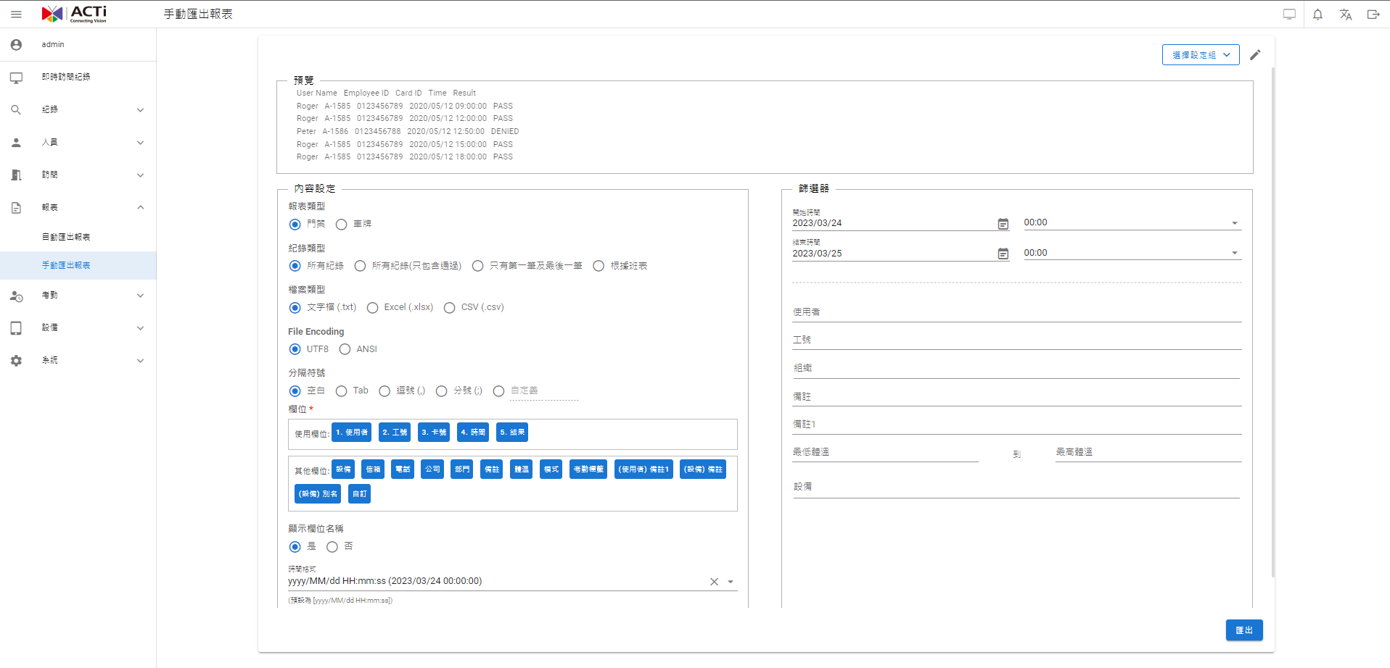
UI – Report Management -> Automatic Report Export
Edit Settings Group
Demo site : acss.acti.com
(Account : admin ; Password : 123456 )

Slide 28
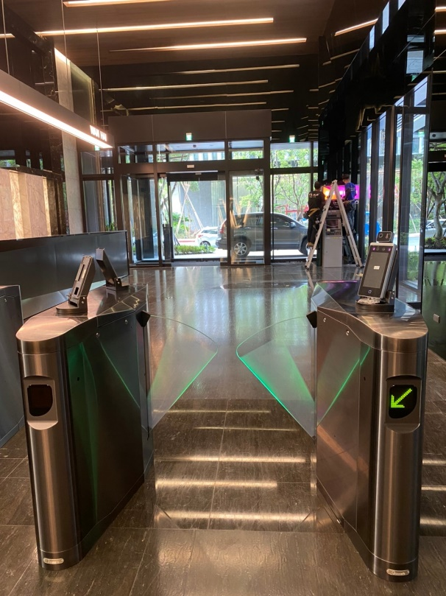
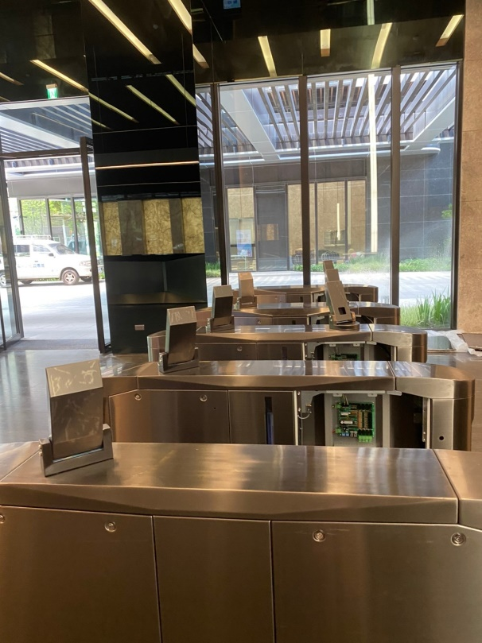
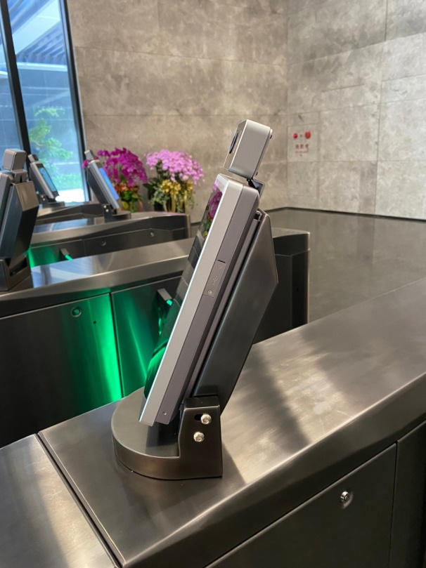
Case Sharing and Application Examples – Integration of Access Control Terminals
Provide Successful Cases and Practical Application Scenarios

Slide 29

Where to Buy
Via Authorized Resellers
https://www.acti.com/Corporate/WhereToBuy
From ACTi Corporation Directly
E-Mail: sales@acti.com
Tel (US): +1-866-410-2284 (Toll Free)
Tel (Non-US): +886-2-2656-2588

Slide 30
Support & Services
Technical Support
- Online Customer Helpdesk - https://www.acti.com/chd
- Phone support
Taiwan or Other Regions : +886-2-2656-5200
        US: +1-866-410-2284 (Toll Free)
RMA Services
- Warranty
- Repair services
Training
- Self-learning

Slide 31


