Slide 1
VMS Technical
Support Tools
New Product Introduction

Slide 2


ACTi offers several useful Technical Support Service tools by which the customers can easily and cost-efficiently service their own systems.
Troubleshooting Utility
https://www.acti.com/product/troubleshooting%20utility
This tool is used for collecting the system and NVR related information into a log file so that it could be evaluated by the customer or forwarded to ACTi FAE for more efficient support.
DB Builder
https://www.acti.com/product/DBBuilder
The purpose of this tool is to rebuild the NVR 3 database when the hard drive is disconnected or the playback files missing.
For more self-service tips, please visit: https://www.acti.com/products/vms-support

Slide 3

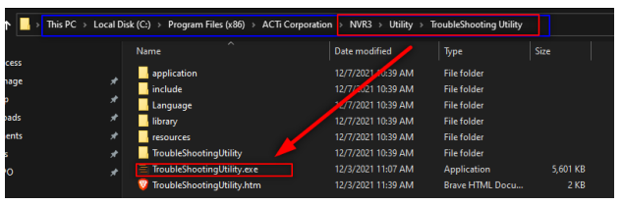
Troubleshooting Utility
If you have NVR 3 version v3.0.16.23 or newer, the Troubleshooting Utility is already installed in your server. If older, then you can download it from acti.com, as shown on the previous slide.

Slide 4
Troubleshooting Utility
The Utility will provide 7 reports:
System: Details about the Host PC.
Programs: programs on the unit
Processes: Process currently on active on the host
Services: Services and the status.
SQL Server: status of the NVR 3 database
Storage: status of the HDD or Virtual drive accessible by the host.
Device: Devices connected to the NVR 3

Slide 5
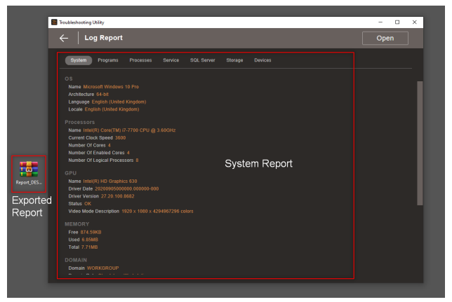
Troubleshooting Utility
Example of the user interface.

Slide 6
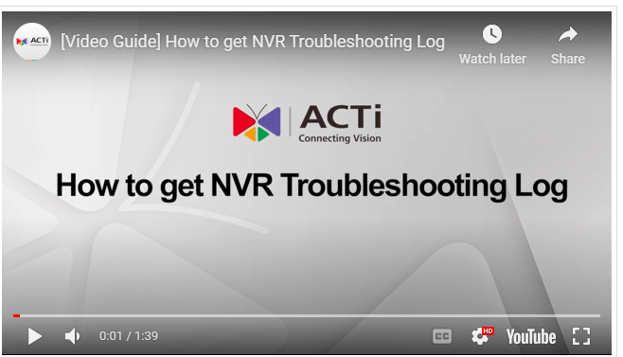
Troubleshooting Utility
You can also watch this video that guides you through the steps.
https://www.acti.com/video/v2926

Slide 7
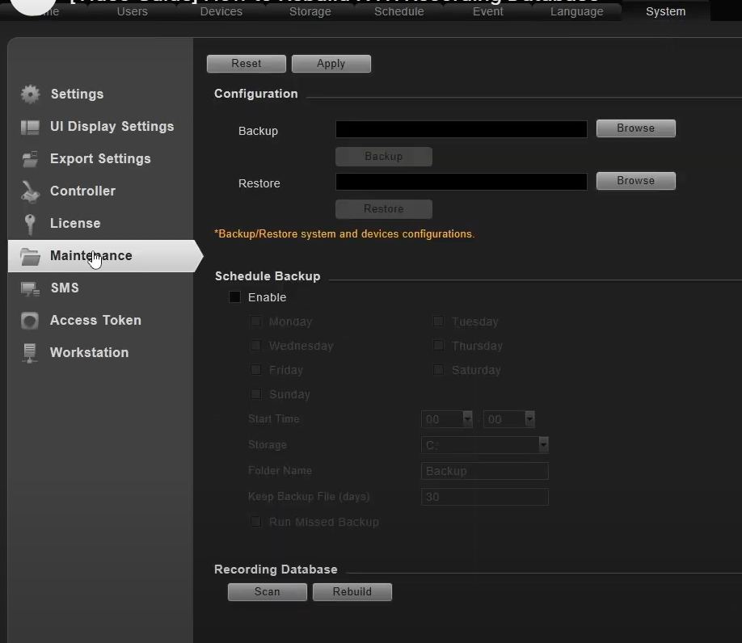

DB Builder
If you have NVR 3 version v3.0.16.29 or newer, the Database Builder is already integrated into your NVR.
Go to System
Go to Maintenance
Scan
Rebuild
The recordings will be recovered after that.
For the older versions of NVR, please download the DB Builder utility from ACTi website, and run it.

Slide 8
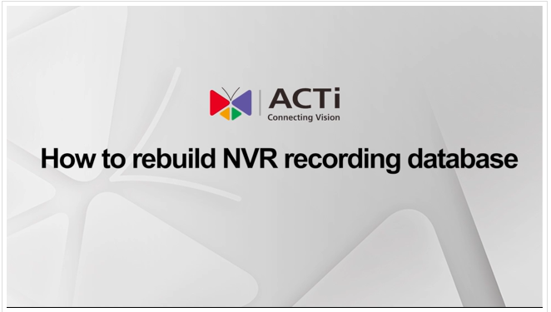
DB Builder
You can also watch this video that guides you through the steps.
https://www.acti.com/video/v2928

