Slide 1
INR-490
New Product Introduction

Slide 2
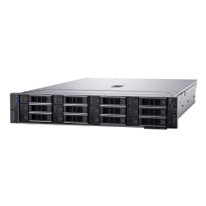
ACTi is introducing the newest products:
INR-490
256-Channel 12-Bay RAID Rackmount Standalone NVR with Redundant Power Supply, Additional Computing Power, Recording Throughput 550 Mbps, Instant Playback, e-Map, VGA Port, Remote Access, Video Export, 225-Channel Live View Layout, 225-Channel Synchronized Playback, 64-channel free license included (for ACTi video devices) and additional license required (for integration with POS, access control and extended devices), Supports External Storage (iSCSI), Hardware RAID 0, 1, 5, 6, 10, 50, 60, 12-Bay (Storage Disks not included), AC 100-240V

Slide 3
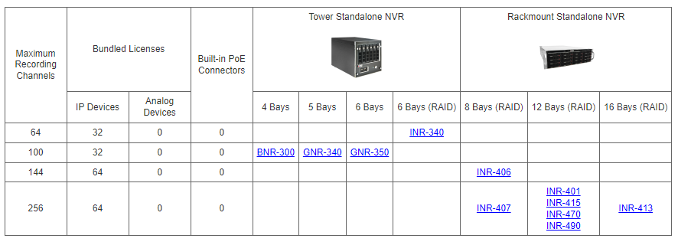
Product Matrix:
INR-490 is the next generation version of a popular INR-470.

Slide 4
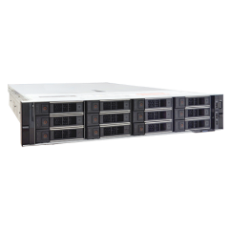
Spec Comparison:
Model | INR-470 | INR-490
Photo
Maximum Channels | 256 | 256
Storage Bays | 12 | 12
RAID | 0, 1, 5, 6, 10, 50, 60 | 0, 1, 5, 6, 10, 50, 60
Recording Throughput | 500 Mbps | 550 Mbps
CPU | Intel Xeon Silver 4210 | Intel Xeon Silver 4309Y
RAM | 16GB, DDR4, 2666MT/s | 16GB, DDR4, 3200MT/s
Operating System | Windows 10 IoT | Windows Server 2022
Bundled NVR Software | NVR 3 Corporate | NVR 3 Corporate

Slide 5
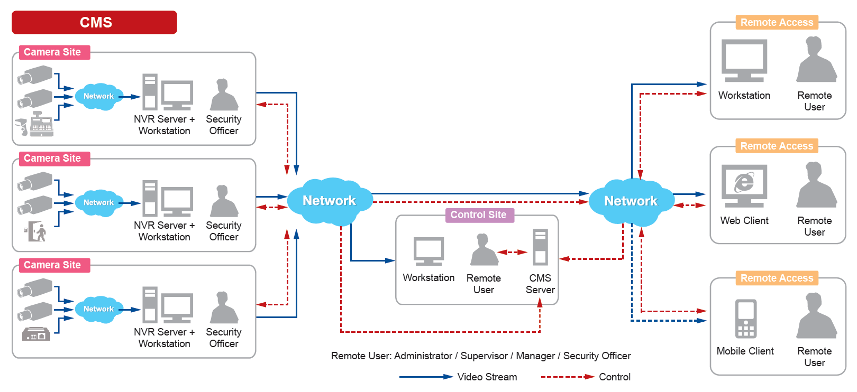
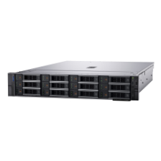
Typical High Level Solution Architecture
INR-490 is most often used in the multi-site mission critical projects together with the Control Center.

Slide 6
Supported VMS and Solutions
Both INR-470 and the new INR-490 are used in the following solutions:
Solution Name | Solution ID
Windows-Based NVR Solution | S110
Windows-Based NVR and Decoder Client Solution | S111
Windows-Based NVR and Redundancy Solution | S112
Windows-Based NVR and Control Center Solution | S120
Windows-Based NVR, Control Center and TV Wall Solution | S121
Windows-Based NVR, Control Center and Decoder Client Solution | S122

Slide 7
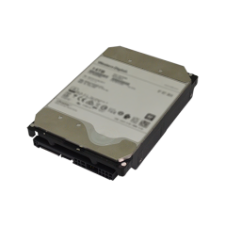
Related Accessories
Accessory Type | Part Number
Rackmount Rails | Bundled
Hard Drive Options | ACTi offers a wide range of Hard Drives for INR-490, up to 22TB. Read more: https://www.acti.com/product/INR-490?tab=related-products
Extended Storage | PSTR-0405

