Slide 1
Z812, Z813, Z813-P1, Z819, Z810
New Product Introduction
2-8MP Outdoor Zoom Domes

Slide 2
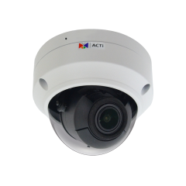
ACTi is introducing the newest products:
Z812
2MP 4.3x Outdoor Zoom Dome with IR LED 60m, WDR 120dB
Z813
4MP Deep Learning AI 4.3x Outdoor Zoom Dome with IR LED 60m, WDR 120dB
Z813-P1
4MP Deep Learning AI 4.3x Outdoor Zoom Dome with IR LED 60m, WDR 130dB

Slide 3
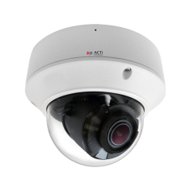
Z819
5MP Deep Learning AI 4.3x Outdoor Zoom Dome with IR LED 60m, WDR 130dB
Z810
8MP 4.3x Outdoor Zoom Dome with IR LED 60m, WDR 130dB

Slide 4
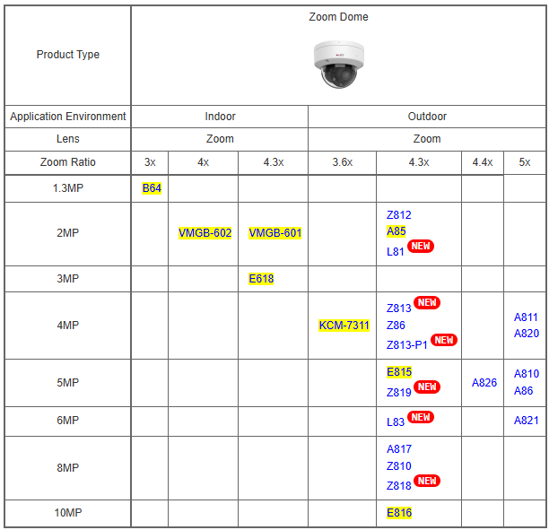
Product Matrix

Slide 5
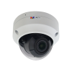
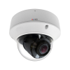
Spec Comparison:
Model | Z812 | Z813 | Z813-P1 | Z819 | Z810
Photo
Product type | Zoom Dome | Zoom Dome | Zoom Dome | Zoom Dome | Zoom Dome
Resolution | 2MP | 4MP | 4MP | 5MP | 8MP
Lens | Zoom, 4.3x | Zoom, 4.3x | Zoom, 4.3x | Zoom, 4.3x | Zoom, 4.3x
LED | IR LED | IR LED | IR LED | IR LED | IR LED
WDR | 120dB | 130dB | 130dB | 130dB | 130dB
Audio | Built-in Mic | Built-in Mic, Line-in, Line-out | Built-in Mic, Line-in, Line-out | Built-in Mic | Built-in Mic, Line-in, Line-out
Environment | IP68, IK10 | IP68, IK10 | IP68, IK10 | IP68, IK10 | IP68, IK10
Analytics | Yes | Yes | Yes | Yes | Yes
NDAA | Yes | Yes | Yes | Yes | Yes
UL Listed | Yes | Yes | Yes | Yes | Yes

Slide 6
Supported VMS and Solutions
 | Standard Features | AI Events/Meta | Solutions
NVR 3 Corporate | Yes | Yes | S110, S111, S112
NVR 3 Business | Yes | Yes | S110, S111, S112
CMS 2 | Yes | Yes | S120, S121, S122
ZNR-Series NVR | Yes | Yes | S60
ENR-Series NVR | Yes |  | S72

Slide 7


