Slide 1
A426, A826
New Product Introduction

Slide 2

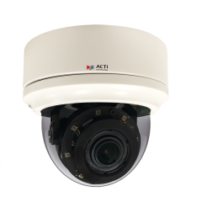
ACTi is introducing the newest products:
A426
5MP Zoom Bullet with Deep Learning AI, D/N, Adaptive IR, Extreme WDR, SLLS, 4.4x Zoom Lens
A826
5MP Zoom Dome with Deep Learning AI, D/N, Adaptive IR, Extreme WDR, SLLS, 4.4x Zoom Lens

Slide 3
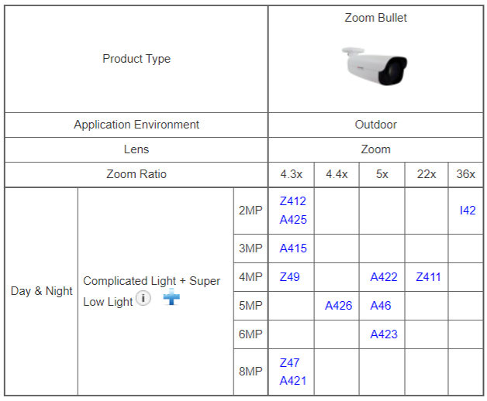
Product Matrix:
The main value of A426 is to provide a model like A46, but with Deep Learning AI built-in.

Slide 4
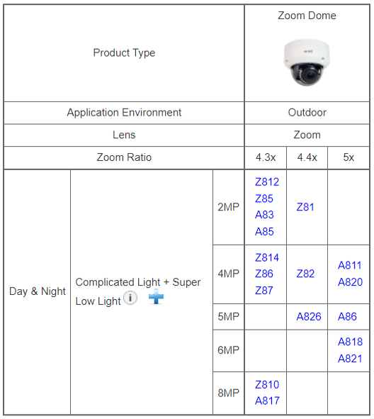
Product Matrix:
The main value of A826 is to provide a model like A86, but with Deep Learning AI built-in.

Slide 5
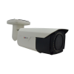

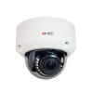

Spec Comparison:
 | A46 | A426 | A86 | A826
Product type | Zoom Bullet | Zoom Bullet | Zoom Dome | Zoom Dome
Resolution | 5MP | 5MP | 5MP | 5MP
Zoom | 5x | 4.4x | 5x | 4.4x
IR LED | Yes | Yes | Yes | Yes
WDR | Extreme 125dB | Extreme 130dB | Extreme 125dB | Extreme 130dB
Low Light | Superior | Superior | Superior | Superior
Audio | Yes | Yes | Yes | Yes
Deep Learning AI | No | Yes | No | Yes

Slide 6
Built-in Deep Learning AI:
Category | Deep Learning Algorithm
Face | Face Recognition, Face Detection
People | People Detection, Intrusion Detection (Forbidden Area Detection), People Line Crossing Detection, People Enter Area Detection, People Incorrect Direction Detection, People Loitering Detection, People Tracking
License Plate | License Plate Detection, Automatic License Plate Recognition (ALPR)
Vehicle | Vehicle Detection, Vehicle Counting (Traffic Jam), Vehicle Line Crossing Detection, Vehicle Enter Area Detection, Vehicle Incorrect Direction Detection
Other | Object Based Motion Detection, Object Line Crossing Detection, Object Area Counting (Crowd Detection), Missing Object Detection, Unattended Object Detection, Object Loitering Detection, Tampering Detection, Audio Detection

Slide 7




ACTi AI Solution Architecture
MOBILE CLIENT
E-mail
alerts
alerts
video
video
Realtime
analytics data
Realtime
analytics data, alerts
AI CAMERA
NVR SERVER
(ACTi NVR 3 Corporate)
NVR CLIENT

Slide 8
Supported VMS and Solutions
 | Standard Features | AI Events/Meta | Solutions
NVR 3 Corporate | Yes | Yes | S110, S111, S112
NVR 3 Business | Yes | Yes | S110, S111, S112
CMS 2 | Yes | Yes | S120, S121, S122
ZNR-Series NVR | Yes |  | S60
ENR-Series NVR | Yes |  | S72

Slide 9
ACTi Advantages compared to Server-Based AI Providers
Hundreds of channels with deep learning analytics can be managed by a single VMS server, using just a common server hardware configuration. The Server-based AI solutions have limited number of channels and require very expensive hardware.
VMS video recording functionality is much better secured when the VMS does not have the burden of running the analytics that may consume the server resource to its limits.
Faster response to the events – AI cameras can control the other nearby PTZ cameras for instant response, to get better video coverage of the scene. The analyses that are processed on the VMS side will be too slow for proper response.
Since the AI features are inside the camera, there are no Analytics related licenses required on the server side. Therefore, the cost of VMS in some cases is up to 10 times lower than the server-side AI solutions.

Slide 10
NVR and CMS Features
ACTi NVR 3 Corporate (and CMS 2) manages the analytics events from the cameras as follows:
Set up the analytic rules and thresholds – for example, how big is the crowd, how long time is considered loitering.
Receive real-time analytic events from all the cameras and respond by the pre-defined actions, such as send e-mail, instant pop-up of the video channel on the VMS screen and more.
Automatically push video to the mobile app of the patrolling security guards.
Search by the specific filter rules, bookmarks, thumbnails.

Slide 11
Security Applications
ACTi offers end-to-end solutions for facility and campus security management using deep learning AI cameras and the video management systems (VMS).
The AI cameras can fulfill the following security applications:
Blacklisted vehicles identification
(using ALPR)
Blacklisted persons identification
(using Face Recognition)
Suspicious loitering
(using People Loitering Detection)
Crowd detection
(using People Area Counting with predefined threshold)
Trespassing Detection
(using People Enter Area Detection)
Suspicious items
(using Unattended Object Detection)

Slide 12
Traffic Applications
ACTi offers end-to-end solutions for traffic management using deep learning AI cameras and the video management systems (VMS).
The AI cameras can fulfill the following traffic applications:
Blacklisted vehicles identification
(using ALPR)
Traffic Jam Detection
(using single frame based Vehicle Counting)
Illegal Stopping
(using Stopped Vehicle Detection)
Direction Violation Detection
(using Vehicle Incorrect Direction Detection)
Restricted Area Driving Detection
(using Vehicle Enter Area Detection)
Illegal Parking
(using Vehicle Loitering Detection)

Slide 13
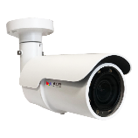
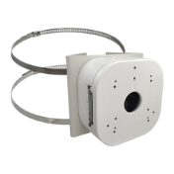
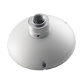
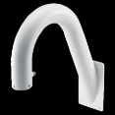
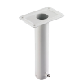
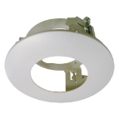
A426, A826 Popular Installation Methods
Model | Photo | Mounting Method | Accessory Part | Photo | Notes
A426 |  | Ceiling, Wall | No accessory required
A426 |  | Pole | PMAX-0534 |  | Pole Mount with Junction Box, supports 3.25" to 7.0" Poles
A826 |  | Ceiling, Wall (face forward) | No accessory required
A826 |  | Wall (face down) | PMAX-0405 + PMAX-0303
A826 |  | Pendant | PMAX-0405 + PMAX-0102
A826 |  | Flush | PMAX-1035

