Slide 1
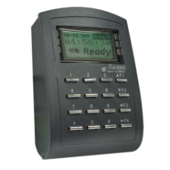
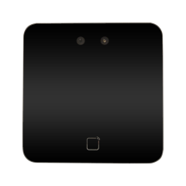
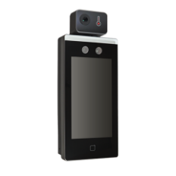
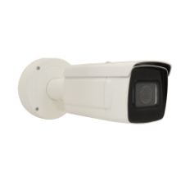
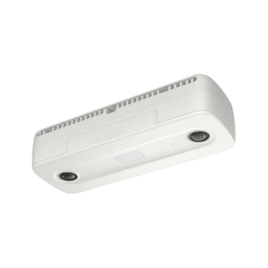
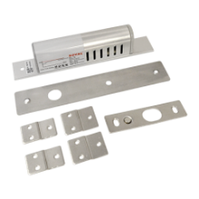
Access Control
Devices
For Access Control Smart Server

Slide 2

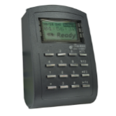

Overview
Access Control Smart Server has already been fully integrated with various types of devices, ranging from RFID readers, controllers, face recognition door stations, fingerprint scanners, ALPR cameras, locks and other devices.
Face Recognition* devices
ALPR devices*
Locks
RFID
Access Control Smart Server
* Not available in the US/CA.
RFID with Tailgating detection

Slide 3
System Flow
ACSS Server
(Access Control Server)
Data Switch
Access Control Device
(Card, Face Reader)
1. Create User Profile (card number, face photo)
2. Send User Profile into Devices (White List)
3. Device controls the door directly
4. Access log is stored in the device
5. The server fetches the access log
6. The server creates the report

Slide 4
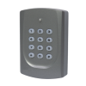
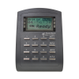
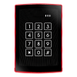
RFID Devices
Model | R10C-10 | R11C-30 | R11C-33 | R11C-34
Photo
Device type | RFID Reader | RFID Reader and Controller | RFID Reader and Controller | RFID Reader and Controller
Communication Frequency | 13.56 MHz | 125 KHz, 13.56 MHz | 125 KHz | 125 KHz
RFID Options | MIFARE | EM, MIFARE, NFC | HID Prox | HID Prox
User database (card capacity) | - | 16 000 | 16 000 | 3 000
Access Mode |  | Card only | Card, Password, or both | Card, Password or both

Slide 5
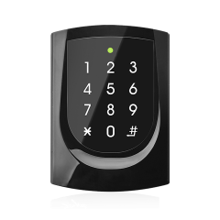
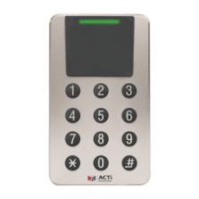
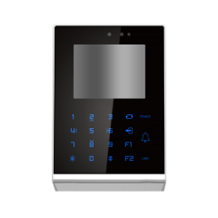
RFID Devices
Model | R11C-310 | R11C-311 | R73C-31 * | R73C-32 *
Photo
Device type | RFID Reader | RFID Reader | RFID Reader and Controller | RFID Reader and Controller
Communication Frequency | 13.56 MHz | 13.56 MHz | 125kHz | 13.56 MHz
RFID Options | EM, MIFARE | EM, MIFARE | EM | MIFARE
User database (card capacity) | 16000 | 16000 | 100000 | 100000
Access Mode | Card only Card of Password Card and Password | Card only Card of Password Card and Password | Card only Card of Password Card and Password | Card only Card of Password Card and Password
Environment | Indoor | Outdoor | Indoor | Indoor
NEW
NEW
* Not available in the US/CA.

Slide 6
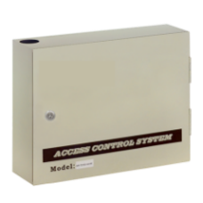
Multi-Door Controllers
Model | R11-20
Photo
Device type | Multi-Door Controller
Communication Frequency | 13.56 MHz
RFID Options | EM, Mifare, HID Prox
User database (card capacity) | 16000
Relay Output | Alarm Relay x 1, Lock Relay x 2
Digital Input | Egree (R.T.E.) x 2, Door Contact x 2, Fire Laarm x 1
NEW

Slide 7

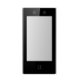
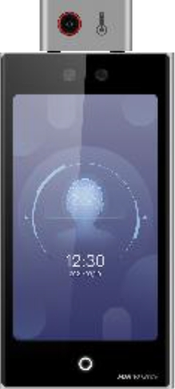
Face Recognition* Devices
Model | R71CF-311 | R71CF-312 | R71CF-313 | R72FT-32
Photo
Device type | Face Recognition & RFID Reader + Controller | Face Recognition & RFID Reader + Controller | Face Recognition & RFID Reader + Controller | Face Recognition & Fingerprint & RFID Reader & Temperature + Controller
Description | 2MP EM LCD Card Wiegand Reader and Controller with Bundle 3,000 Card Database / 1,500 Face Database, EM. | 2MP Mifare LCD Wiegand Reader and Controller with Bundle 3,000 Card Database / 1,500 Face Database. | 2MP Semi-outdoor Mifare LCD Wiegand Reader and Controller with Bundle 50,000 Card Database / 6,000 Face Database. | Thermal and Optical 2MP Mifare FeliCa DESFire EV1 EV2 LCD Card Reader and Controller with Bundle 500,000 Card Database / 100,000 Face Database / 10,000 Fingerprint DB.
NEW
* Not available in the US/CA.

Slide 8
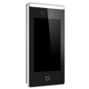
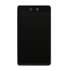
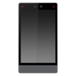
Face Recognition* Devices
Model | R71CF-35 | R71CF-36 | R71CF-37 | R71CF-39
Photo
Device type | Face Recognition & RFID Reader + Controller | Face Recognition & RFID Reader + Controller | Face Recognition & RFID Reader + Controller | Face Recognition & RFID Reader + Controller
Description | 2MP Mifare LCD Card Wiegand Reader and Controller with Bundle 50,000 Card Database / 20,000 Face Database. | 2MP Mifare LCD Card Wiegand Reader and Controller with Bundle 6,000 Card Database / 5,000 Face Database. | 2MP Mifare LCD Wiegand Reader and Controller with Bundle 50,000 Card Database / 50,000 Face Database. | Semi-Outdoor 2MP Mifare LCD Card Wiegand Reader and Controller with Bundle 100,000 Card Database / 100,000 Face Database.
* Not available in the US/CA.

Slide 9
ALPR* Devices
Model | VMGB-410
Photo
Device type | ALPR Bullet Camera
Description | 2MP Automatic License Plate Recognition Zoom Bullet with D/N, Adaptive IR, Extreme WDR, SLLS, 4.3x Zoom Lens
ALPR Usage Region | Taiwan
* Not available in the US/CA.

Slide 10
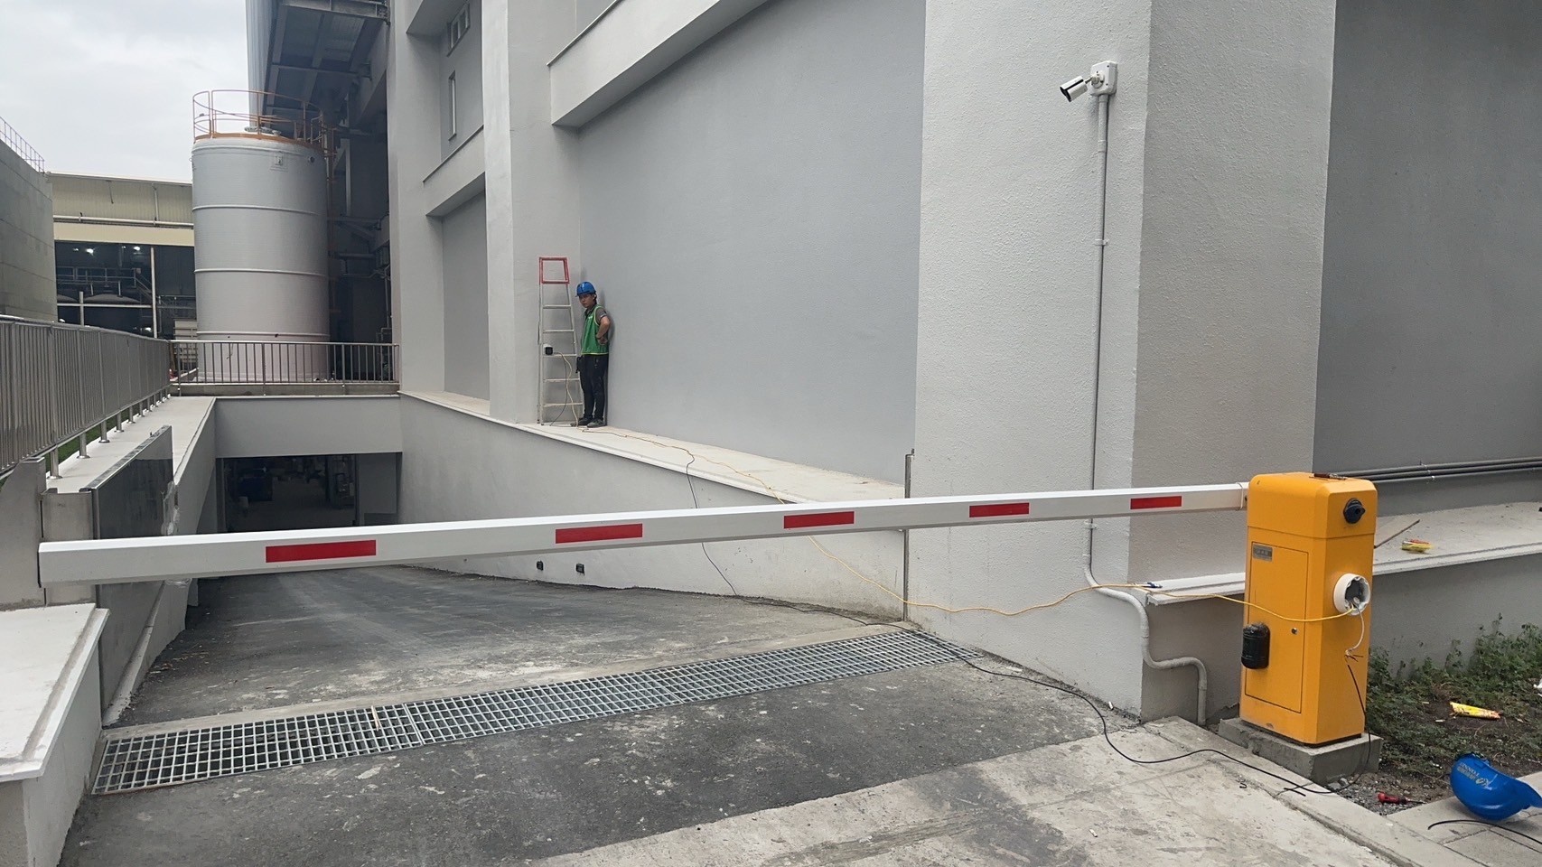
How to Install ALPR Cameras
Possible installation location #2 (height: ~2m)
Possible installation location #1 (height: ~1.5-2m)
Possible installation location #3 (height: ~1.5m)
* Not available in the US/CA.

Slide 11
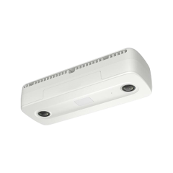
Tailgating* Detection Devices
Model | Q963
Photo
Device type | People Counting Camera
Application | When used in combination with RFID reader, using the Access Control Standard server binding, then the tailgating can be detected and alerted in ACSS when the number of RFID swipes and the actual person count do not match.
* Not available in the US/CA.

Slide 12
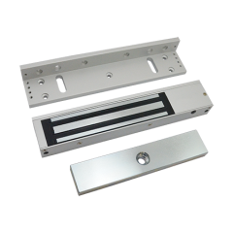
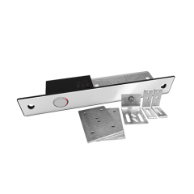


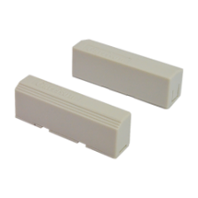
Locks
Model | PLOC-0001 | PLOC-0002 | PLOC-2002 | PLOC-3001 | PLOC-4001
Photo
Device type | Lock | Lock | Lock | Lock | Lock
Description | Soyal LK-1201A Electric Bolt Lock | Soyal LK-1207A-36 Electric Bolt Lock | Soyal AR-0600M + AR-0600MZL Magnet Lock + Bracket | Automatic door Electric Bolt lock | Magnetic Switch

Slide 13

Where to Buy
Via Authorized Resellers
https://www.acti.com/Corporate/WhereToBuy
From ACTi Corporation Directly
E-Mail: sales@acti.com
Tel (US): +1-866-410-2284 (Toll Free)
Tel (Non-US): +886-2-2656-2588

Slide 14
Support & Services
Technical Support
- Online Customer Helpdesk - https://www.acti.com/chd
- Phone support
US: +1-866-410-2284 (Toll Free)
Other Regions: +886-2-2656-5200
RMA Services
- Warranty
- Repair services
Training
- Self-learning

