Slide 1
Windows NVR
How to Sell

Slide 2

Contents
Introduction of NVR 3 Product Family
NVR 3 Editions Comparison
Value Position by Scale
Value Position & Unique Selling Points
NVR 3 Features
Lite Web Client Introduction
ACTi Mobile Client for NVR 3
Redundancy Solutions
TV Wall Products
Learn More about NVR 3
Where to Buy
Support and Services

Slide 3

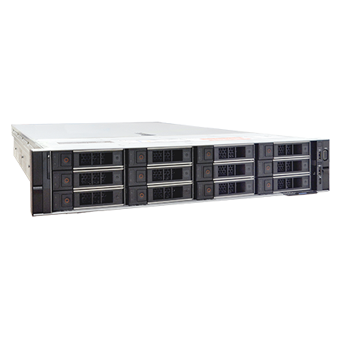
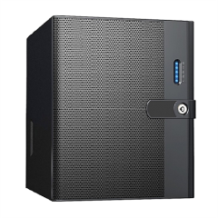
Introduction of NVR 3 Product Family
NVR 3 is one of the most famous ACTi products – it is a professional and elegant network video recorder platform with wide range of features and extremely reliable performance!
Both standalone and software versions available.
Standalone NVR options based on NVR 3
(INR and GNR series)
Software editions of NVR 3

Slide 4
Introduction of NVR 3 Product Family
There are two EDITIONS of NVR 3 available – Business and Corporate.
Depending on the scale of the project, the user can choose either NVR 3 Business or Corporate.
It is also possible to upgrade the servers with the existing Business edition to the Corporate edition.
There are regular updates available for both editions, usually once per quarter. These updates are called VERSIONS.
ACTi offers the updates for free!
The latest version of NVR 3 is 3.0.16.

Slide 5
NVR Editions Comparison
Feature | NVR 3 Business | NVR 3 Corporate
Maximum Number of Channels | 100 | 200 (Standalone NVR 256)
Free ACTi Camera Channels Included | 32 | 1
Free 3rd Party Camera Channels Included | 1 | 1
CMS Support | No | Yes
POS, Access Control, Network IO Support | No | Yes
eMap | Yes | Yes
Google Map | No | Yes
Embedded Websites within Display | No | Yes
PTZ Control | Yes | Yes
Redundancy Support (N+1, N-to-N) | Yes | Yes
Workstation, Web Client, Mobile Client | Yes | Yes
Display Layouts (maximum grid size)* | 225 | 225
* NVR 3 display grid cells can be merged into different shape and size.

Slide 6
Value Position by Scale
Features
Full
CMS 2 + NVR 3 Corporate
NVR 3 Corporate, GNR, INR
NVR 3 Business, BNR
YVR, ZNR, ENR
Essential
4ch
16ch
32ch
64ch
100ch
200ch
500ch+
Channels

Slide 7
Value Position & Unique Selling Points
Unique Selling Points:
The most affordable high-quality VMS in the industry!
  NVR 3 Business comes with 32 free (!) channel licenses.
  Very competitive price per channel for the add-on licenses.
  No perpetual fees.
Has all the features you need!
  Get over 95% of all the features that the top ISV brands have, in many cases, even for free.
  ACTi continuously adds more features to ensure it has all you need!

Slide 8
Value Position & Unique Selling Points
Unique Selling Points:
Easy to Migrate to ACTi NVR!
  Keep all the existing cameras while migrating to ACTi NVR
  ACTi support & service team helps with seamless and worry-free migration
  Enjoy immediate cost saving
Easy to Switch Between ACTi NVR Editions!
  Easily migrate from Business to Corporate while keeping configurations and recordings
Free Upgrades!
  ACTi offers quarterly software upgrades, for free!
  Get more features every quarter.

Slide 9
Value Position & Unique Selling Points
Unique Selling Points:
Unique Features help you win projects!
  ACTi NVR provides several world leading features for you to win
  Our service personnel helps with A&E requirements fulfillment
Exclusive custom-made NVR features for you!
  For the large projects, ACTi helps develop customized features by request
Turn ACTi NVR into your own brand!
  White label and non-brand NVR options available.
  Secure your business with exclusive NVR branding.

Slide 10
Value Position & Unique Selling Points
Unique Selling Points:
Ultimate Reliability Guaranteed!
  RAID-supported Standalone NVR available
  Various Redundancy Service options available (N+1, N-to-N)
  Backup Service options available (make auto-backups of critical recordings)
  Widest range of system health check options available
Integrate ACTi NVR with Your System
  ACTi provides easy-to-use Integration API/SDK for solution integration
  Enjoy live video, playback and events within your own main system

Slide 11
Value Position & Unique Selling Points
Unique Selling Points:
Expand VMS up to 200 000 Channels!
  You can combine hundreds of NVR servers into a single system using ACTi CMS 2, up to 200 000 channels.
  ACTi smart network architecture ensures stable and seamless data flow even in the large-scale projects.
Wide range of Service Tools & Utilities
  - Free project planning tools for your VMS
  - Additional special purpose utilities to work along with NVR

Slide 12
Value Position & Unique Selling Points
Unique Selling Points:
Try Full Features without any Cost!
  ACTi provides NVR live demo access for the members at nvr.acti.com (free registration).
  NVR 3 Business and Corporate can be downloaded for free from ACTi website and tested immediately (free registration).
Learn About VMS Conveniently by Video Tutorials
  ACTi offers nice walk-through video clips for quick learning and first impression.

Slide 13
NVR 3 Features
SETUP
Intuitive setup flow that does not even require training.
Convenient copying and applying the configuration to multiple channels with a few mouse clicks.
Easy to migrate NVR to another server.
Easy to manage hundreds of users by linking the NVR to the Active Directory.
The camera related settings can be done within NVR Setup interface without needing to open the camera's own web page.

Slide 14
NVR 3 Features
LIVE VIEW
ACTi Windows NVR provides up to 225 channel live view layout with the flexible grid cell sizing.
Built-in dewarping capabilities help creating nice panoramic images for any types of fisheye cameras.
Integrated Google map with the GPS located cameras.
Embedded web pages inside the live view grid for conveniently accessing work related information.
Hardware accelerated video decoding (Intel, Nvidia and AMD).
Supporting smart phones and web cams as the video camera channels.
Various types of PTZ controls - mouse, joystick, on-screen arrows.
Two-way audio for voice verification.

Slide 15
NVR 3 Features
RECORDING
Frame rate acceleration upon the events for the highest quality video evidence.
Frame rate deceleration during the period of no activity in order to save the storage space.
Scheduled recording and event triggered recording based on the various types of analytics, motion detection or digital inputs.
Automatic synchronization of the SD card recordings of the cameras.
Pre-scheduled recording backups using the Backup Server.

Slide 16
NVR 3 Features
EVENT
Supporting the wide range of event triggers, such as video analytics, motion detection, digital input events, tampering, audio and various system status events.
The event responses include video channel pop-up, switching the triggered channel to the hotspot area of the grid, switch to a different view, command PTZ cameras, generate sound alerts, activate digital output devices via cameras, execute various types of pre-defined commands, send a notification or e-mail, push video or snapshot to the FTP server.
Event responses to the mobile devices include push notification, push video and Line Notify.

Slide 17
NVR 3 Features
SEARCH
Thumbnail search for quickly finding out the section of interest.
Search by specific events, such as video analytics, motion detection, digital input or system status alert.
Create bookmarks while reviewing the video evidence and later find those points instantly by using the bookmark search.

Slide 18
NVR 3 Features
PLAYBACK
Instant playback on the top of the live view as a pop-up.
Embedded playback inside the live view grid when using the Lite web client.
Multi-channel synchronized playback for efficient investigation of the incident.
Most flexible range of playback speeds from 1/64x to 256x.

Slide 19
NVR 3 Features
EXPORT
Export videos to the common video format, such as .avi, .mkv, .mov, .mp4, including video cropping.
Create authentic video exports by exporting the original video file within a video player as an executable file. The export is completed in just a few seconds.
Export videos as pure original files and play them back later by using the Archive Player, also known as the Authentic Video Evidence Player.
Hardware accelerated exports supported.

Slide 20
NVR 3 Features
VIDEO ANALYTICS
Manage the Face related events from ACTi deep learning AI cameras, such as Face Recognition and Face Detection.
Manage the People related events from ACTi deep learning AI cameras, such as People Detection, Intrusion Detection (Forbidden Area Detection), People Line Crossing Detection, People Enter Area Detection, People Incorrect Direction Detection, People Loitering Detection, People Tracking.
Manage the License Plate related events from ACTi deep learning AI cameras, such as License Plate Detection, Automatic License Plate Recognition (ALPR).
Manage the Vehicle related events from ACTi deep learning AI cameras, such as Vehicle Detection, Vehicle Density Counting (Traffic Jam), Vehicle Line Crossing Detection, Vehicle Enter Area Detection, Vehicle Incorrect Direction Detection.

Slide 21
NVR 3 Features
CLIENT APPLICATION
Workstation app for the Windows-based PC is the full-featured version of the NVR client.
For the web browser users both Full Web Client and Lite Web Client are available.
ACTi Mobile Client is available for both Android and iOS, capable of managing unlimited channels, single channel live view, PTZ control, Digital Output control, video search and playback, video export, push video and notification.
For the clients that do not intend to use the mouse and the keyboard, the HDMI-supported video decoder can be used.

Slide 22
NVR 3 Features
USER MANAGEMENT
Unlimited number of users, Active Directory, Customizable permissions for user groups, Account lockout, Automatic logout after idle, Playback password protected with dual authentication, Password validity period, Password Expiration Notification.
Cyber Security compliant features, including recording files encryption to prevent unauthorized access and tampering of the evidence.
Logging of all the user operations.

Slide 23
NVR 3 Features
SYSTEM MANAGEMENT
N+1 and N-to-N redundancy services available.
Various types of RAID configurations available.
System health monitoring, including CPU, memory, network, disk status, S.M.A.R.T.
Self-protection - auto-logout under overload, auto-switch to the lighter stream, lower the display frame rate when necessary.
Support the centralized System Health Management platform that can monitor all the NVR and CMS at the same time.
Includes various system support utilities, such as Troubleshooting Utility, Database Builder and others.
Configuration backup and restore capabilities.
User-friendly silent installation.

Slide 24
NVR 3 Features
INTEGRATION
Worry-free IP camera integration via ONVIF, RTSP.
Supports the third party built-in cameras of the mobile phones and webcams as the video channels.
Various brand POS server data inputs supported.
The wide range of extended devices have been directly integrated - access control, network DIO, license plate, gunshot sensors.
Enabling third party systems to access the NVR via API, SDK or various utilities and plug-ins.
Easy-to-use RTSP streaming for live view, playback and export.

Slide 25
Lite Web Client Introduction
In addition to already supporting Workstation client, Mobile client and Full-featured Web client, the NVR version v3.0.16 also introduces Lite Web Client option.
Lite Web Client is the simplified edition of the browser-based client application. It has less features enabled and simpler appearance, making it very user-friendly for the types of users who are not very technical and do not require full set of features.
While the Full-featured web client is available for Microsoft Edge browser (compatibility mode), the Lite web client can be used with various browsers:
Chrome
Firefox
Safari
Edge

Slide 26
Primary Users of the Lite Web Client
ACTi Web Client Value Position
Role | Client PC | Workstation app | Full Web Client | Lite Web Client
IT Admin (setup) | Dedicated | Y | Y
Security Officer | Dedicated | Y | Y
Supervisor/ Manager | May change anytime |  |  | Y
Owner | May change anytime |  |  | Y

Slide 27
Full Client vs Lite Client Comparison
NVR 3 Corporate v3.0.16 | Workstation Application | Web Browser
 |  | Full Client |  | Lite Client
 |  | Edge in IE Mode (Windows 10 or later) | Chrome, Firefox, Safari, Edge (normal mode) | Chrome, Firefox, Safari, Edge (normal mode)
Live View Layouts | Up to 225 channels | Up to 225 channels | - | Up to 16 channels
Playback | Yes | Yes | - | Embedded Playback
Events | Yes | Yes | - | -
PTZ control | Mouse, Joystick | Mouse, Joystick | - | Mouse only
Codec | H.265, H.264, MJPEG | H.265, H.264, MJPEG | - | H.264, MJPEG
Audio | 2-way | 2-way | - | Audio-in
Stream Switcher | Yes | Yes | - | Default Stream
Setup, Playback tab | Yes | Yes | - | -
Export | Yes | Yes | - | -

Slide 28
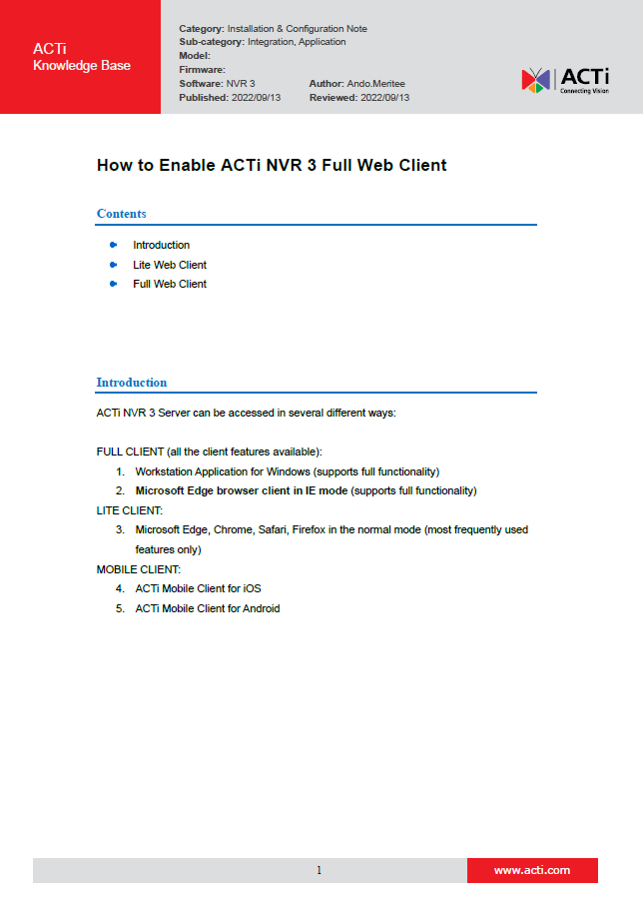
How to Enable Full Web Client
It is very easy to enable the NVR 3 Full Web Client in your Microsoft Edge Browser. It just requires one-time setup with a few clicks.
For the convenience, the simple instruction can be found here:
https://Download.acti.com?id=31324

Slide 29

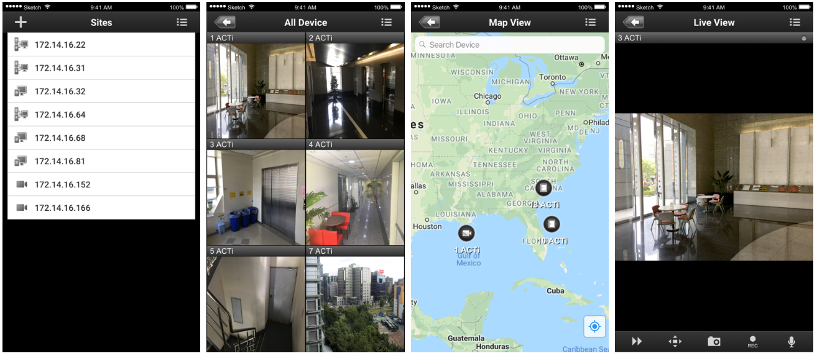
ACTi Mobile Client for NVR 3
ACTi provides a very professional Mobile Client for NVR 3 for free!

Slide 30
ACTi Mobile Client for NVR 3
Function Family | Function | ACTi Mobile Client for Android v1.0.16 or newer ACTi Mobile Client for iOS v1.02 or newer
 |  | NVR 3 | CMS 2
Live | Video Live View | Y | Y
 | Event Message | Y | Y
Audio | Audio In | Y | Y
 | Audio Out | Y | Y
Digital PTZ | Digital PTZ | Y | Y
PTZ | Optical PTZ | Y | Y
 | Preset | Y | Y
 | Preset Tour | Y | Y
 | PTZ Speed | Y | Y
Control | Manual Record | Y | Y
 | Snapshot | Y | Y
 | DO | Y | Y
Playback | Main playback functions | Y | Y
 | Additional playback functions | Y | Y
 | TimeTrack | Y | Y
 | Event Search | Y | Y

Slide 31
Redundancy Solutions
There may be situations where the NVR server may become inaccessible, and the cameras have no recorder to send the video stream to. It could happen due to the network failure, data switch failure, power outage, human error or due to any other reasons. Even though such incidents are very unlikely to happen, the mission critical solutions should have a protection against that. The seamless service can be achieved by using NVR Redundancy Service. It would ensure that whenever the original NVR is not accessible, the alternative system will immediately step in and start recording the video streams of the cameras belonging to the original NVR. ACTi offers two kinds of Redundancy Service solutions: N+1 and N-to-N

Slide 32
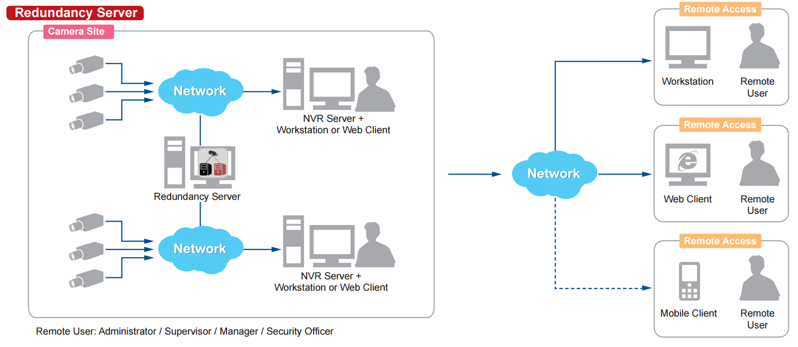
Redundancy Solutions
N+1 Redundancy
There will be an additional NVR 3 server installed in the network which will stay idle and watch over the other NVR servers. By activating the redundancy service licenses (LRDS3000) in that idle NVR 3 server, it will have the capability to watch over the other NVR 3 servers. One redundancy server can monitor up to 16 other NVR servers. If any of those NVR servers becomes inaccessible, then the redundancy server will notice it and will immediately take over the camera management of the original NVR.

Slide 33
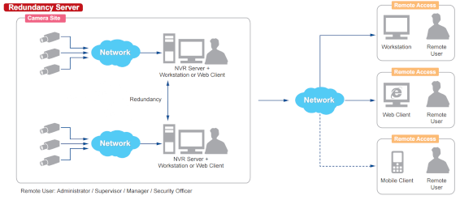
Redundancy Solutions
N-to-N Redundancy
There is also another way to set up the redundancy without requiring the additional server to be installed. It is called N-to-N redundancy. It means that when there is a group of NVR servers installed in the same network, they can watch over each other and take over the cameras of the inaccessible NVR server.
Although the additional idle server is not required, in order to achieve the redundancy capabilities, each of the NVRs must have unused video channels capacity. For example, a standalone NVR server INR-470 comes with the 64 free channels license included and can be extended up to 200 channels with add-on licenses (LNVR3003).

Slide 34
Redundancy Solutions
N-to-N Redundancy
If that server has 150 cameras of its own to manage, it could potentially take the role of watching over 50 more cameras from any other NVR server, provided that the full 200 channels capacity has been enabled with the help of LNVR3003 licenses. In such case, INR-470 becomes the redundancy server for 50 selected camera channels from any other NVR 3 in the network.
Applying the same concept to all the NVR 3 servers, they all will be able to use their surplus channel quota to act as redundancy servers.
This method also provides flexibility - you can decide which camera channels you want to serve under redundancy mode. You can skip less important channels, for example. However, if the full redundancy must be achieved in the network, then on average each NVR should have twice as many video channel licenses activated than there are cameras under that NVR.

Slide 35
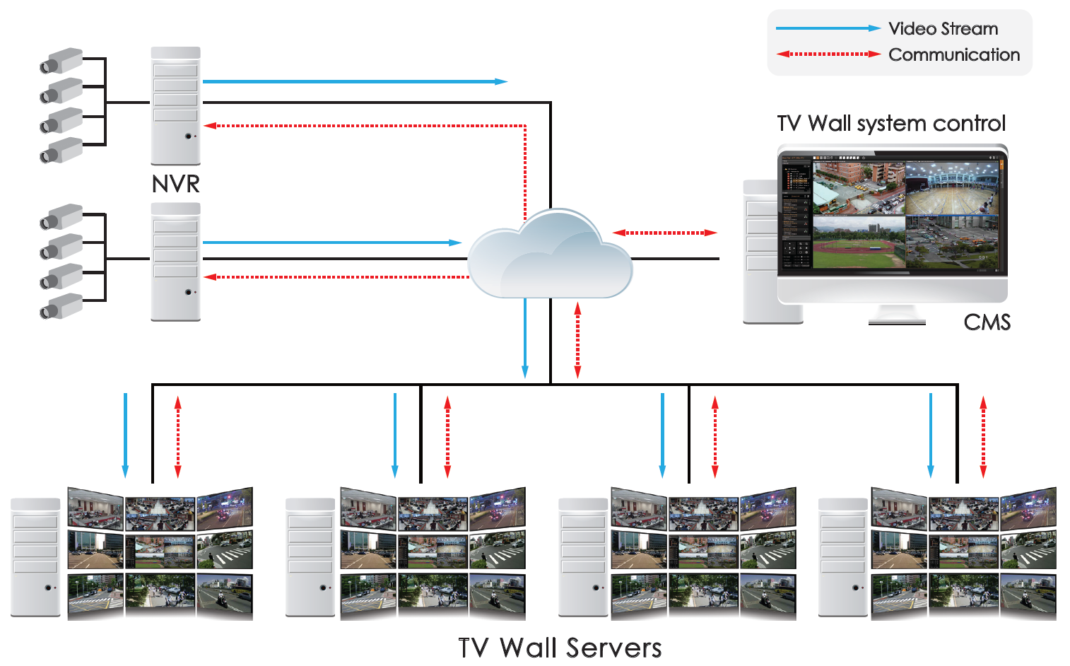
TV Wall Products
For the easier overview of multiple NVR servers, the TV Wall Solution can be used.

Slide 36
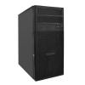
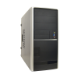
TV Wall Products
Model | TVW-300 | TVW-301
Photo
Product Type | Standalone TV Wall | Standalone TV Wall
Maximum Number of Monitors | 4 | 4
Maximum Display Layout | 64 (per monitor) | 64 (per monitor)
CPU/RAM | Intel Core i7-8700K / 16GB | Intel Core i7-10700K / 16GB
GPU | NVIDIA GeForce GTX1650 x 2 | ZOTAC GAMING GeForce GTX 1650(ZT-T16520H-10L) x 2
E-Map and Google Maps | Yes | Yes
System Drive | SSD 256GB | SSD 256GB
More features: https://www.acti.com/products/spec/TVW-300%7CTVW-301

Slide 37
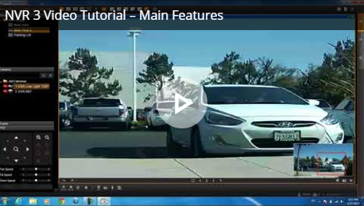
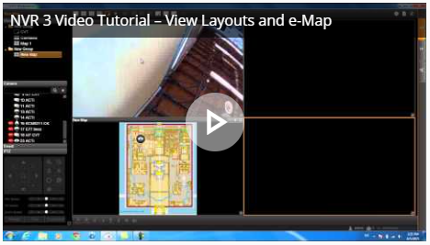
Learn More About NVR 3
Video Tutorials
https://www.acti.com/video/v1468
https://www.acti.com/video/v1478
Try NVR 3 Live Demo for Free!
Visit nvr.acti.com
(Microsoft Edge recommended)

Slide 38

Where to Buy
Via Authorized Resellers
https://www.acti.com/Corporate/WhereToBuy
From ACTi Corporation Directly
E-Mail: sales@acti.com
Tel (US): +1-866-410-2284 (Toll Free)
Tel (Non-US): +886-2-2656-2588

Slide 39
Support & Services
Technical Support
- Online Customer Helpdesk - https://www.acti.com/chd
- Phone support
US: +1-866-410-2284 (Toll Free)
Other Regions: +886-2-2656-5200
RMA Services
- Warranty
- Repair services
Training
- Self-learning

