Slide 1
ACTi Products
Introduction
ST2-1
Best Quality Products with Short Zoom, Best Low Light.

Slide 2

Contents
Zoom Bullets
Zoom Domes
Solutions
VMS Solution Partners
Vertical Markets & Applications
Where to Buy
Support and Services

Slide 3
Zoom Bullets

Slide 4
Main Features
Resolution
2-8MP
Super Fast Frame Rate
120 fps
Zoom
4.3x ~ 5x
WDR / Low Light
Extreme WDR (up to 150dB) / Extreme Low Light Sensitivity
Analytics
Built-in analytics (Deep learning)
Audio
Two-way audio

Slide 5
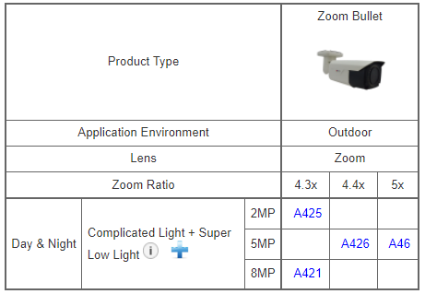
Product Offering
Matrix View: Zoom Bullets

Slide 6
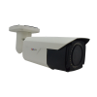

Product Offering
Model | A425 | A426 | A46 | A421
Photo
Type | Zoom Bullet | Zoom Bullet | Zoom Bullet | Zoom Bullet
Resolution | 2MP | 5MP | 5MP | 8MP
fps | 120@2MP | 30@5MP | 30@5MP | 30@8MP
Lens | f2.8-12mm | f2.7-12mm | f2.7-13.5mm | f2.8-12mm
Zoom Ratio | 4.3x | 4.4x | 5x | 4.3x
Corridor Mode | Yes | Yes | Yes | Yes
Audio | Mic-in, Line-in, Line-out | Line-in, Line-out | Line-in, Line-out | Mic-in, Line-in, Line-out
Analytics | Yes Deep Learning | Yes Deep Learning | Yes | Yes Deep Learning
Low Light | Extreme | Superior | Superior | Superior
WDR | Extreme (142dB) | Extreme (130dB) | Extreme (125dB) | Extreme (130dB)

Slide 7
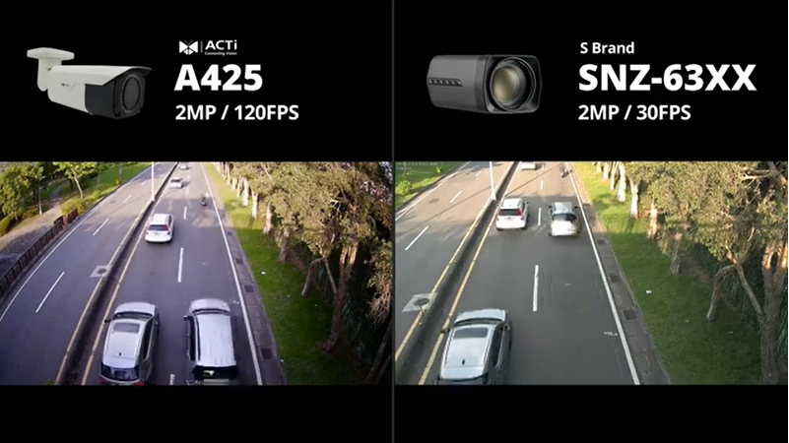
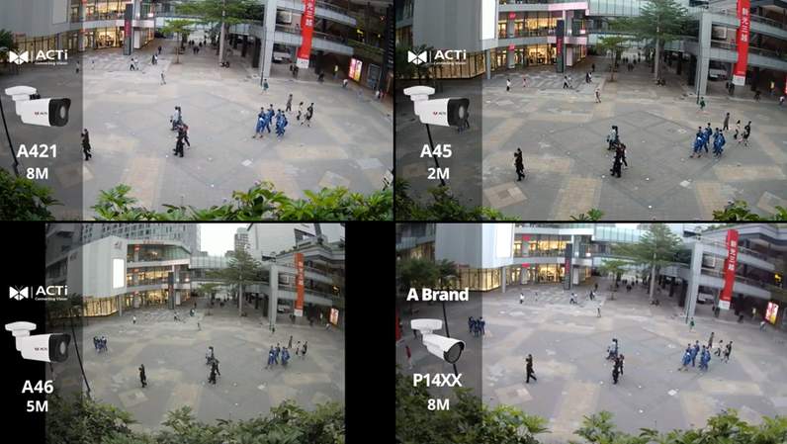
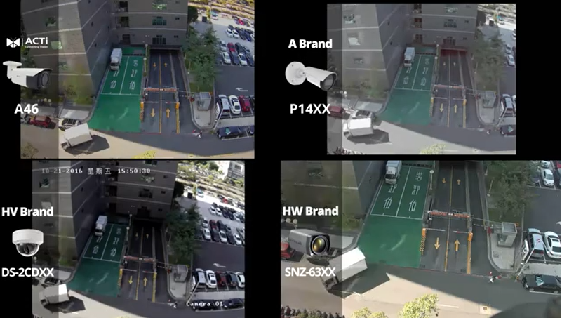
Video Clips & Photos
A425
A421
https://www.acti.com/video/v2789
https://www.acti.com/video/v2729
A46
https://www.acti.com/video/v2272

Slide 8
Zoom Domes

Slide 9
Main Features
Resolution
2-8MP
Super Fast Frame Rate
120 fps
Zoom
3x ~ 5x
WDR / Low Light
Extreme WDR (up to 150dB) / Extreme Low Light Sensitivity
Analytics
Built-in analytics (Deep learning)
Audio
Two-way audio

Slide 10
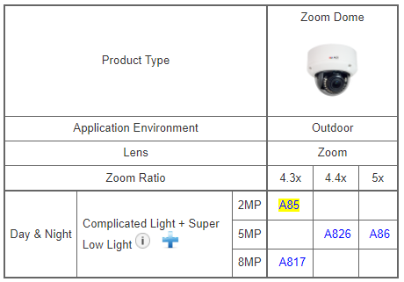
Product Offering
Matrix View: Zoom Domes

Slide 11
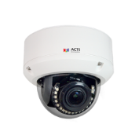

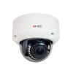
Product Offering
Model | A85 | A826 | A86 | A817
Photo
Type | Zoom Dome | Zoom Dome | Zoom Dome | Zoom Dome
Resolution | 2MP | 5MP | 5MP | 8MP
fps | 60@2MP | 30@5MP | 30@5MP | 30@8MP
Lens | f2.8-12mm | f2.7-12mm | f2.7-13.5mm | f2.8-12mm
Zoom Ratio | 4.3x | 4.4x | 5x | 4.3x
Corridor Mode | Yes | Yes | Yes | Yes
Audio | Mic-in, Line-in, Line-out | Line-in, Line-out | Mic-in, Line-in, Line-out | Mic-in, Line-in, Line-out
Analytics | Yes | Yes Deep Learning | Yes | Yes Deep Learning
Low Light | Extreme | Superior | Superior | Superior
WDR | Extreme (142dB) | Extreme (130dB) | Extreme (125dB) | Extreme (130dB)

Slide 12
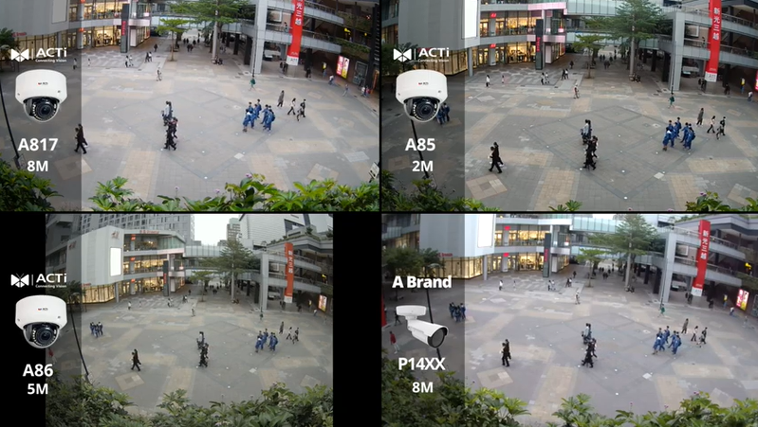
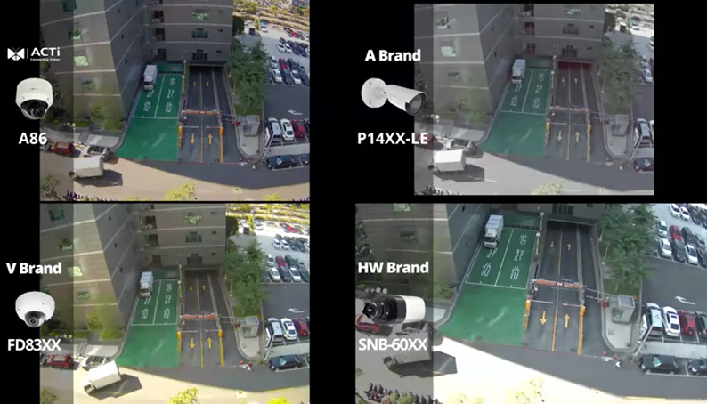
Video Clips & Photos
A817
A86
https://www.acti.com/video/v2730
https://www.acti.com/video/v2273

Slide 13
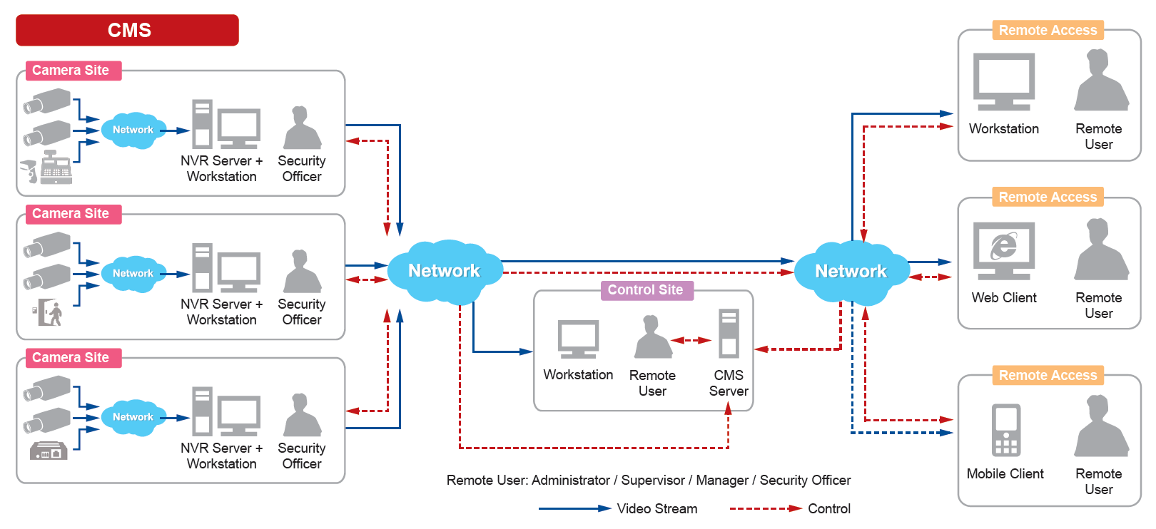
Solutions
ACTi Unified Solution Architecture consists of NVR servers and CMS.
Small Scale projects: NVR only
Large Scale projects: NVR + CMS

Slide 14
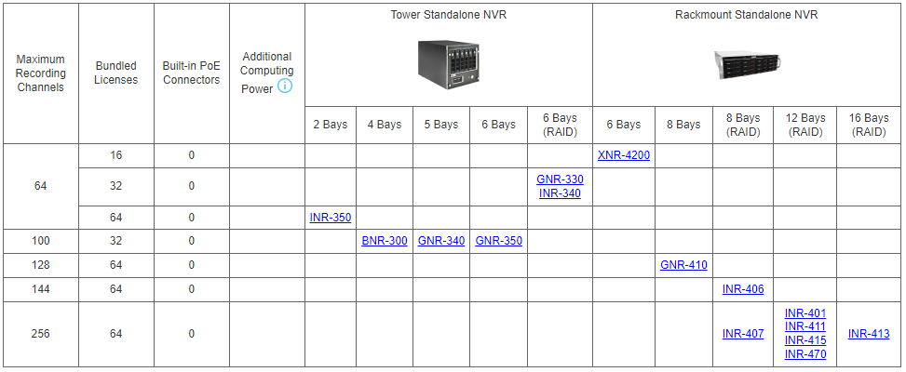
Solutions
Windows-based Standalone NVR options

Slide 15
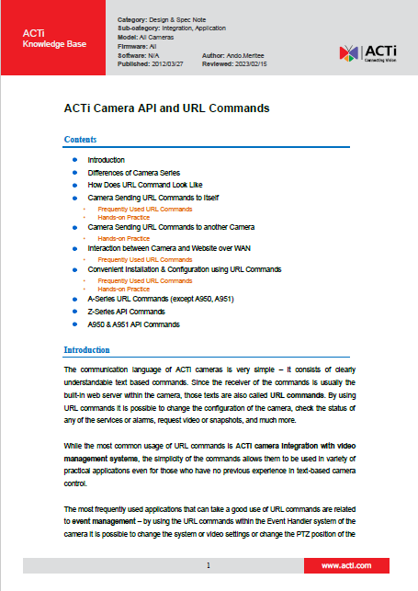
Solutions
Third party Solution Integration
ACTi provides an in-depth integration API/Url Commands document for solution integration purposes.
Download here: https://Download.acti.com?id=528

Slide 16
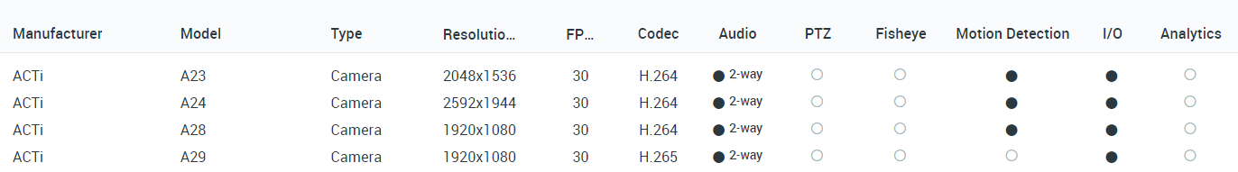
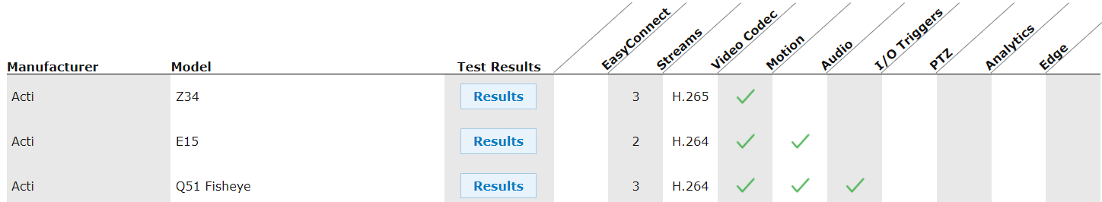
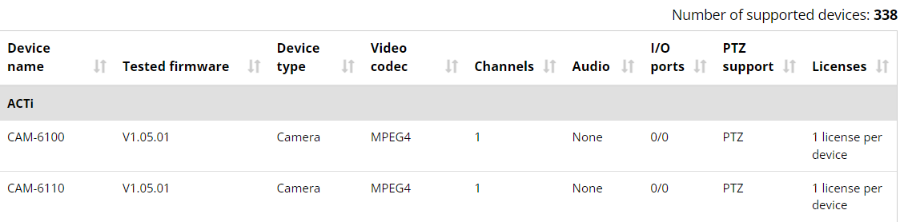
VMS Solution Partners
Network Optix
https://nxvms.com/ipvd?vendors=ACTi
Exacq
https://exacq.com/integration/ipcams/#search=acti~tags=false
Milestone
https://www.milestonesys.com/support/tools-and-references/supported-devices/xprotect-corporate-and-xprotect-expert/?AdvancedSearchDisplayed=true&ManufacturerId=3

Slide 17
Vertical Markets & Applications
Traffic
- Traffic jam monitoring
- Incidents investigation
Utility
- Perimeter protection
- Incidents investigation
Education (schools)
- Property protection
- Students protection
- Violence and Bullying prevention
Retail
- Property protection
- Theft prevention
- Business monitoring
Hotel & Casino
- Property protection
- Scam prevention
- Safety of the guests
Parking Lot
- Incident management
- Car theft prevention
- Access control

Slide 18

Where to Buy
Via Authorized Resellers
https://www.acti.com/Corporate/WhereToBuy
From ACTi Corporation Directly
E-Mail: sales@acti.com
Tel (US): +1-866-410-2284 (Toll Free)
Tel (Non-US): +886-2-2656-2588

Slide 19
Support & Services
Technical Support
- Online Customer Helpdesk - https://www.acti.com/chd
- Phone support
US: +1-866-410-2284 (Toll Free)
Other Regions: +886-2-2656-5200
RMA Services
- Warranty
- Repair services
Training
- Self-learning

