Slide 1
ACTi Products
Introduction
ST2-3
Special Purpose Cameras

Slide 2

Contents
Covert Cameras
  Introduction
  Covert Camera Options
  Disguise Accessory Options
  Covert Camera Selector Tool
  Video Clips & Photos
Service Desk Camera
  Introduction
  Product Options
Where to Buy
Support and Services

Slide 3
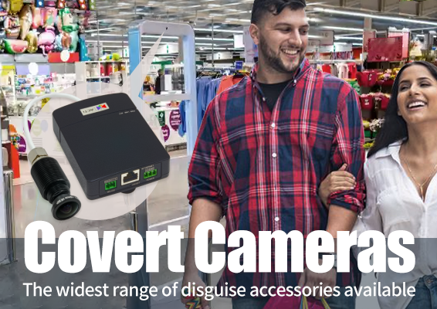
Covert Cameras

Slide 4
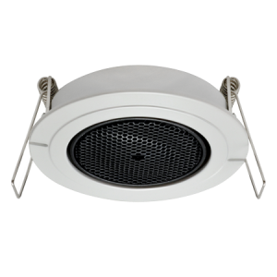
Introduction
Throughout the years, ACTi has developed the covert camera solutions from the applications perspective. Different markets require specific disguise methods to make the camera discreet or even completely invisible. Although the covert cameras are very small, they still require additional accessories to fully hide them. ACTi has developed so many different types of disguise accessories over time, therefore becoming the leader of the covert camera solutions. Have you ever seen a loudspeaker in the ceiling that looks like this?
Actually, it is not a speaker. It is a unique “speaker mount”, designed by ACTi, that allows the pinhole camera to be hidden behind it. You can read more about it below.

Slide 5
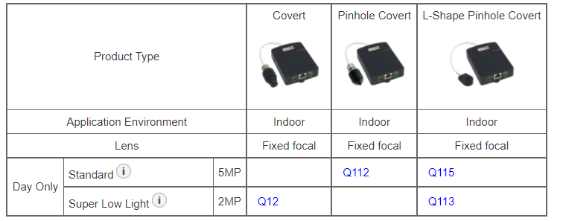
Covert Camera Options
Matrix View:

Slide 6
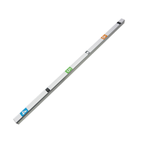
Disguise Accessory Options
Height Strip
The entrances of retail stores often have the height strips as stickers on the door frames. Now these can be replaced with special height strip mounts that allow the lens module of the camera to be hidden inside it.
You can place the height strip directly onto the doorframe or add a tilt wedge behind the height strip, to adjust the viewing direction. Both height strips and tilt wedges come in 2 colors - silver and bronze.
PMAX-0331 - Height Strip Mount (Silver)
PMAX-0332 - Height Strip Mount (Bronze)
PMAX-0335 - Tilt wedge (silver)
PMAX-0336 - Tilt wedge (bronze)
The applicable covert camera models: Q113, Q115

Slide 7
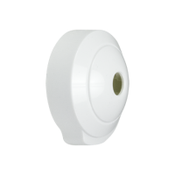
Disguise Accessory Options
Wall Mount
When there is no space inside the walls to hide the camera, it can also be surface mounted using the tiny wall mount that comes with the camera package.
The applicable covert camera models: Q113, Q115

Slide 8
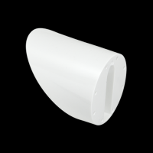
Disguise Accessory Options
Tilted Wall Mount
It is like the previous one, but it is tilted downwards. This allows the camera to be installed higher onto the wall. It is also included in the camera package.
The applicable covert camera models: Q113, Q115

Slide 9
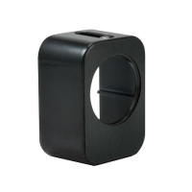
Disguise Accessory Options
In-Wall Mount
When there is a space behind the thin wall or some custom-made board, then the lens module could be mounted onto the inner surface of that board, using the in-wall mount, which is included in the camera package.
The applicable covert camera models: Q113, Q115

Slide 10
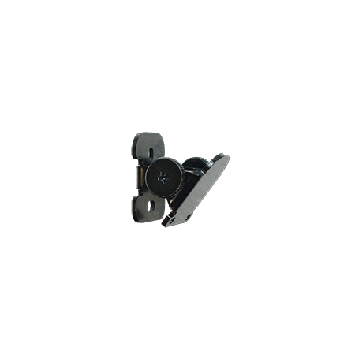
Disguise Accessory Options
Adjustable Surface Mount
This is a mount that is used to attach the lens module to the custom-built disguise widget. It comes with the flexible tilting capabilities.
This accessory is to be purchased separately: PMAX-0334
The applicable covert camera models: Q113, Q115

Slide 11
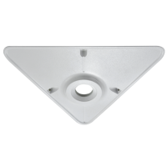
Disguise Accessory Options
Corner Mount
This is a mount that is used to attach the lens module to the custom-built disguise widget. It comes with the flexible tilting capabilities.
This accessory is to be purchased separately: PMAX-0403
The applicable covert camera models: Q12, Q112

Slide 12
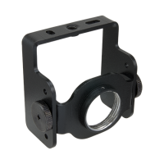
Disguise Accessory Options
Highly Adjustable Mount
The special locations, such as the inside of the ATM machine, could use such mounts.
This accessory is to be purchased separately: PMAX-1108
The applicable covert camera models: Q12, Q112

Slide 13
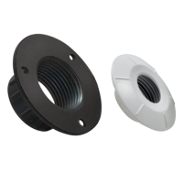
Disguise Accessory Options
Fixed Flush Mount
When there is a space behind the surface, the larger lens modules can be disguised using this flush mount. It is included in the camera package.
This accessory is to be purchased separately: PMAX-1108
The applicable covert camera models: Q12

Slide 14
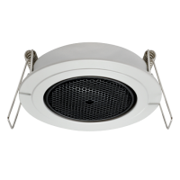
Disguise Accessory Options
Adjustable “Speaker” Mount
This mount is disguised as a loudspeaker. The pinhole camera is almost invisible inside it. Furthermore, this speaker can still be slightly tilted towards the monitored area.
This accessory is to be purchased separately: PMAX-1017
The applicable covert camera models: Q112

Slide 15
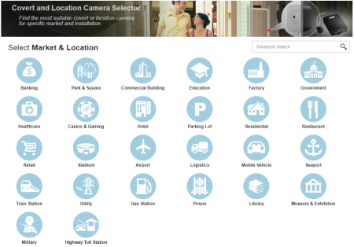
Covert Camera Selector
To make the selection of the covert cameras and their accessories really simple, ACTi has created a very user-friendly online tool called Covert Camera Selector. With a few steps, the choice of the cameras and accessories can be confirmed together with the 3D installation simulation and the video clips.
The location of the tool: https://www.acti.com/covertselector/

Slide 16
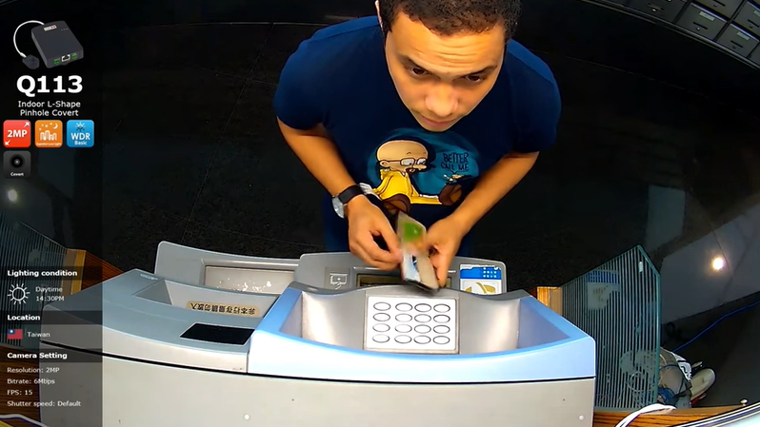
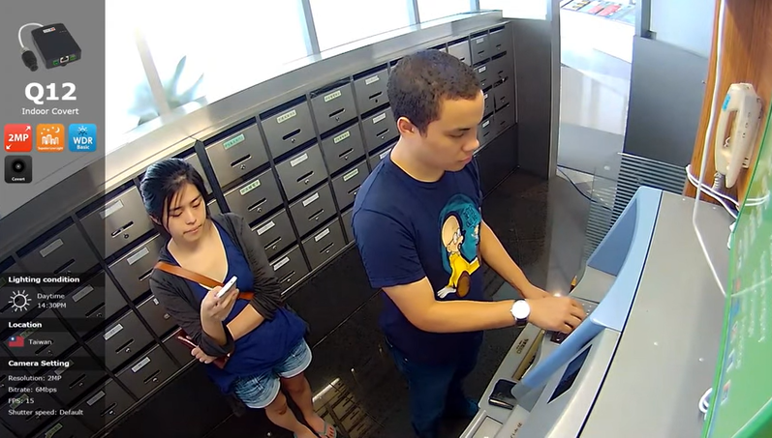
Video Clips & Photos
Q113
Q12
https://www.acti.com/video/v1516
https://www.acti.com/video/v1515

Slide 17
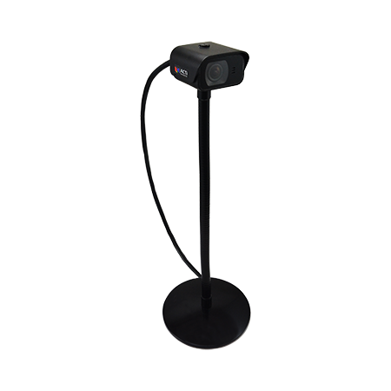
Service Desk Camera

Slide 18

Introduction
ACTi's Q22 micro box camera can be installed at any service counter or wherever critical employee and customer interactions take place. It is about half the size of a deck of cards, weights a little under 0.5 kg (1 lb) and has a sturdy IK10 rated casing. The Q22 is equipped with a powerful microphone that can provide clear audio recordings.
The Q22-K1 kit includes flexible gooseneck bracket which can be adjusted to fit a variety of different counters. The bracket is supported by a desktop mount with a strong magnet which adds further stability on magnetic surfaces to prevent accidental movement.

Slide 19
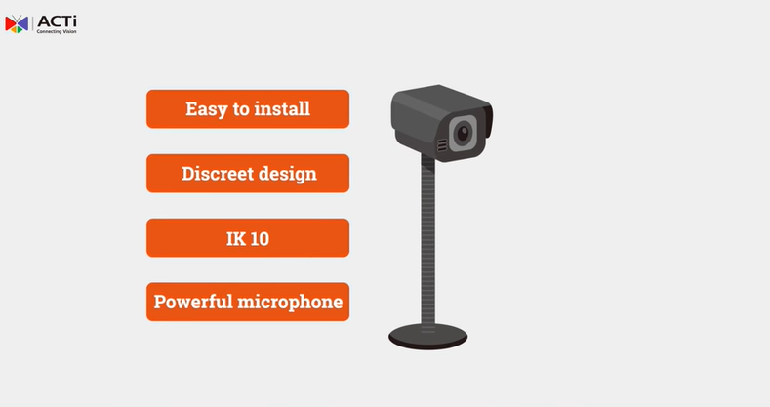
Introduction
Introduction Video Clip
https://www.acti.com/Video/v1590

Slide 20
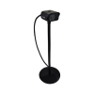
Product Options
Photo
Model | Q22 | Q22-K1
Maximum resolution | 2MP
Low Light Sensitivity | Superior
Horizontal Viewing Angle | 112.7°
Audio Type | Built-in Microphone, Mic-in, Line-out
Environmental Casing | Vandal proof metal casing (IP68), Weatherproof lens module (IK10)
Bundled Accessories (Q22-K1) | Gooseneck Bracket, Desktop Mount

Slide 21

Where to Buy
Via Authorized Resellers
https://www.acti.com/Corporate/WhereToBuy
From ACTi Corporation Directly
E-Mail: sales@acti.com
Tel (US): +1-866-410-2284 (Toll Free)
Tel (Non-US): +886-2-2656-2588

Slide 22
Support & Services
Technical Support
- Online Customer Helpdesk - https://www.acti.com/chd
- Phone support
US: +1-866-410-2284 (Toll Free)
Other Regions: +886-2-2656-5200
RMA Services
- Warranty
- Repair services
Training
- Self-learning

