Slide 1
ACTi Products
Introduction
ST3-3
Windows-based NVR products with the scale of 4-32 channels.

Slide 2

Contents
Introduction of NVR 3 Product Family
NVR 3 Editions Comparison
Value Position by Scale
Standalone Server Options
Transportation-Grade Products
Value Position & Unique Selling Points
Lite Web Client Introduction
ACTi Mobile Client for NVR 3
Redundancy Solutions
Learn More about NVR 3
Where to Buy
Support and Services

Slide 3

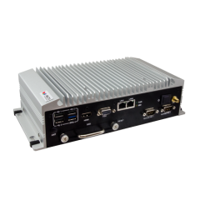
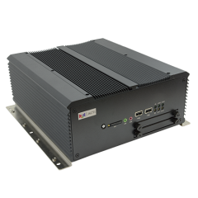
Introduction of NVR 3 Product Family
NVR 3 is one of the most famous ACTi products – it is a professional and elegant network video recorder platform with wide range of features and extremely reliable performance!
Both standalone and software versions available.
Standalone NVR options based on NVR 3
(MNR series)
Software editions of NVR 3

Slide 4
Introduction of NVR 3 Product Family
There are two EDITIONS of NVR 3 available – Business and Corporate.
Depending on the scale of the project, the user can choose either NVR 3 Business or Corporate.
It is also possible to upgrade the servers with the existing Business edition to the Corporate edition.
There are regular updates available for both editions, usually once per quarter. These updates are called VERSIONS.
ACTi offers the updates for free!
The latest version of NVR 3 is 3.0.16.

Slide 5
NVR Editions Comparison
Feature | NVR 3 Business | NVR 3 Corporate
Maximum Number of Channels | 100 | 200 (Standalone NVR 256)
Free ACTi Camera Channels Included | 32 | 1
Free 3rd Party Camera Channels Included | 1 | 1
CMS Support | No | Yes
POS, Access Control, Network IO Support | No | Yes
eMap | Yes | Yes
Google Map | No | Yes
Embedded Websites within Display | No | Yes
PTZ Control | Yes | Yes
Redundancy Support (N+1, N-to-N) | Yes | Yes
Workstation, Web Client, Mobile Client | Yes | Yes
Display Layouts (maximum grid size)* | 144 (225 from v3.0.17) | 144 (225 from v3.0.17)
* NVR 3 display grid cells can be merged into different shape and size.

Slide 6
Value Position by Scale
Features
Full
CMS 2 + NVR 3 Corporate
NVR 3 Corporate, GNR, INR
NVR 3 Business, BNR
ZNR, ENR
Essential
4ch
16ch
32ch
64ch
100ch
200ch
500ch+
Channels

Slide 7
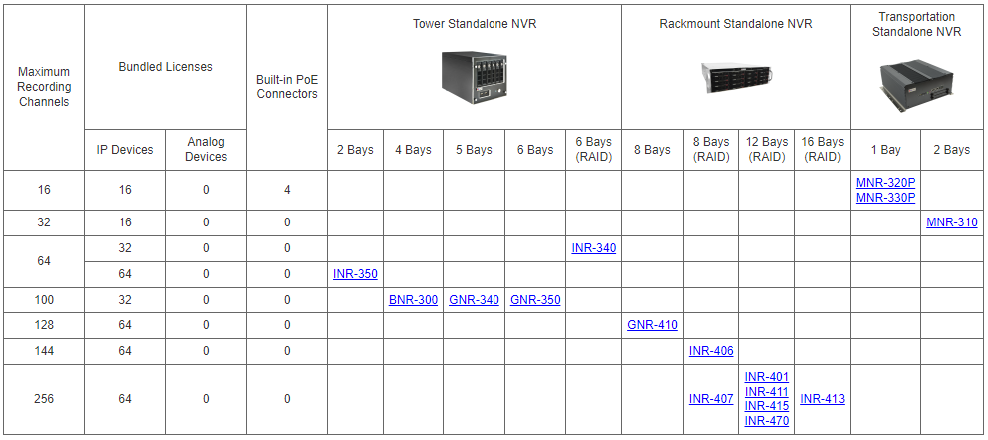
Standalone Server Options
NVR 3 Channel Range 4-32:

Slide 8
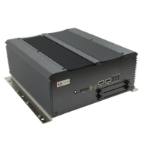
Transportation-Grade Products
The MNR-series Standalone NVR servers can endure and are certified for harsh environments, such as trains, buses, ships, factories, mines, etc.
Model | MNR-320P | MNR-330P | MNR-310
Photo
Type | Transportation NVR | Transportation NVR | Transportation NVR
Max Channels | 16 | 16 | 32
Free Channels | 16 | 16 | 16
PoE Connectors | 4 | 4 | -
Storage | 1 Bay | 1 Bay | 2 Bays
Transportation Certified | E-Mark | E-Mark | E-Mark

Slide 9
Value Position & Unique Selling Points
Unique Selling Points:
The most affordable high-quality VMS in the industry!
  Very competitive price per channel for the add-on licenses.
  No perpetual fees.
Has all the features you need!
  Get over 95% of all the features that the top ISV brands have, in many cases, even for free.
  ACTi continuously adds more features to ensure it has all you need!

Slide 10
Value Position & Unique Selling Points
Unique Selling Points:
Easy to Migrate to ACTi NVR!
  Keep all the existing cameras while migrating to ACTi NVR
  ACTi support & service team helps with seamless and worry-free migration
  Enjoy immediate cost saving
Free Upgrades!
  ACTi offers quarterly software upgrades, for free!
  Get more features every quarter.

Slide 11
Value Position & Unique Selling Points
Unique Selling Points:
Unique Features help you win projects!
  ACTi NVR provides several world leading features for you to win
  Our service personnel helps with A&E requirements fulfillment
Exclusive custom-made NVR features for you!
  For the large projects, ACTi helps develop customized features by request
Turn ACTi NVR into your own brand!
  White label and non-brand NVR options available.
  Secure your business with exclusive NVR branding.

Slide 12
Value Position & Unique Selling Points
Unique Selling Points:
Ultimate Reliability Guaranteed!
  RAID-supported Standalone NVR available
  Various Redundancy Service options available (N+1, N-to-N)
  Backup Service options available (make auto-backups of critical recordings)
  Widest range of system health check options available
Integrate ACTi NVR with Your System
  ACTi provides easy-to-use Integration API/SDK for solution integration
  Enjoy live video, playback and events within your own main system

Slide 13
Value Position & Unique Selling Points
Unique Selling Points:
Expand VMS up to 200 000 Channels!
  You can combine hundreds of NVR servers into a single system using ACTi CMS 2, up to 200 000 channels.
  ACTi smart network architecture ensures stable and seamless data flow even in the large-scale projects.
Wide range of Service Tools & Utilities
  - Free project planning tools for your VMS
  - Additional special purpose utilities to work along with NVR

Slide 14
Value Position & Unique Selling Points
Unique Selling Points:
Try Full Features without any Cost!
  ACTi provides NVR live demo access at nvr.acti.com
  NVR 3 Business and Corporate can be downloaded for free from ACTi website and tested immediately (free registration).
Learn About VMS Conveniently by Video Tutorials
  ACTi offers nice walk-through video clips for quick learning and first impression.

Slide 15
Lite Web Client Introduction
In addition to already supporting Workstation client, Mobile client and Full-featured Web client, the NVR version v3.0.16 also introduces Lite Web Client option.
Lite Web Client is the simplified edition of the browser-based client application. It has less features enabled and simpler appearance, making it very user-friendly for the types of users who are not very technical and do not require full set of features.
While the Full-featured web client is available for Microsoft Edge browser (compatibility mode), the Lite web client can be used with various browsers:
Chrome
Firefox
Safari
Edge

Slide 16
Primary Users of the Lite Web Client
ACTi Web Client Value Position
Role | Client PC | Workstation app | Full Web Client | Lite Web Client
IT Admin (setup) | Dedicated | Y | Y
Security Officer | Dedicated | Y | Y
Supervisor/ Manager | May change anytime |  |  | Y
Owner | May change anytime |  |  | Y

Slide 17
Full Client vs Lite Client Comparison
NVR 3 Corporate v3.0.16 | Workstation Application | Web Browser
 |  | Full Client |  | Lite Client
 |  | Edge in IE Mode (Windows 10 or later) | Chrome, Firefox, Safari, Edge (normal mode) | Chrome, Firefox, Safari, Edge (normal mode)
Live View Layouts | Up to 144 channels (225 ch from v.3.0.17) | Up to 144 channels (225 ch from v.3.0.17) | - | Up to 16 channels
Playback | Yes | Yes | - | Embedded Playback
Events | Yes | Yes | - | -
PTZ control | Mouse, Joystick | Mouse, Joystick | - | Mouse only
Codec | H.265, H.264, MJPEG | H.265, H.264, MJPEG | - | H.264, MJPEG
Audio | 2-way | 2-way | - | Audio-in
Stream Switcher | Yes | Yes | - | Default Stream
Setup, Playback tab | Yes | Yes | - | -
Export | Yes | Yes | - | -

Slide 18
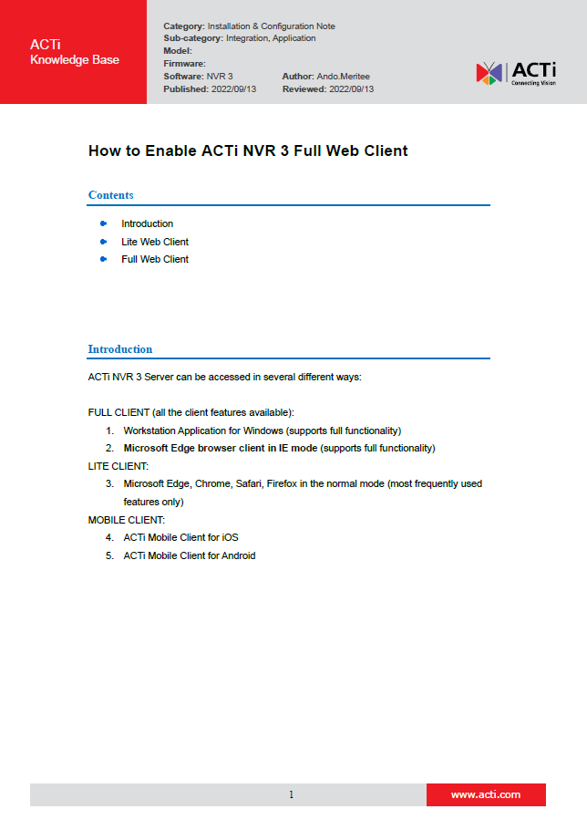
How to Enable Full Web Client
It is very easy to enable the NVR 3 Full Web Client in your Microsoft Edge Browser. It just requires one-time setup with a few clicks.
For the convenience, the simple instruction can be found here:
https://Download.acti.com?id=31324

Slide 19

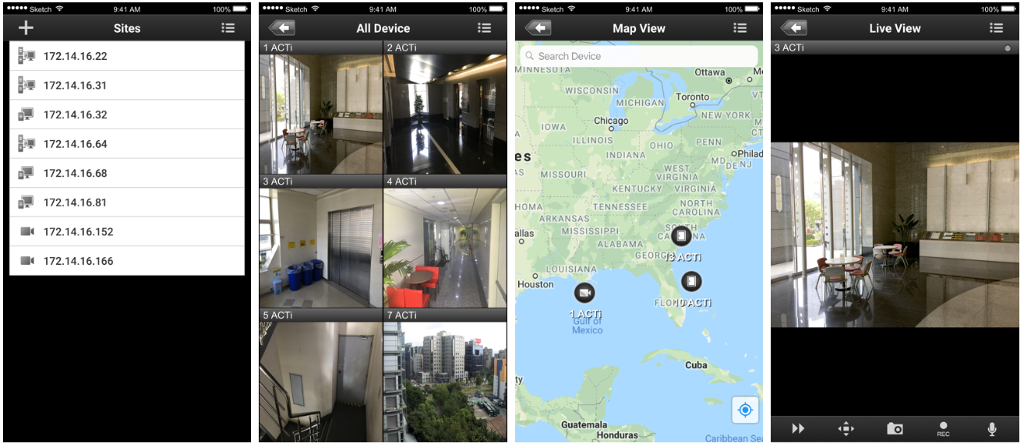
ACTi Mobile Client for NVR 3
ACTi provides a very professional Mobile Client for NVR 3 for free!

Slide 20
ACTi Mobile Client for NVR 3
Function Family | Function | ACTi Mobile Client for Android v1.0.16 or newer ACTi Mobile Client for iOS v1.02 or newer
 |  | NVR 3 | CMS 2
Live | Video Live View | Y | Y
 | Event Message | Y | Y
Audio | Audio In | Y | Y
 | Audio Out | Y | Y
Digital PTZ | Digital PTZ | Y | Y
PTZ | Optical PTZ | Y | Y
 | Preset | Y | Y
 | Preset Tour | Y | Y
 | PTZ Speed | Y | Y
Control | Manual Record | Y | Y
 | Snapshot | Y | Y
 | DO | Y | Y
Playback | Main playback functions | Y | Y
 | Additional playback functions | Y | Y
 | TimeTrack | Y | Y
 | Event Search | Y | Y

Slide 21
Redundancy Solutions
There may be situations where the NVR server may become inaccessible, and the cameras have no recorder to send the video stream to. It could happen due to the network failure, data switch failure, power outage, human error or due to any other reasons. Even though such incidents are very unlikely to happen, the mission critical solutions should have a protection against that. The seamless service can be achieved by using NVR Redundancy Service. It would ensure that whenever the original NVR is not accessible, the alternative system will immediately step in and start recording the video streams of the cameras belonging to the original NVR. ACTi offers two kinds of Redundancy Service solutions: N+1 and N-to-N

Slide 22
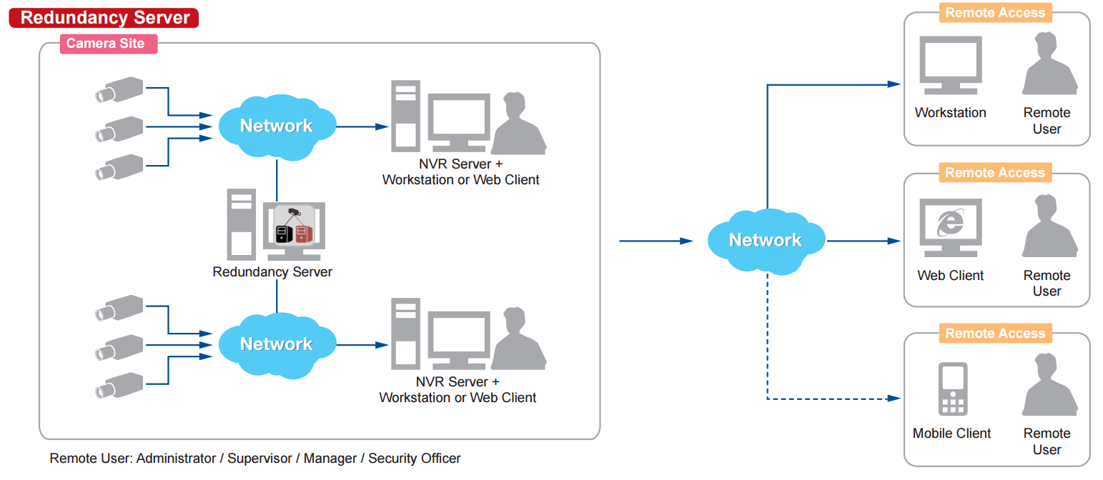
Redundancy Solutions
N+1 Redundancy
There will be an additional NVR 3 server installed in the network which will stay idle and watch over the other NVR servers. By activating the redundancy service licenses (LRDS3000) in that idle NVR 3 server, it will have the capability to watch over the other NVR 3 servers. One redundancy server can monitor up to 16 other NVR servers. If any of those NVR servers becomes inaccessible, then the redundancy server will notice it and will immediately take over the camera management of the original NVR.

Slide 23
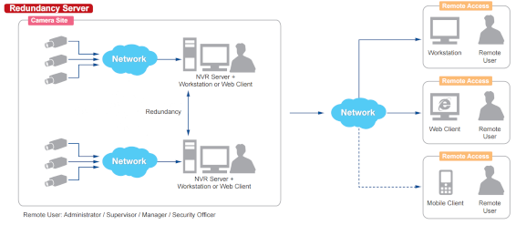
Redundancy Solutions
N-to-N Redundancy
There is also another way to set up the redundancy without requiring the additional server to be installed. It is called N-to-N redundancy. It means that when there is a group of NVR servers installed in the same network, they can watch over each other and take over the cameras of the inaccessible NVR server.
Although the additional idle server is not required, in order to achieve the redundancy capabilities, each of the NVRs must have unused video channels capacity. For example, a standalone NVR server INR-470 comes with the 64 free channels license included and can be extended up to 200 channels with add-on licenses (LNVR3003).

Slide 24
Redundancy Solutions
N-to-N Redundancy
If that server has 150 cameras of its own to manage, it could potentially take the role of watching over 50 more cameras from any other NVR server, provided that the full 200 channels capacity has been enabled with the help of LNVR3003 licenses. In such case, INR-470 becomes the redundancy server for 50 selected camera channels from any other NVR 3 in the network.
Applying the same concept to all the NVR 3 servers, they all will be able to use their surplus channel quota to act as redundancy servers.
This method also provides flexibility - you can decide which camera channels you want to serve under redundancy mode. You can skip less important channels, for example. However, if the full redundancy must be achieved in the network, then on average each NVR should have twice as many video channel licenses activated than there are cameras under that NVR.

Slide 25
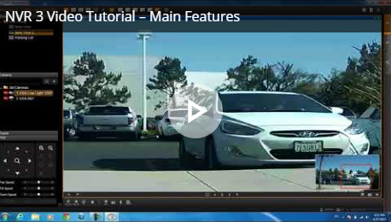
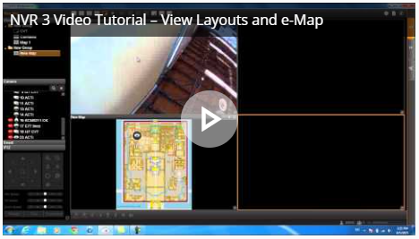
Learn More About NVR 3
Video Tutorials
https://www.acti.com/video/v1468
https://www.acti.com/video/v1478
Try NVR 3 Live Demo for Free!
Visit nvr.acti.com
(Microsoft Edge recommended)

Slide 26

Where to Buy
Via Authorized Resellers
https://www.acti.com/Corporate/WhereToBuy
From ACTi Corporation Directly
E-Mail: sales@acti.com
Tel (US): +1-866-410-2284 (Toll Free)
Tel (Non-US): +886-2-2656-2588

Slide 27
Support & Services
Technical Support
- Online Customer Helpdesk - https://www.acti.com/chd
- Phone support
US: +1-866-410-2284 (Toll Free)
Other Regions: +886-2-2656-5200
RMA Services
- Warranty
- Repair services
Training
- Self-learning

