Slide 1
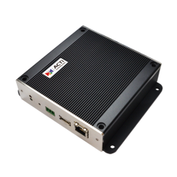
ACTi Encoders & Decoders
Introduction
ST2-2
Encoders/Decoders

Slide 2

Contents
Encoders
  Introduction
  Product Offering
  Solution Architecture
Decoders
  Introduction
  Product Offering
  Solution Architecture
  Applications
  Installation
  Benefits of ACTi Decoders
  Successful Project References
  Where to Buy
  Support and Services

Slide 3
Encoders

Slide 4
Introduction
Video Encoders are the devices that convert the video stream of the analog cameras into the digitalized IP network stream.
The benefits of using the encoders:
to keep the existing analog cameras (costly to change or have special purpose).
to make use of the endless capabilities of the IP network
to migrate the recorder solution from DVR to NVR.
to have more secure data transmission

Slide 5
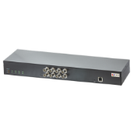
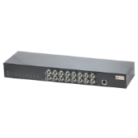


Product Offering
Video Encoders
Product Segment | Channels | Standard Video Encoder | Rackmount Video Encoder
Commercial (-10C ~ 50C) | 8 |  | V31
 | 16 |  | V32
Industrial (-40C ~ 76C) | 1 | V21
 | 4 | V24

Slide 6
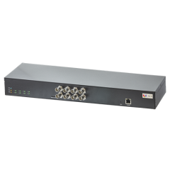
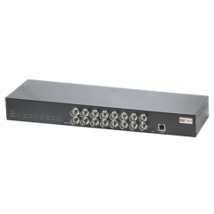
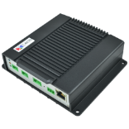
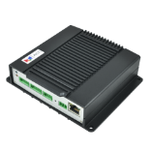
Product Offering
Model | V21 | V24 | V31 | V32
Photo
Type | Standard Encoder | Standard Encoder | Rackmount Encoder | Rackmount Encoder
Maximum Channels | 1 | 4 | 8 | 16
Fps, Resolution | 30@960x480 | 30@960x480 | 30@960x480 | 30@960x480
Analog video input | 1 x CVBS (BNC) | 4 x CVBS (BNC) | 8 x CVBS (BNC) | 16 x CVBS (BNC)
Analog video output | 1 x CVBS (BNC) | - | - | -
Local storage | MicroSDXC slot | MicroSDXC slot | MicroSDXC slot | MicroSDXC slot
Audio | 1/1, Terminal block | 4/1, Terminal block | 8/1, Terminal block | 16/1, Terminal block
Power source | DC, PoE | DC, PoE | AC | AC
Serial Port | 1 x RS-485/RS-422 | 1 x RS-485/RS-422 | 2 x RS-485/RS-422 | 2 x RS-485/RS-422
Operating Temperature | -40°C ~ 76°C (-40°F ~ 168.8°F) | -40°C ~ 76°C (-40°F ~ 168.8°F) | -10°C ~ 50°C (14°F ~ 122°F) | -10°C ~ 50°C (14°F ~ 122°F)

Slide 7
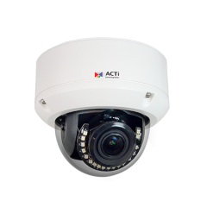
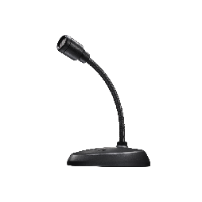
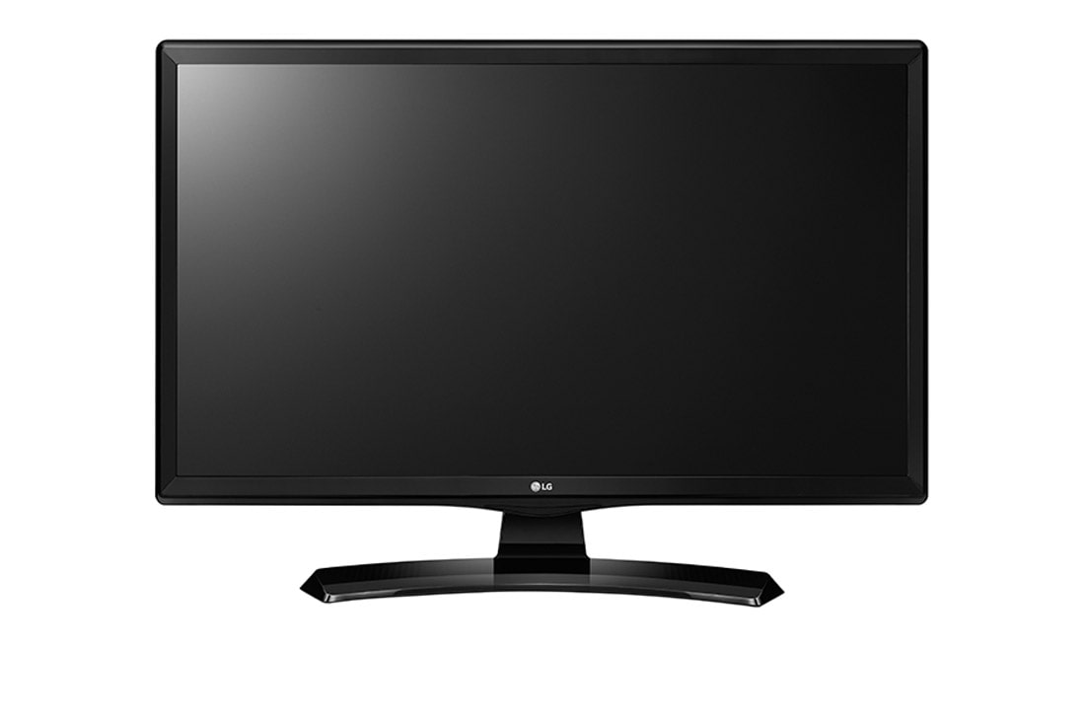
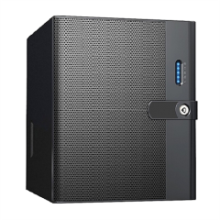


Solution Architecture
Coaxial cable
IP Camera
Audio cable
Microphone
Ethernet
HDMI
MicroSDXC
Video Encoder
NVR
Monitor
Analog Cameras

Slide 8
Decoders

Slide 9
Introduction
ECD Series Decoders main application is to enable a simple static live view monitor, without keyboard and mouse. The monitor is usually attached to the wall, sometimes on the desk.
It receives the live video feed from the IP cameras directly or via NVR and outputs the grid up to 16 channels.
Theft Prevention – the public display monitor with surveillance footage is placed in the shopping area to discourage any attempts of shoplifting.
Supervising – the TV panel at the supervisor’s desk allows easy monitoring of the staff.
Security Station – for some screens where the interaction with keyboard and mouse is not needed, the ECD-based TV panel solution is most optimized.

Slide 10
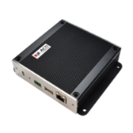
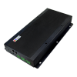
Product Offering
Model | ECD-1100 | ECD-200
Photo
Video Decoding | Yes | Yes
Digital Signage | Yes | No
Maximum Channels | 16 | 16
Maximum Frame Rate vs. Resolution | 30 fps at 1080p | 30 fps at 4K
Compression | H.264 | H.264, H.265
Analog Video Output | 1 x CVBS, BNC connector
Storage | External storage option via USB | 2.5” SATA, MicroSDXC
Power Source | DC 12V, PoE | DC 12V
Mounting | Surface, Pole, VESA mount 10x10 | Surface, Pole, VESA mount 10x10

Slide 11
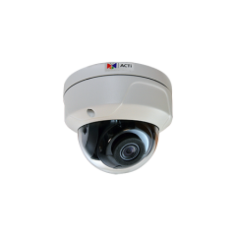
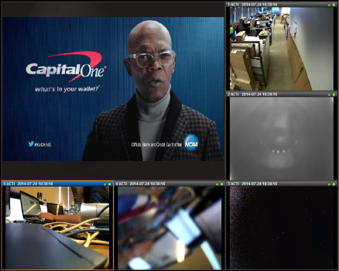
Solution Architecture
Ethernet
HDMI
SMALL SCALE
The decoder can be used together with just a few IP cameras. Even the recorder is not needed in some cases. Those are the temporary locations mostly, such as the passenger traffic screening for possible fever using the thermal IP cameras.
Ethernet
HDMI cable
ECD-series
Decoder
TV Panel
(Camera Static Client)
ACTi Cameras
or Third-Party Cameras (ONVIF)

Slide 12
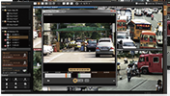
Solution Architecture
Ethernet
HDMI
MEDIUM SCALE
The cameras are connected to the NVR 3 server, and the video streams from the NVR go to the decoder that displays the result on the TV panel via HDMI cable.
NVR Display
Ethernet
Ethernet
HDMI
cable
NVR Server
(ACTi or Third party)
ECD-series
Decoder
TV Panel
(VMS Static Client)
IP Cameras

Slide 13
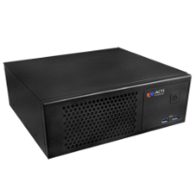


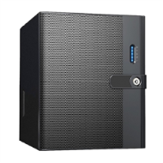
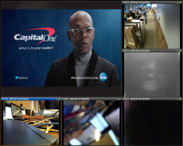

Solution Architecture
Ethernet
HDMI
LARGE SCALE
Even the large systems containing CMS, TV Wall, NVR and cameras can make a good use of decoders as a part of the solution architecture. Just like the medium scale, the decoder will be linked with the NVR servers.
CMS
Server
Various displays
(Workstation, TV Wall, Mobile, …)
Ethernet
HDMI cable
IP Cameras
NVR Servers and their displays
ECD-series
Decoders
TV Wall

Slide 14

Applications
RETAIL
Public Display Monitor
ECD-series decoder together with the TV panel is installed in the shopping area with two purposes. It allows the employees to easily monitor the situation between the aisles without leaving the checkout area.
At the same time, the potential thieves or robbers will be intimidated by the presence of such public display monitors and they will most likely avoid any illegal activities in the premises.

Slide 15

Applications
HOSPITAL
Service Desk Monitor
The nurses and the receptionists can easily monitor the activities in the lobby, corridors and wards by looking at the screen on the wall with the live video footage from the critical locations.

Slide 16

Applications
AIRPORT
Security Inspection Monitor
The security inspection area requires such video monitors so that the officers have better overview of all the activities around that area, including the inspection zone and the queue area before that.
While being busy with the inspections, the monitor gives them the additional capabilities to have a hands-free overview of the situation.
The public display monitors can also be used in the areas where the travel luggage is processed to make sure there are no incidents there.

Slide 17

Applications
FACTORY
Supervising Monitor
The supervisors can have the monitors with the video streams from all the critical locations right in front of them.
That way they do not have to constantly run between various locations of the production area.

Slide 18

Applications
GOVERNMENT
Interview Monitor
The police department or the other government organizations that conduct interviews with the people must have the constant monitoring capabilities for the safety reasons. The monitors connected via decoder serve this purpose perfectly.

Slide 19
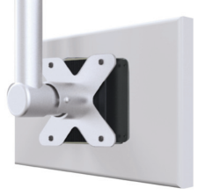
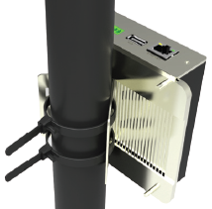
Decoder Installation Options
Installation Method | Description | Additional Info
VESA Mount | Placed between the VESA 10x10 mount and the TV panel. The special bolts included in the package. Very durable metal chassis.
Pole Mount | For TV panels larger than 10x10 VESA, the pole mount can be used which is included in the package.
Surface Mount | There are additional screw holes for surface mounting.
Hide | Place it above the drop ceiling (for wall TV panel) or under the desk (desktop TV panel).

Slide 20
Benefits of ACTi Decoders
Lowest cost of NVR Client compare with any PC
Lowest cost of Camera Client compare with any PC
Lowest cost of TV Wall structure
Up to 16 channels of concurrent video display
Independent from NVR
Manageable over the IP network
Programmable tours (auto changing views)
Flexible installation options
Powered by PoE or DC 12V
Worry-free maintenance

Slide 21
Successful Project References
Business Type | Country | Purpose
 |  | VMS Static Client | Camera Static Client | TV Wall
Retail | US
Factory | US
Banking | Australia |  | Y
Factory | US |  |  | Y
Government | US |  | Y
Retail | US |  | Y
Government | Taiwan | Y

Slide 22

Where to Buy
Via Authorized Resellers
https://www.acti.com/Corporate/WhereToBuy
From ACTi Corporation Directly
E-Mail: sales@acti.com
Tel (US): +1-866-410-2284 (Toll Free)
Tel (Non-US): +886-2-2656-2588

Slide 23
Support & Services
Technical Support
- Online Customer Helpdesk - https://www.acti.com/chd
- Phone support
US: +1-866-410-2284 (Toll Free)
Other Regions: +886-2-2656-5200
RMA Services
- Warranty
- Repair services
Training
- Self-learning

