Slide 1
ACTi Products
Introduction
ST2-2
Best Quality Products with High Zoom, Multi-Lens, Hemispheric and Encoders/Decoders.

Slide 2

Contents
Zoom Boxes and Zoom Bullets
Surround View Cameras
PTZ Cameras
Learning-based Auto Focus
Solutions
VMS Solution Partners
Vertical Markets & Applications
Where to Buy
Support and Services

Slide 3
Zoom Boxes and Zoom Bullets

Slide 4
Main Features
Resolution
2-5MP
High Zoom
Zoom Ratio up to 36x
WDR / Low Light
Extreme WDR (up to 150dB) / Extreme Low Light Sensitivity
Analytics
Built-in analytics
Audio
Two-way audio

Slide 5
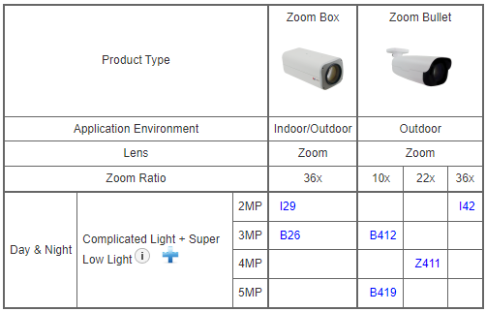
Product Offering
Matrix View: Zoom Boxes and Zoom Bullets

Slide 6
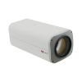
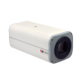
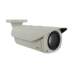
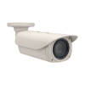
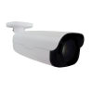
Product Offering
Model | I29 | B26 | I42 | B412 | Z411 | B419
Photo
Type | Zoom Box | Zoom Box | Zoom Bullet | Zoom Bullet | Zoom Bullet | Zoom Bullet
Resolution | 2MP | 3MP | 2MP | 3MP | 4MP | 5MP
fps | 60@2MP | 30@3MP | 60@2MP | 30@3MP | 30@4MP | 30@5MP
Lens | f4.6-165mm | f4.6-165mm | f4.6-165mm | f4.7-47mm | f6.5-143mm | f4.7-47mm
Zoom Ratio | 36x | 36x | 36x | 10x | 22x | 10x
Corridor Mode | Yes | Yes | Yes | Yes | Yes | Yes
Audio | Line-in, Line-out | Line-in, Line-out | Line-in, Line-out | Built-in Mic, Mic-in, Line-in, Line-out | Line-in, Line-out | Built-in Mic, Mic-in, Line-in, Line-out
Analytics | Yes | Yes | Yes | Yes | Yes | Yes
Low Light | Extreme | Superior | Extreme | Superior | Extreme | Superior
WDR | Extreme (145dB) | Extreme (145dB) | Extreme (145dB) | Extreme (145dB) | Extreme (150dB) | Extreme (120dB)

Slide 7
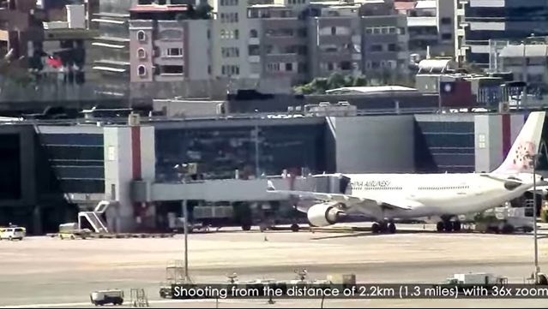
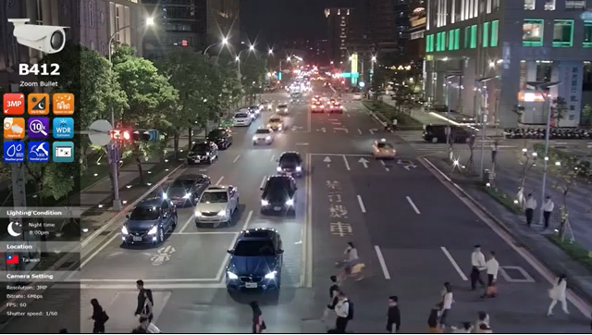
Video Clips & Photos
I29 / I42
B412
https://www.acti.com/video/v1725
https://www.acti.com/video/v1850

Slide 8
Surround View Cameras

Slide 9
Main Features
Various types available
Hemispheric, multi-imager bullets and domes, 180 and 360 degree options
Resolution
Up to 12MP
Analytics
Deep learning based analytics (face recognition, ALPR)
Audio
Two-way audio, built-in microphone
WDR
Extreme WDR (130dB)
Installation flexibility
Ceiling, Wall, Pole, Corner, Pendant and more

Slide 10
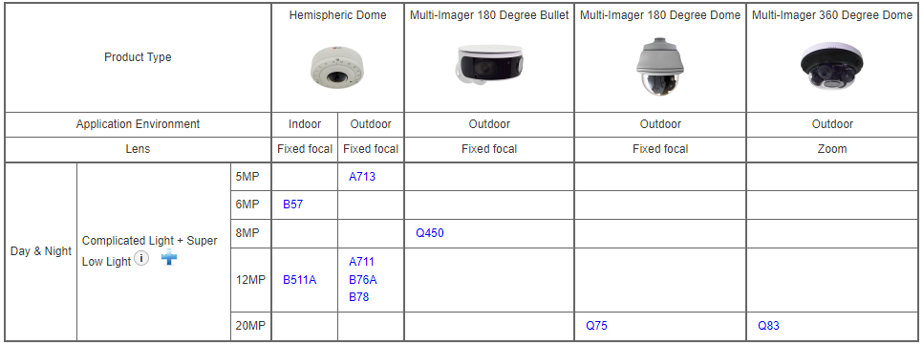
Product Offering
Matrix View: Hemispheric Domes & Multi-Imager Cameras

Slide 11
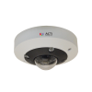
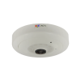
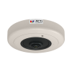
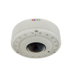
Product Offering
Model | A713 | B57 | B511A | A711 | B76A | B78
Photo
Type | Hemispheric | Hemispheric | Hemispheric | Hemispheric | Hemispheric | Hemispheric
In/Outdoor | Outdoor | Indoor | Indoor | Outdoor | Outdoor | Outdoor
Resolution | 5MP | 6MP | 12MP | 12MP | 12MP | 12MP
IR LED | Yes | Yes | Yes | Yes | Yes | Yes
Lens rotation | - | - | - | - | Yes | Yes
Audio | Line-in, Line-out | Built-in Mic, Mic-in, Line-in, Line-out | Built-in Mic, Mic-in, Line-in, Line-out | Line-in, Line-out | Built-in Mic, Mic-in, Line-in, Line-out | Built-in Mic, Mic-in, Line-in, Line-out
Analytics | Yes | Yes | Yes | Yes | Yes | Yes
Low Light | Superior | Superior | Superior | Superior | Superior | Superior
WDR | Extreme (130dB) | Extreme (130dB) | Extreme (130dB) | Extreme (130dB) | Extreme (130dB) | Extreme (130dB)

Slide 12
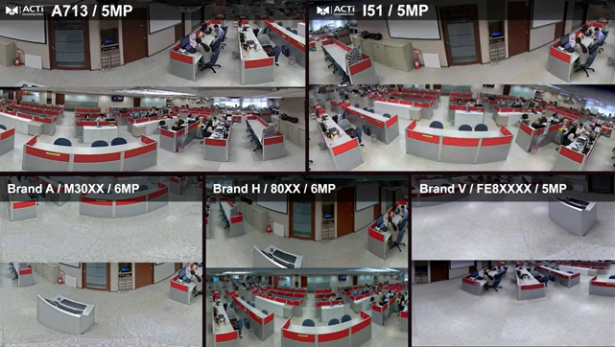
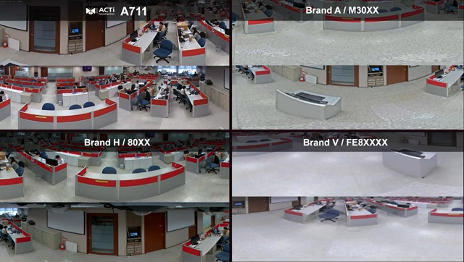
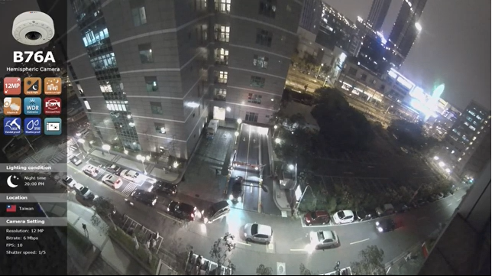
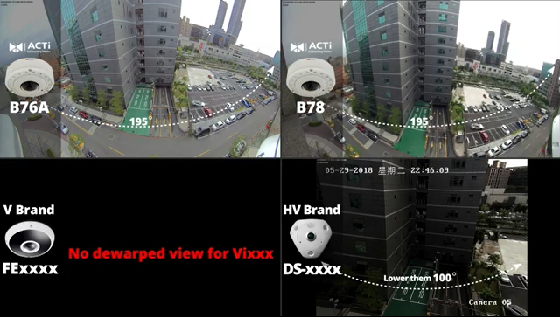
Video Clips & Photos
A713
A711
https://www.acti.com/video/v2790
https://www.acti.com/video/v2793
B76A
B78
https://www.acti.com/video/v1681
https://www.acti.com/video/v2084

Slide 13
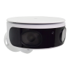
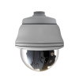

Product Offering
Model | Q450 | Q75 | Q83
Photo
Type | Multi-Imager 180 Degree Bullet | Multi-Imager 180 Degree Dome | Multi-Imager 360 Degree Dome
Resolution | 8MP | 20MP | 20MP
Viewing Angle | 182° | 180° | 360°
Number of lenses | 2 | 4 | 4
IR LED | Yes | Yes | Yes
Audio | - | Line-in, Line-out | Built-in Mic, Line-in, Line-out
Analytics | Yes | Yes | Yes (Deep Learning)
Low Light | Superior | Superior | Superior
WDR | Superior (120dB) | Advanced (100dB) | Superior (120dB)

Slide 14
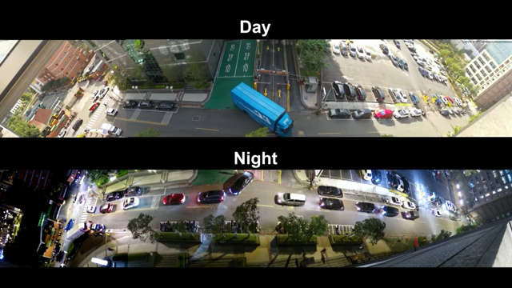
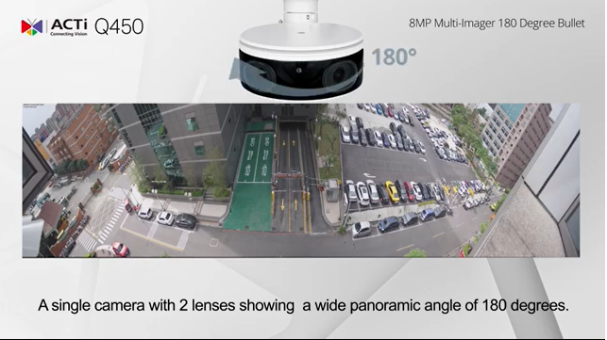
Video Clips & Photos
Q75
Q450
https://www.acti.com/video/v2258
https://www.acti.com/video/v2298

Slide 15
Product Offering
Deep Learning Analytics of Q83 Multi-Imager - Everything you need!
Face Recognition (user DB: 10,000), Face Detection, People Detection, Car Detection, Object Based Motion Detection, Tampering Detection, Object Line Crossing Detection, Object Area Counting, Intrusion Detection (Forbidden Area Detection), Missing Object Detection, Unattended Object Detection, Object Loitering Detection, People Counting, People Line Crossing Detection, People Enter Area Detection, People Incorrect Direction Detection, People Loitering Detection, People Tracking, Vehicle Counting, Vehicle Line Crossing Detection, Vehicle Enter Area Detection, Vehicle Incorrect Direction Detection, Vehicle Loitering Detection, Vehicle Tracking, Stopped vehicle detection, License Plate Detection, Automatic License Plate Recognition (ALPR).

Slide 16
PTZ Cameras

Slide 17
Main Features
Various types available
Mini PTZ, Speed Dome, indoor and outdoor versions.
Resolution
Up to 8MP (4K) with full frame rate
High Zoom
Zoom Ratio up to 40x
Focus
Learning-based auto focus
WDR
Extreme WDR (up to 145dB)
Analytics
Deep learning based analytics

Slide 18
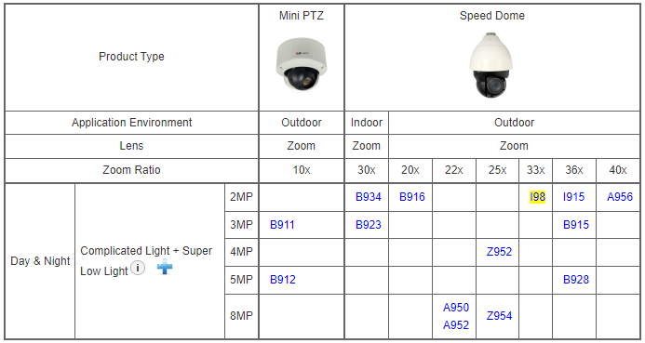
Product Offering
Matrix View: PTZ

Slide 19
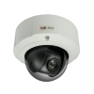
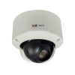
Product Offering
10x Zoom | B911 | B912
Photo
Type | Mini PTZ | Mini PTZ
In/Outdoor | Outdoor | Outdoor
Resolution | 3MP | 5MP
fps | 30@3MP | 30@5MP
Lens | f4.7-47mm | f4.7-47mm
Zoom Ratio | 10x | 10x
IR LED | No | No
Audio | Mic-in, Line-in, Line-out | Mic-in, Line-in, Line-out
Analytics | Yes | Yes
Low Light | Superior | Superior
WDR | Extreme (145dB) | Extreme (120dB)

Slide 20
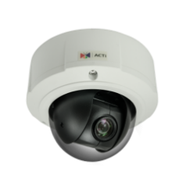
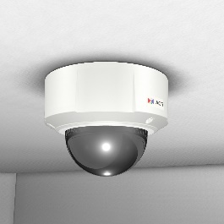
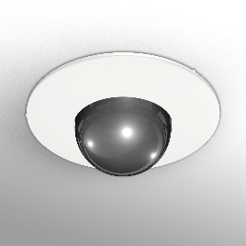
Product Offering
Unique Value of ACTi Mini PTZ (10x Zoom)
Compact and discreet: (Ø x H): 152.8mm x 131mm (6" x 5.2")
Surface mount ready: no accessories needed, easy to install
Flush mount available for even more discreet installation

Slide 21
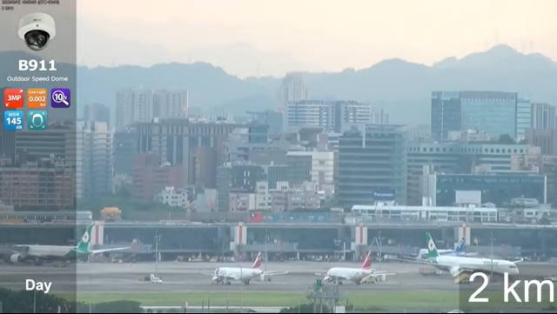
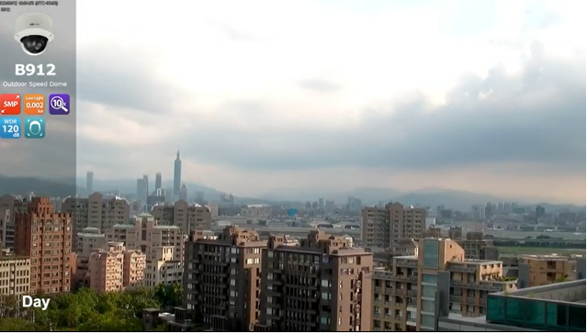
Video Clips & Photos
B911
B912
https://www.acti.com/video/v2810
https://www.acti.com/video/v2811

Slide 22
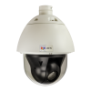
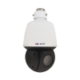

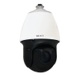
Product Offering
20-25x | B916 | Z952 | A950 | A952 | Z954
Photo
Type | Speed Dome | Speed Dome | Speed Dome | Speed Dome | Speed Dome
In/Outdoor | Outdoor | Outdoor | Outdoor | Outdoor | Outdoor
Resolution | 2MP | 4MP | 8MP | 8MP | 8MP
fps | 60@2MP | 30@4MP | 30@8MP | 30@8MP | 30@8MP
Lens | f4.7-94mm | f4.8-120mm | f6.4-138.5mm | f6.4-138.5mm | f6.0-150mm
Zoom Ratio | 20x | 25x | 22x | 22x | 25x
IR LED | No | Yes | Yes | Yes | Yes
Audio | Mic-in, Line-in, Line-out | Line-in, Line-out | - | Line-in, Line-out | Line-in, Line-out
Analytics | Yes | Yes | Yes | Yes (Deep Learning) | Yes (Deep Learning)
Low Light | Superior | Superior | Extreme | Extreme | Superior
WDR | Extreme (145dB) | Superior (120dB) | Extreme (120dB) | Extreme (140dB) | Superior (120dB)

Slide 23
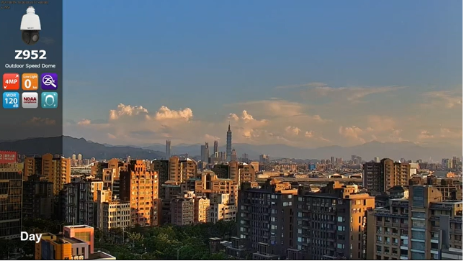
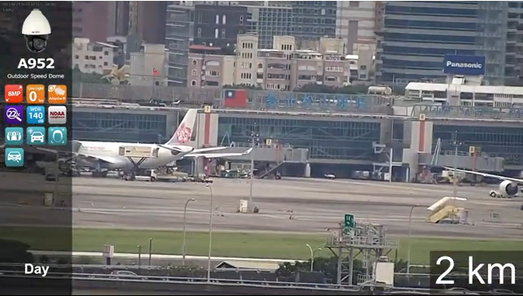
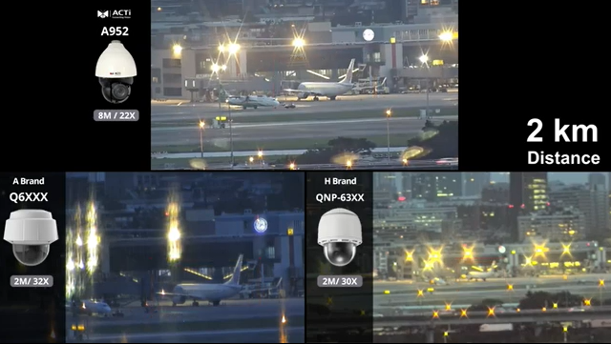
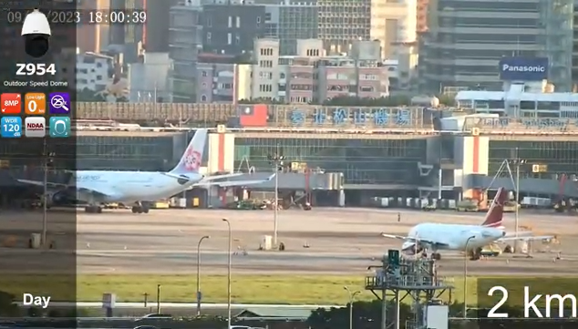
Video Clips & Photos
Z952
A952
https://www.acti.com/video/v2801
https://www.acti.com/video/v2796
A952
Z954
https://www.acti.com/video/v2798
https://www.acti.com/video/v2800

Slide 24
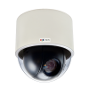
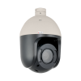
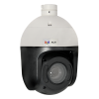

Product Offering
30-40x | B934 | B923 | I98 | I915 | A956 | B915 | B928
Photo
Type | Speed Dome | Speed Dome | Speed Dome | Speed Dome | Speed Dome | Speed Dome | Speed Dome
In/Outdoor | Indoor | Indoor | Outdoor | Outdoor | Outdoor | Outdoor | Outdoor
Resolution | 2MP | 3MP | 2MP | 2MP | 2MP | 3MP | 5MP
fps | 60@2MP | 30@3MP | 60@2MP | 60@2MP | 60@2MP | 30@3MP | 30@5MP
Lens | f4.5-135mm | f4.5-135mm | f4.5-148.5mm | f4.6-165.6mm | f4.3-170mm | f4.6-165.6mm | f4.6-165.6mm
Zoom Ratio | 30x | 30x | 33x | 36x | 40x | 36x | 36x
IR LED | No | No | Yes | Yes | Yes | Yes | Yes
Audio | Mic-in, Line-in, Line-out | Mic-in, Line-in, Line-out | Line-in, Line-out | Line-in, Line-out | Line-in, Line-out | Line-in, Line-out | Line-in, Line-out
Analytics | Yes | Yes | Yes | Yes | Yes (Deep Learning) | Yes | Yes
Low Light | Superior | Superior | Superior | Extreme | Extreme | Superior | Superior
WDR | Extreme (145dB) | Extreme (145dB) | Extreme (145dB) | Extreme (145dB) | Extreme (140dB) | Extreme (145dB) | Extreme (120dB)

Slide 25
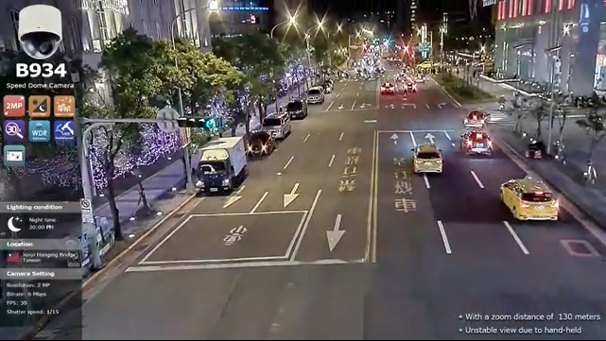
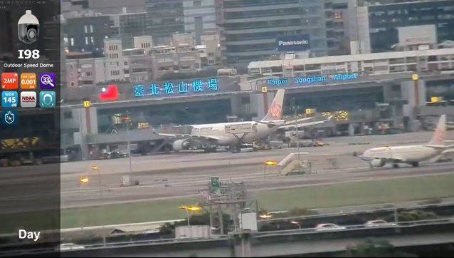
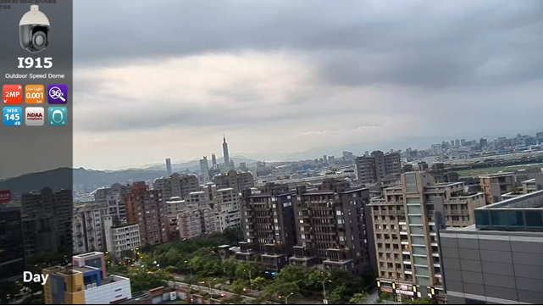
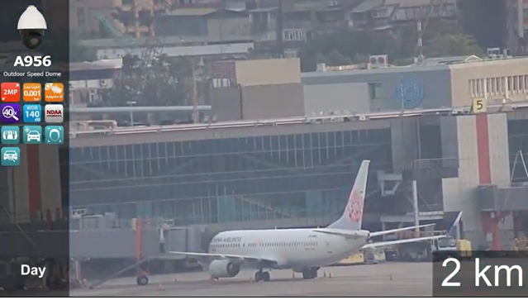
Video Clips & Photos
B934
I98
https://www.acti.com/video/v1684
https://www.acti.com/video/v2806
I915
A956
https://www.acti.com/video/v2807
https://www.acti.com/video/v2795

Slide 26
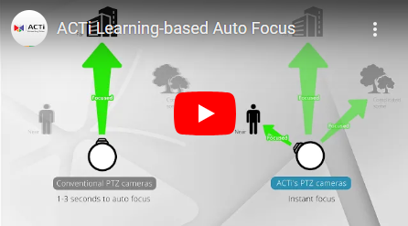
Learning-based Auto Focus
Learning-based Auto Focus technology is used in selected ACTi Speed Dome cameras to increase focusing speed after panning, tilting or zooming.
While conventional cameras have to search for the ideal focus every time upon PTZ operation, ACTi smart PTZ cameras already know what the ideal focus is, therefore the focusing process is extremely fast. It knows the ideal focus because of self-learning from the previous operations. Sometimes a few seconds make a big difference in collecting the critical evidence.
To know more, please watch this video clip:
Supported camera models:
B911, B912, B915, B923, B928.

Slide 27
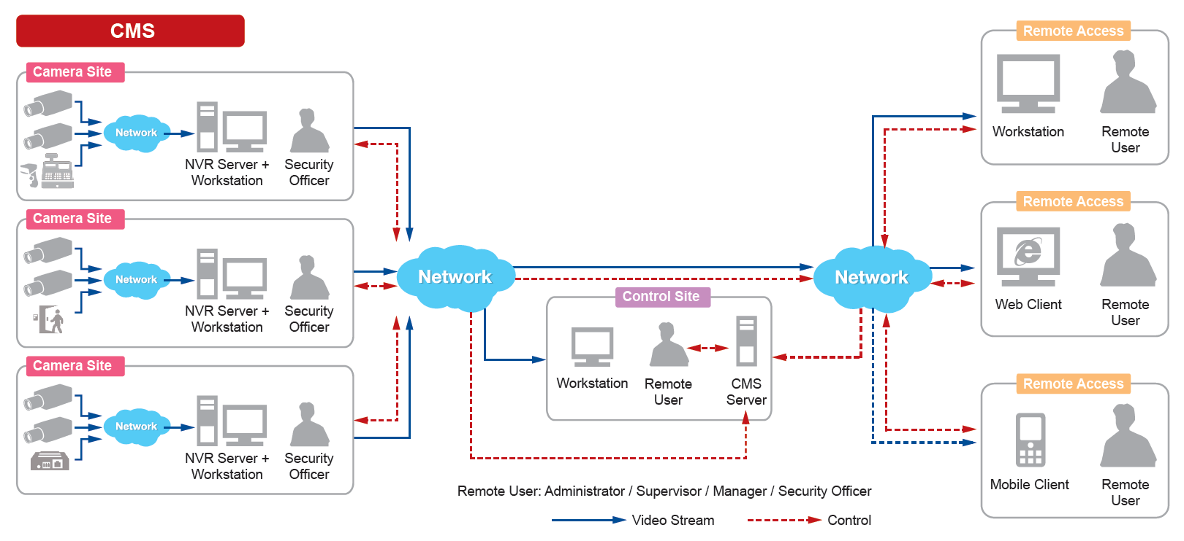
Solutions
ACTi Unified Solution Architecture consists of NVR servers and CMS.
Small Scale projects: NVR only
Large Scale projects: NVR + CMS

Slide 28
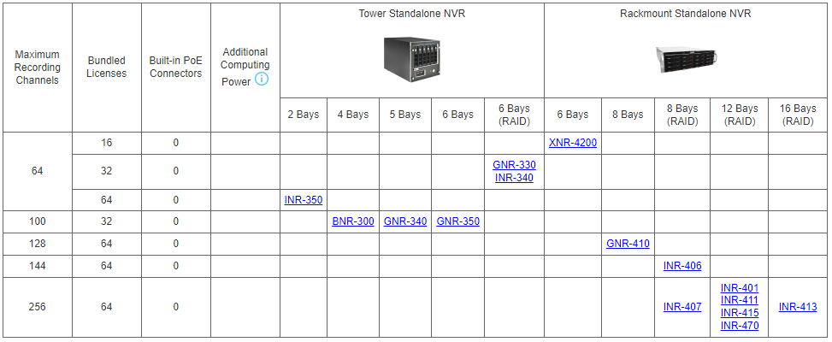
Solutions
Windows-based Standalone NVR options

Slide 29
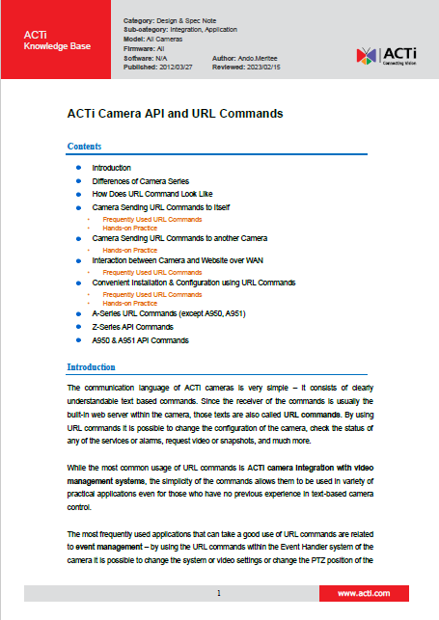
Solutions
Third party Solution Integration
ACTi provides an in-depth integration API/Url Commands document for solution integration purposes.
Download here: https://Download.acti.com?id=528

Slide 30
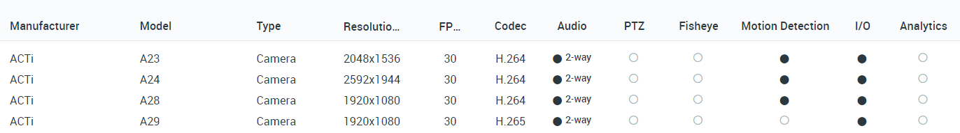
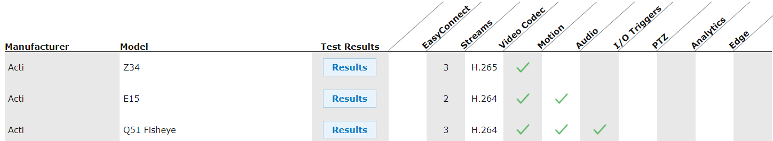
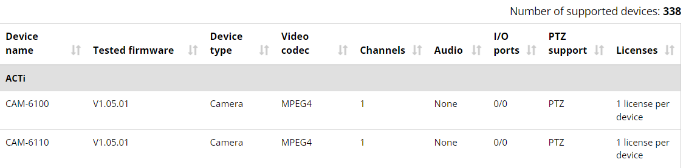
VMS Solution Partners
Network Optix
https://nxvms.com/ipvd?vendors=ACTi
Exacq
https://exacq.com/integration/ipcams/#search=acti~tags=false
Milestone
https://www.milestonesys.com/support/tools-and-references/supported-devices/xprotect-corporate-and-xprotect-expert/?AdvancedSearchDisplayed=true&ManufacturerId=3

Slide 31
Vertical Markets & Applications
Traffic
- Traffic jam monitoring
- Incidents investigation
Utility
- Perimeter protection
- Incidents investigation
Education (schools)
- Property protection
- Students protection
- Violence and Bullying prevention
Retail
- Property protection
- Theft prevention
- Business monitoring
Hotel & Casino
- Property protection
- Scam prevention
- Safety of the guests
Parking Lot
- Incident management
- Car theft prevention
- Access control

Slide 32

Where to Buy
Via Authorized Resellers
https://www.acti.com/Corporate/WhereToBuy
From ACTi Corporation Directly
E-Mail: sales@acti.com
Tel (US): +1-866-410-2284 (Toll Free)
Tel (Non-US): +886-2-2656-2588

Slide 33
Support & Services
Technical Support
- Online Customer Helpdesk - https://www.acti.com/chd
- Phone support
US: +1-866-410-2284 (Toll Free)
Other Regions: +886-2-2656-5200
RMA Services
- Warranty
- Repair services
Training
- Self-learning

