Slide 1

Access Control
Smart Server
Introduction

Slide 2

Access Control Smart Server Introduction
Access Control Smart Server (ACSS) is an easy-to-use access control software for managing employees and visitors access through the doors and gates as well as managing employee attendance.

Slide 3
Core Functions of ACSS
Core Function | Business focus | Employee | Visitor | Customer
Access Control Management Doors, gates, locks, identification of face*, card, ALPR*, tailgating* detection | Core Business | Y
Attendance Management Work shifts, clock-in, clock-out, late, absent | Core Business | Y
Visitor management Visitor enrollment for temporary access | New Focus |  | Y
Construction site management Temporary sites management | New Focus | Y
Food ordering management Conveniently manage the employee services | Project-based (popular) | Y
Conference room management Book the available meeting rooms in your company | Occasionally | Y
Customer arrival management Track when the customers arrive to the appointments | Occasionally | Y |  | Y
* Not available in the US/CA.

Slide 4
Functions vs End User Agenda
Core Function | Save Cost | Gain | Reduce Risk | Effortless Learning
Access Control Management Doors, gates, locks, identification of face*, card, ALPR*, tailgating* detection | Y |  | Y | Y
Attendance Management Work shifts, clock-in, clock-out, late, absent | Y |  |  | Y
Visitor management Visitor enrollment for temporary access | Y |  |  | Y
Construction site management Temporary sites management | Y |  | Y | Y
Food ordering management Conveniently manage the employee services | Y | Y |  | Y
Conference room management Book the available meeting rooms in your company | Y | Y |  | Y
Customer arrival management Track when the customers arrive to the appointments |  | Y |  | Y
* Not available in the US/CA.

Slide 5
Functions vs System Integrator’s Agenda
Core Function | Win More | Better Margin | Reduce Risk | Effortless Learning
Access Control Management Doors, gates, locks, identification of face*, card, ALPR*, tailgating* detection | Y | Y |  | Y
Attendance Management Work shifts, clock-in, clock-out, late, absent | Y |  |  | Y
Visitor management Visitor enrollment for temporary access | Y | Y |  | Y
Construction site management Temporary sites management | Y | Y |  | Y
Food ordering management Conveniently manage the employee services | Y |  |  | Y
Conference room management Book the available meeting rooms in your company | Y |  |  | Y
Customer arrival management Track when the customers arrive to the appointments | Y |  |  | Y
* Not available in the US/CA.

Slide 6
End User Applications vs ACSS Functions
End User Applications | ACSS Functions
Identification | ACSS provides various methods of identification, such as face* recognition, fingerprint* recognition, RFID based identification.
Monitor Dashboard | The convenient dashboard gives the overview of all the recent and live activities. The denied and approved access notes are colored.
Detect Events | The violations, such as using an invalid card, unregistered or blacklisted face, will result with the triggered event.
Respond to Alarms | There are various ways to respond to alarms, such as verifying the video from the security cameras, notifying the team by e-mail.
Investigate Incidents | Each incident is like a service ticket, it can be used to track the incident during later investigation.
Manage Evidence | All the important evidence, such as abnormal access attempt, can be backed up. The video from the VMS can also be backed up.
Link to Management | Easy ways to report the incidents to the management team.
* Not available in the US/CA.

Slide 7
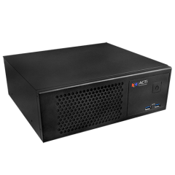
Access Control Smart Server Introduction
ACTi offers standalone version of Access Control Smart Server (model ACS-100)
Most access control solution manufacturers only offer the software-based server, which requires the management of an additional computer, which is IT overhead and a security risk.
ACTi door stations do the identification process within the door unit without requiring any server-side computing resources. It also eliminates the risk of unstable access control process due to server overload or network failures, which may happen to the other vendors’ software that uses server-side identification.
ACTi offers full solution: software and all the devices. This way the customer does not need to worry about having multiple systems from different vendors.

Slide 8
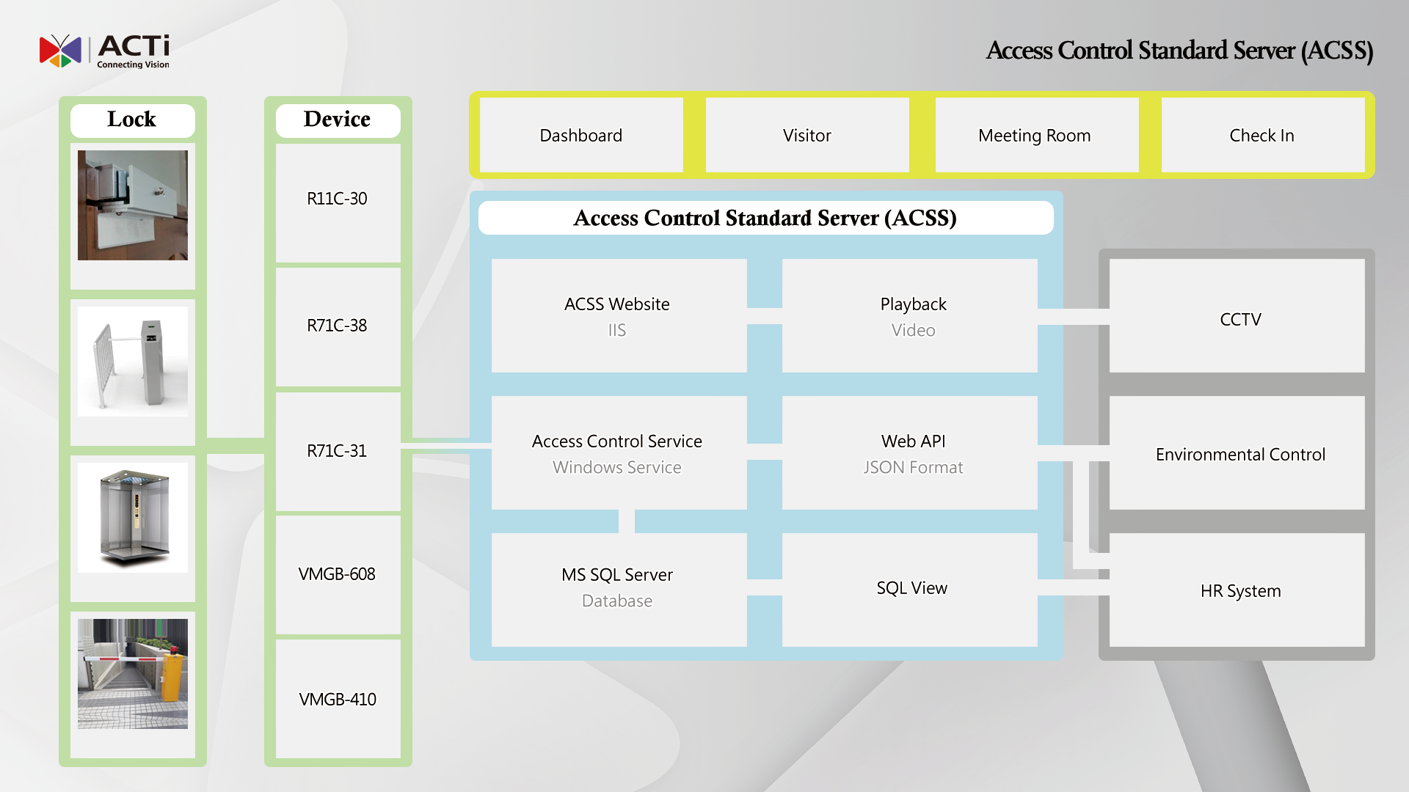
System Architecture
Access Control Smart Server (ACSS)
* R7x Series not available in the US/CA.

Slide 9
System Flow
ACSS Server
(Access Control Server)
Data Switch
Access Control Device
(Card, Face Reader)
1. Create User Profile (card number, face photo)
2. Send User Profile into Devices (Whitelist)
3. Device controls the door directly
4. Access log is stored in the device
5. The server fetches the access log
6. The server creates the report

Slide 10
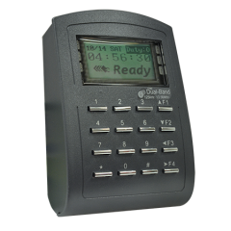

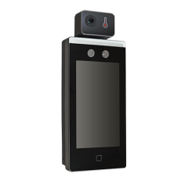
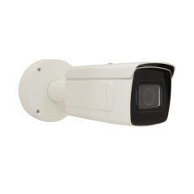
Integrated Products
The most frequently used products supported by ACSS server:
R11C-30
RFID
Card Reader
Card DB: 16000
Elevators up to 64 floors
Supported cards: Mifare (including Easy Card)
EM
R71CF-313*
Face Recognition Door Station
Face DB: 1500
Photo based profiles
Recognition distance 0.3m-1.5m
Supported cards:
EM (125kHz)
R72FT-31*
Face Recognition & Fever Detection Door Station
Face DB: 6000
Photo based profiles
Recognition distance 0.5m-3m
Supported cards:
Mifare (including Easy Card)
VMGB-410*
ALPR Camera
Deep learning based ALPR
Speed <60km/h
Identification: 4.5m-30m
ALPR supported countries: Taiwan
* Not available in the US/CA.

Slide 11
FEATURES

Slide 12
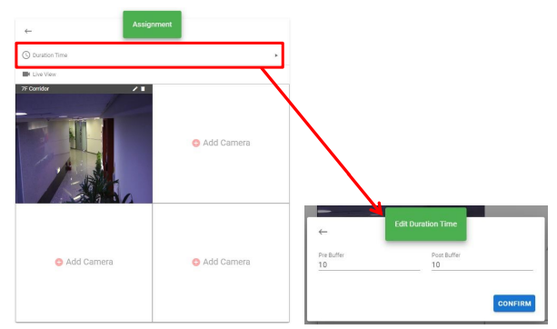
Video Verification for Access Control
You can bind up to 4 surveillance camera video streams with access points.

Slide 13
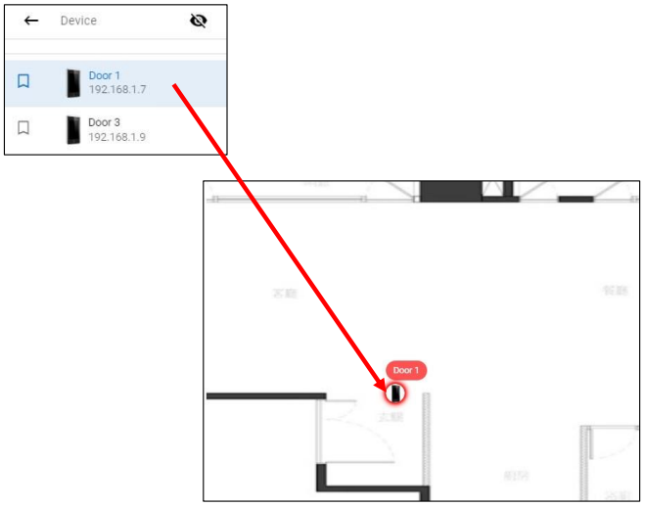
E-Map
Intuitive navigation for investigating incidents immediately.

Slide 14
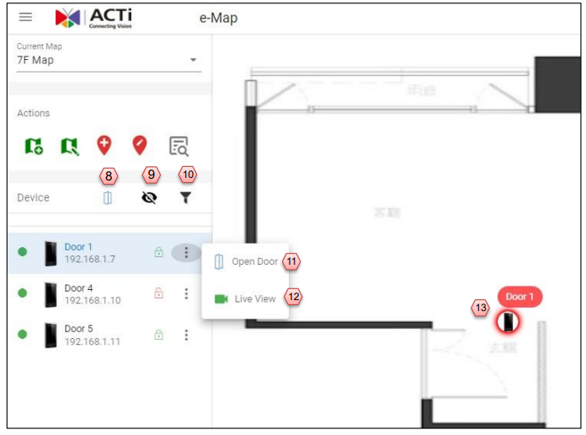
E-Map
Easy to open doors by the situational awareness and by verifying the video first.

Slide 15
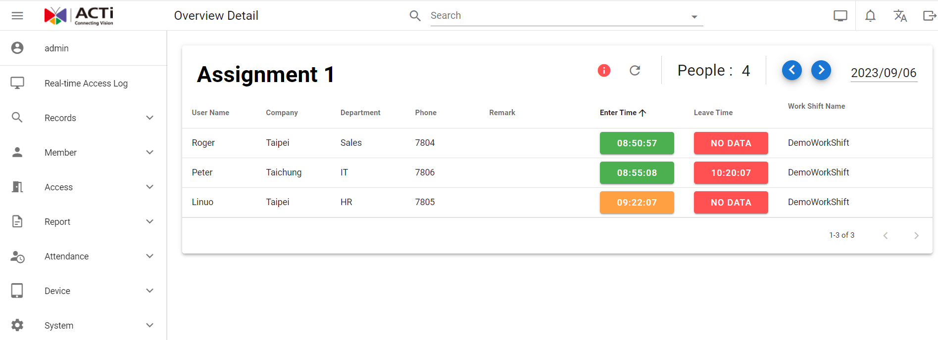
Attendance Management
The example of the convenient user interface of the attendance management.

Slide 16
Attendance Management
The Attendance Manage system includes following parameters:
Fill in the shift name
Fill the working hours
Fill in the off-duty time
The earliest time allowed for early arrival
Late start time buffer
Deadline for late arrivals
Break start time
Break end time
Allow early leave start time
End Time allowed for early leave
The latest overtime deadline
On the right side, you can preview the schedule timeline according to the set time
The working hours will be automatically calculated according to the settings here

Slide 17
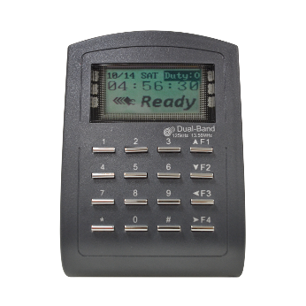
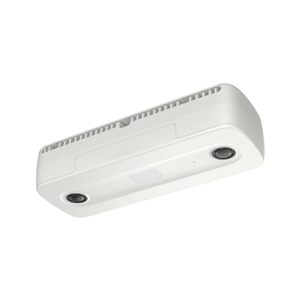
Tailgating* Detection
If you are using Q96x, VMGB-6xx or other People Counting devices, you can use them for the Tailgating detection function on your access control device.
The basic algorithm or logic of Tailgating is defined as the
number of registered users of a particular swiped card should match the number of persons passing by.
If this condition is not met, then a Tailgating event is triggered. So, when an I/O device, such as a warning light, is connected to the access control device and a tailgating event occur, the alarm light will be triggered.
Count the RFID swipes
Count the people passing through
Alarm if count mismatch!!
* Not available in the US/CA.

Slide 18
Tailgating* Detection
Scenario Examples:
No swiped card recorded, a person passes by, tailgating is triggered
One card/face is swiped in, one person passes by, no tailgating occur
Once card/face is swiped in, two or more persons pass by, tailgating is triggered
One card/face is swiped repeatedly, two or more persons pass by, tailgating is triggered
* Not available in the US/CA.

Slide 19
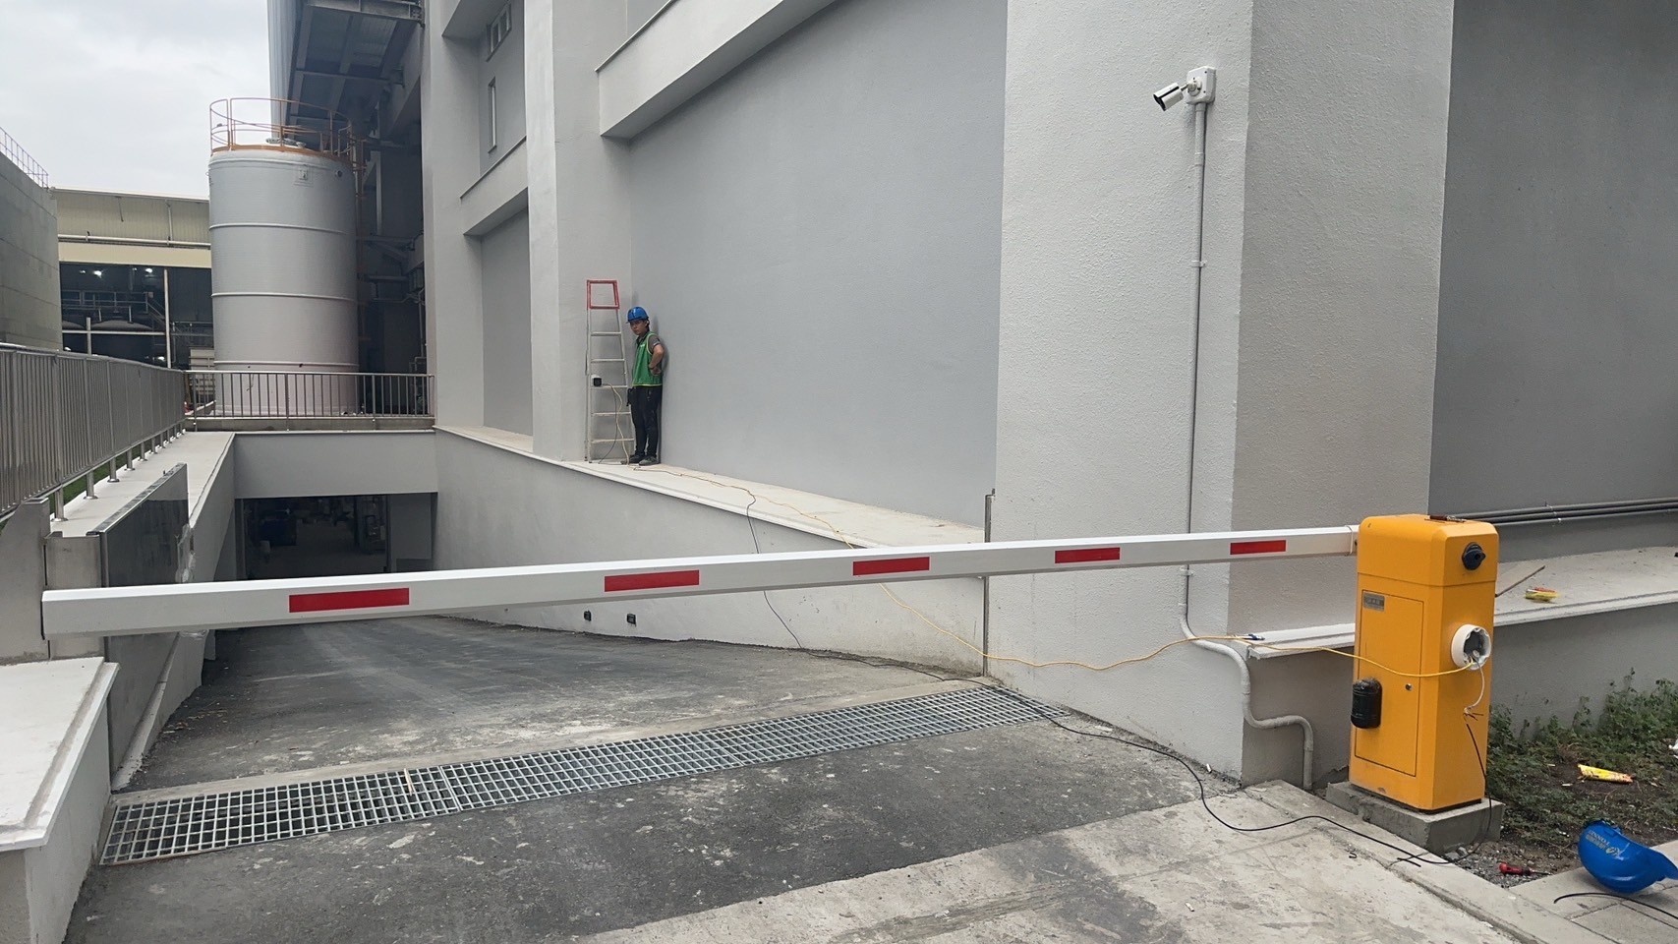
ALPR based Access Control – How to Install Cameras
Possible installation location #2 (height: ~2m)
Possible installation location #1 (height: ~1.5-2m)
Possible installation location #3 (height: ~1.5m)
* Not available in the US/CA.

Slide 20
Brand Comparison
 | ACTi | SOYAL | Hundure | TQuark | Hikvision | PAPAGO
RFID Reader | Y | Y | Y | Y
Face recognition door station | Y |  |  | Y | Y | Y
Cloud-based face recognition |  |  |  | Y |  | Y
Free Server Software | Y | Y | Y |  | Y
Integrate with other equipment | Y |  |  | Y
Customized features | Y |  | Y | Y |  | Y

Slide 21
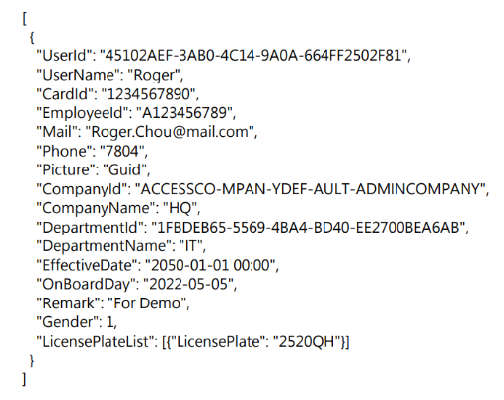
Integration with ACSS
Access Control Event Log Export
- Customized Reports
- Open Database
- Web API
Personnel profile data synchronization
- Web API
- Data linker
Equipment integration
- The user specifies the equipment
- If the API exists, we can do the integration by contacting the equipment supplier by special project request.

Slide 22




ACSS Live Demo
Welcome to try the free demo of ACSS server
http://acss.acti.com/

Slide 23

Where to Buy
Via Authorized Resellers
https://www.acti.com/Corporate/WhereToBuy
From ACTi Corporation Directly
E-Mail: sales@acti.com
Tel (US): +1-866-410-2284 (Toll Free)
Tel (Non-US): +886-2-2656-2588

Slide 24
Support & Services
Technical Support
- Online Customer Helpdesk - https://www.acti.com/chd
- Phone support
US: +1-866-410-2284 (Toll Free)
Other Regions: +886-2-2656-5200
RMA Services
- Warranty
- Repair services
Training
- Self-learning

