Slide 1
ACTi Products
Introduction
ST1-5
Best spec to price ratio, in-house designed SoC driven

Slide 2

Contents
Value Position & Unique Selling Points
Core Features
Product Offering
Video Clips and Photos
Solutions
Vertical Markets & Applications
Where to Buy
Support and Services

Slide 3
Value Position & Unique Selling Points
Core Value:
Up to 10 Megapixel with ACTi in-house designed SoC
Unique Selling Points:
Most popular form factors – cubes, boxes, domes, turrets, bullets
Fixed and Zoom lens options for flexibility
Great specifications, up to 10MP
Wide range of mounting accessory support
NDAA Compliant

Slide 4
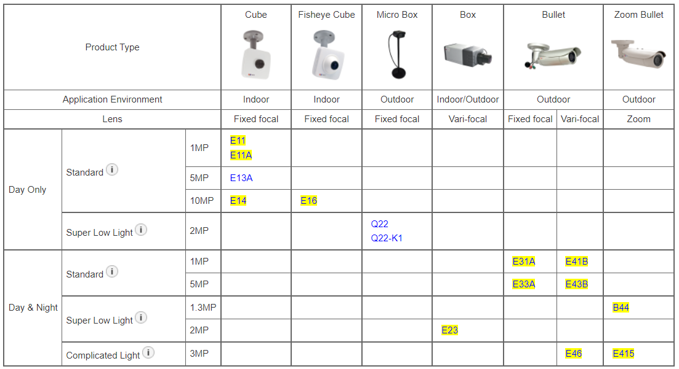
Product Offering
Matrix View of Cube, Box, Bullet Cameras

Slide 5
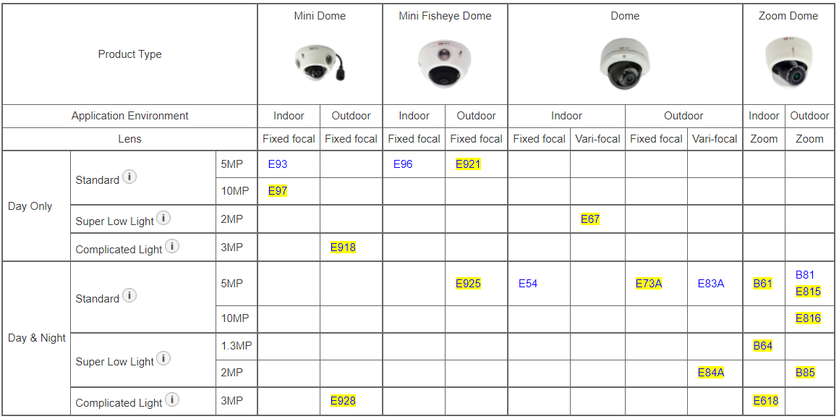
Product Offering
Matrix View of Dome Cameras

Slide 6
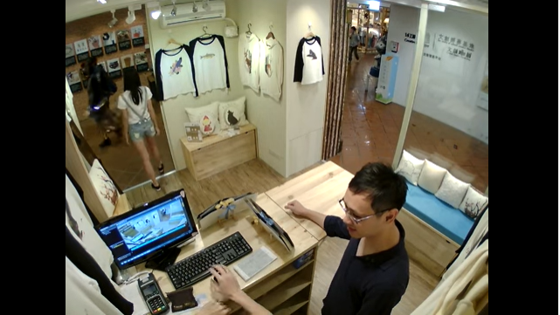
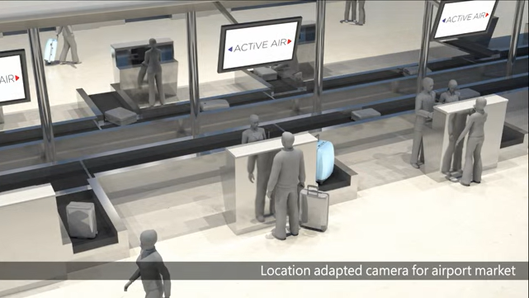
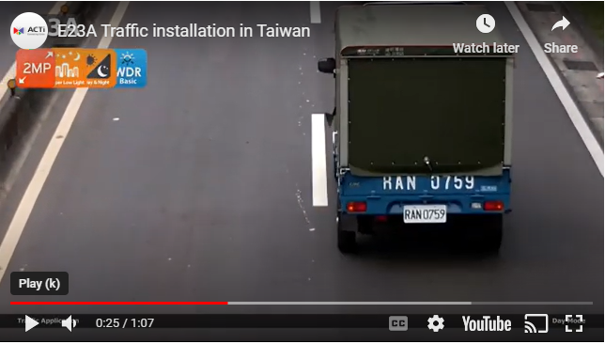
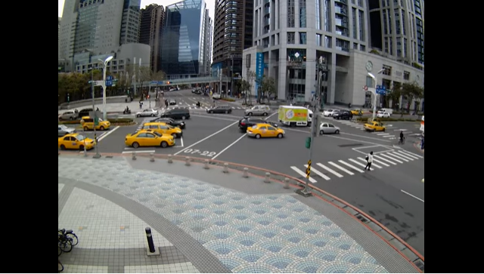
Video Clips & Photos
Cube Cameras in Retail
Q22 for Special Applications
https://www.acti.com/video/v322
https://www.acti.com/video/v1552
E23A Traffic Application
B81 Traffic Application
https://www.acti.com/video/v564
https://www.acti.com/video/v300

Slide 7
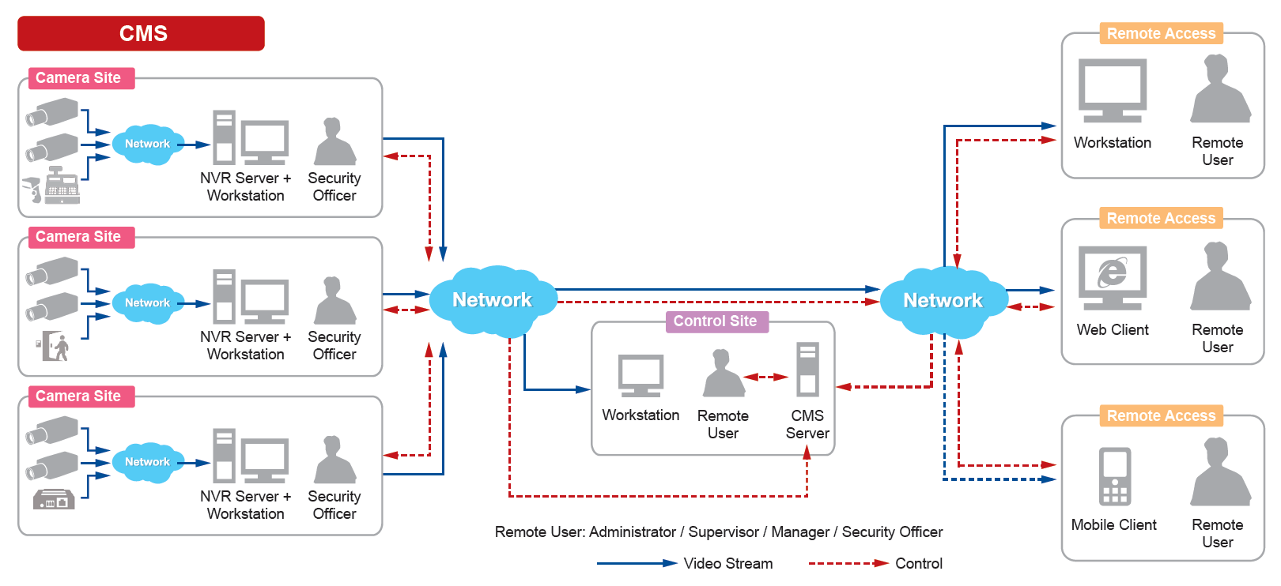
Solutions
ACTi Unified Solution Architecture consists of NVR servers and CMS.
Small Scale projects: NVR only
Large Scale projects: NVR + CMS

Slide 8
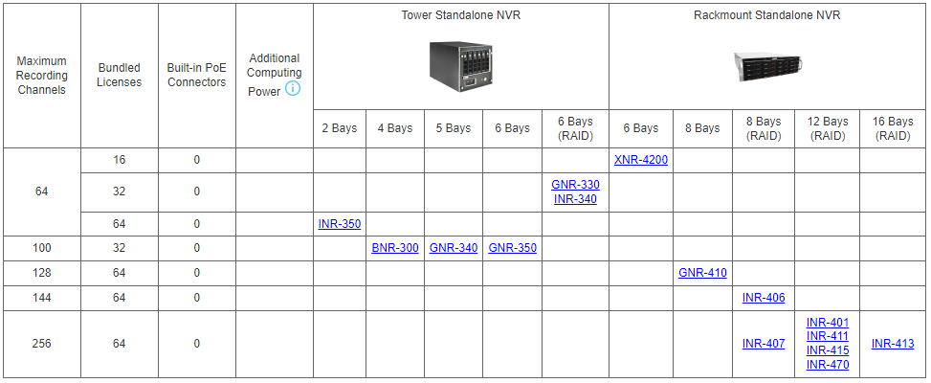
Solutions
Windows-based Standalone NVR options

Slide 9
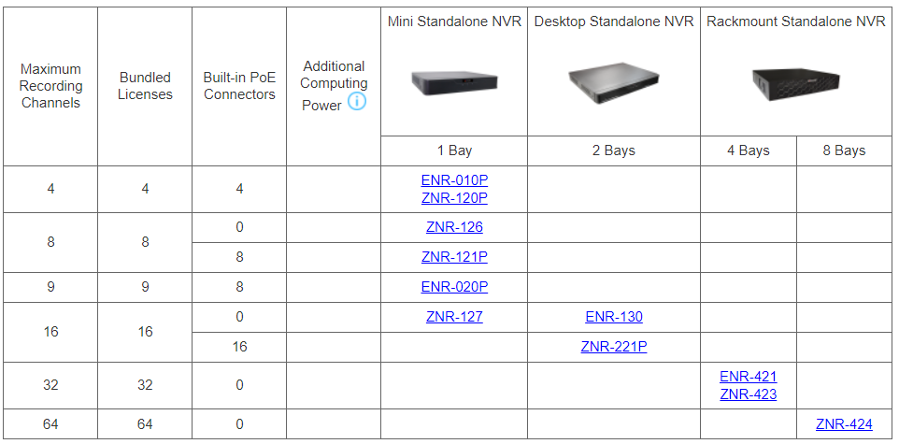
Solutions
SoC-based Standalone NVR options

Slide 10
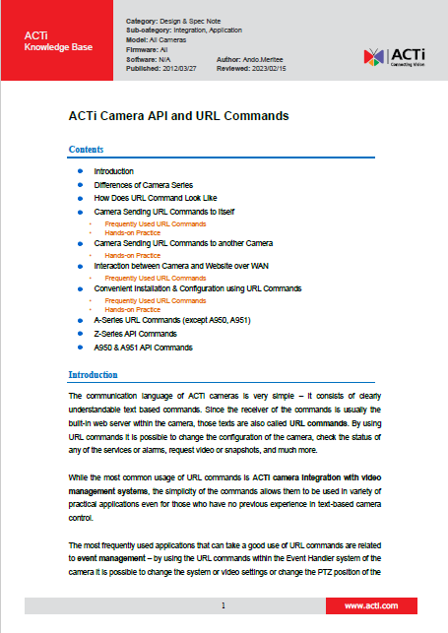
Solutions
Third party Solution Integration
ACTi provides an in-depth integration API/Url Commands document for solution integration purposes.
Download here: https://Download.acti.com?id=528

Slide 11
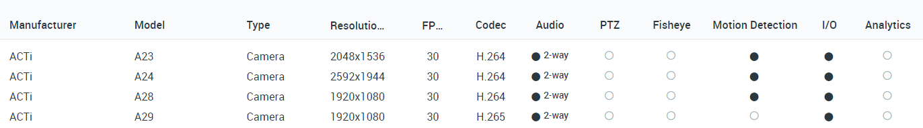
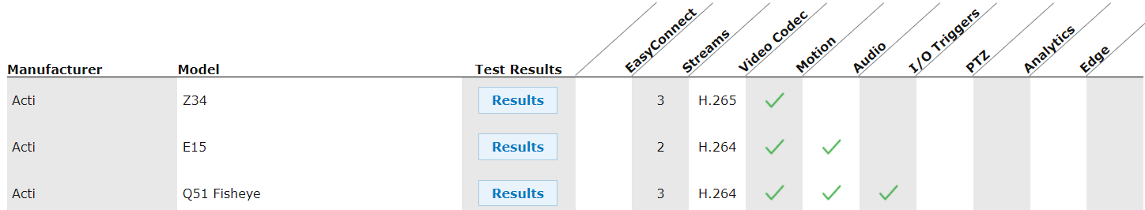
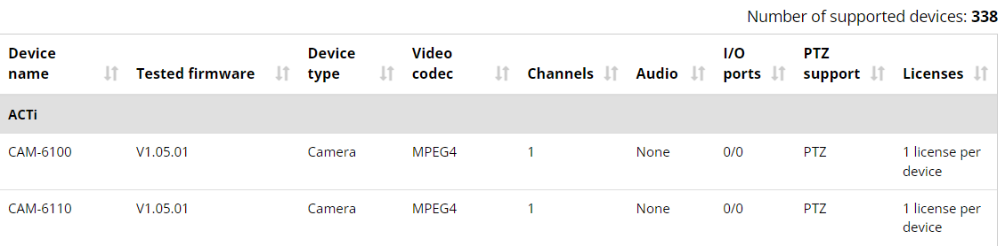
VMS Solution Partners
Network Optix
https://nxvms.com/ipvd?vendors=ACTi
Exacq
https://exacq.com/integration/ipcams/#search=acti~tags=false
Milestone
https://www.milestonesys.com/support/tools-and-references/supported-devices/xprotect-corporate-and-xprotect-expert/?AdvancedSearchDisplayed=true&ManufacturerId=3

Slide 12
Vertical Markets & Applications
Residential
- Vandalism & theft prevention
- Safety of the residents
- Incidents investigation
Healthcare
- Property protection
- Patients monitoring
Education (schools)
- Property protection
- Students protection
- Violence and Bullying prevention
Retail
- Property protection
- Theft prevention
- Business monitoring

Slide 13

Where to Buy
Via Authorized Resellers
https://www.acti.com/Corporate/WhereToBuy
From ACTi Corporation Directly
E-Mail: sales@acti.com
Tel (US): +1-866-410-2284 (Toll Free)
Tel (Non-US): +886-2-2656-2588

Slide 14
Support & Services
Technical Support
- Online Customer Helpdesk - https://www.acti.com/chd
- Phone support
US: +1-866-410-2284 (Toll Free)
Other Regions: +886-2-2656-5200
RMA Services
- Warranty
- Repair services
Training
- Self-learning

