Slide 1
ACTi Products
Introduction
ST3-8
Windows-based NVR products with the scale of 501-1000 channels.

Slide 2

Contents
Introduction of Large-Scale Solution Architecture
Introduction of CMS Options
Value Position by Scale
Standalone CMS Comparison
Value Position & Unique Selling Points
Lite Web Client Introduction
ACTi Mobile Client for CMS 2
Where to Buy
Support and Services

Slide 3
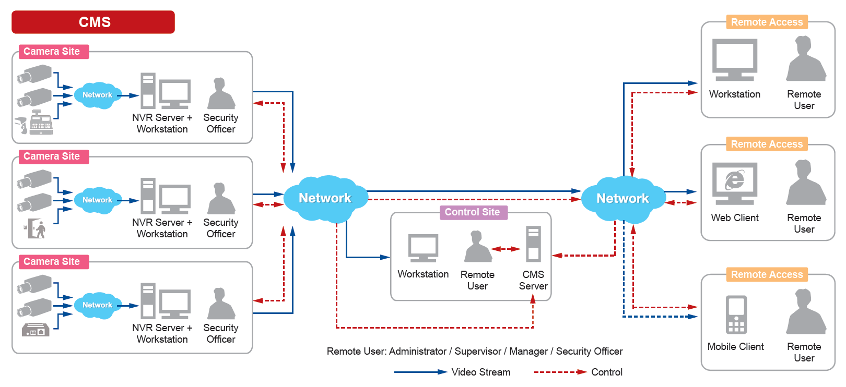
Introduction of Large-Scale Solution Architecture
The system that is larger than 256 channels usually consists of multiple NVR servers, managed by Central Management System (CMS).

Slide 4

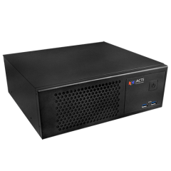
Introduction of CMS Options
CMS 2 is Central Management System software that can manage thousands of NVR servers up to unlimited number of channels.
Both standalone and software versions available.
Software edition of CMS 2
Unlimited number of channels depending on selected hardware
Standalone CMS Server: CMS-100
Up to 800 channels

Slide 5
Value Position by Scale
Features
Full
CMS 2 + NVR 3 Corporate
NVR 3 Corporate, GNR, INR
NVR 3 Business, BNR
ZNR, ENR
Essential
4ch
16ch
32ch
64ch
100ch
200ch
500ch+
Channels

Slide 6
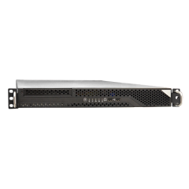
Standalone CMS Comparison
Feature | CMS-100 | CMS-201
Photo
Product Type | Desktop Standalone CMS | Rackmount Standalone CMS
Maximum Number of Channels | 800 | 6400
Free License | 100 | 200
CPU | Intel Core i7-6700TE | Intel Core i7-7700
Maximum Display layouts | 64 | 144
Storage Bays | 1 | 1
System Drive | SSD, 128GB | SSD, 256GB

Slide 7
Value Position & Unique Selling Points
Unique Selling Points:
The most affordable high-quality CMS in the industry!
  Standalone CMS has at least 100 free channel licenses.
  Very competitive price per channel for the add-on licenses.
  No perpetual fees.
Has all the features you need!
  Get over 95% of all the features that the top ISV brands have, in many cases, even for free.
  ACTi continuously adds more features to ensure it has all you need!
Free Upgrades!
  ACTi offers quarterly software upgrades, for free!
  Get more features every quarter.

Slide 8
Value Position & Unique Selling Points
Unique Selling Points:
Unique Features help you win projects!
  ACTi CMS provides several world leading features for you to win
  Our service personnel helps with A&E requirements fulfillment
Exclusive custom-made CMS features for you!
  For the large projects, ACTi helps develop customized features by request
Turn ACTi CMS into your own brand!
  White label and non-brand CMS options available.
  Secure your business with exclusive CMS branding.

Slide 9
Value Position & Unique Selling Points
Unique Selling Points:
Expand CMS up to any number of Channels!
  You can combine hundreds of NVR servers into a single system using ACTi CMS 2, up to unlimited number of channels.
  ACTi smart network architecture ensures stable and seamless data flow even in the large-scale projects.
Wide range of Service Tools & Utilities
  - Free project planning tools for your VMS
  - Additional special purpose utilities to work along with CMS

Slide 10
Lite Web Client Introduction
In addition to already supporting Workstation client, Mobile client and Full-featured Web client, the CMS 2 also introduces Lite Web Client option.
Lite Web Client is the simplified edition of the browser-based client application. It has less features enabled and simpler appearance, making it very user-friendly for the types of users who are not very technical and do not require full set of features.
While the Full-featured web client is available for Microsoft Edge browser (compatibility mode), the Lite web client can be used with various browsers:
Chrome
Firefox
Safari
Edge

Slide 11
Primary Users of the Lite Web Client
ACTi Web Client Value Position
Role | Client PC | Workstation app | Full Web Client | Lite Web Client
IT Admin (setup) | Dedicated | Y | Y
Security Officer | Dedicated | Y | Y
Supervisor/ Manager | May change anytime |  |  | Y
Owner | May change anytime |  |  | Y

Slide 12
Full Client vs Lite Client Comparison
CMS 2 | Workstation Application | Web Browser
 |  | Full Client |  | Lite Client
 |  | Edge in IE Mode (Windows 10 or later) | Chrome, Firefox, Safari, Edge (normal mode) | Chrome, Firefox, Safari, Edge (normal mode)
Live View Layouts | Up to 144 channels | Up to 144 channels | - | Up to 16 channels
Playback | Yes | Yes | - | Embedded Playback
Events | Yes | Yes | - | -
PTZ control | Mouse, Joystick | Mouse, Joystick | - | Mouse only
Codec | H.265, H.264, MJPEG | H.265, H.264, MJPEG | - | H.264, MJPEG
Audio | 2-way | 2-way | - | Audio-in
Stream Switcher | Yes | Yes | - | Default Stream
Setup, Playback tab | Yes | Yes | - | -
Export | Yes | Yes | - | -

Slide 13
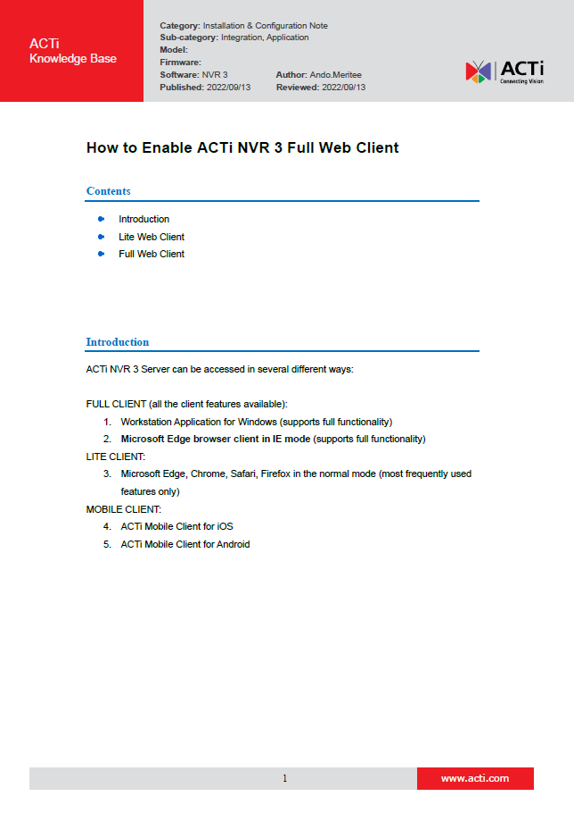
How to Enable Full Web Client
It is very easy to enable the NVR 3 or CMS 2 Full Web Client in your Microsoft Edge Browser. It just requires one-time setup with a few clicks.
For the convenience, the simple instruction can be found here:
https://Download.acti.com?id=31324

Slide 14

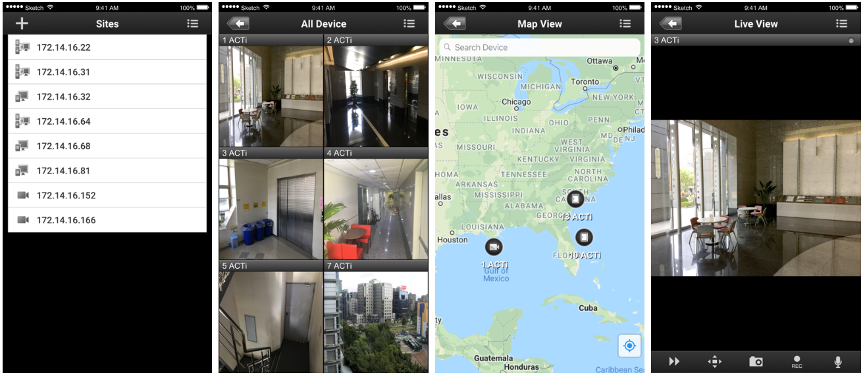
ACTi Mobile Client for CMS 2
ACTi provides a very professional Mobile Client for NVR 3 for free!

Slide 15
ACTi Mobile Client for CMS 2
Function Family | Function | ACTi Mobile Client for Android v1.0.16 or newer ACTi Mobile Client for iOS v1.02 or newer
 |  | NVR 3 | CMS 2
Live | Video Live View | Y | Y
 | Event Message | Y | Y
Audio | Audio In | Y | Y
 | Audio Out | Y | Y
Digital PTZ | Digital PTZ | Y | Y
PTZ | Optical PTZ | Y | Y
 | Preset | Y | Y
 | Preset Tour | Y | Y
 | PTZ Speed | Y | Y
Control | Manual Record | Y | Y
 | Snapshot | Y | Y
 | DO | Y | Y
Playback | Main playback functions | Y | Y
 | Additional playback functions | Y | Y
 | TimeTrack | Y | Y
 | Event Search | Y | Y

Slide 16

Where to Buy
Via Authorized Resellers
https://www.acti.com/Corporate/WhereToBuy
From ACTi Corporation Directly
E-Mail: sales@acti.com
Tel (US): +1-866-410-2284 (Toll Free)
Tel (Non-US): +886-2-2656-2588

Slide 17
Support & Services
Technical Support
- Online Customer Helpdesk - https://www.acti.com/chd
- Phone support
US: +1-866-410-2284 (Toll Free)
Other Regions: +886-2-2656-5200
RMA Services
- Warranty
- Repair services
Training
- Self-learning

