Slide 1
ACTi Products
Introduction
ST3-4
VMS products with the scale of 33-100 channels, based on ZNR-series servers and cost-effective cameras.

Slide 2

Contents
Value Position & Unique Selling Points
Product Offering
Solutions
Vertical Markets & Applications
Where to Buy
Support and Services

Slide 3
Value Position & Unique Selling Points
Core Value:
VMS product with the scale of 33-100 channels, based on ZNR-series servers and cost-efficient cameras.
Unique Selling Points:
Very competitive pricing. The lowest among leading non-China brands.
Great for budget sensitive projects and markets up to 100 channels
Quick installation
NDAA Compliant

Slide 4
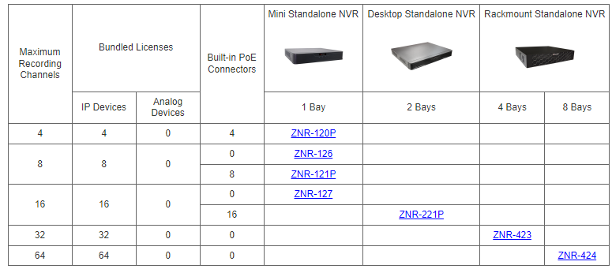
Product Offering
Matrix View

Slide 5
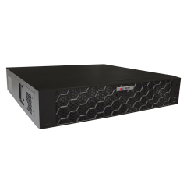
Product Offering
Model | ZNR-424
Photo
Type | Rackmount
Max Channels | 64
Storage Bays | 8
Codec | H.264/265
Recording Throughput | 320 Mbps
ONVIF | Yes
NDAA | Yes

Slide 6
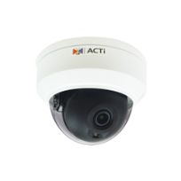



Solutions
Solution Architecture
Web Client
ZNR-424
IP Cameras

Slide 7
Vertical Markets & Applications
Residential
- Vandalism & theft prevention
- Safety of the residents
- Incidents investigation
Healthcare
- Property protection
- Patients monitoring
Education (schools)
- Property protection
- Students protection
- Violence and Bullying prevention
Retail
- Property protection
- Theft prevention
- Business monitoring

Slide 8

Where to Buy
Via Authorized Resellers
https://www.acti.com/Corporate/WhereToBuy
From ACTi Corporation Directly
E-Mail: sales@acti.com
Tel (US): +1-866-410-2284 (Toll Free)
Tel (Non-US): +886-2-2656-2588

Slide 9
Support & Services
Technical Support
- Online Customer Helpdesk - https://www.acti.com/chd
- Phone support
US: +1-866-410-2284 (Toll Free)
Other Regions: +886-2-2656-5200
RMA Services
- Warranty
- Repair services
Training
- Self-learning

