Slide 1
ACTi Products
Introduction
ST3-1
VMS products with the scale of 4-32 channels, based on ZNR-series servers and cost-effective cameras.

Slide 2

Contents
Value Position & Unique Selling Points
Product Offering
Solutions
Vertical Markets & Applications
Where to Buy
Support and Services

Slide 3
Value Position & Unique Selling Points
Core Value:
VMS product with the scale of 4-32 channels, based on ZNR-series servers and cost-efficient cameras.
Unique Selling Points:
Various form factor options – mini, desktop, rackmount
Quick installation
Very competitive pricing. The lowest among leading non-China brands.
Great for budget sensitive projects and markets up to 32 channels
NDAA Compliant

Slide 4
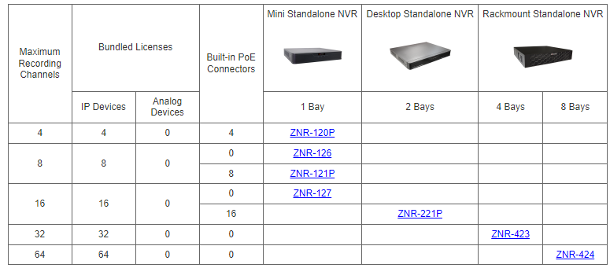
Product Offering
Matrix View

Slide 5
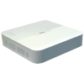
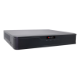
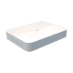
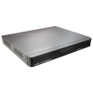
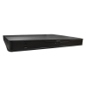
Product Offering
Model | ZNR-120P | ZNR-126 | ZNR-121P | ZNR-127 | ZNR-221P | ZNR-423
Photo
Type | Mini | Mini | Mini | Mini | Desktop | Rackmount
Max Channels | 4 | 8 | 8 | 16 | 16 | 32
Storage Bays | 1 | 1 | 1 | 1 | 2 | 4
Codec | H.264/265 | H.264/265 | H.264/265 | H.264/265 | H.264/265 | H.264/265
Recording Throughput | 40 Mbps | 64 Mbps | 60 Mbps | 64 Mbps | 160 Mbps | 160 Mbps
ONVIF | Yes | Yes | Yes | Yes | Yes | Yes
NDAA | Yes | Yes | Yes | Yes | Yes | Yes

Slide 6
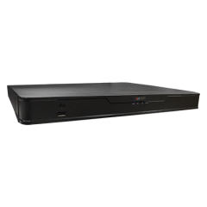
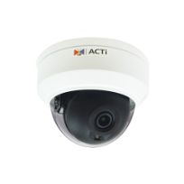



Solutions
Solution Architecture
Web Client
ZNR-Series Standalone NVR
IP Cameras

Slide 7
Vertical Markets & Applications
Residential
- Vandalism & theft prevention
- Safety of the residents
- Incidents investigation
Healthcare
- Property protection
- Patients monitoring
Education (schools)
- Property protection
- Students protection
- Violence and Bullying prevention
Retail
- Property protection
- Theft prevention
- Business monitoring

Slide 8

Where to Buy
Via Authorized Resellers
https://www.acti.com/Corporate/WhereToBuy
From ACTi Corporation Directly
E-Mail: sales@acti.com
Tel (US): +1-866-410-2284 (Toll Free)
Tel (Non-US): +886-2-2656-2588

Slide 9
Support & Services
Technical Support
- Online Customer Helpdesk - https://www.acti.com/chd
- Phone support
US: +1-866-410-2284 (Toll Free)
Other Regions: +886-2-2656-5200
RMA Services
- Warranty
- Repair services
Training
- Self-learning

