Slide 1
ACTi Products
Introduction
ST3-0
Hybrid DVR (mixed analog and IP camera channels).

Slide 2

Contents
Value Position & Unique Selling Points
Product Offering
Solutions
Solutions: Recommended Camera Options
Vertical Markets & Applications
Where to Buy
Support and Services

Slide 3
Value Position & Unique Selling Points
Core Value:
6-24 channel Hybrid DVR products to combine with HD analog cameras or IP cameras for the price driven projects.
Unique Selling Points:
Hybrid design – supports both analog and IP cameras
Remote access from anywhere over the IP network
Supporting all the 4 popular formats - TVI/AHD/CVI/CVBS (most known Hybrid DVR brands only support up to 3 of them)
Plug & Play
NDAA Compliant

Slide 4
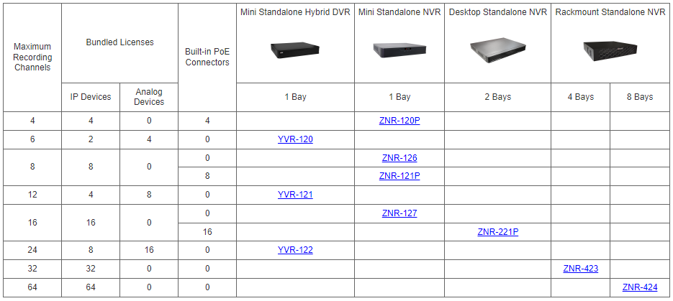
Product Offering
Matrix View

Slide 5
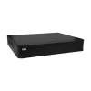
Product Offering
Model | YVR-120 | YVR-121 | YVR-122
Photo
Type | Standalone Hybrid DVR | Standalone Hybrid DVR | Standalone Hybrid DVR
Max Analog Channels | 4 | 8 | 16
Maximum IP Channels | 2 | 4 | 8
Total Channels | 6 | 12 | 24
Storage Bays | 1 | 1 | 1
Analog Video Formats | TVI/AHD/CVI/CVBS | TVI/AHD/CVI/CVBS | TVI/AHD/CVI/CVBS
Maximum fps vs Resolution | (TVI/AHD/CVI) 5MP@20fps 4MP@30fps 2MP@30fps 1MP@60fps (CVBS) | (TVI/AHD) 5MP@12fps 4MP@15fps 2MP@30fps 1MP@30fps (CVI) 2MP@30fps 1MP@30fps (CVBS) | (TVI/AHD) 5MP@12fps 4MP@15fps 2MP@30fps 1MP@30fps (CVI) 2MP@30fps 1MP@30fps (CVBS)
NDAA | Yes | Yes | Yes

Slide 6
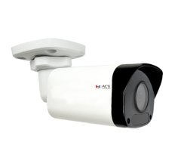
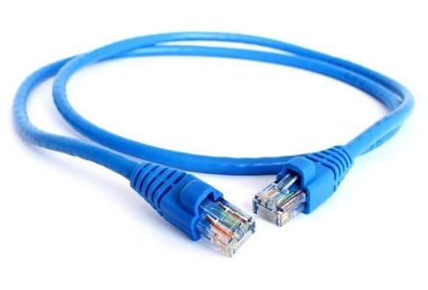
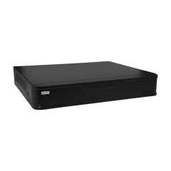
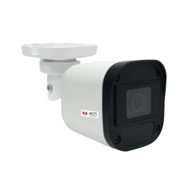
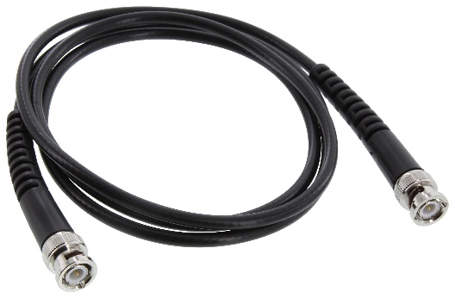
Solutions
Hybrid DVR (YVR-xxx) series can connect to the analog and IP cameras. The coaxial cable is used for analog connections. The IP cameras connect using the Ethernet cable using ONVIF protocol.
IP Camera
(ONVIF)
Ethernet Cable
Hybrid DVR
(YVR-series)
Analog Camera
(Yxx Series)
Coaxial Cable
(with BNC connectors)

Slide 7
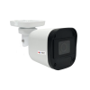
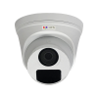
Solutions: Recommended Camera Options
Model | Y31 | Y32 | Y71 | Y72
Photo
Type | Analog Mini Bullet | Analog Mini Bullet | Analog Dome | Analog Dome
Resolution | 2MP | 5MP | 2MP | 5MP
Lens | f2.8mm | f2.8mm | f2.8mm | f2.8mm
Hor Viewing Angle | 90.5° | 102.2° | 90.5° | 102.2°
Analog Video Output | 1 x BNC connector, supports TVI/AHD/CVI/CVBS | 1 x BNC connector, supports TVI/AHD/CVI/CVBS | 1 x BNC connector, supports TVI/AHD/CVI/CVBS | 1 x BNC connector, supports TVI/AHD/CVI/CVBS
Maximum fps vs Resolution | (TVI/AHD/CVI) 30 fps at 1920 x 1080 (CVBS) NTSC, PAL | (TVI/AHD) 20 fps at 2592 x 1944 (CVI) 25 fps at 2880 x 1620 (CVBS) NTSC, PAL | (TVI/AHD/CVI) 30 fps at 1920 x 1080 (CVBS) NTSC, PAL | (TVI/AHD) 20 fps at 2592 x 1944 (CVI) 25 fps at 2880 x 1620 (CVBS) NTSC, PAL
Weatherproof | IP67 | IP67 | IP67 | IP67
NDAA | Yes | Yes | Yes | Yes

Slide 8
Vertical Markets & Applications
Residential
- Vandalism & theft prevention
- Safety of the residents
- Incidents investigation
Healthcare
- Property protection
- Patients monitoring
Education (schools)
- Property protection
- Students protection
- Violence and Bullying prevention
Retail
- Property protection
- Theft prevention
- Business monitoring

Slide 9

Where to Buy
Via Authorized Resellers
https://www.acti.com/Corporate/WhereToBuy
From ACTi Corporation Directly
E-Mail: sales@acti.com
Tel (US): +1-866-410-2284 (Toll Free)
Tel (Non-US): +886-2-2656-2588

Slide 10
Support & Services
Technical Support
- Online Customer Helpdesk - https://www.acti.com/chd
- Phone support
US: +1-866-410-2284 (Toll Free)
Other Regions: +886-2-2656-5200
RMA Services
- Warranty
- Repair services
Training
- Self-learning

