Slide 1
ACTi Products
Introduction
ST1-3
Price to price camera competition against IP brands – 10-20% lower.

Slide 2

Contents
Value Position & Unique Selling Points
Core Features
Product Offering
Video Clips and Photos
Solutions
Vertical Markets & Applications
Where to Buy
Support and Services

Slide 3
Value Position & Unique Selling Points
Core Value:
Price to price camera competition against IP brands – 10-20% lower.
Unique Selling Points:
The best WDR models – 150dB! (look at the photos)
Excellent video quality with 4MP
Quad Streams
Built-in Analytics
Both fixed and zoom lens options available for bullets and domes
Very competitive pricing against leading IP brands
Great for quality demanding but limited budget projects and markets

Slide 4
Core Features
Resolution
4MP
Frame Rate
Full frame rate (30fps) at maximum resolution
WDR
Extreme WDR (150dB)
Audio
Two-way
Corridor Mode
The image can be rotated by 90 degrees for corridor applications.
ONVIF
Easy integration with the wide range of VMS brands

Slide 5
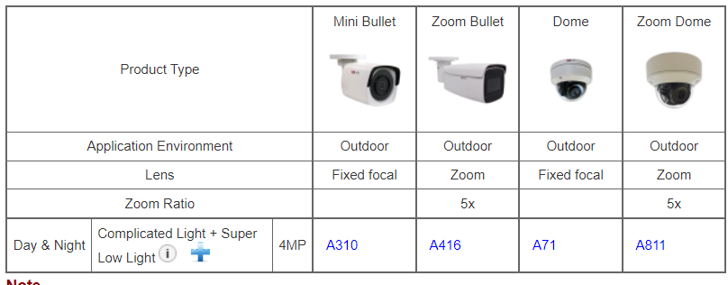
Product Offering
Matrix View

Slide 6
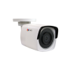
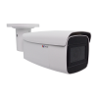
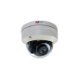
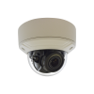
Product Offering
Model | A310 | A416 | A71 | A811
Photo
Type | Mini Bullet | Zoom Bullet | Dome | Zoom Dome
Resolution | 4MP | 4MP | 4MP | 4MP
fps | 30@4MP | 30@4MP | 30@4MP | 30@4MP
Lens | f2.8mm | f2.8-12mm | f2.8mm | f2.8-12mm
Zoom Ratio | - | 4.3x | - | 4.3x
Corridor Mode | Yes | Yes | Yes | Yes
Audio | - | Line-in, Mic-in, Line-out | Line-in, Mic-in, Line-out | Line-in, Mic-in, Line-out
Analytics | Yes | Yes | Yes | Yes
WDR | Extreme (150dB) | Extreme (150dB) | Extreme (150dB) | Extreme (150dB)

Slide 7
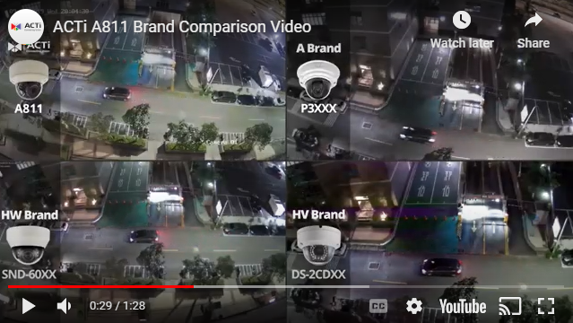
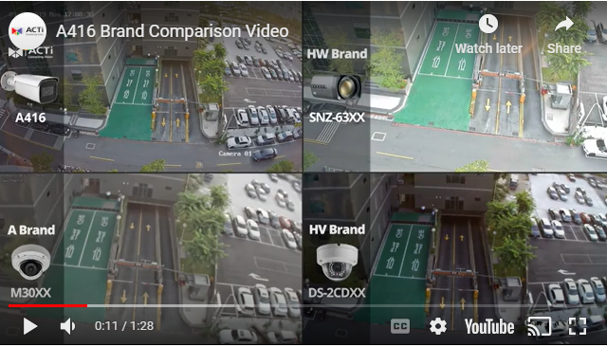
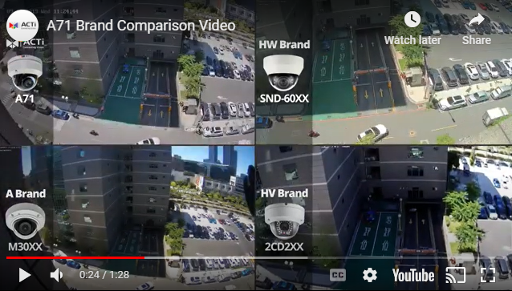
Video Clips & Photos
A811
A416
https://www.acti.com/video/v2220
https://www.acti.com/video/v2206
A71
https://www.acti.com/video/v2188

Slide 8
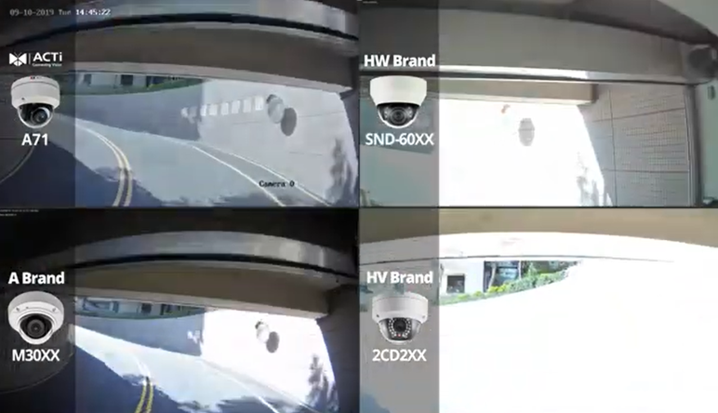
Video Clips & Photos
This is how ACTi’s 150dB WDR compares to the other brands.

Slide 9
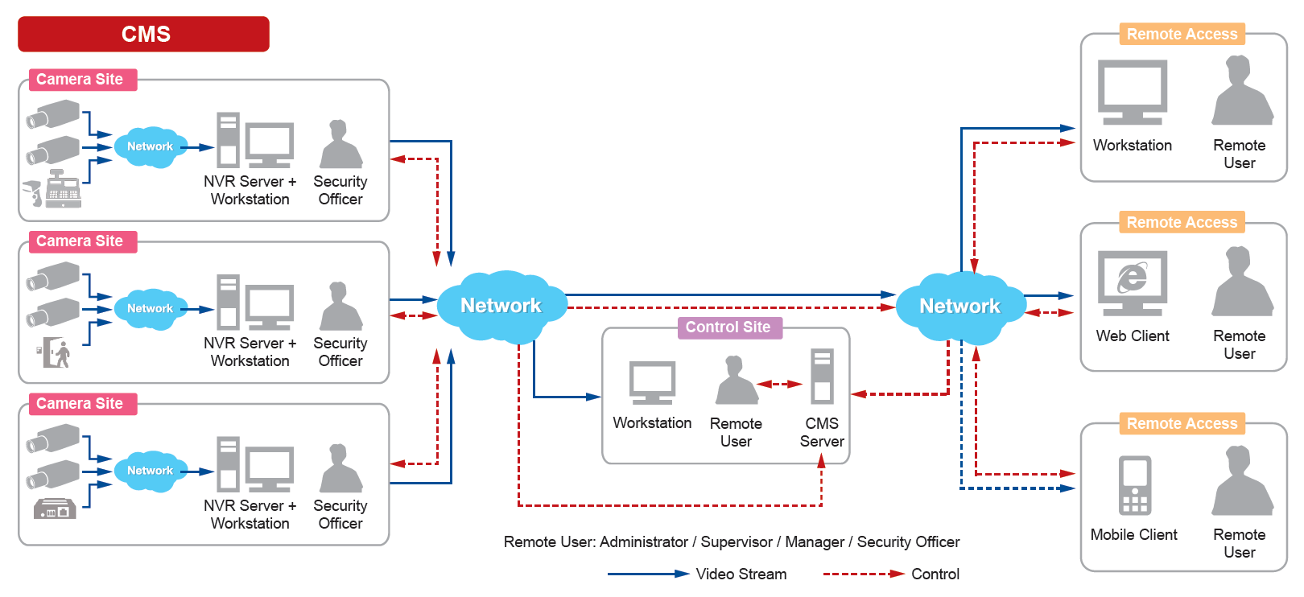
Solutions
ACTi Unified Solution Architecture consists of NVR servers and CMS.
Small Scale projects: NVR only
Large Scale projects: NVR + CMS

Slide 10
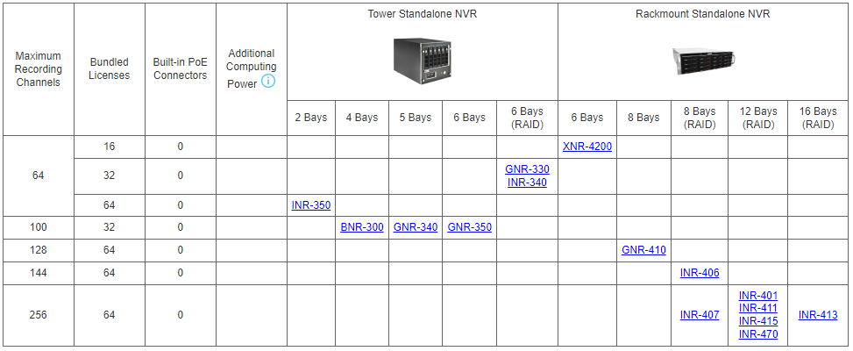
Solutions
Windows-based Standalone NVR options

Slide 11
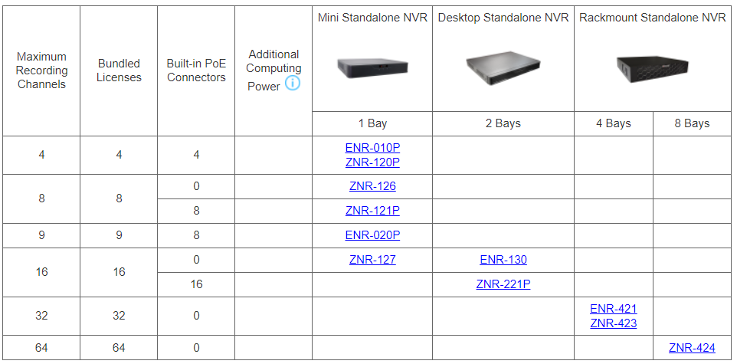
Solutions
SoC-based Standalone NVR options

Slide 12
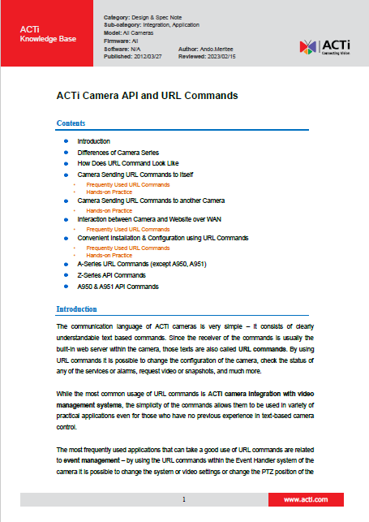
Solutions
Third party Solution Integration
ACTi provides an in-depth integration API/Url Commands document for solution integration purposes.
Download here: https://Download.acti.com?id=528

Slide 13
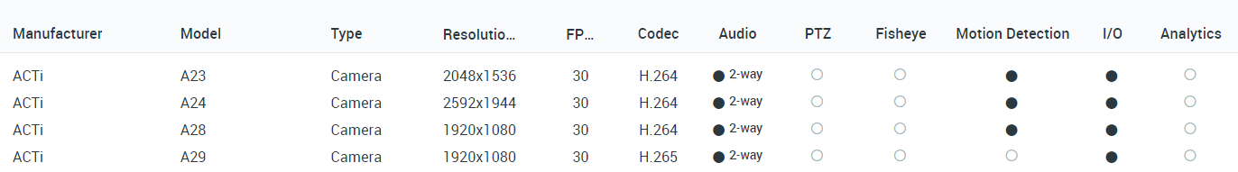
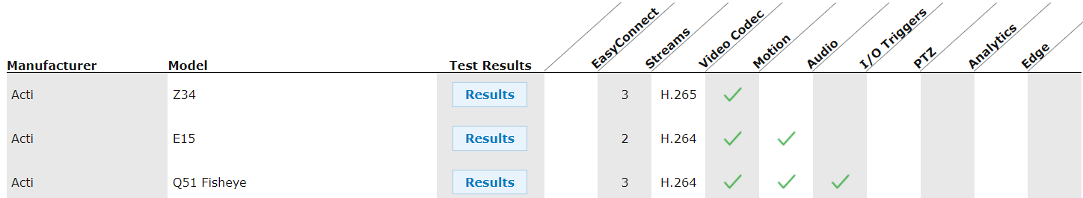
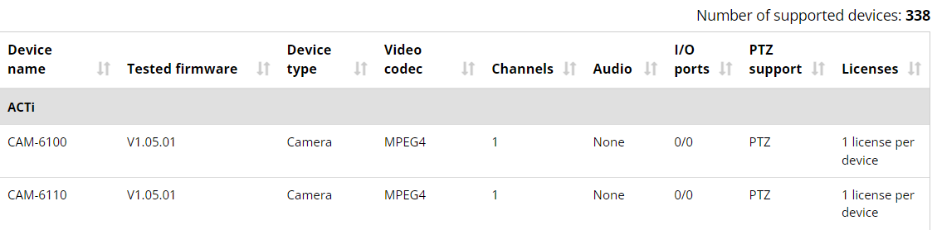
VMS Solution Partners
Network Optix
https://nxvms.com/ipvd?vendors=ACTi
Exacq
https://exacq.com/integration/ipcams/#search=acti~tags=false
Milestone
https://www.milestonesys.com/support/tools-and-references/supported-devices/xprotect-corporate-and-xprotect-expert/?AdvancedSearchDisplayed=true&ManufacturerId=3

Slide 14
Vertical Markets & Applications
Residential
- Vandalism & theft prevention
- Safety of the residents
- Incidents investigation
Healthcare
- Property protection
- Patients monitoring
Education (schools)
- Property protection
- Students protection
- Violence and Bullying prevention
Retail
- Property protection
- Theft prevention
- Business monitoring
Hotel & Casino
- Property protection
- Scam prevention
- Safety of the guests
Parking Lot
- Incident management
- Car theft prevention
- Access control

Slide 15

Where to Buy
Via Authorized Resellers
https://www.acti.com/Corporate/WhereToBuy
From ACTi Corporation Directly
E-Mail: sales@acti.com
Tel (US): +1-866-410-2284 (Toll Free)
Tel (Non-US): +886-2-2656-2588

Slide 16
Support & Services
Technical Support
- Online Customer Helpdesk - https://www.acti.com/chd
- Phone support
US: +1-866-410-2284 (Toll Free)
Other Regions: +886-2-2656-5200
RMA Services
- Warranty
- Repair services
Training
- Self-learning

