Slide 1
ACTi Products
Introduction
ST1-1
The best price to migrate from analog to IP with the fixed lens

Slide 2

Contents
Value Position & Unique Selling Points
Core Features
Product Offering
Video Clips and Photos
Solutions
Vertical Markets & Applications
Where to Buy
Support and Services

Slide 3
Value Position & Unique Selling Points
Core Value:
The best price to migrate from analog to IP with the fixed lens
Unique Selling Points:
Most popular form factors – domes, turrets, bullets
Simple installation – fixed lens, no adjustments needed
Excellent video quality up to 8MP.
Very competitive pricing. The lowest among leading non-China brands.
Great for budget sensitive projects and markets
NDAA Compliant

Slide 4
Core Features
Resolution
2MP, 4MP, 5MP, 8MP
Audio
Most models have built-in microphone
Corridor Mode
The image can be rotated by 90 degrees for corridor applications.
ONVIF
Easy integration with the wide range of VMS brands
NDAA
All the cameras are NDAA compliant

Slide 5
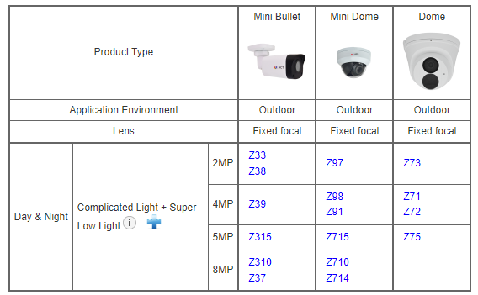
Product Offering
Matrix View

Slide 6
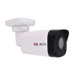
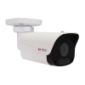
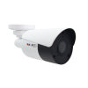
Product Offering
Model | Z33 | Z38 | Z39 | Z315 | Z310 | Z37
Photo
Type | Mini Bullet | Mini Bullet | Mini Bullet | Mini Bullet | Mini Bullet | Mini Bullet
Resolution | 2MP | 2MP | 4MP | 5MP | 8MP | 8MP
fps | 30@2MP | 30@2MP | 25@4MP 30@3MP | 25@5MP 30@3MP | 20@8MP 30@5MP | 20@8MP 30@5MP
HOR | 100.5° | 102.1° | 99° | 112.9° | 99° | 90°
Corridor Mode |  | Yes | Yes | Yes | Yes
Audio |  | Mic | Mic | Mic | Mic
NDAA | Yes | Yes | Yes | Yes | Yes | Yes

Slide 7
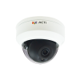
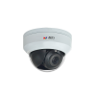
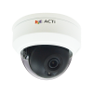
Product Offering
Model | Z97 | Z98 | Z91 | Z715 | Z710 | Z714
Photo
Type | Mini Dome | Mini Dome | Mini Dome | Mini Dome | Mini Dome | Mini Dome
Resolution | 2MP | 4MP | 4MP | 5MP | 8MP | 8MP
fps | 30@2MP | 25@4MP 30@3MP | 20@4MP 30@3MP | 25@5MP 30@3MP | 20@8MP 30@5MP | 20@8MP 30@5MP
HOR | 102.1° | 99° | 101.8° | 112.9° | 90° | 99°
Corridor Mode | Yes | Yes | Yes | Yes |  | Yes
Audio |  |  | Mic | Mic |  | Mic
NDAA | Yes | Yes |  | Yes | Yes | Yes

Slide 8
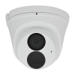
Product Offering
Model | Z73 | Z71 | Z72 | Z75
Photo
Type | Dome (Turret) | Dome (Turret) | Dome (Turret) | Dome (Turret)
Resolution | 2MP | 4MP | 4MP | 5MP
fps | 30@2MP | 30@4MP | 25@4MP 30@3MP | 25@5MP 30@3MP
HOR | 100.5° | 94.7° | 101.1° | 112.9°
Corridor Mode | Yes |  | Yes | Yes
Audio | Mic | Mic | Mic | Mic
NDAA | Yes | Yes | Yes | Yes

Slide 9
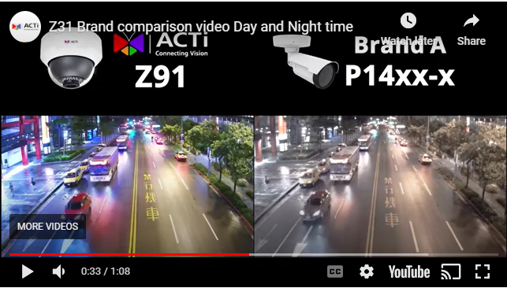
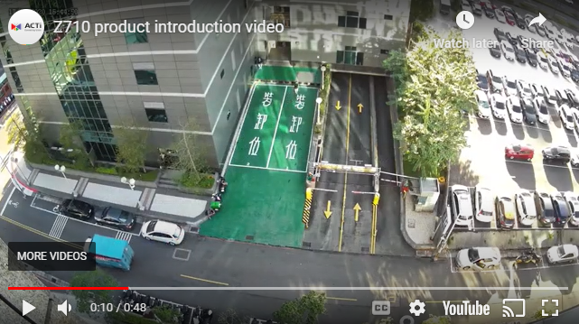
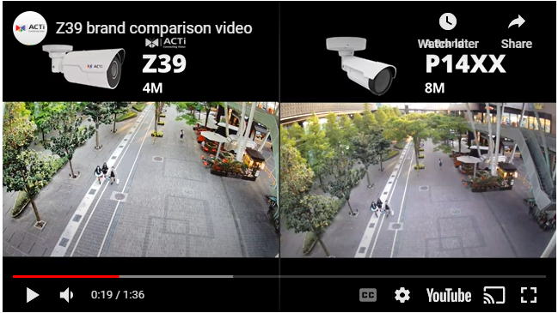
Video Clips & Photos
Z91
Z710
https://www.acti.com/video/v1823
https://www.acti.com/video/v2543
Z39
https://www.acti.com/video/v2732

Slide 10
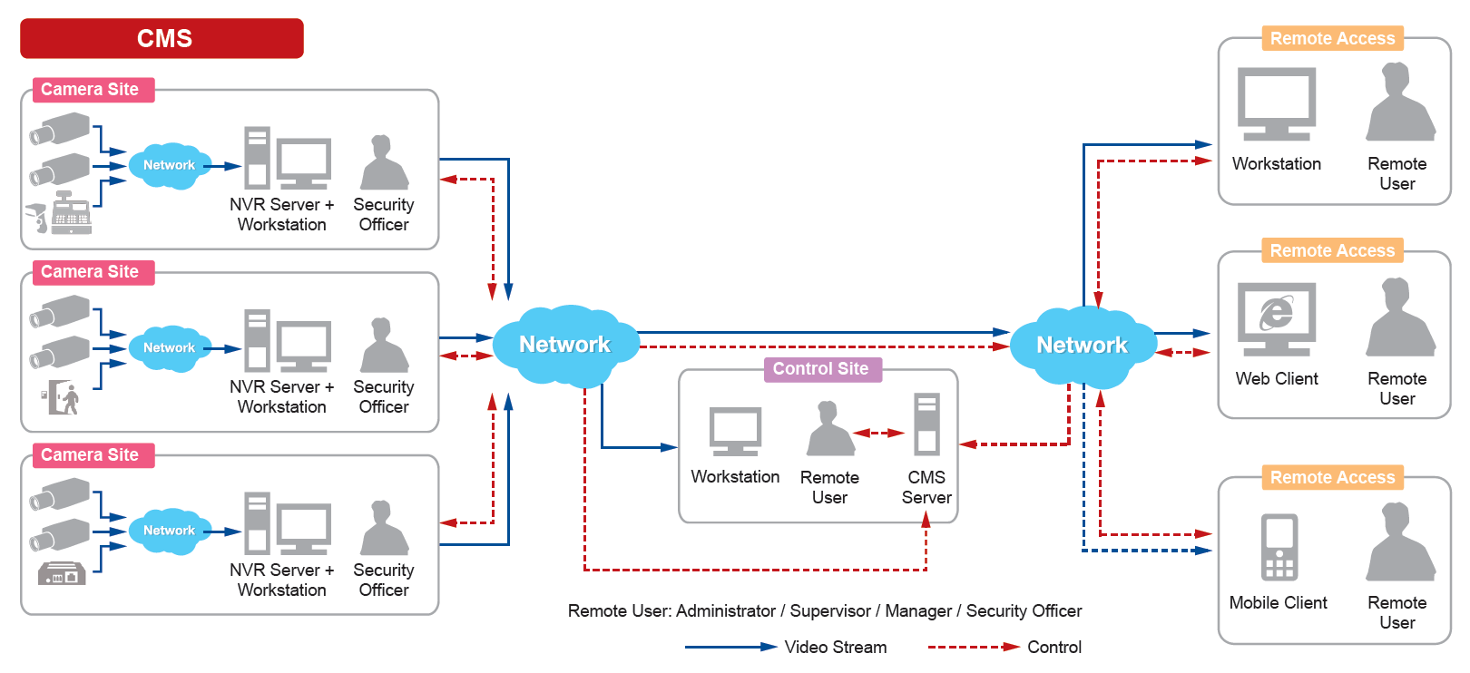
Solutions
ACTi Unified Solution Architecture consists of NVR servers and CMS.
Small Scale projects: NVR only
Large Scale projects: NVR + CMS

Slide 11
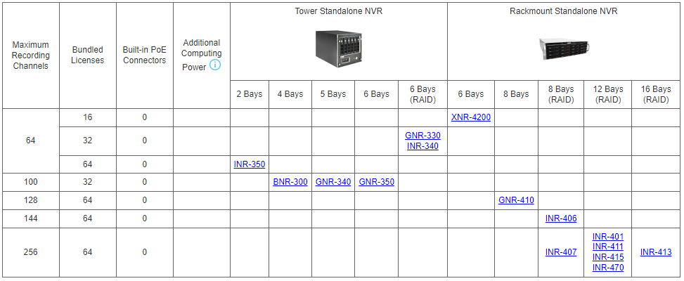
Solutions
Windows-based Standalone NVR options

Slide 12
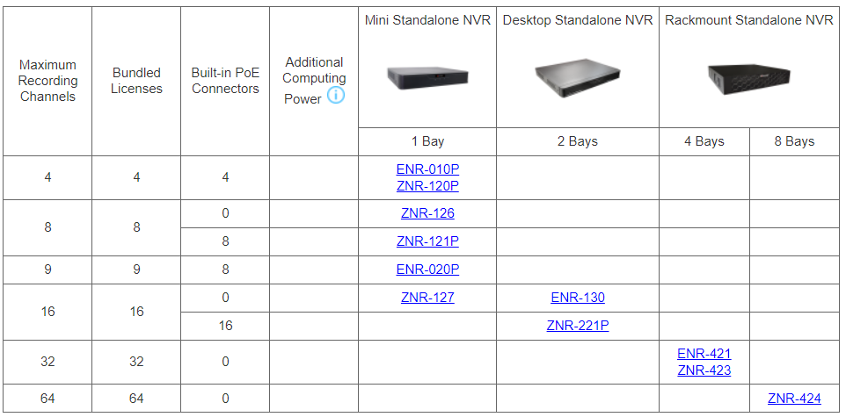
Solutions
SoC-based Standalone NVR options

Slide 13
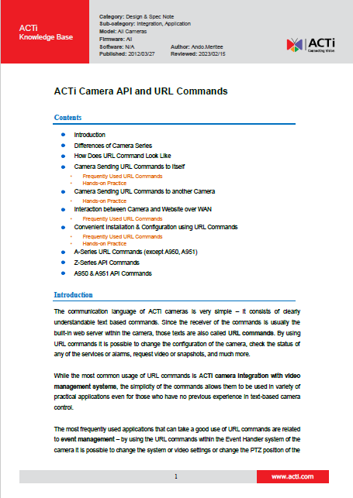
Solutions
Third party Solution Integration
ACTi provides an in-depth integration API/Url Commands document for solution integration purposes.
Download here: https://Download.acti.com?id=528

Slide 14
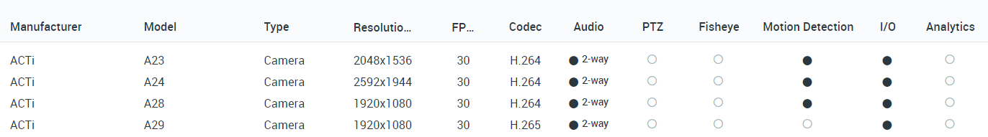
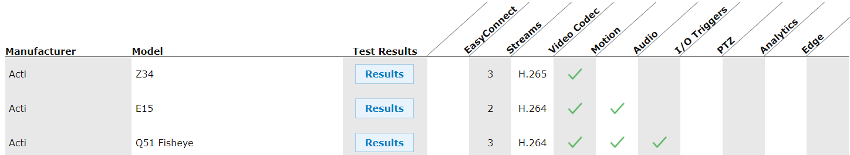
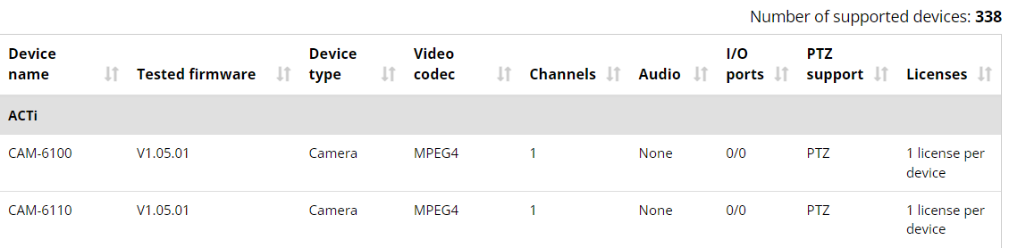
VMS Solution Partners
Network Optix
https://nxvms.com/ipvd?vendors=ACTi
Exacq
https://exacq.com/integration/ipcams/#search=acti~tags=false
Milestone
https://www.milestonesys.com/support/tools-and-references/supported-devices/xprotect-corporate-and-xprotect-expert/?AdvancedSearchDisplayed=true&ManufacturerId=3

Slide 15
Vertical Markets & Applications
Residential
- Vandalism & theft prevention
- Safety of the residents
- Incidents investigation
Healthcare
- Property protection
- Patients monitoring
Education (schools)
- Property protection
- Students protection
- Violence and Bullying prevention
Retail
- Property protection
- Theft prevention
- Business monitoring

Slide 16

Where to Buy
Via Authorized Resellers
https://www.acti.com/Corporate/WhereToBuy
From ACTi Corporation Directly
E-Mail: sales@acti.com
Tel (US): +1-866-410-2284 (Toll Free)
Tel (Non-US): +886-2-2656-2588

Slide 17
Support & Services
Technical Support
- Online Customer Helpdesk - https://www.acti.com/chd
- Phone support
US: +1-866-410-2284 (Toll Free)
Other Regions: +886-2-2656-5200
RMA Services
- Warranty
- Repair services
Training
- Self-learning

