Slide 1
ACTi Products
Introduction
ST0
Analog fixed or vari-focal

Slide 2

Contents
Value Position & Unique Selling Points
Core Features
Product Offering
Solutions
Vertical Markets & Applications
Where to Buy
Support and Services

Slide 3
Value Position & Unique Selling Points
Core Value:
High-definition analog cameras for the price driven applications.
Unique Selling Points:
Most popular form factors – domes, bullets
Simple installation – fixed lens, no adjustments needed
Excellent video quality up to 5MP, with extreme low light and WDR.
The price is low, in most cases lower than any IP cameras
Great for budget sensitive projects and markets
NDAA Compliant
Supports all the popular analog formats in the industry, allowing the widest possible range of DVR options worldwide.

Slide 4
Core Features
Resolution
2MP, 5MP
Low Light
Extreme Low Light Sensitivity and Extreme WDR
NDAA
All the analog cameras are NDAA compliant
Plug & Play
No network related setup required
Wide Integration Support
Supports all the common formats: TVI/AHD/CVI/CVBS

Slide 5
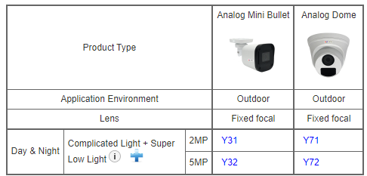
Product Offering
Matrix View

Slide 6
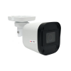
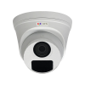
Model | Y31 | Y32 | Y71 | Y72
Photo
Type | Analog Mini Bullet | Analog Mini Bullet | Analog Dome | Analog Dome
Resolution | 2MP | 5MP | 2MP | 5MP
Lens | f2.8mm | f2.8mm | f2.8mm | f2.8mm
Hor Viewing Angle | 90.5° | 102.2° | 90.5° | 102.2°
Analog Video Output | 1 x BNC connector, supports TVI/AHD/CVI/CVBS | 1 x BNC connector, supports TVI/AHD/CVI/CVBS | 1 x BNC connector, supports TVI/AHD/CVI/CVBS | 1 x BNC connector, supports TVI/AHD/CVI/CVBS
Maximum fps vs Resolution | (TVI/AHD/CVI) 30 fps at 1920 x 1080 (CVBS) NTSC, PAL | (TVI/AHD) 20 fps at 2592 x 1944 (CVI) 25 fps at 2880 x 1620 (CVBS) NTSC, PAL | (TVI/AHD/CVI) 30 fps at 1920 x 1080 (CVBS) NTSC, PAL | (TVI/AHD) 20 fps at 2592 x 1944 (CVI) 25 fps at 2880 x 1620 (CVBS) NTSC, PAL
Weatherproof | IP67 | IP67 | IP67 | IP67
NDAA | Yes | Yes | Yes | Yes
Availability | 2023/10 | 2023/10 | 2023/10 | 2023/10

Slide 7
Analog streaming formats overview
In the analog CCTV world, there are 4 popular formats being used. In order to work seamlessly, both the camera and the DVR must use the same format.
Hardware Brand | Product Branding/ Series Name | Supported Protocols/Formats
 |  | TVI | CVI | AHD | CVBS (old, D1)
 |  | Digital, up to 4K, but also backward compatible with analog, via BNC, 1080p to 300 meters | Digital, up to 4K, 720p to 500 meters, 1080p to 300 meters | Analog, Up to 5MP over coax | D1 equivalent resolution, 480~700 TVL, fully analog
 |  | Techpoint (& Hikvision) | Dahua | NextChip (Korea) | (global standard) | Inventor of the format
Hanwha | Analog HD+ |  |  | Y
Hikvision | HDTVI | Y
Dahua | HDCVI |  | Y
Geovision | Analog HD | Y | - | Y
Bosch | Analog |  |  |  | Y
ACTi | Analog | Y | Y | Y | Y
HDTVI = High Definition Transport Video Interface
HDCVI = High Definition Composite Video Interface
AHD = Analog High Definition
CVBS = Composite Video Broadcast Signal

Slide 8
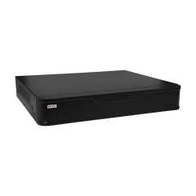
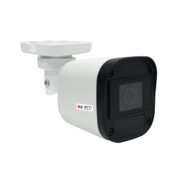
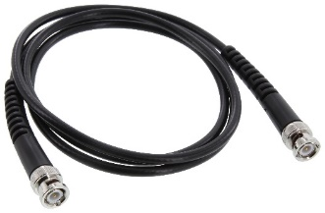
Solutions
ACTi also provides the Hybrid DVR (YVR-xxx) series which can be used together with the Analog camera series (Yxx). Although these hybrid DVRs also support ONVIF IP cameras, our focused solution strategy is to sell them together with the analog cameras.
Yxx Series
Analog cameras
Coaxial Cable
YVR-series
Hybrid DVR

Slide 9
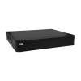
Solutions
Hybrid DVR options:
Models | Images | Storage Bays | Maximum Recording Channels | Bundled Licenses |  | Built-in PoE Connectors
 |  |  |  | IP Devices | Analog Devices
YVR-120 |  | 1 | 6 | 2 | 4 | 0
YVR-121 |  | 1 | 12 | 4 | 8 | 0
YVR-122 |  | 1 | 24 | 8 | 16 | 0

Slide 10
Vertical Markets & Applications
Residential
- Vandalism & theft prevention
- Safety of the residents
- Incidents investigation
Healthcare
- Property protection
- Patients monitoring
Education (schools)
- Property protection
- Students protection
- Violence and Bullying prevention
Retail
- Property protection
- Theft prevention
- Business monitoring

Slide 11

Where to Buy
Via Authorized Resellers
https://www.acti.com/Corporate/WhereToBuy
From ACTi Corporation Directly
E-Mail: sales@acti.com
Tel (US): +1-866-410-2284 (Toll Free)
Tel (Non-US): +886-2-2656-2588

Slide 12
Support & Services
Technical Support
- Online Customer Helpdesk - https://www.acti.com/chd
- Phone support
US: +1-866-410-2284 (Toll Free)
Other Regions: +886-2-2656-5200
RMA Services
- Warranty
- Repair services
Training
- Self-learning

