Slide 1

NVR 3 Corporate v3.0.16 Introduction

Slide 2
Overview
NVR 3 Corporate is the most advanced Windows-based network video recorder software that is distributed as downloadable software as well as in the form of Standalone NVR servers, and which has been continuously developed and enhanced by ACTi throughout the past 10 years.
Key Features
Maximum Number of Video Devices: 200 (software), 256 (standalone NVR)
Free License: 1 (1 channels for ACTi and 1 channel for third-party video device)
Event trigger, response and notification
Client options: Workstation, Web Client, Mobile Client
Video export formats: RAW, AVI, EXE
Location-based management with e-Map & Google Map
Non-ACTi camera support via licensed Camera Device Pack

Slide 3
Introduction NVR 3 Corporate v3.0.16
NVR 3 Corporate v 3.0.16 (release: 2022/06/10) is one of the most significant enhancements of all times. It contains so many great enhancements and useful features to the customers.
Selected Highlights of v3.0.16
Multi-Browser Support
Lite Web Client
RTSP Streaming
HTTPs (Server-Server, Server-Camera, Server-Client)
Live View Layout up to 144 Channels
Playback Speed up to 256x
System Monitoring and Notifications
GPU Accelerated Video Export

Slide 4
New Features of v3.0.16
Category | Feature | Description
Client | Lite Web Client | The newly created web client version with simpler interface (more information on the separate slides)
 | Multi-Browser Support | Several brands of browsers can be used to access the NVR, including Microsoft Edge (full or lite web client), Chrome, Firefox, Safari (lite web client)
 | Supported Browser Versions | Edge: 80.0.361.66 (Chromium-based) or later Chrome: 71.0.3578 or later Firefox: 64.0.2 or later Safari: 12.0.2 or later
 | GPU Accelerated Video Export | Hardware accelerated fast video export under Nvidia and Intel platforms.
 | Re-Focus | Trigger the re-focusing of the auto-focus cameras via NVR
 | Live View Layouts | Added layouts: 9x9, 10x10 and 12x12
 | High Speed Playback | Playback speed up to 256x

Slide 5
Category | Feature | Description
Security | HTTPs | Client-to-Server via HTTPs Server-to-Server via HTTPs Server-to-Camera via HTTPs
 | Password Expiration Notification | If the password with the expiry date has been set for the user, then the user will get the warning message of the expiry when the due date is getting closer, via Workstation application.
 | Whitelist of Client IP Addresses | The administrator of the NVR can define the list of permitted IP addresses which can be used to access the NVR.
System Monitor (additional features) | GPU | GPU loading detection (Workstation only)
 | Memory | Memory limit exceeded (Server PC, media server, schedule service)
 | Network | Network interface usage (in/out rate) (Server PC)
 | Disk | Camera; Server: S.M.A.R.T failure, S.M.A.R.T. normal
 | CPU | CPU limit exceeded (Media server, schedule service)

Slide 6
Category | Feature | Description
Streaming | RTSP Streaming | RTSP/TCP Streaming Output
User Management | Active Directory Filtering | The large Active Directory databases may contain thousands of names. To quickly find the needed name from the list in order to add it as the NVR user, the convenient keyword-based filters have been added.
Device Management | Devices Grouping | The devices can be pre-grouped for efficient permission and view management.
Integration | Snapshots to Line Messenger | The NVR server’s event hander can be configured to send messages with the snapshots to the Line Messenger using Line Notify API.
 | Access Control Integration with Open Options | Receive event messages (via NVR plug-in), open and close door (via NVR plug-in)

Slide 7
Category | Feature | Description
ONVIF-related enhancements | Edge Storage Retrieval | The NVR retrieves the video recordings from the camera’s on-board storage (MicroSD) upon the recovery of the network connection, via ONVIF.
 | OSD Settings Removal | The OSD setting scan be removed via ONVIF protocol.
 | Remote Focus via NVR Client | Focusing near or far, via ONVIF.
 | Copy Settings | Copy function for camera settings, including Media and Motion Detection settings via ONVIF.
 | Motion Setup | Cell motion detection setup via ONVIF.

Slide 8
Lite Web Client Introduction
In addition to already supporting Workstation client, Mobile client and Full-featured Web client, the NVR version v3.0.16 also introduces Lite Web Client option.
Lite Web Client is the simplified edition of the browser-based client application. It has less features enabled and simpler appearance, making it very user-friendly for the types of users who are not very technical and do not require full set of features.
While the Full-featured web client is available for Microsoft Edge browser (compatibility mode), the Lite web client can be used with various browsers:
Chrome
Firefox
Safari
Edge

Slide 9
Primary Users of the Lite Web Client
ACTi Web Client Value Position
Role | Client PC | Workstation app | Full Web Client | Lite Web Client
IT Admin (setup) | Dedicated | Y | Y
Security Officer | Dedicated | Y | Y
Supervisor/ Manager | May change anytime |  |  | Y
Owner | May change anytime |  |  | Y

Slide 10
Full Client vs Lite Client Comparison
NVR 3 Corporate v3.0.16 (2022/06/10) | Workstation Application | Web Browser
 |  | Full Client |  | Lite Client
 |  | Edge in IE Mode (Windows 10 or later) | Chrome, Firefox, Safari, Edge (normal mode) | Chrome, Firefox, Safari, Edge (normal mode)
Live View Layouts | Up to 144 channels | Up to 144 channels | - | Up to 16 channels
Playback | Yes | Yes | - | Embedded Playback (see the next slide)
Events | Yes | Yes | - | -
PTZ control | Mouse, Joystick | Mouse, Joystick | - | Mouse only
Codec | H.265, H.264, MJPEG | H.265, H.264, MJPEG | - | H.264, MJPEG
Audio | 2-way | 2-way | - | Audio-in
Stream Switcher | Yes | Yes | - | Default Stream
Setup and Playback tab | Yes | Yes | - | -
Export | Yes | Yes | - | -

Slide 11
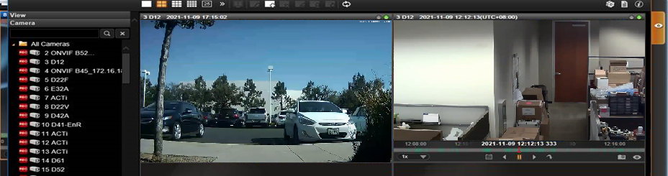
Instant Playback vs Embedded Playback
While the Workstation app and the Full web client can do multi-channel playback under Playback tab, or playback pop-up on the top of the Live View layout, the Lite Web Client uses Embedded Playback – the playback can be used inside the Live View channel.
Embedded Playback:

Slide 12
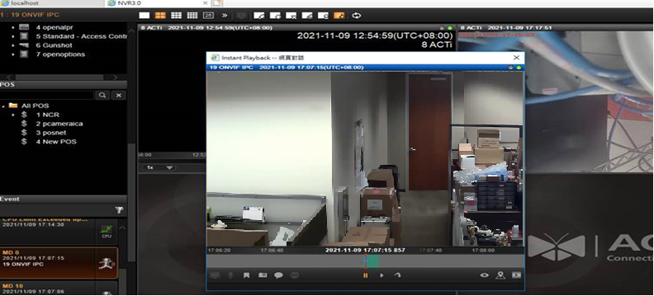
In comparison, the full-featured web client and the Workstation application are using what we call “Instant Playback” – it is the pop-up of the playback window on the top of the live view.
Instant Playback:

Slide 13
Considerations about Lite Web Client vs Browser
How did ACTi decide about which browsers would support Full web client and which ones would support Lite web client?
Lite web client is using very limited PC resources compared to the full client due to its simpler design and the smaller range of available features. Therefore it can be used under various browser platforms without needing to put much consideration about the browser’s technology, usage of memory and CPU, etc.
Since most of the browsers are using auto-updates, any next version of the browser may unexpectedly have a different behavior regarding the computer resource consumption. For any VMS manufacturer it would be impossible to predict those changes. While our duty is to always provide the most reliable client interface to our customer, therefore we have enabled the Full web client only for Microsoft Edge users, and the wider range of the browsers (Chrome, Firefox, Safari, Edge) can be used for the Lite web client.
Whenever the full-featured client is needed, there is a Workstation application as well as Microsoft Edge based full web client available.

