Slide 1
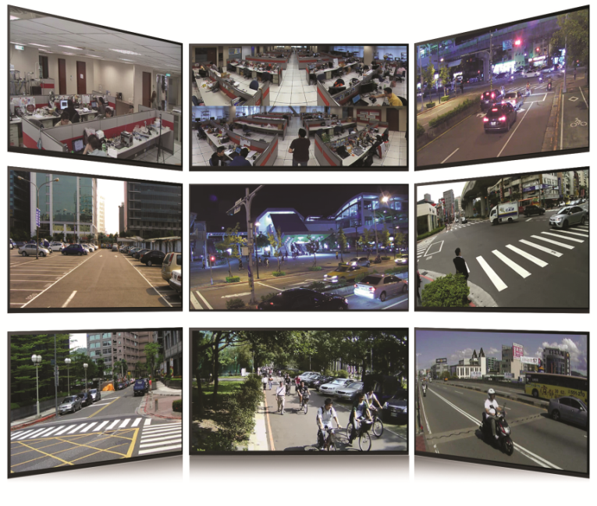
ACTi Media Display Systems
Surveillance Video & Digital Signage Displays

Slide 2
Media Display Systems Overview
ACTi provides the wide range of display solutions for the small and large scale projects.
Media Display Applications | Application Scenario | Number of Video Channels | Solution |  |  |  |  |  |  |  |  |  | Learn more
 |  |  | Video Display (Decoder) |  |  |  |  |  |  | Video Source
 |  |  | ECD-1000 | ECD-200 | ZNR-127 | MDS-100 | TV Wall Server | NVR Client | CMS Client | NVR Server | CMS Server | Cameras
Security Guarding | Monitoring the NVR/CMS | Medium | Y | Y | Y | - | - | Y | Y | Y | Y | Y | Learn More
Critical Security Management | Collaborating in front of the TV Wall | Large | Y | Y | - | - | Y | - | Y | Y | Y | Y | Learn More
Operations Monitoring | Observing the tasks | Small | Y | Y | Y | - | - | Y | - | Y | - | Y | Learn More
Digital Signage for the Employees | Internal communication | Small | Y | - | - | Y | - | - | - | option | - | option | Learn More
Digital Signage for the Customers | Videos for the customers | Small | Y | - | - | Y | - | - | - | option | - | option | Learn More
Special Highlights |  | Networking Type | local | local | local | cloud | local | local | local | local/ cloud | local/ cloud | local
 |  | Display Capability | 1080p | 4K | 1080p | 1080p | 4K | 4K | 4K | - | - | -
 |  | NDAA Compliance | Y | - | Y | Y | Y | Y | Y | Y | Y | Y
 |  | TAA Compliance | Y | Y | Y | Y | Y | Y | Y | Y | Y | Y
 |  | Made in Taiwan | Y | Y | Y | Y | Y | Y | Y | Y | Y | Y

Slide 3
Security Guarding
Monitoring the NVR/CMS

Slide 4
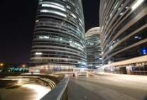
Applications
Security guarding applications in generally consist of one or multiple screens, monitored by the security officer.
COMMERCIAL BUILDING
Security Desk Monitor
The monitoring officer’s duty is to ensure the safety of the people and the property with the help of the desk monitors of the video surveillance system.
Additionally, the security officer can use the on-the-go solution during the patrols using ACTi Mobile Client app.

Slide 5
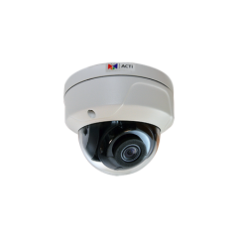
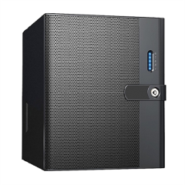
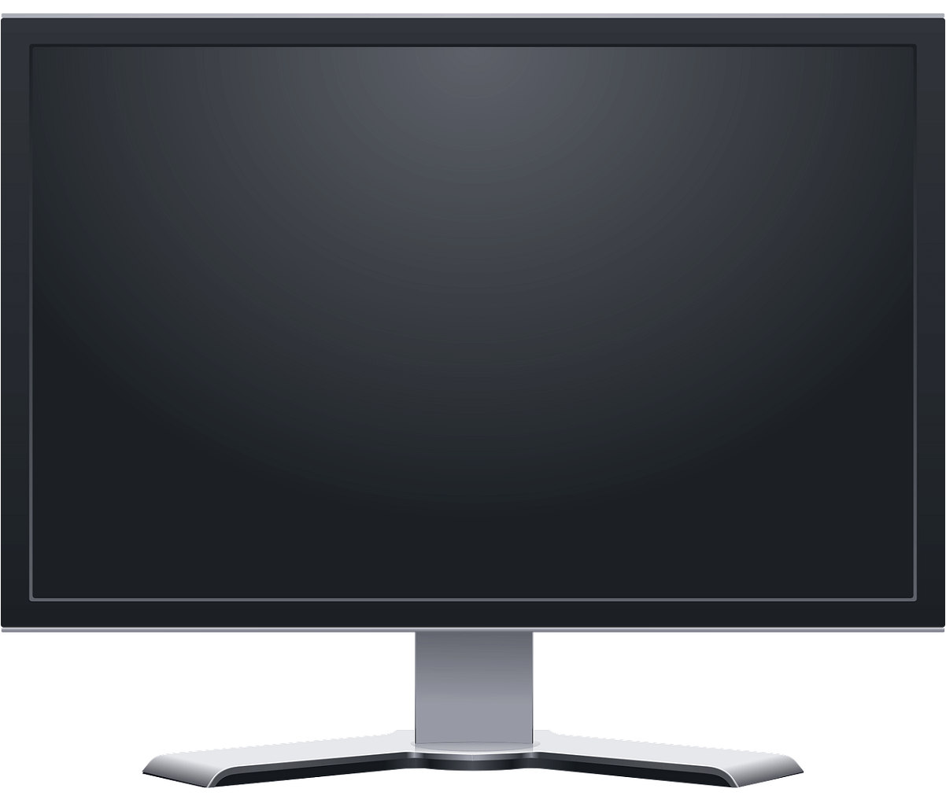
Solution Architecture
Solution info on acti.com: https://www.acti.com/solutions/small-scale-video-surveillance-solution?sid=S801
SMALL SCALE
When there are less than 16 channels to monitor, usually the NVR server itself provides the video feed for the display monitor.
ACTi has a wide range of NVR servers to choose from. The recommended NVR for this scale are either ENR or ZNR series.
Ethernet
HDMI cable
NVR Server
Monitor
IP Cameras

Slide 6
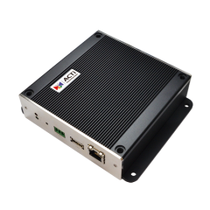
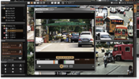
Solution Architecture
Solution info on acti.com: https://www.acti.com/solutions/small-scale-video-surveillance-solution?sid=S803
MEDIUM SCALE
When multiple screens are needed for the best possible overview, most of them can be the passive screens with the live view only, without keyboard and mouse controls. For those screens the ECD-1000 or ECD-200 decoders can be used. When incidents happen, those can be investigated using the NVR client display instead.
NVR Display
Ethernet
Ethernet
HDMI
cable
NVR Server
ECD-1000/ECD-200
(decoder)
Monitor
IP Cameras

Slide 7
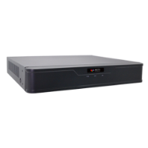
Solution Architecture
Solution info on acti.com: https://www.acti.com/solutions/small-scale-video-surveillance-solution?sid=S803
MEDIUM SCALE
Compared to the previous slide, one of the ECD-series decoders has been replaced with ZNR-127. Although ZNR-127 has the recording capabilities of its own, in this architecture it only serves the decoder’s role. It is a good choice when both H.265 compression and NDAA are required.
NVR Display
ECD-1000/ECD-200
(decoder)
NVR Server
Ethernet
HDMI
cable
ZNR-126/127
(decoder)
Monitor
IP Cameras

Slide 8
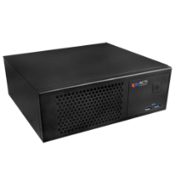


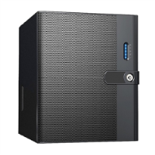
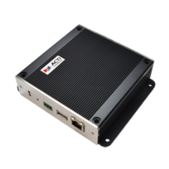
Solution Architecture
Solution info on acti.com: https://www.acti.com/solutions/large-scale-video-surveillance-solution?sid=S844
LARGE SCALE
When there are more channels than one NVR server can manage, then multiple NVR servers will be used together with CMS which connects all the sources together. For the passive screens that do not require controls, the decoders can be used.
CMS
Server & Display
Ethernet
HDMI cable
IP Cameras
NVR Servers and their displays
ECD-1000/ECD-200
(decoder)
Monitor

Slide 9
Comparison of Decoders
 | ECD-1000 | ECD-200 | ZNR-127
Display Channels | 16 | 16 | 16
Display Resolution | 1080p | 4K | 1080p
Compression | H.264 | H.264, H265 | H.264, H265
Video Source | Camera or NVR | Camera or NVR | Camera
Manageability | Over the IP network | Over the IP network | Over the IP network
Installation | Desk, wall, VESA, pole, hidden | Desk, wall, VESA, pole, hidden | Desk, hidden
Digital Signage Mode | Yes | No | No
NDAA Compliant | Yes | No | Yes
TAA, Made in Taiwan | Yes | Yes | Yes

Slide 10
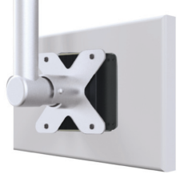
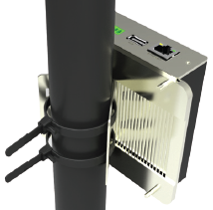
Installation based on the example of ECD-1000
Installation Method | Description | Additional Info
VESA Mount | Placed between the VESA 10x10 mount and the TV panel. The special bolts included in the package. Very durable metal chassis.
Pole Mount | For TV panels larger than 10x10 VESA, the pole mount can be used which is included in the package.
Surface Mount | There are additional screw holes for surface mounting.
Hide | Place it above the drop ceiling (for wall TV panel) or under the desk (desktop TV panel).

Slide 11
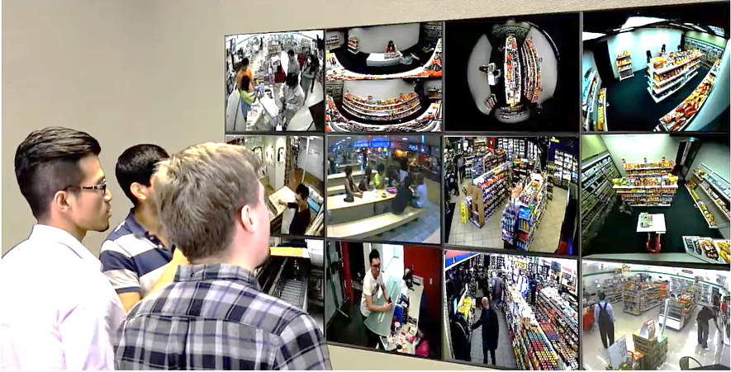
Critical Security Management
Collaborating in front of the TV Wall

Slide 12
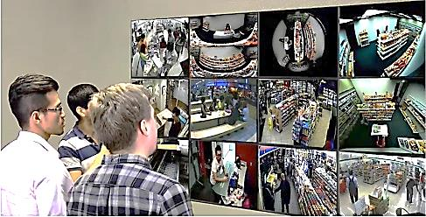
Applications
There are locations that require very intensive live monitoring by the multiple people in order to ensure the safety or prevent losses. Those locations have a high number of cameras and require TV Walls for joint collaboration.
CASINO, AIRPORT or HIGH SECURITY BUILDING
TV Wall Collaboration
The team of video analyzers is looking at the matrix of the screens to ensure the safety or prevent losses. The large TV Wall allows multiple people stand together and collaborate.
The content of the TV Wall can easily be altered by either CMS Client or even with the help of ACTi Mobile Client app.
The TV Walls are very common in high security buildings, airports and casinos.

Slide 13

Solution Architecture
Solution info on acti.com: https://www.acti.com/solutions/tv-wall-solution?sid=S881
LARGE SCALE
The channels that need to remain interactive, can be managed by TV Wall Servers. The passive channels can be displayed by the help of the decoders.
CMS
Server & Display
Ethernet
TV Wall Servers & Displays
HDMI cable
IP Cameras
NVR Servers and their displays
ECD-1000/ECD-200
(decoder)
Monitor

Slide 14
Comparison of Decoders
 | ECD-1000 | ECD-200 | ZNR-127
Display Channels | 16 | 16 | 16
Display Resolution | 1080p | 4K | 1080p
Compression | H.264 | H.264, H265 | H.264, H265
Video Source | Camera or NVR | Camera or NVR | Camera
Manageability | Over the IP network | Over the IP network | Over the IP network
Installation | Desk, wall, VESA, pole, hidden | Desk, wall, VESA, pole, hidden | Desk, hidden
Digital Signage Mode | Yes | No | No
NDAA Compliant | Yes | No | Yes
TAA, Made in Taiwan | Yes | Yes | Yes

Slide 15
Installation based on the example of ECD-1000
Installation Method | Description | Additional Info
VESA Mount | Placed between the VESA 10x10 mount and the TV panel. The special bolts included in the package. Very durable metal chassis.
Pole Mount | For TV panels larger than 10x10 VESA, the pole mount can be used which is included in the package.
Surface Mount | There are additional screw holes for surface mounting.
Hide | Place it above the drop ceiling (for wall TV panel) or under the desk (desktop TV panel).

Slide 16
Operations Monitoring
Observing the tasks

Slide 17

Applications
The following examples contain the applications where the main objective is not the security of the premises or loss prevention, but rather the inspection of some processes.
FACTORY
Supervising Monitor
The supervisors can have the monitors with the video streams from all the critical locations right in front of them.
That way they do not have to constantly run between various locations of the production area.

Slide 18

Applications
GOVERNMENT
Interview Monitor
The police department or the other government organizations that conduct interviews with the people must have the constant monitoring capabilities for the safety reasons. The monitors connected via ECD-1000 serve this purpose perfectly.

Slide 19

Applications
AIRPORT
Security Inspection Monitor
The security inspection area requires such video monitors so that the officers have better overview of all the activities around that area, including the inspection zone and the queue area before that.
While being busy with the inspections, the monitor gives them the additional capabilities to have a hands-free overview of the situation.
The public display monitors can also be used in the areas where the travel luggage is processed to make sure there are no incidents there.

Slide 20

Applications
HOSPITAL
Service Desk Monitor
The nurses and the receptionists can easily monitor the activities in the lobby, corridors and wards by looking at the screen on the wall with the live video footage from the critical locations.

Slide 21

Applications
RETAIL
Public Display Monitor
ECD-1000 together with the TV panel is installed in the shopping area with two purposes. It allows the employees to easily monitor the situation between the aisles without leaving the checkout area.
At the same time, the potential thieves or robbers will be intimidated by the presence of such public display monitors and they will most likely avoid any illegal activities in the premises.
Part of the screen can be used as the digital signage content at the same time.

Slide 22
Solution Architecture
Solution info on acti.com: https://www.acti.com/solutions/small-scale-video-surveillance-solution?sid=S801
SMALL SCALE
When there are less than 16 channels to monitor, usually the NVR server itself provides the video feed for the display monitor.
ACTi has a wide range of NVR servers to choose from. The recommended NVR for this scale are either ENR or ZNR series.
Ethernet
HDMI cable
NVR Server
Monitor
IP Cameras

Slide 23
Solution Architecture
Solution info on acti.com: https://www.acti.com/solutions/small-scale-video-surveillance-solution?sid=S807
SMALL SCALE
The decoder ECD-1000 or ECD-200 or ZNR-127 can be used together with just a few IP cameras. Even the recorder is not needed in some cases. Those are the temporary locations mostly, such as the passenger traffic screening for possible fever using the thermal IP cameras. Each decoder supports up to 16 channels.
Ethernet
HDMI cable
ECD-1000/ECD-200/ZNR-127
(decoder)
Monitor
IP Cameras

Slide 24
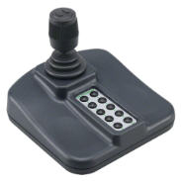
Solution Architecture
Solution info on acti.com: https://www.acti.com/solutions/small-scale-video-surveillance-solution?sid=S806
SMALL SCALE
Another possibility is to use the decoder for the solution that also includes the joystick for the PTZ control.
PTZ Controller
USB
Ethernet
HDMI cable
ECD-1000/ECD-200
(decoder)
Monitor
IP Cameras

Slide 25
Solution Architecture
Solution info on acti.com: https://www.acti.com/solutions/small-scale-video-surveillance-solution?sid=S803
MEDIUM SCALE
When multiple screens are needed for the best possible overview, most of them can be the passive screens with the live view only, without keyboard and mouse controls. For those screens the ECD-1000 or ECD-200 decoders can be used. When incidents happen, those can be investigated using the NVR client display instead.
NVR Display
Ethernet
Ethernet
HDMI
cable
NVR Server
ECD-1000/ECD-200
(decoder)
Monitor
IP Cameras

Slide 26
Solution Architecture
Solution info on acti.com: https://www.acti.com/solutions/small-scale-video-surveillance-solution?sid=S803
MEDIUM SCALE
Compared to the previous slide, one of the ECD-series decoders has been replaced with ZNR-127. Although ZNR-127 has the recording capabilities of its own, in this architecture it only serves the decoder’s role. It is a good choice when both H.265 compression and NDAA are required.
NVR Display
ECD-1000/ECD-200
(decoder)
NVR Server
Ethernet
HDMI
cable
ZNR-126/127
(decoder)
Monitor
IP Cameras

Slide 27
Comparison of Decoders
 | ECD-1000 | ECD-200 | ZNR-127
Display Channels | 16 | 16 | 16
Display Resolution | 1080p | 4K | 1080p
Compression | H.264 | H.264, H265 | H.264, H265
Video Source | Camera or NVR | Camera or NVR | Camera
Manageability | Over the IP network | Over the IP network | Over the IP network
Installation | Desk, wall, VESA, pole, hidden | Desk, wall, VESA, pole, hidden | Desk, hidden
Digital Signage Mode | Yes | No | No
NDAA Compliant | Yes | No | Yes
TAA, Made in Taiwan | Yes | Yes | Yes

Slide 28
Installation based on the example of ECD-1000
Installation Method | Description | Additional Info
VESA Mount | Placed between the VESA 10x10 mount and the TV panel. The special bolts included in the package. Very durable metal chassis.
Pole Mount | For TV panels larger than 10x10 VESA, the pole mount can be used which is included in the package.
Surface Mount | There are additional screw holes for surface mounting.
Hide | Place it above the drop ceiling (for wall TV panel) or under the desk (desktop TV panel).

Slide 29
Digital Signage for the Employees
Internal communication
https://www.acti.com/applications/digital-signage

Slide 30
Applications
Digital Signage is a convenient method of visual communication within the company. Various types of information can be delivered to the employees, including the work related information, emergency evacuation information, etc.
FACTORY
Internal Communication
The factory’s production related reminders, SOP, work schedule, emergency warnings – all these can be delivered using the TV panels nearby the staff. Those TV panels are managed by the digital signage system.
The digital signage content can be combined with the video footage from the premises.

Slide 31
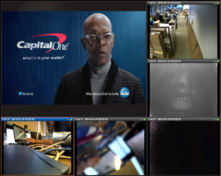
Locally Managed Digital Signage
Solution info on acti.com: https://www.acti.com/solutions/media-management-solution?sid=S185
ECD-1000 is not only a surveillance video decoder. It also has the digital signage capability. The preloaded video clips or images can be shown instead of surveillance videos, in the user defined layout.
HDMI
cable
ECD-1000
(digital signage)

Slide 32

Locally Managed Digital Signage
Various display layout options available:
The signage video clips can be stored on a USB thumb drive, which can be attached to the ECD-1000.
It is possible to configure each ECD-1000 station separately, or use a special management utility, called Digital Signage Station 1, to do 1-to-many content management. This software requires license.

Slide 33
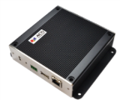


Locally Managed Digital Signage
The example of 1-to-many management:
Device A
Content A, Schedule A
Group B
Content B, Schedule B
Digital Signage
Station
Content C, Schedule C
Group C

Slide 34
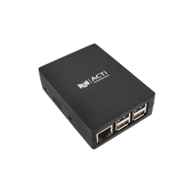

Cloud-Manageable Digital Signage
Solution info on acti.com: https://www.acti.com/solutions/media-management-solution?sid=S181
In order to conveniently manage contents of each screen over the Internet from anywhere, the cloud-manageable digital signage solution can be used instead. No management server hardware needed. Monthly plans for the cloud access.
Cloud Media Management Service
Internet
HDMI
cable
MDS-100

Slide 35
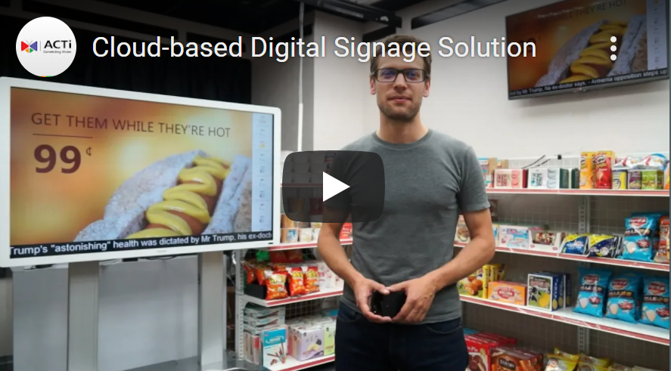
Cloud-Manageable Digital Signage
Video introduction of the Cloud-based digital signage solution: https://www.acti.com/video/v1940

Slide 36
Cloud-Manageable Digital Signage
Advantages of the cloud
The cloud-based solution lets you manage all your screens from any device with a web browser - your laptop, tablet or smartphone.
The architecture is extremely flexible and always grows with your needs, whether you have one screen or one thousand! With our pay-as-you-go pricing, you only pay for what you really use.

Slide 37
Cloud-Manageable Digital Signage
Flexible content
The MDS-100 can display a variety of file types:
Video files
Videos from YouTube
Video streams (e.g. from security cameras)
Images (JPEG, PNG and GIF - including transparency and animation)
PowerPoint slideshows (PPT, PPTX)
PDF files
Word documents (DOC, DOCX)
Excel spreadsheets (XLS, XLSX)
Web pages
Widgets (weather, preconfigured text, real-time news via RSS, and more)

Slide 38
Cloud-Manageable Digital Signage
Easy installation
Simply connect the MDS-100 to the screen and the Internet, link it to your account in the management portal, and the device is ready to immediately commence playback.
All of the content is stored locally on each unit's memory card (16 GB, card included). During regular playback, there is only little bandwidth used. However, the device requires Internet connectivity to let you remotely manage its settings and content. The connection is possible via an Ethernet cable or a Wi-Fi network.
The MDS-100 connects to your account in a smart and secure way that typically doesn't require any configuration of your firewall. But, if needed, it offers a detailed configuration of static IP address, proxy server, and other network settings.

Slide 39
Cloud-Manageable Digital Signage
Efficient operation
The MDS-100 has been designed to handle failures of power or Internet connection without you ever having to manually intervene.
In case of a power loss, the unit automatically starts and resumes its scheduled playback immediately after the power has been restored.
The Internet failure is also no issue as the MDS-100 can work normally for up to 30 days completely offline. Please note that when offline, the device cannot be reconfigured, the content cannot be changed, and the schedule cannot be updated.
In case of any issue, a warning will be displayed instantly on the management portal along with details of the issue and the device's location on an interactive map. You will also receive an email notification.
The MDS-100 can even automatically turn on and off the TV panel. You can schedule the screen to be switched to a standby mode at night and save your electricity bill.

Slide 40
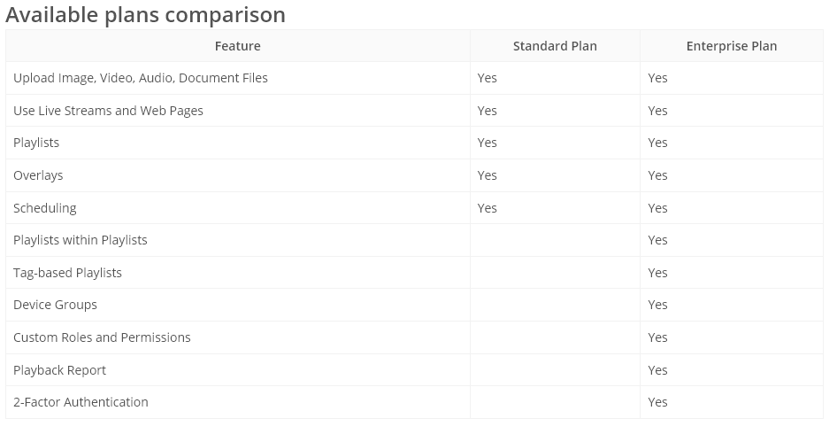
Cloud-Manageable Digital Signage

Slide 41
Cloud-Manageable Digital Signage
How to get started
Order the MDS-100 and a license for each signage screen from your sales representative
Create your account in the management portal (app.acti.com)
Connect the MDS-100 to the monitor and type the registration code into the management portal
Done! You you have successfully turned your screen into a smart digital signage

Slide 42
Digital Signage for the Customers
Videos for the customers
https://www.acti.com/applications/digital-signage

Slide 43
Applications
Digital Signage is a convenient method of visual communication with the customers. Various types of information can be delivered to the customers such as ads, store information, floor plan, and more.
RETAIL
Ads via Digital Signage
The digital signage in retail has become very popular. The targeted ads help boost the sales.
ACTi offers both locally managed and cloud-manageable digital signage solution for retail.

Slide 44
Locally Managed Digital Signage
Solution info on acti.com: https://www.acti.com/solutions/media-management-solution?sid=S185
ECD-1000 is not only a surveillance video decoder. It also has the digital signage capability. The preloaded video clips or images can be shown instead of surveillance videos, in the user defined layout.
HDMI
cable
ECD-1000
(digital signage)

Slide 45
Locally Managed Digital Signage
Various display layout options available:
The signage video clips can be stored on a USB thumb drive, which can be attached to the ECD-1000.
It is possible to configure each ECD-1000 station separately, or use a special management utility, called Digital Signage Station 1, to do 1-to-many content management. This software requires license.

Slide 46
Locally Managed Digital Signage
The example of 1-to-many management:
Device A
Content A, Schedule A
Group B
Content B, Schedule B
Digital Signage
Station
Content C, Schedule C
Group C

Slide 47
Cloud-Manageable Digital Signage
Solution info on acti.com: https://www.acti.com/solutions/media-management-solution?sid=S181
In order to conveniently manage contents of each screen over the Internet from anywhere, the cloud-manageable digital signage solution can be used instead. No management server hardware needed. Monthly plans for the cloud access.
Cloud Media Management Service
Internet
HDMI
cable
MDS-100

Slide 48
Cloud-Manageable Digital Signage
Video introduction of the Cloud-based digital signage solution: https://www.acti.com/video/v1940

Slide 49
Cloud-Manageable Digital Signage
Advantages of the cloud
The cloud-based solution lets you manage all your screens from any device with a web browser - your laptop, tablet or smartphone.
The architecture is extremely flexible and always grows with your needs, whether you have one screen or one thousand! With our pay-as-you-go pricing, you only pay for what you really use.

Slide 50
Cloud-Manageable Digital Signage
Flexible content
The MDS-100 can display a variety of file types:
Video files
Videos from YouTube
Video streams (e.g. from security cameras)
Images (JPEG, PNG and GIF - including transparency and animation)
PowerPoint slideshows (PPT, PPTX)
PDF files
Word documents (DOC, DOCX)
Excel spreadsheets (XLS, XLSX)
Web pages
Widgets (weather, preconfigured text, real-time news via RSS, and more)

Slide 51
Cloud-Manageable Digital Signage
Easy installation
Simply connect the MDS-100 to the screen and the Internet, link it to your account in the management portal, and the device is ready to immediately commence playback.
All of the content is stored locally on each unit's memory card (16 GB, card included). During regular playback, there is only little bandwidth used. However, the device requires Internet connectivity to let you remotely manage its settings and content. The connection is possible via an Ethernet cable or a Wi-Fi network.
The MDS-100 connects to your account in a smart and secure way that typically doesn't require any configuration of your firewall. But, if needed, it offers a detailed configuration of static IP address, proxy server, and other network settings.

Slide 52
Cloud-Manageable Digital Signage
Efficient operation
The MDS-100 has been designed to handle failures of power or Internet connection without you ever having to manually intervene.
In case of a power loss, the unit automatically starts and resumes its scheduled playback immediately after the power has been restored.
The Internet failure is also no issue as the MDS-100 can work normally for up to 30 days completely offline. Please note that when offline, the device cannot be reconfigured, the content cannot be changed, and the schedule cannot be updated.
In case of any issue, a warning will be displayed instantly on the management portal along with details of the issue and the device's location on an interactive map. You will also receive an email notification.
The MDS-100 can even automatically turn on and off the TV panel. You can schedule the screen to be switched to a standby mode at night and save your electricity bill.

Slide 53
Cloud-Manageable Digital Signage

Slide 54
Cloud-Manageable Digital Signage
How to get started
Order the MDS-100 and a license for each signage screen from your sales representative
Create your account in the management portal (app.acti.com)
Connect the MDS-100 to the monitor and type the registration code into the management portal
Done! You you have successfully turned your screen into a smart digital signage

Slide 55
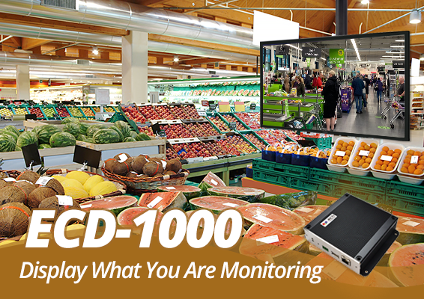
Contact ACTi for more information about the Media Display Systems, by sales@acti.com

