Slide 1
Active Shooter
Solutions
January 2020

Slide 2

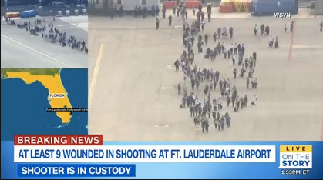
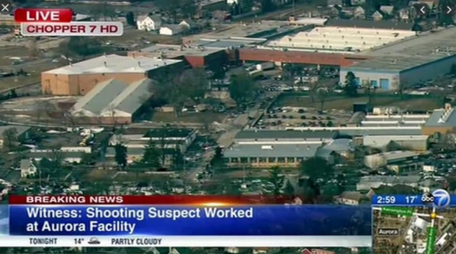
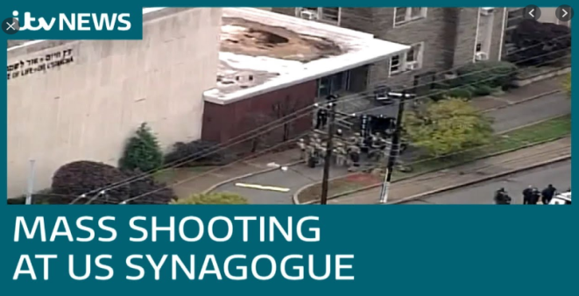

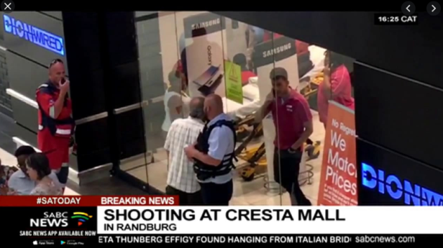
Shooter Incidents in the News
Schools
Airports
Enterprises
Places of Worship
Residential
Retail

Slide 3
Challenges
There is a growing trend of shooting incidents worldwide
The shooters often target the crowded areas, such as schools, factories, enterprises, airports, shopping centers, residential areas. The shooters always have the advantage of surprise.
To avoid or minimize the casualties, it is important to have an early warning about the shooter.
While there are active shooters in premises, it is important to know where they are and to which direction they are heading.
It is necessary to instantly notify all the people in the area who are potentially at risk of becoming a target.
Ideally, the shooter should be disabled even before the first shots are fired.

Slide 4
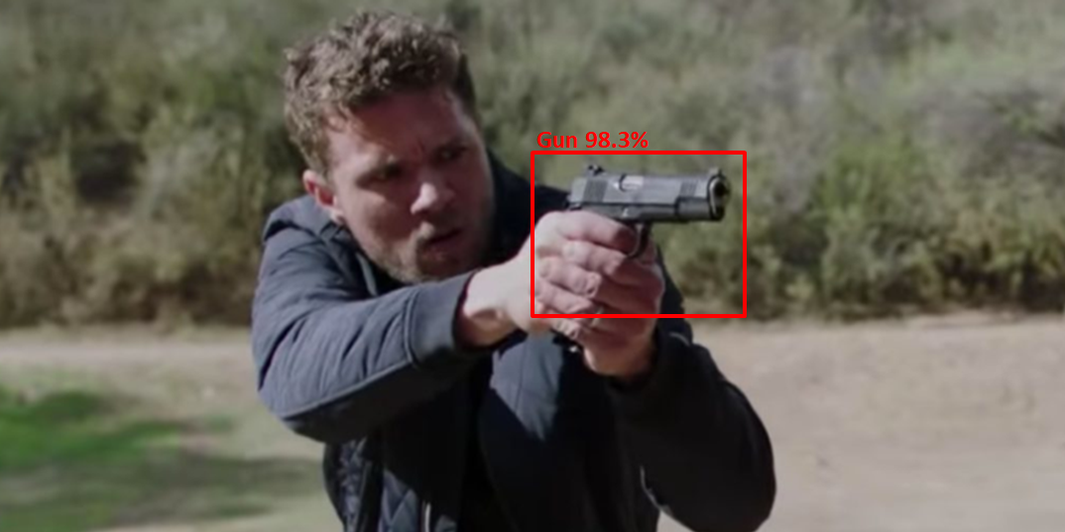
First Line of Defense
The first line of defense is the AI-based gun detection using surveillance cameras.
It is possible to identify the guns even before the shots are fired.
ACTi’s Deep Learning AI Division has developed the Gun Detection Server that is able to recognize various types of guns by analyzing the live video footage of the surveillance cameras. The accuracy depends on the clarity of the video footage and the object size. The AI can be re-trained for each project to have the capability of recognizing the frequently used guns of a specific country or area.

Slide 5
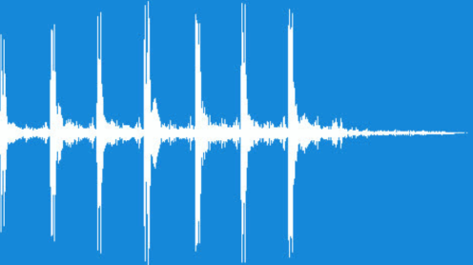

Second Line of Defense
The second line of defense is the acoustic gunshot detection.
It is based on the multiple gunshot sensors installed around the area.
Even when the shooter has been able to hide the gun from the surveillance cameras, the alarm goes off when the first shot is fired.
The gunshot sensors are able to distinguish gunshots from fireworks and other loud sounds.
In addition to ACTi’s own gunshot sensors, ACTi also partners with well-known Gunshot Sensor brands in the US – their sensors have been integrated with ACTi’s Shooter Alert solution.

Slide 6

Second Line of Defense
Gunshot sensors for the reference
Model | MGB-180 | MGB-181
Photo
Application Environment | Indoor | Outdoor
Metadata | Shooting alert with the location, last shot timer | GPS coordinates of shots, number of shooters, lost shot timer
Network type | IP Network via Ethernet cable | IP Network via Ethernet cable
Response time | < 1 second | < 1 second
Failover | WiFi + Battery | WiFi + Battery
Power | PoE | PoE, Solar (optional)
SoC | Qualcomm Snapdragon | Qualcomm Snapdragon
Solution Integration | ACTi NVR 3, ACTi CMS 2 | ACTi NVR 3, ACTi CMS 2
Deployment frequency | Mesh pattern with 80m/260ft gaps | Mesh pattern with 80m/260ft gaps

Slide 7
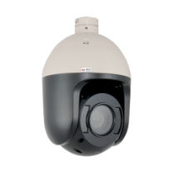
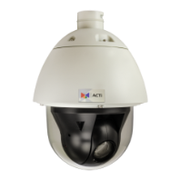

Video Verification
To make sure there is no false alarm in such highly critical situation, the instant verification becomes crucial!
To maximize the video coverage of the shooter, as soon as the shooter’s location has been confirmed by the gunshot sensors, all the nearby PTZ cameras will turn towards the shooter automatically!
The live video and the instant playback from all the relevant cameras will be popping up on the top of the central management system to assist with instant verification.
Having received shooter’s geolocation from the sensors, the ACTi’s central management system automatically notifies the smart PTZ cameras to turn towards the pre-defined zone and zoom in using ACTi command protocol.

Slide 8
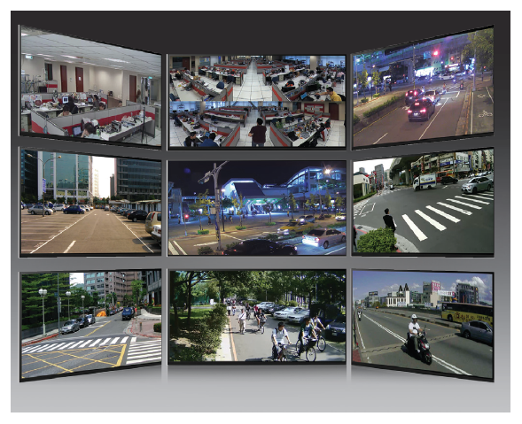
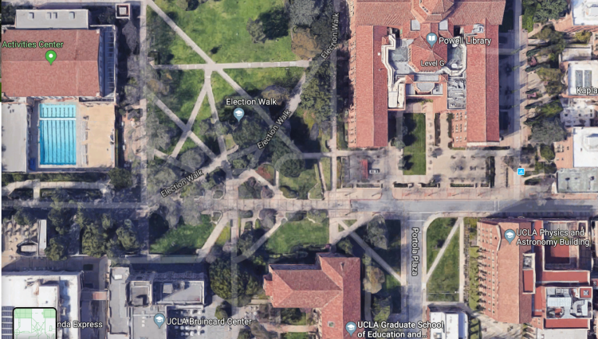
Central Control
When the early warning alarm goes off, the shooter's location will be visible on the map of the central management system (CMS).
The live video channels of the given location will pop up on the screen of the CMS for instant verification.
Instant notification is pushed to all the mobile devices of the security personnel.
ACTi CMS can manage up to 6400 video surveillance cameras concurrently.
Push Notification to the mobile app works even when the phone’s screen is turned off.

Slide 9
Notify Everybody
In addition to the audio broadcast systems, the use of TV screens can be very helpful while coordinating the actions of a large number of people.
ACTi’s Digital Signage System is a convenient cloud-manageable media network that provides daily used information on the screens of hundreds of locations.
When the security officers presses a button, all the screens of the premises will switch to the alert mode instantly, providing instructions to the viewers.
Watch the video introduction of ACTi Digital Signage System.
Active Shooter Alert!
RUN!
HIDE!
FIGHT!
The alert message stays on all the screens until the end of the incident. When the alarm button is switched to back to the normal position, the regular media content display resumes automatically.

Slide 10
Summary
ACTi provides a wide range of solution options to completely prevent or minimize the damage of the shooting incidents.
The shooting can be detected by a specially designed gunshot detection sensors for both indoor and outdoor locations. These sensors can be deployed with 80m/260ft intervals across the area.
ACTi central management system is able to link the gunshot detection event with the related live video streams for instant verification and actions.
ACTi mobile app is able to receive instant alerts even when the screen is off.
ACTi gun detection system is an additional feature that aims to identify the presence of guns using the video-based deep learning AI.
ACTi digital signage system is helping spread information about shooting throughout the premises for instant actions – run, hide, fight!
ACTi smart PTZ cameras can turn towards the shooting area for more evidence.

Slide 11
Contact Us
Welcome to contact us!
sales@acti.com
Read more!
www.acti.com

