Slide 1
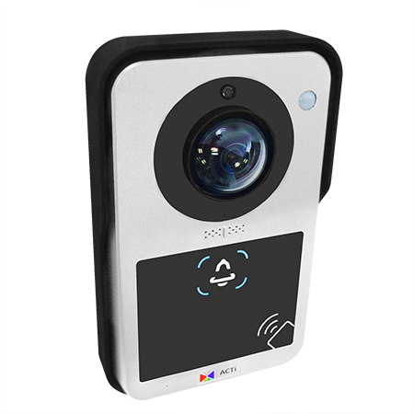
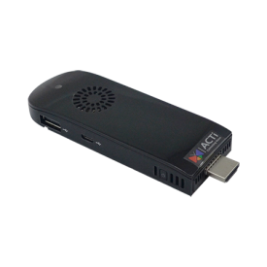
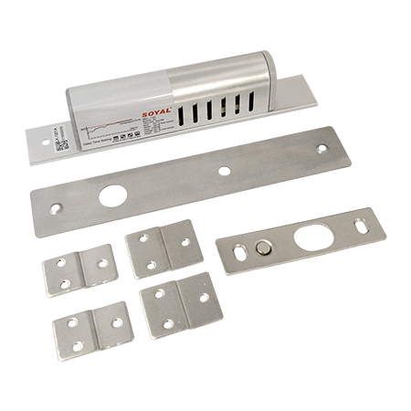

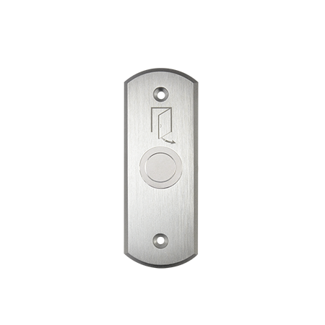


Access Control Solution Packages
K00022

Slide 2
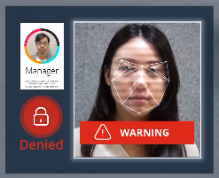
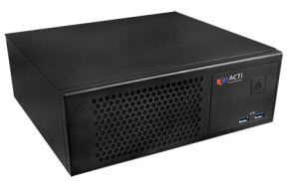
K00022
Q951 Facial Recognition Door Station
6MP 104.5° Fixed Lens Camera
99% Accuracy (1% of attempts require retry)
Database of 20000 Users
Intercom Feature
RFID Card
Access Rule Service through dongle Based software
Mobile Client
Euro
Prices is Direct from ACTi Taipei Office, Excludes Shipping, Tax and Installation

Slide 3
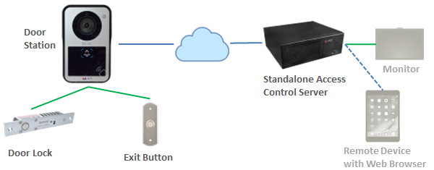
Euro
Prices is Direct from ACTi Taipei Office, Excludes Shipping, Tax and Installation

Slide 4
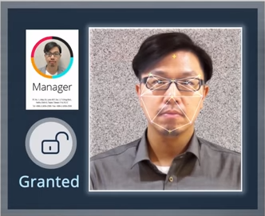

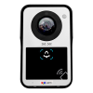
Server for Instant Recognition
Facial Recognition to Open Door - Accepted
Prices is Direct from ACTi Taipei Office, Excludes Shipping, Tax and Installation

Slide 5


Server for Instant Recognition
Facial Recognition to Open Door - Denied
Prices is Direct from ACTi Taipei Office, Excludes Shipping, Tax and Installation

Slide 6
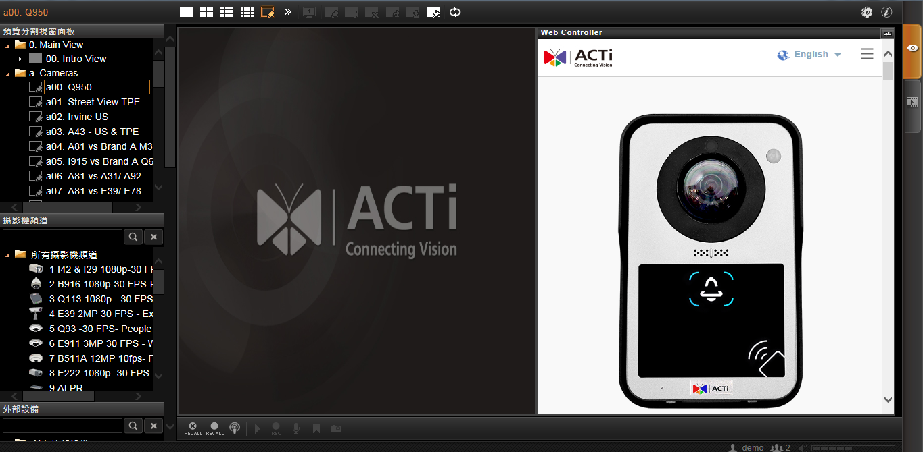
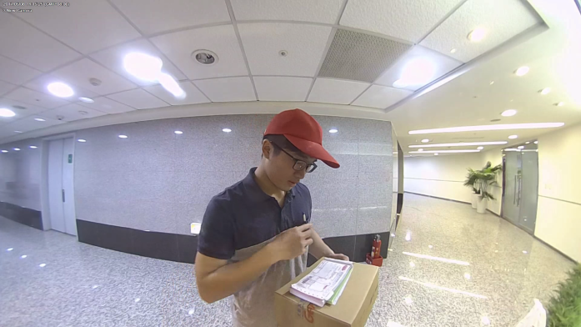
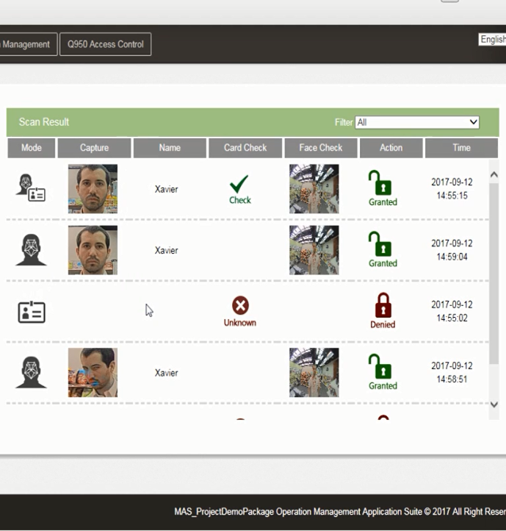
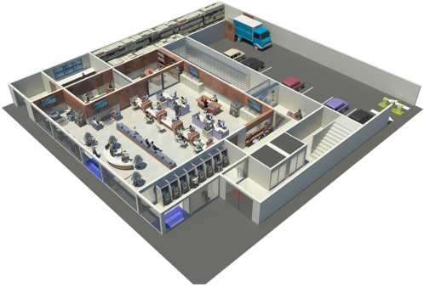

Live Video Footage
Access Information
eMap For Camera Location

Slide 7
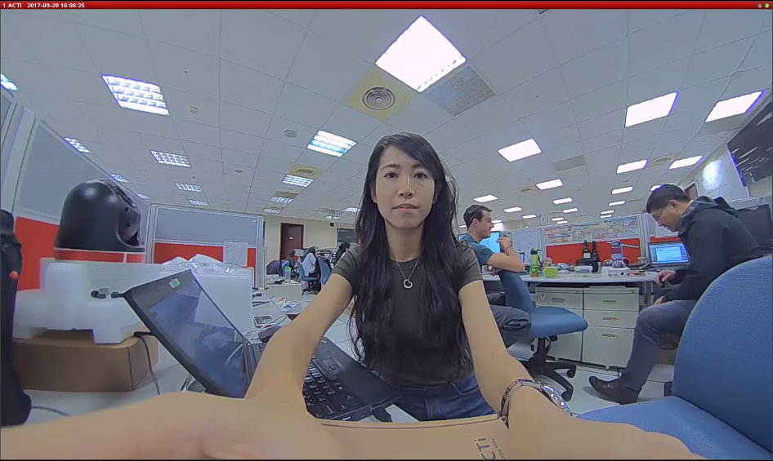


Hot Spot Video Triggered by Intercom
Click Mic Button to Talk to your visitor

Slide 8

MAS Platform for Database Management

Slide 9

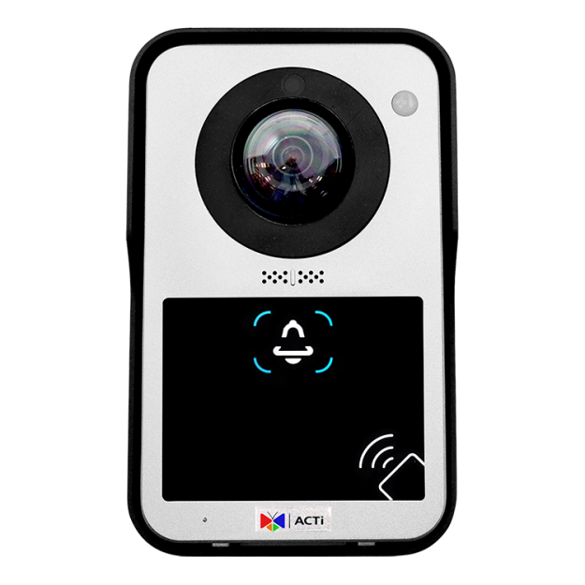
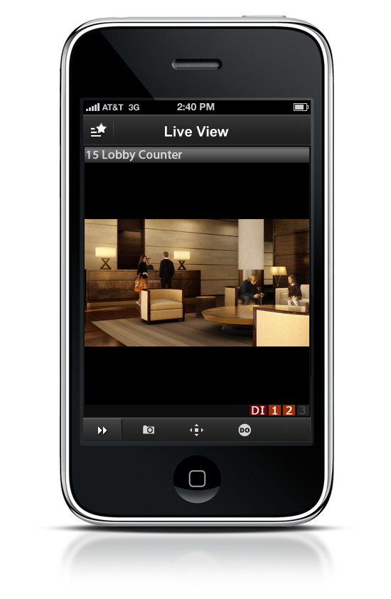


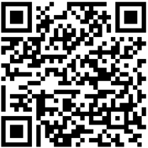

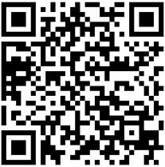

Mobile Client
Mobile Client
Built-in Micro SD card slot

Slide 10
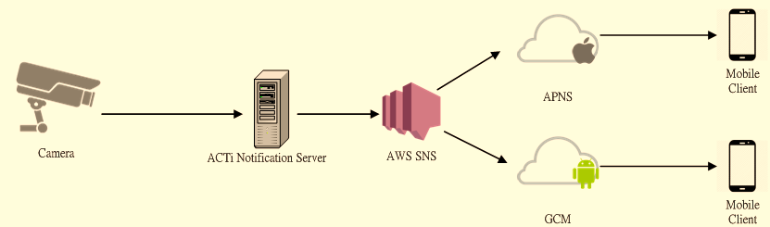
Push Notification Network Architecture
Push notification via Cloud charges service fee of € 10 per account per year.

Slide 11

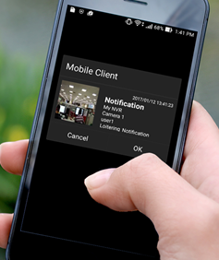
Mobile Client
Door bell rings
Pop-up notification on Mobile Client
Go to Mobile Client
Tap to talk to the visitor.
Tap to open the door.
Push notification via Cloud charges service fee of € 10 per account per year.

Slide 12
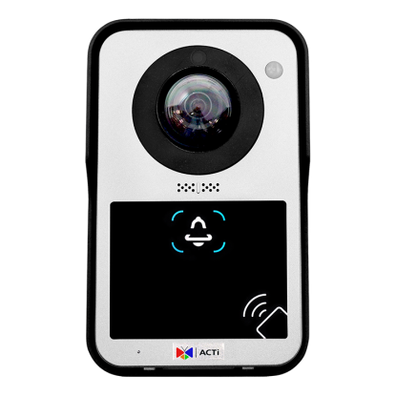


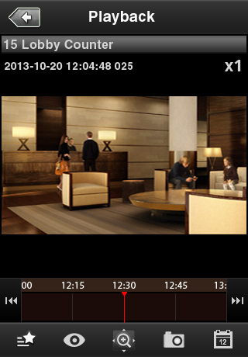
Recordings
Store the recordings on Micro SD card
Access the Live View/ Recordings on Mobile Client
Micro SD card not included.

Slide 13
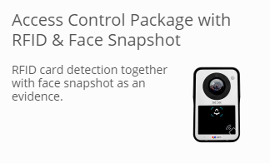
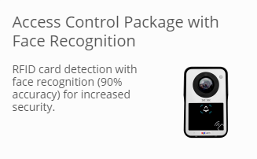

Product Summary
K00019
K00021
K00022
BUDGET
FEATURING
ULTIMATE
Click to View Full Package Description!

Slide 14
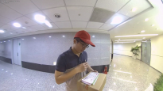






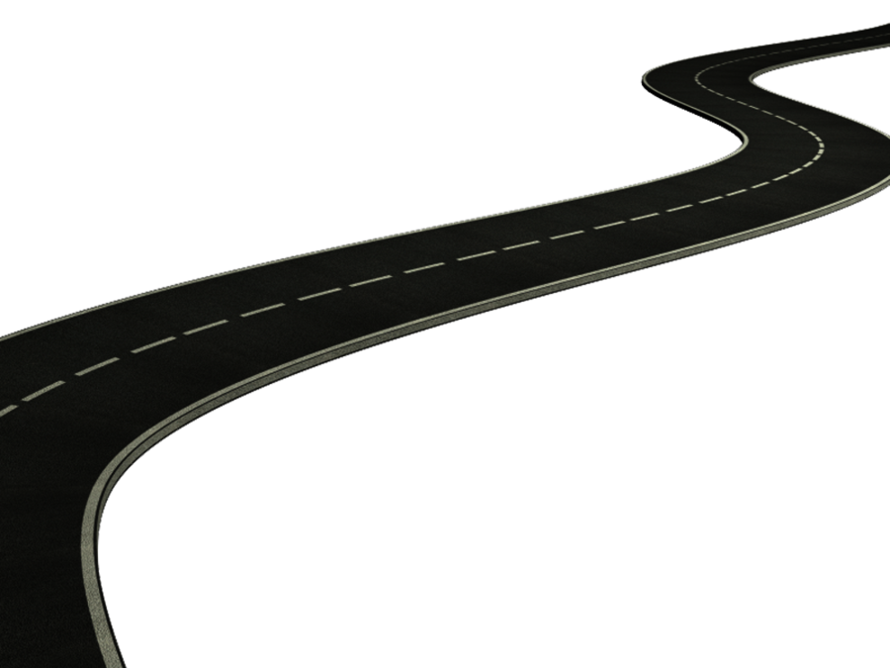

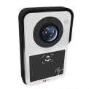

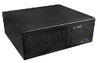





Application: Remote Employee
DI/O
Contact ACTi Sales Today!
↓Employee Outside Office Hours
RFID for Access Management
One Platform Manages all

Slide 15
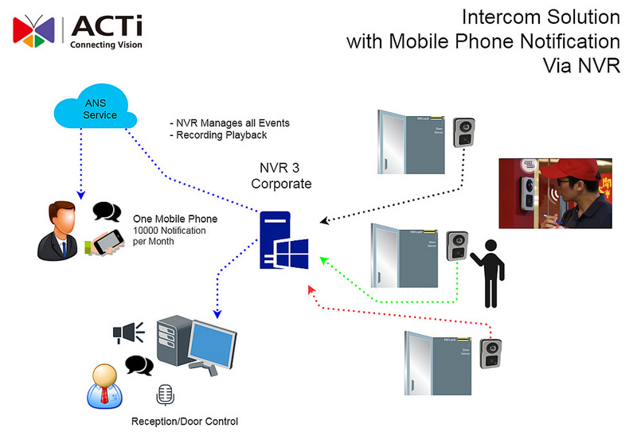

Slide 16
“Everything You Need And More”
Contact ACTi Sales Today
Sales@acti.com

