Slide 1

P
ALPR Parking Lot to OM/BI Solution: The HOW, WHAT & WHY

Slide 2





ALPR Parking Lot to OM/BI Solution: The HOW, WHAT & WHY
Number: GT 5861K
Entering
Benefits
Outline
Technologies
Demonstration
P

Slide 4
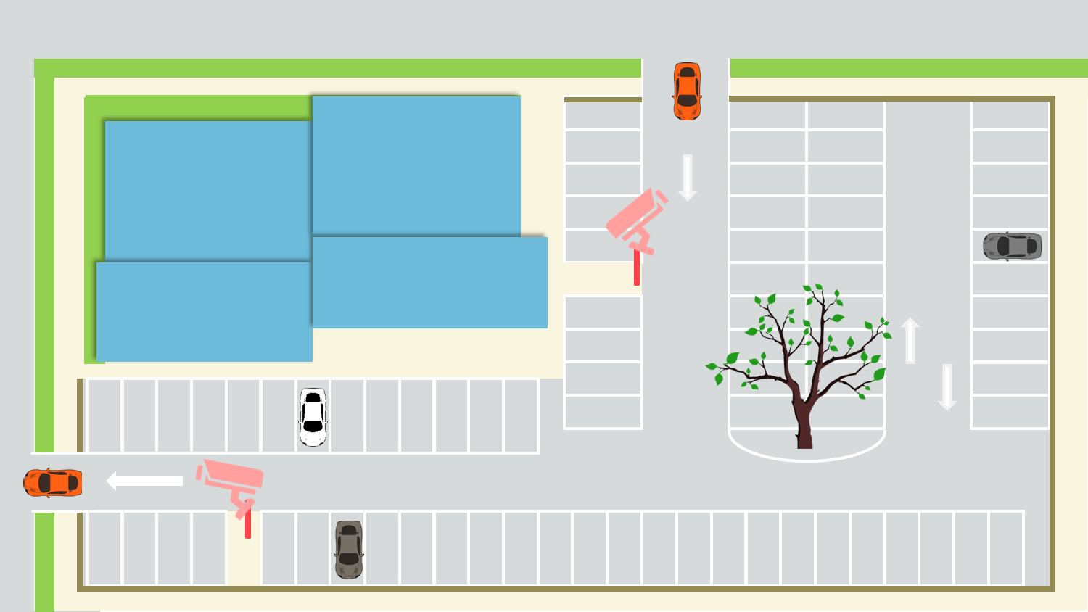
Outline Introduction
Subject:
Installation of Zoom Camera in Parking Lot to acquire Number Plate of cars entering the area/store. These information are then used to analyze and derive marketing method and strategies for suburban stores.
Installation Equipment:
Camera for acquiring Number Plate Information ……… 2 pcs
ALPR Server, NVR and other Network Peripherals……… 1 Set
Cause:
In the suburban roadside stores revenue are mainly based on visits by vehicles, by acquiring the license plate of the car and use it for marketing, it can be used for customer revisit rate, VIP customer visit and store management, etc.

Slide 5
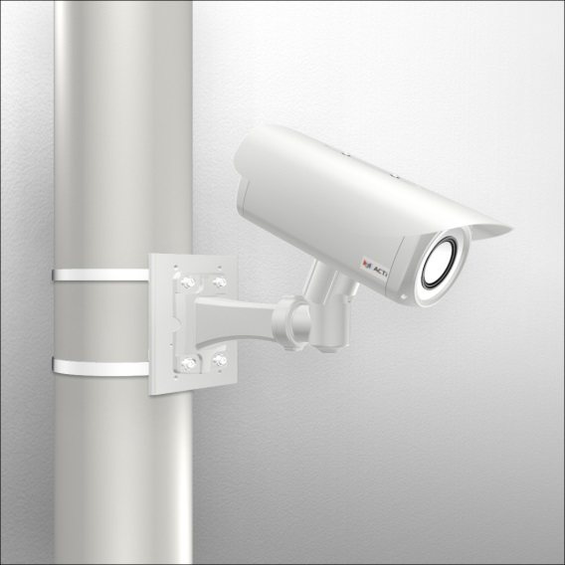
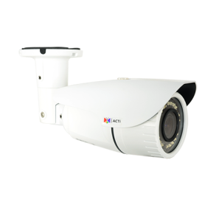
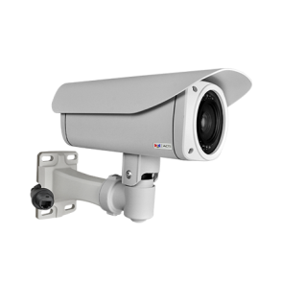
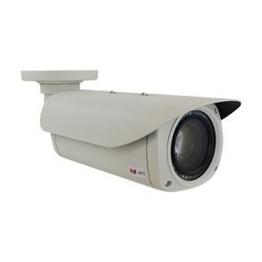
Demonstrations : Camera Installation
Suggested Models
Mounting Selector
A43
2MP
4.3X Optical
1100 TVL
B49
3MP
10X Optical
1450 TVL
I42
2MP
36X Optical
1800 TVL
I45
2MP
30X Optical
1800 TVL
I47
4MP
30X Optical
1850 TVL

Slide 6

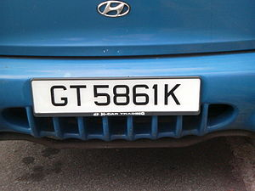
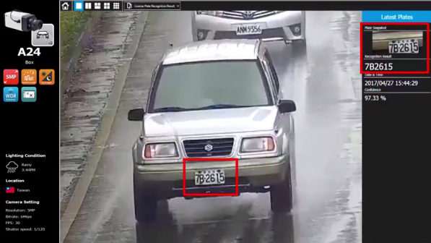


Technologies : ALPR &Visitor Car Management System
GT5861K
Entrance
ALPR Server 2
Data collection from both entrance and exit with number plate details sent to centrally management server within store for categorization and analysis
Exit
Future Vision
Greetings at door &
Employee mobile notification

Slide 7


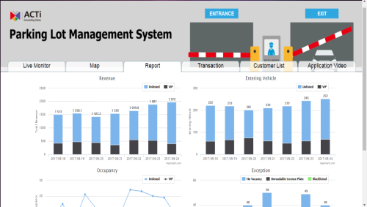
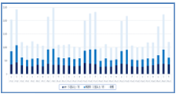
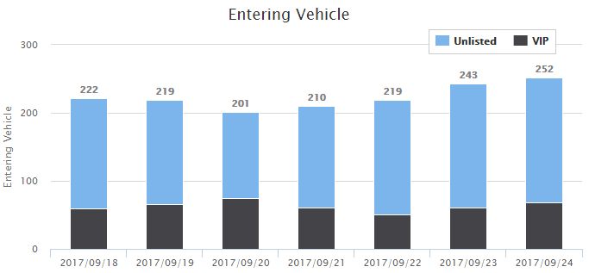
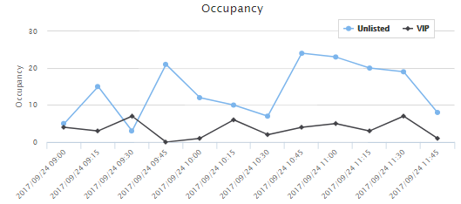
Benefits : From Data to Informative Graphs
ACTi Parking Lot MAS
Revisit Rate Control
Entering Vehicle
Occupancy

Slide 8

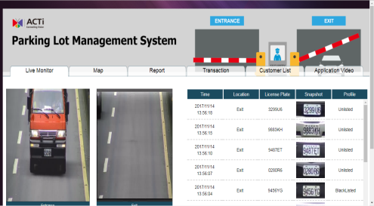



Benefits : VIP & Blacklist Feature
Member Detail
Mr. Jacek Weglarz
09/11/1987
Sales Account Manager
ACTi Corporation
Purchase History
iPhone X 256GB Black ……………....………………..$1399
iPhone 6S 128GB White ………………………………..$999
Notes
Enjoys newest technologies
Car Plate
4591 H7

Slide 9
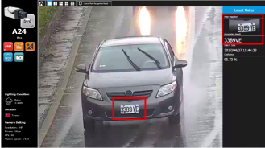


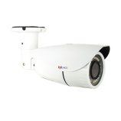
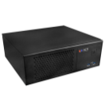

Architecture
ALPR Server 2 License
3
LAN
MAR-100 Server
2
IP Camera
1
MAS Parking Lot License
4

Slide 10



Contact ACTi Sales
Sales@acti.com

Slide 11
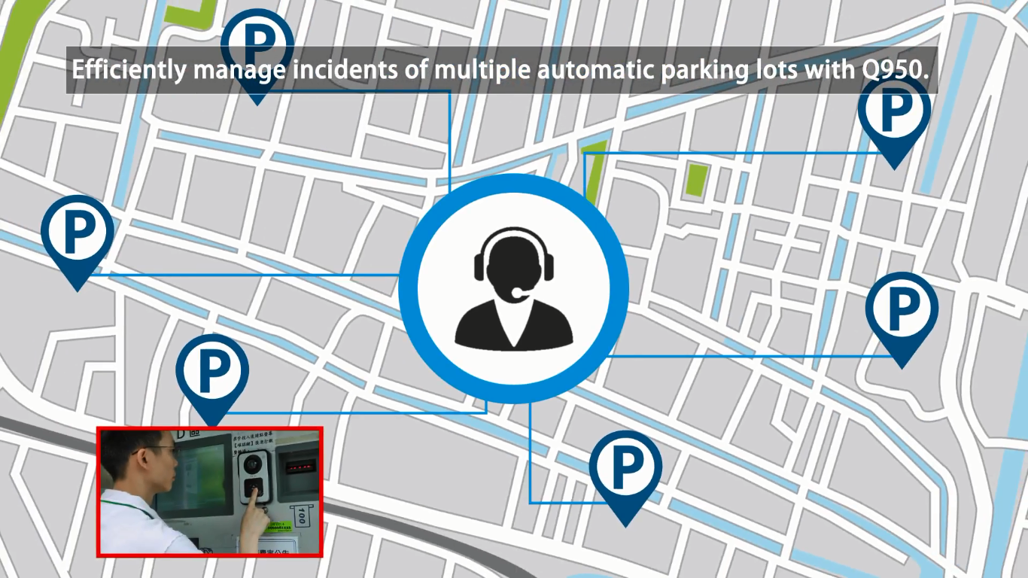


Central Management
Efficiently manage multiple parking Lot with our CMS Solution

Slide 12
P
ALPR Parking Lot to OM/BI Solution: The HOW, WHAT & WHY
www.acti.com
Parking Lot Demo Site
sales@acti.com

