Slide 1
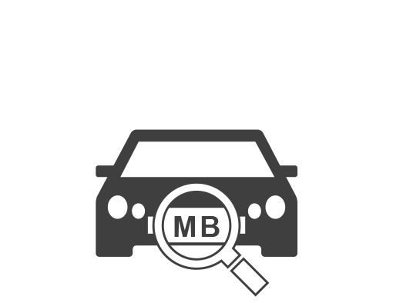
ALPR
(Automated License Plate Recognition)
Solutions
2016-May

Slide 2
Agenda
ALPR Application Suite (Multi-site Cloud Solution)
Applications Using ALPR Solution
Overview
Products
Cameras
Standalone Servers
Software
Overview
Features
Demo Site
ACTi’s ALPR Offering

Slide 3
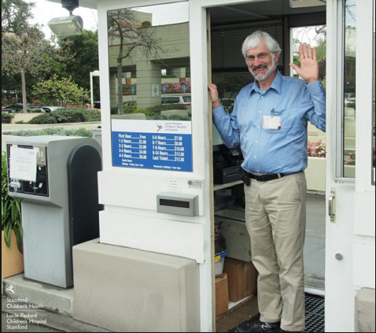
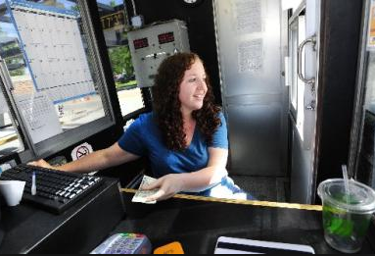

Challenges you’re facing
How can I lower my investment for a dedicated IP surveillance system in the entrance area?
How can I automatically open the gate for VIP customers and employees in real-time?
How can I promptly receive alarms for vehicles in a blacklist?

Slide 4
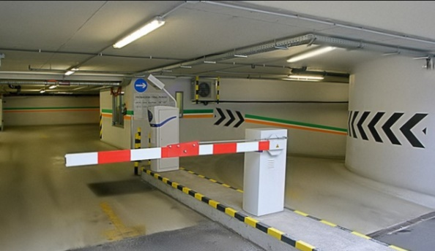
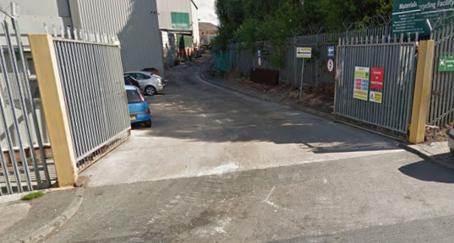
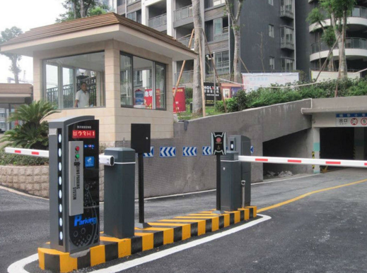
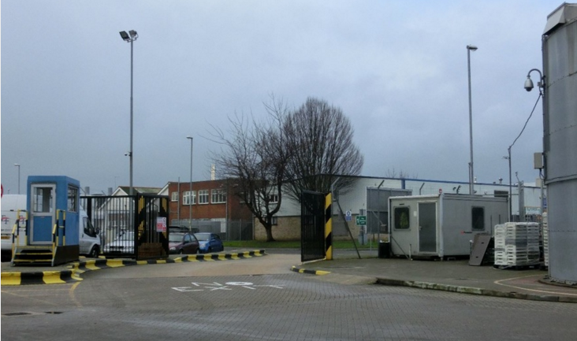
Automatic License Plate Recognition
ALPR Solution Application
Ideal for Parking lots and Entrance Gates
few cameras X many locations

Slide 5
ALPR Application Suite (Multi-site Cloud Solution)

Slide 6



Architecture Overview
MAS Clients
ACTi Cloud MAS
ACTi ALPR Server 2
Internet
ACTi Camera
Site 1
ALPR Application Suite
ACTi ALPR Server 2
ACTi ALPR Server 2
ACTi Camera
Site 2
Site N
ACTi Camera
ACTi Cloud MAS:
ALPR Application Suite

Slide 7
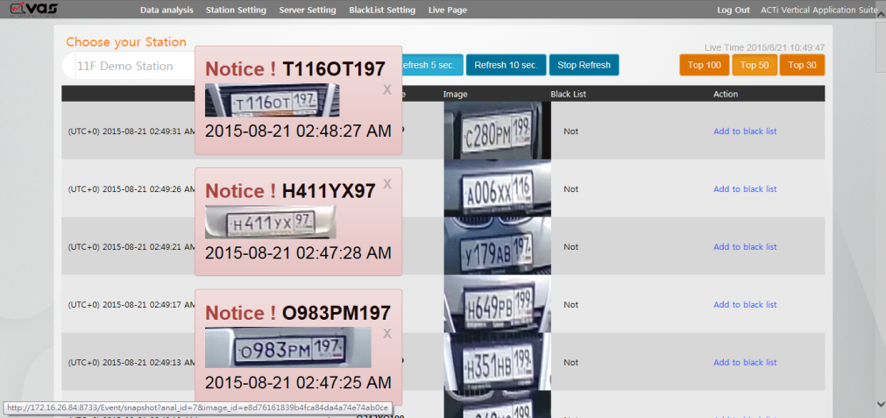
ACTi Cloud MAS:
ALPR Application Suite
Manages data coming from unlimited number of ALPR analysis through unlimited ALPR servers
ALPR analysis is performed on local servers and Cloud MAS is used for Operational Management
Cloud
Scalable
Multi-Channel , Multi-Site
Unified Solution

Slide 8
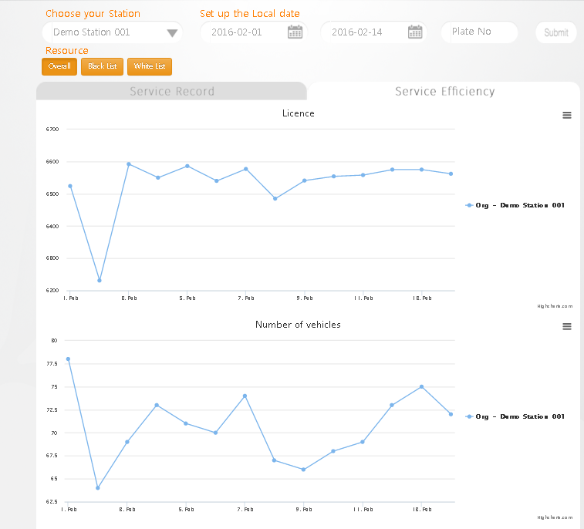
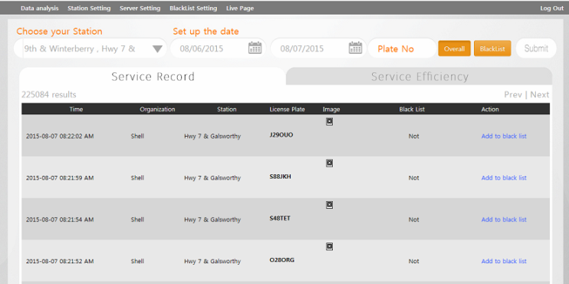
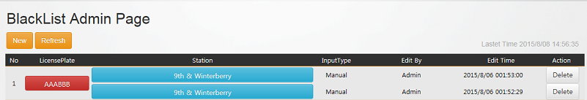
ACTi Cloud MAS:
ALPR Application Suite
ACTI Cloud MAS
Functions
ALPR Real Time Analysis Results from different ALPR servers into single layout
- Blacklist Management
-Real Time Notifications
-Traffic Performance Analysis Reports
-Export Report Data
-User management
-User Log reports
MAS Cloud Demo Site:
http://vas.acti.com/VAS/VAS_Client/index.aspx
Credentials: admin/123
* Upcoming Functions

Slide 9
ALPR solution for
Automatic License Plate Recognition

Slide 10
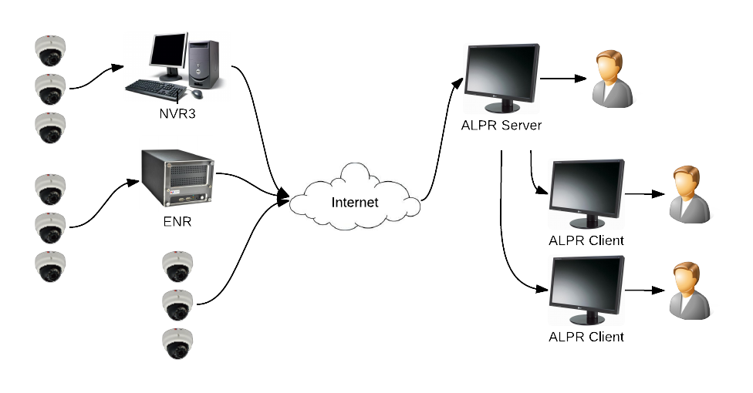


ALPR System Architecture Overview
LAN/WAN

Slide 11
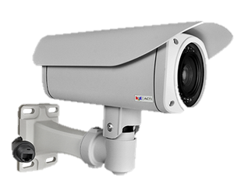
Recommended model for ALPR Solution
I45 (Bullet Camera)
  2MP Bullet camera
  SLLS low light enhancement
  Extreme WDR (145dB)
  Adaptive IR
  Integrated mounting option
Camera Selection

Slide 12
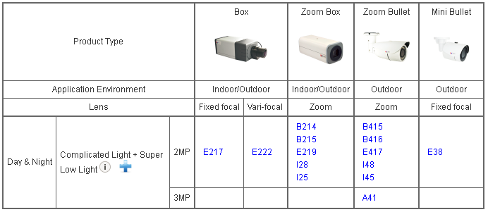
Camera Selection
Other suggested models
2MP or above to ensure the pixel per inch/meter of the license plates.
Low light & complicated light would be recommended for better quality.
See more information here: http://www.acti.com/productmatrix/share/2607

Slide 13
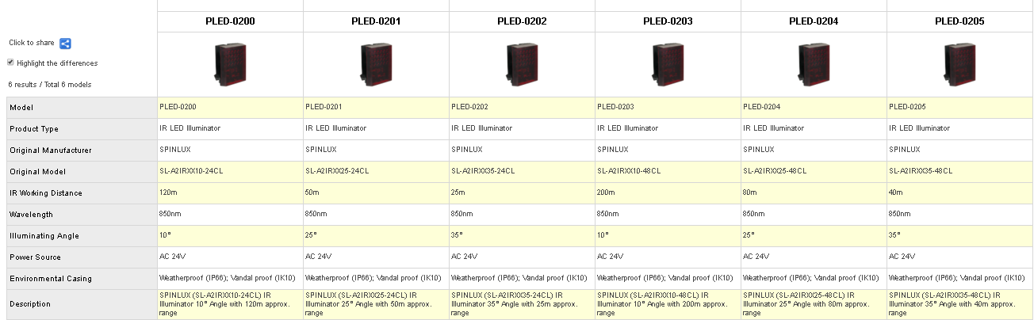
External Illuminators
More information:
http://www.acti.com/products/spec/share/2550

Slide 14
ACTi ALPR Standalone Servers
LPR-110
LPR-120
Ruggedized Server
Rackmount Server (1U)
Standalone ALPR
ALPR Server 2 Software
Maximum 1 SATA disk (Without Storage Disk)
HDMI/USB/2-way audio
Standalone ALPR
ALPR Server 2 Software
Maximum 2 SATA disks (Without Storage Disks)
HDMI/USB/2-way audio
6 Channels supported
6 Channels supported
Specs details:
http://www.acti.com/products/spec/share/2606

Slide 15
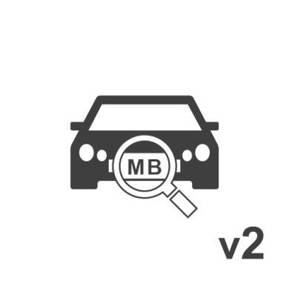
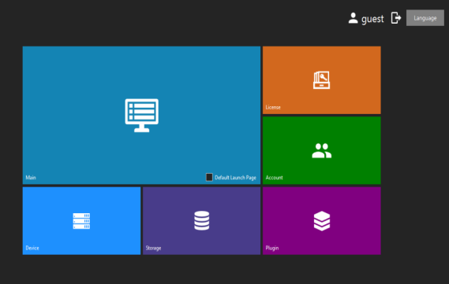
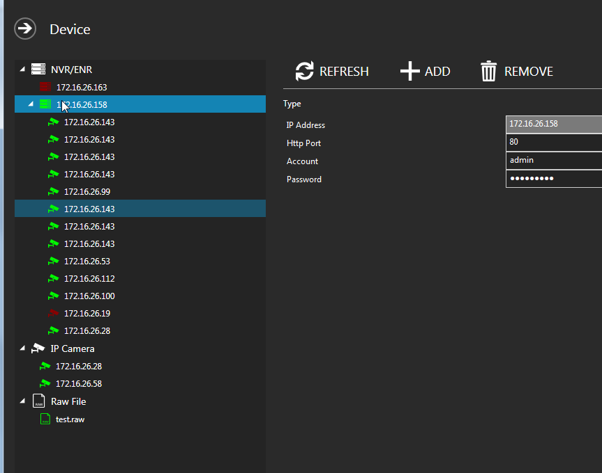
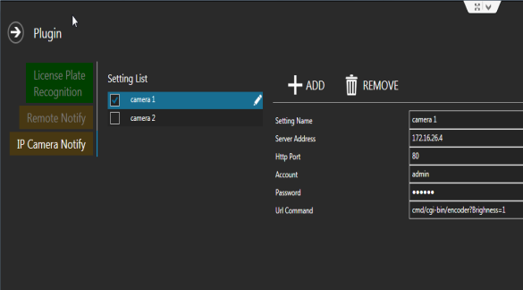
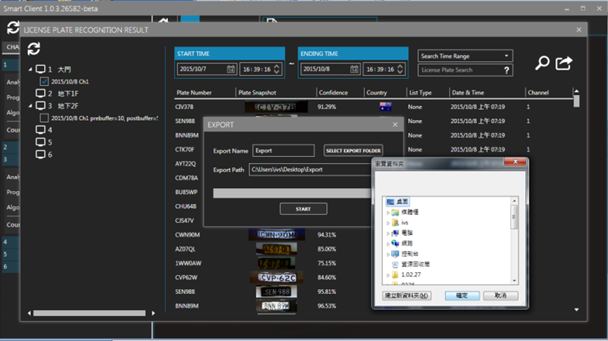
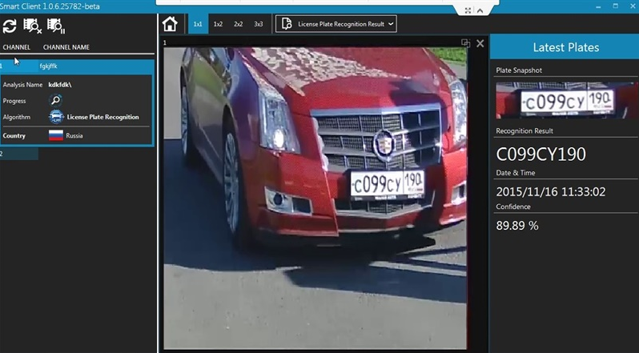
ALPR Server 2 Software
Features
ALPR Server
Windows 10 UI style (tiles)
Device Management
Plugins
Blacklists & Whitelists
Remote Notifications
Trigger alarms
Analysis Results & Export Data

Slide 16
ALPR Supported Countries
North America
  United states
Europe
  UK
  Ireland
  Spain
  Hungary
  Malta
  Italy
  Slovakia
  Czech Republic
  Denmark
  Poland
  Romania
  European Union (Generic)
Latin America
  Mexico
Asia & Pacific
  Taiwan
  Russia
  Georgia
  Hong Kong
  Australia
Middle East & Africa
  Jordan
  Oman
  Tanzania
Upcoming in 2016
Canada
Switzerland
New Zeeland
Mongolia
Indonesia
Saudi Arabia
Ecuador

Slide 17
Thank you!

Slide 18
Optional Architecture
Internet
Local Server MAS
ACTi ALPR Standalone Server
ACTi Camera
Site 1
ALPR Application Suite
MAS Web Clients
ACTi ALPR Standalone Server
ACTi ALPR Standalone Server
ACTi Camera
Site 2
Site N
ACTi Camera
On particular project request, the ALPR Application Suite can be installed in a local Server

Slide 19

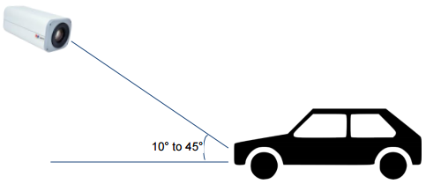
Location & Installation
Height of characters should be larger than 40 pixels ①
The distance between characters should be larger than 4 pixels. Please refer to ②
Shape of the license plate:
①
②
License plates should look as rectangular as possible
Ideal Shooting angle

