Slide 1
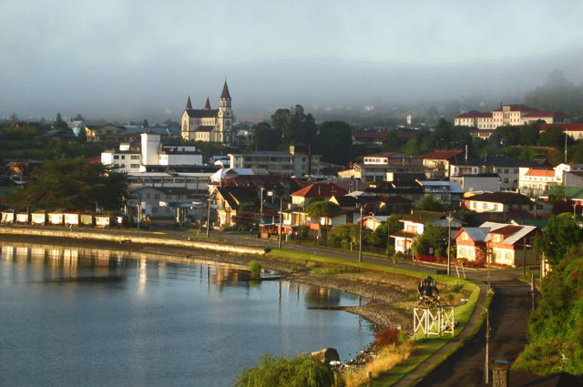
Smart City Surveillance
2015.11.20

Slide 2
Objective
Provide a safe environment for residents and tourists alike
Protect people’s property and prevent crime
Monitor Traffic Flows
Monitor Suspicious activities
Crime Investigation and Evidences
Protect city’s council property from vandalism
Save evidence for car accidents

Slide 3
Smart City Surveillance
Stage I –
Security & Operation Management

Slide 4
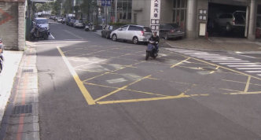
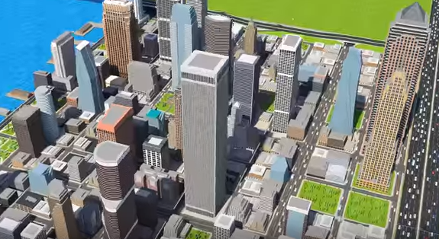
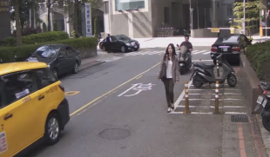
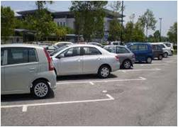
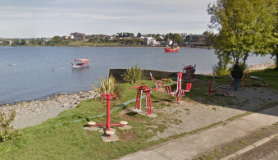
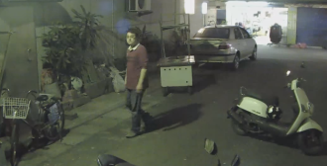
Areas to Secure
Road Intersection
Side Roads
Street Alleys
Public Parkings
Public Recreational Areas

Slide 5
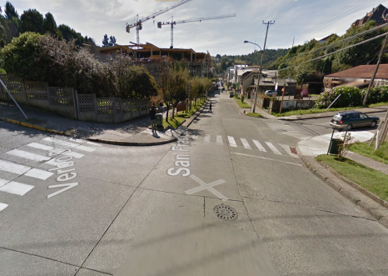
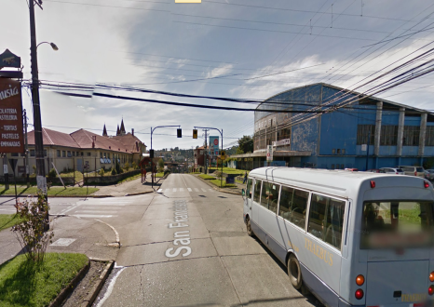
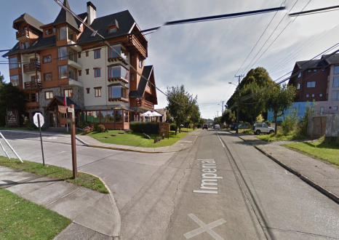
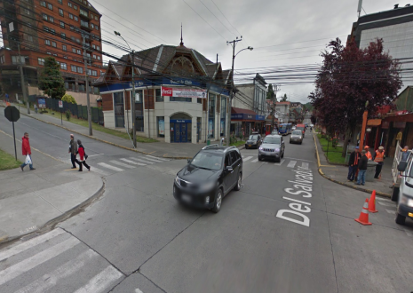
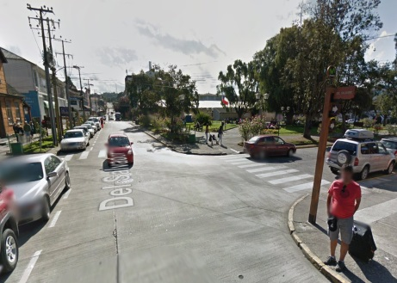
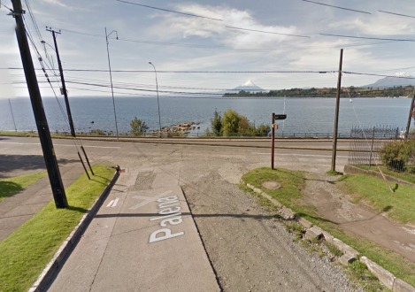
Road Intersections
Monitoring Objective
Monitor cars movement to prevent crash
Gather evidence to accident when crash happens
Monitor people’s behavior to prevent crime
Function Requirement
Dust and weather proof
→IP66
Capability to high contrast of light
→Wide Dynamic Range
Clear Image at low light condition
→Noise Deduction
Wide rang area cover
→Wide angle lens
→Panorama lens

Slide 6
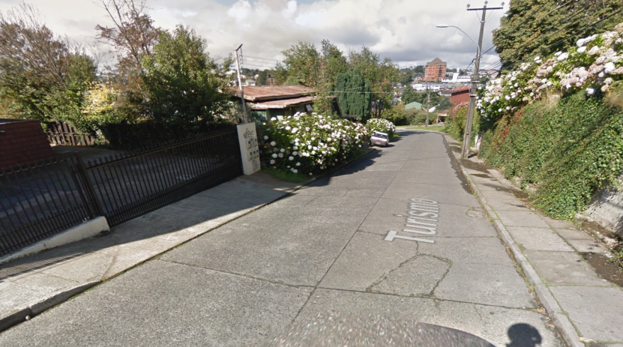
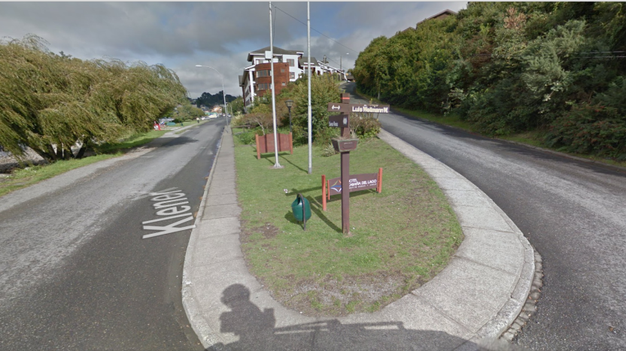
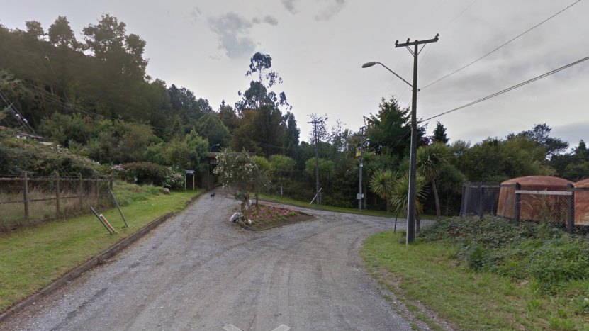
Side Roads
Monitoring Objective
Monitor prevent from theft
Monitor if any fire, hazard happens
Function Requirement
Wide rang area cover
→Wide angle lens
→Panorama lens
Clear Image at low light condition
→Noise Deduction
PTZ
→PTZ camera
→Speed dome
→PT scanner capability
Cover both near & far Side
→Good DOF

Slide 7
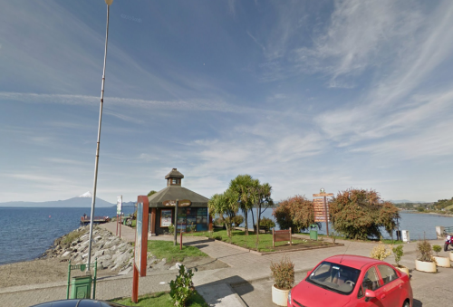
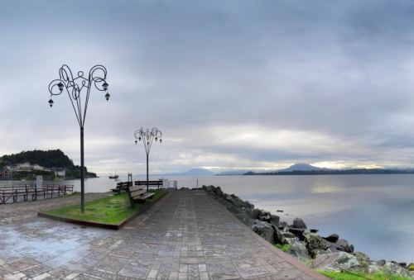
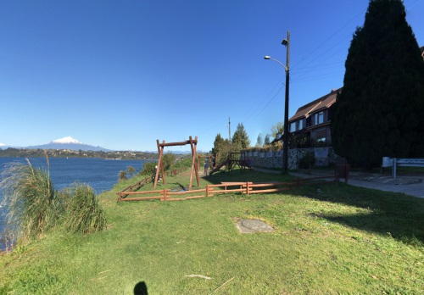
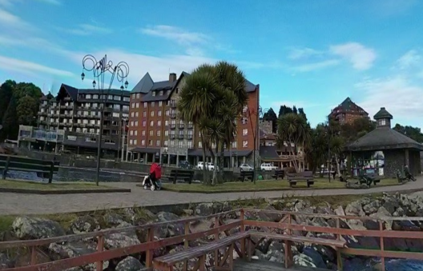

Public Recreational Areas
Monitoring Objective
Monitor residents / tourists to prevent accidents or violation
Protect equipment from vandalism
Monitor strangers in area to prevent crime or attacking
Function Requirement
24 hours surveillance
→Day/Night mode
Clear Image at low light condition
→Noise Deduction
Precisely Lighting Control
→Auto-IRIS

Slide 8
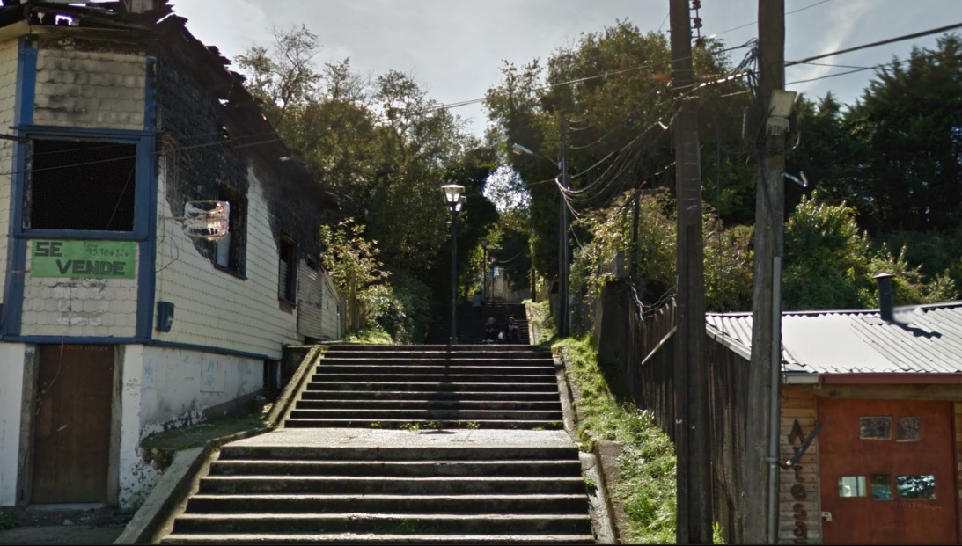
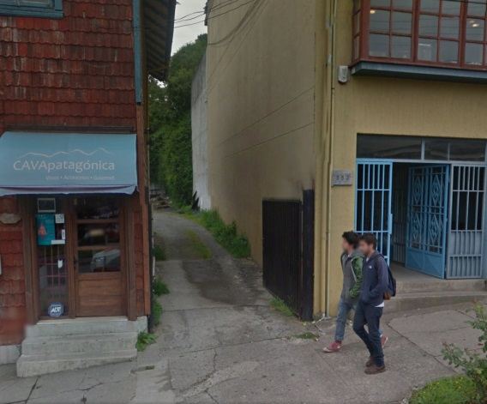
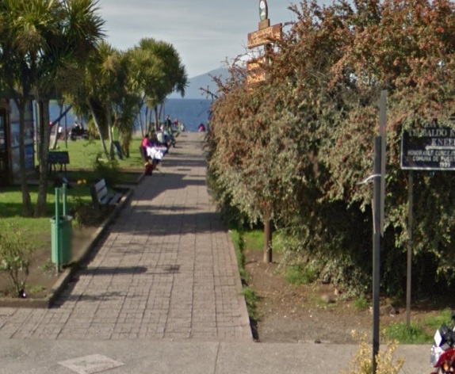
Street Alleys
Monitoring Objective
Monitor students / staff behavior to prevent bulling or violation
Monitor strangers in campus to prevent crime or attacking
Function Requirement
24 hours surveillance
→Day/Night mode
Adapt to changing light condition
→Adapted profiles
Dust and weather proof
→IP66
Capability to low light condition
→Noise Deduction

Slide 9
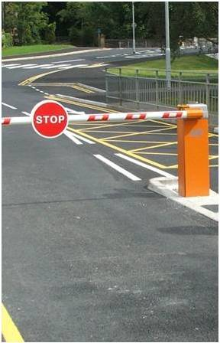
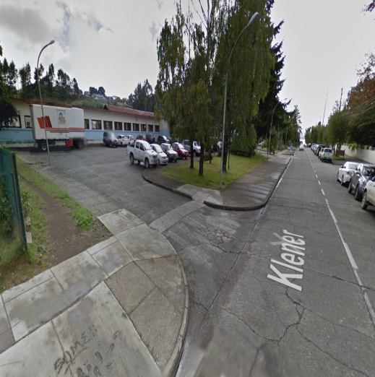
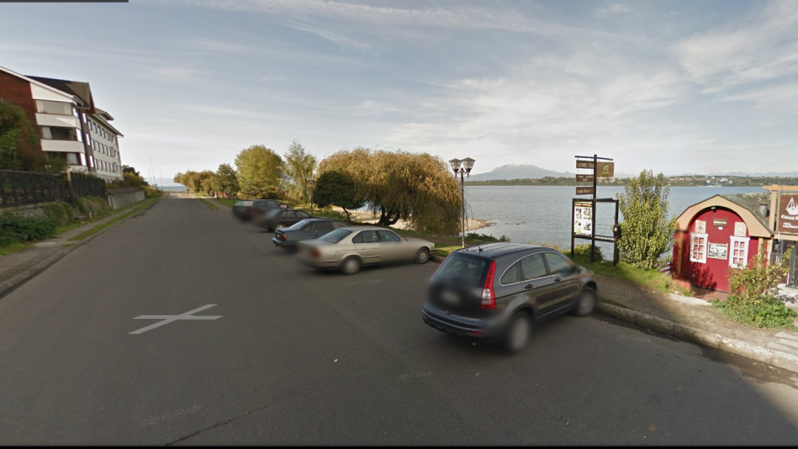
Public Parking
Monitoring Objective
Car plate recognition to indentify permitted vehicles
Driver recognition to prevent strangers get in
Monitor station staff to prevent attacking
Function Requirement
24 hours surveillance →Day/Night mode
Adapt to changing light condition
→Adapted profiles
Dust and weather proof → IP66
Clear image to facial & license recognition
→High megapixel
Clear image to facial & license recognition
→Optical zoom & auto focus
Capability to high contrast of light
→Wide Dynamic Range
Capability to low light condition
→Noise Deduction

Slide 10
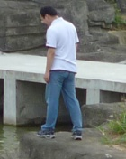


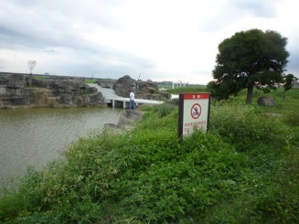

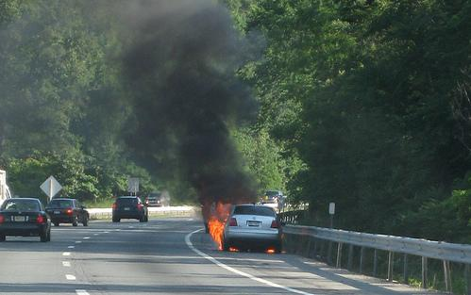
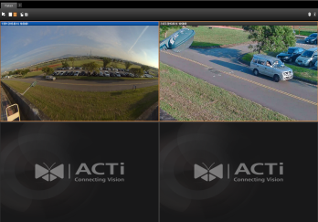

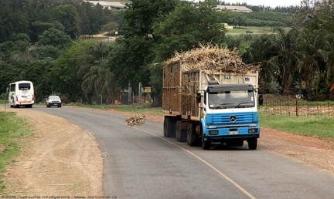
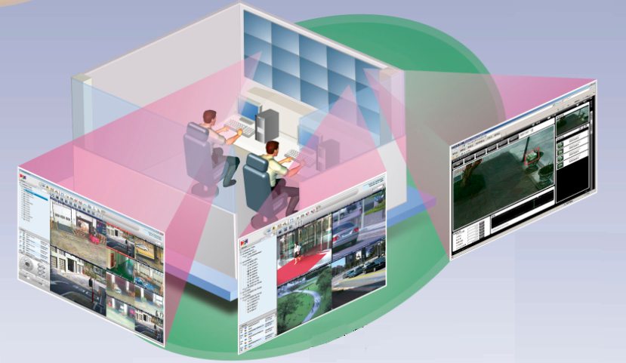
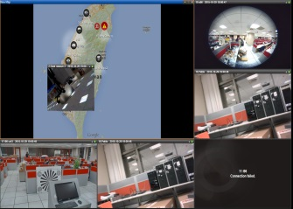
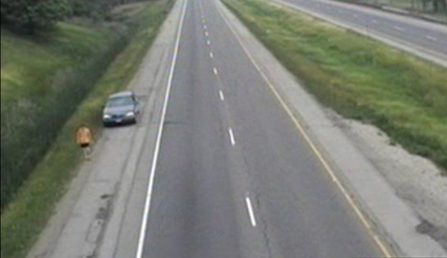

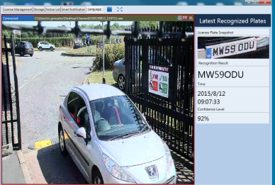


Forbidden
Area
Fire/Smoke Detection
Loitering
Detection
NVR
Unattended Object
Lake
Public Venues
Highway
LAN/WAN/Wireless
City Council Control Center
CMS
General Road
Human Detection
ALPR
TV WALL
Highway
Video
Stopped Car
10

Slide 11













Architecture
NVR Redundancy Server
(Backup INR-450)
Property
TV Wall
(TVW-100)
INR-440
Motion
CMS server (CMS-200)
LPR
CMS Client (SWS-100) x2
CMS Redundancy
Server (CMS-200)
Alarm
ALPR Server
(IVS-110)
Alarm DI/DO
Internet remote clients
LAN/WAN Access
CMS Clients
The Internet
Alarm device
Multi sites management
Video Stream 1 (Recording) – Full Resolution & Full FPS
Mobile Clients
Video Stream 2 (Live View) – VGA Resolution & 5 FPS
Notes:
兩個camera 區塊

Slide 12
Introducing Security Plus
Line Crossing
Unattended Object
Enter Area
Tamper
Missing Object
Incorrect Direction

Slide 13

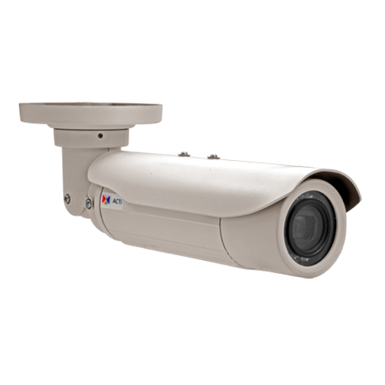


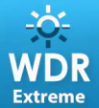





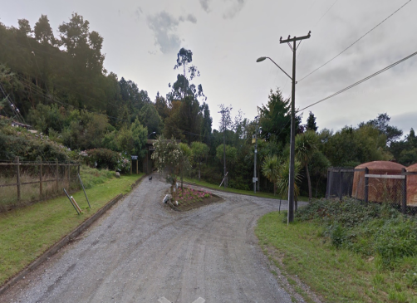
E417
Day and night Bullet camera with mechanical IR cut filter
Minimum illumination 0 lux with IR LED on
Built-in video analytics for smarter surveillance
Triple video stream
10 x optical Zoom, f4.9-49mm / F2.8-3.5, Adaptive iris, Auto focus
60 fps at 1920 x 1080 resolution (1100TV lines)
Digital Input/ Output port for external devices
Two way Audio
Weatherproof IP66 and Vandal Proof (IK10) rated casing
Built-in heater
Extreme Wide Dynamic Range (145DB)
2D+3D Digital noise reduction
Micro sd card supported for local storage
Onvif compliant
2 MP
Public Parking
Road Intersection
Side Roads

Slide 14
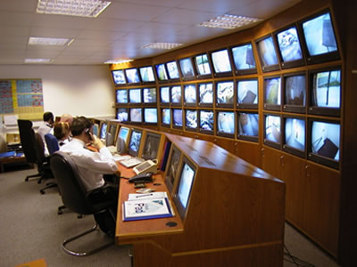
Why Built-in Video Analytics ?
Personnel only watches one monitor for few minutes before losing focus.
It is more difficult to have high attention span on many monitors.
Personnel may not know what to look for.
Let camera do the detection, counting and video analysis for you.

Slide 15

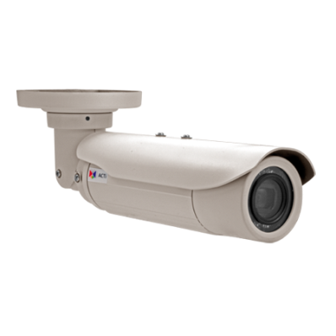

Built-in Video Analytics
Forbidden Area
Camera Tampering
And many more…
Loitering
Unattended Object
*Also available on I98 and B76

Slide 16
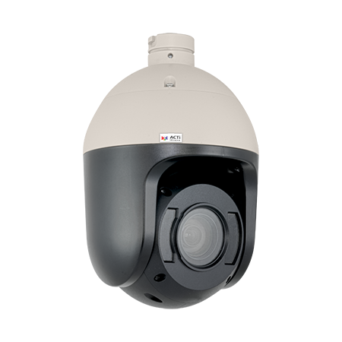






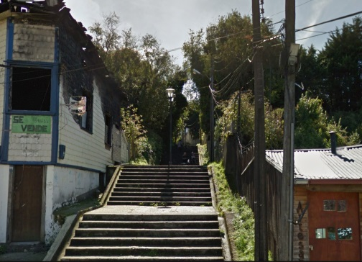
I98
Day and night BUIL-in ir leds speed dome
Built-in Object tracking and Video analytics for smarter surveillance
Triple video stream
33 x optical Zoom, f4.5-148.5mm / F1.6-5.0, Adaptive iris, Auto focus
60 fps at 1920 x 1080 resolution (1800TV lines)
Digital Input/ Output port for external devices
Two way Audio
Weatherproof IP66 and Vandal Proof (IK10) rated casing
Built-in heater / fan
Extreme Wide Dynamic Range (145DB)
2D+3D Digital noise reduction
Micro sd card supported for local storage
2 MP
Public Recreational Areas
Road Intersection
Street Alleys

Slide 17
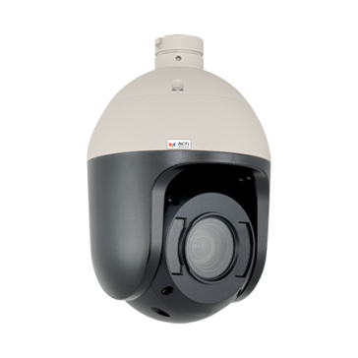

What is PTZ Auto Tracking
PTZ Auto Tracking - The ability of the camera to analyze its video to detect a moving object and use its PTZ functionality to track the object automatically.

Slide 18
Application For Auto Tracking
Large areas with restricted or limited access, where every moving object (people, vehicles) should be monitored and evidence recorded.
Isolated areas
Monitor suspicious activities in non regular areas (people in a park in late night hours)
Forbidden areas such as borders of the country.
Perimeter of high security facilities (government building, military base, prison, etc).
Benefits of PTZ Auto Tracking
Manual PTZ operation not required – more channels can be managed with less operators. Labor cost saving.
Easier to process the video exports – most activity within the same channel.

Slide 19
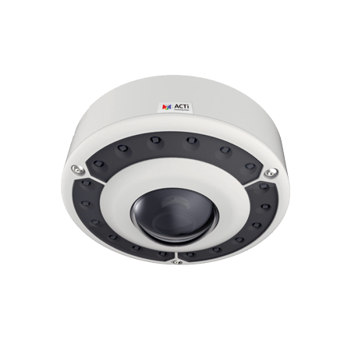


B76
Day and night hemispheric camera with built-in ir leds
Built-in video analytics for smarter surveillance
Triple video stream
194.22° overview area
18 fps at 4000 x 3000 resolution (2150 tv lines)
Fisheye View; Dewarped View: 180° / 360° Panorama, ePTZ Digital modes Input/ Output port for external devices
Two way Audio
Weatherproof IP66 and Vandal Proof (IK10) rated casing
Built-in heater
Extreme Wide Dynamic Range (145DB)
Overview zoom & track
Micro sd card supported for local storage
Onvif compliante
12 MP
Public Recreational Areas
Public Parking

Slide 20
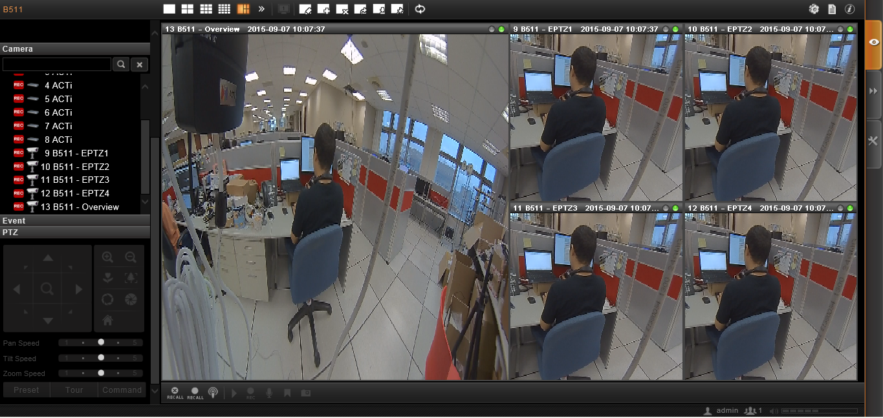
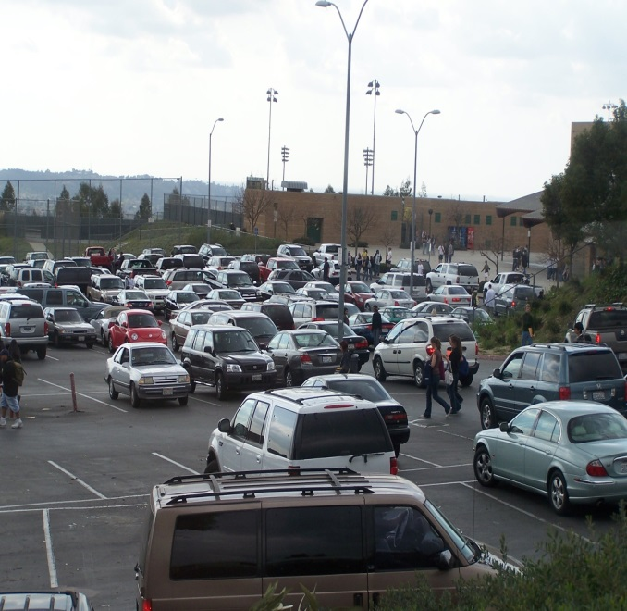


B76 ePTZ mode
(with Digital Auto Tracking)
Track 4 different objects in the scene at the same time while keeping overview recording
Overview – up to 2MP (Panorama or Fisheye Mode)
ePTZ channesl (up to 4): 800x600 each

Slide 21
Benefits of
Digital Auto Tracking (DAT)
Panorama Mode
Bitrate :8-10mpbs (12MP)
Need to export full image
1 CH from NVR
ePTZ (with DAT)
Bitrate: 6mpbs [2MP Overview (2mpbs) ; ePTZ (1mpbs x 4)]
Can export only channel of interest
5 independent CH from NVR
Operator needs to pay attention to all areas of the scene and manually track any object of interest
Operator can focus only in the objects of interest

Slide 22
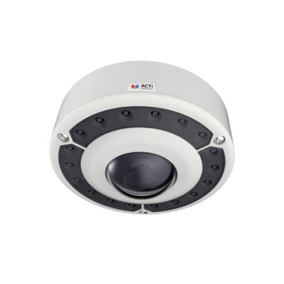
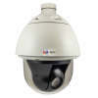
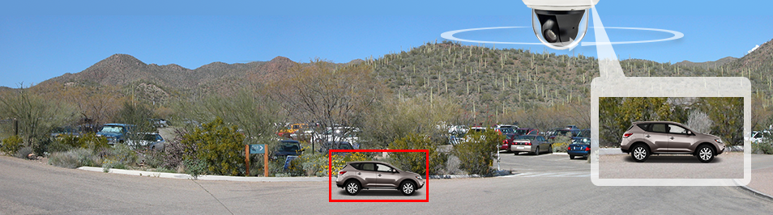
Overview-Zoom-Track
Have full overview in all directions – no blind spots
Get high clarity details when a moving target is detected in any direction

Slide 23

OZT
Cover all areas with Overview (Hemispheric) and track 1 moving object with Speed Dome (Zoom & Tracking)
Will automatically track a single moving object in the scene.
At the same time you keep overview of the whole scene, so you don’t miss any activity!

Slide 24
Software Portfolio Introduction

Slide 25
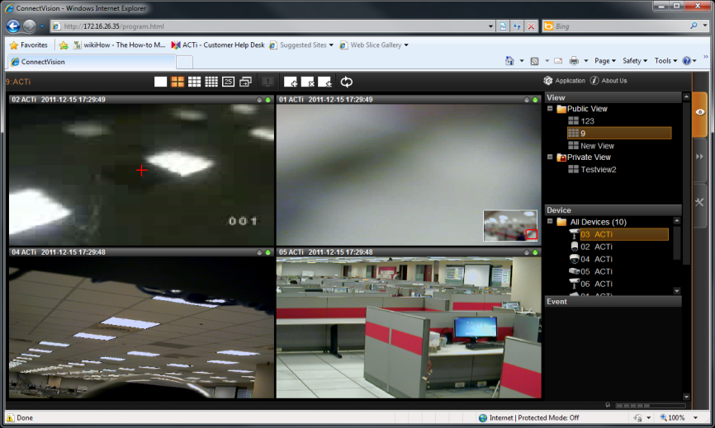

ACTi NVR3
Manage up to 100 IP cameras or video encoders
Live view with 1, 4, 6, 8, 9, 12, 16, 36, 49 &64 window layouts
PTZ and speed control, preset points and tours,
mouse PTZ
E-maps with camera icons and mini live views
Scheduled, event triggered and manual recording
Time and event based search
Full screen playback with AVI video export function
64-channel synchronized playback
Event management with motion detection and DI/DO
Two-way audio, multi-channel audio broadcast
Can support 3rd party brand cameras
4 Channel video export

Slide 26

ACTi Stand-Alone NVR
(INR-440)
Intel Quad Core Xeon 3.1G processor
8GB RAM memory
Rack Mount – 2U
Recording Throughput – 300Mbps
HDD interface - Maximum 12 SATA disks
External Storage Option - SAS, iSCSI, USB
Hardware RAID 0, 1, 5, 6, 10, 50
(W x H x D) 482.6 x 88 x 560 mm
Operating Temperature - 10°C ~ 40°C
Available : Now!

Slide 27


ACTi CMS2
Control Center across Locations, NVRs and Cameras
Direct Management Structure
Control Center to TV Wall Display
Local Storage and Redundancy Management
Smart Search
Flexibility in Ways to Monitor
Work Station/Web Client to Control Center
Mobile to Control Center

Slide 28

ACTi Stand-Alone CMS
(CMS-200)
Intel Core i7-4770S
8GB RAM memory
Dual 1GB Ethernet card
2way audio
Rack Mount Type – Rail Kit (19", 26") – 1U
External Storage Option - USB
Local Access - DVI/VGA/Display port for monitor; keyboard & mouse
(L x W x H) - 43.86 x 4.37 x 37.21 (cm)
Operating Temperature - 0°C ~ 40°C
Available : 2016 – Q1

Slide 29


ACTi TV Wall
Deliver the true value of high megapixel cameras
Support unlimited TV Wall Servers
Support unlimited number of cameras
Layout: 1, 4, 5, 6, 8, 9, 10, 12, 16, 18, 24, 25, 35, 36, 48, 49, 64, Custom
Flexible TV Wall server layout management, adjustable size and position
Display e-Maps with camera icons and live view

Slide 30
ACTi Stand-Alone TV Wall
(TVW-100)
Intel Core i7-4770S
8GB RAM memory
Single Video Graphics Card
Support up to 4 monitors
Dual 1GB Ethernet card
2way audio
Rack Mount Type – Rail Kit (19", 26") – 1U
External Storage Option - USB
Local Access - DVI/VGA/Display port for monitor; keyboard & mouse
(L x W x H) - 43.86 x 4.37 x 37.21 (cm)
Operating Temperature - 0°C ~ 40°C
Available : 2016 – Q1

Slide 31


ACTi ALPRv2
(License Plate Recognition)
Analyze up to 9 concurrent channels
Whitelist / Blacklist management
Client / Server architecture
Can analyze live video feed from cameras & live and playback video from NVR3
Generate alarms based upon events
Generate traffic reports
Export data
SDK available

Slide 32
Stand-Alone ALPR Server
(IVS-110)
Intel Core i7-4770S
8GB RAM memory
Dual 1GB Ethernet card
2way audio
Rack Mount Type – Rail Kit (19", 26") – 1U
External Storage Option - USB
Local Access - DVI/VGA/Display port for monitor; keyboard & mouse
(L x W x H) - 43.86 x 4.37 x 37.21 (cm)
Operating Temperature - 0°C ~ 40°C
Available : 2016 – Q2

Slide 33


ACTi Redundancy Server
Minimize server downtime
Keep the business up and running
Automatic Failover service
Can Monitor up to 16 NVR3 servers

Slide 34
Smart City Surveillance
Stage II – Business Intelligence

Slide 35




ACTI - MAS
(Market Application Suite )
Search Incidents per location
Get Live notifications from all sites
Generate Incidents Reports
Monitor current and Past events Activity
Export video for Authorities
Monitor All activities
Cloud based solution
Available in Q2, 2016

Slide 36
Thank You !!!

